Slide 1

Terrestrial Observations: Drought and Land Degradation
by
Jose Camacho

Slide 2
Integrated Drought Management Programme (IDMP)
Established in 2013 at HMNDP
Main co-sponsors WMO and Global Water Partnership along with over 30 other organizations including FAO, UNCCD, and CBD
Supports stakeholders at all levels by providing policy and management guidance and by sharing scientific information, knowledge and best practices for Integrated Drought Management.
Contributes to global coordination of drought-related efforts of existing organizations & agencies

Slide 3
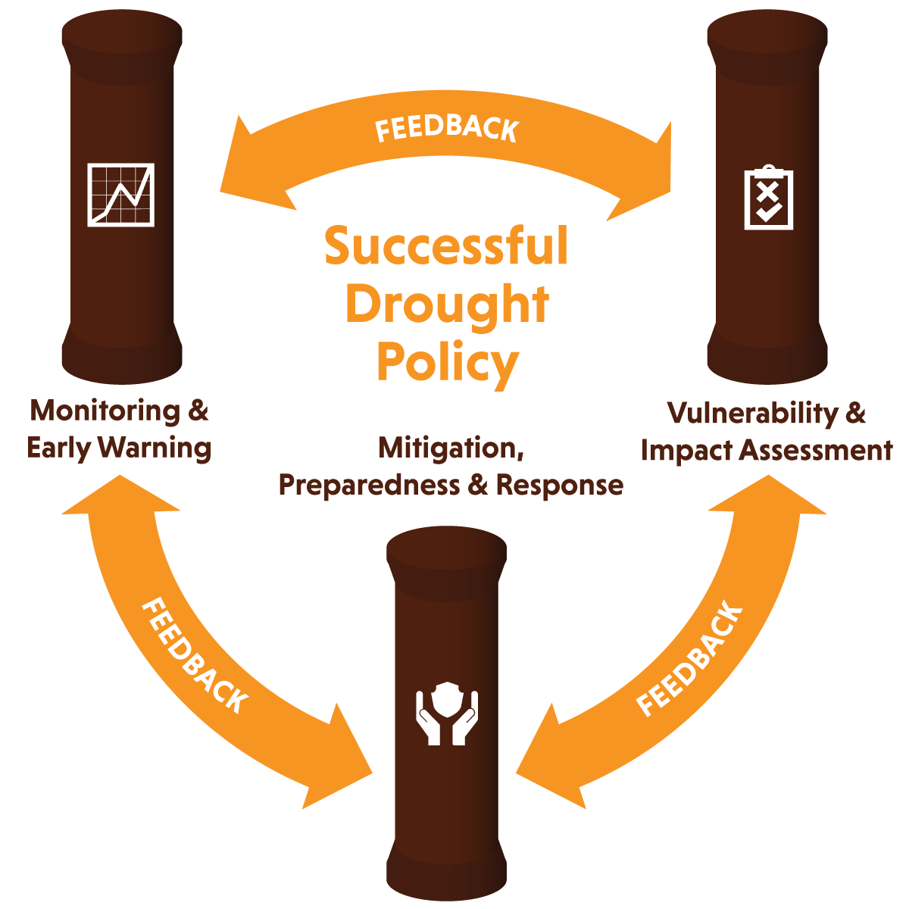
3 Pillars of Integrated Drought Management
Notes:
HMNDP established the pillars of Integrated Drougth management:
- Promoting standard approaches to vulnerability and impact assessment
- Implementing effective drought monitoring, early warning and information systems
- Enhancing preparedness and mitigation actions

Slide 4
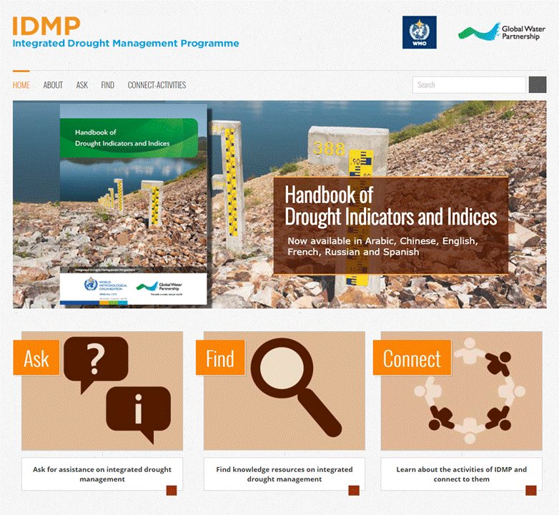

Slide 5
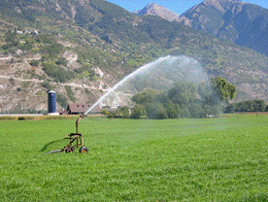
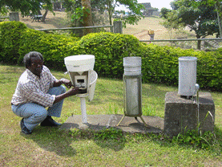
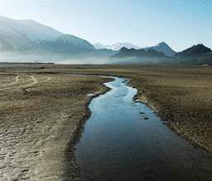
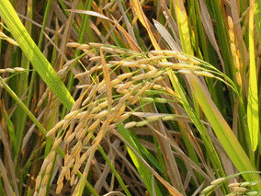
Importance of a Drought Monitoring System
allows for early drought detection
improves response (proactive)
“triggers” actions within a drought plan
a critical mitigation action
foundation of a drought plan
Source: Svoboda, 2009
Notes:
5

Slide 6
Potential Monitoring System Products and Reports
Historical analysis (climatology, impacts, magnitude, frequency)
Operational assessment (cooperative data, SPI and other indices, automated networks, satellite and soil moisture data, media and official requests)
Predictions/Projections (SPI and other indices, soil moisture, streamflow, seasonal forecasts, SST’s)
Source: Svoboda, 2009
Notes:
6

Slide 7

Selecting drought indicators and indices
Timely detection of drought to trigger appropriate communication and coordination to mitigate or respond
Sensitivity to climate, space and time to determine drought onset and termination
Responsive to reflect drought impacts occurring on the ground
Which indicators/indices and triggers to use for going into and coming out of drought
Data for indices/indicator available and record consistent
Ease of implementation? (Human, institutional and financial capacity available)
Notes:
Just as there is no “one-size-fits-all” definition of drought, there is no single index or indicator that can account for and be applied to all droughts in the different climates and of concern to sectors affected by drought.
The following questions may help users to decide which indicators and indices are most appropriate for their current situation:
Do the indicators/indices allow for timely detection of drought in order to trigger appropriate communication and coordination of drought response or mitigation actions?
Are the indices/indicators sensitive to climate, space and time in order to determine drought onset and termination?
Are the indicators/indices and various severity levels responsive and reflective of the impacts occurring on the ground for a given location or region?
Are the chosen indicators, indices and triggers the same, or different, for going into and coming out of drought? Keeping in mind that it is critical to account for both situations.
Are composite (hybrid) indicators being used in order to take many factors and inputs into account?
Are the data and resultant indices/indicators available and stable? In other words, is there a long period of record for the data source that can give planners and decision-makers a strong historical and statistical marker?
Are the indices/indicators easy to implement? Do the users have the resources to dedicate to efforts and will they be maintained diligently when not in a drought situation? This can be better justified if such a system is set up for monitoring all aspects of the hydrologic or climatic cycles, not just droughts.
Overall we need to reflect on that the simplest indicator/index to use is typically the one that is already being produced operationally and freely available, but this does not necessarily mean that it is the best or most applicable. Ultimately, the choice has to be determined by users at the regional, national or local levels. The preferred and recommended approach is for users to take a multiple or composite/hybrid indicator/index approach as part of a DEWS within the context of a comprehensive drought mitigation plan.

Slide 8
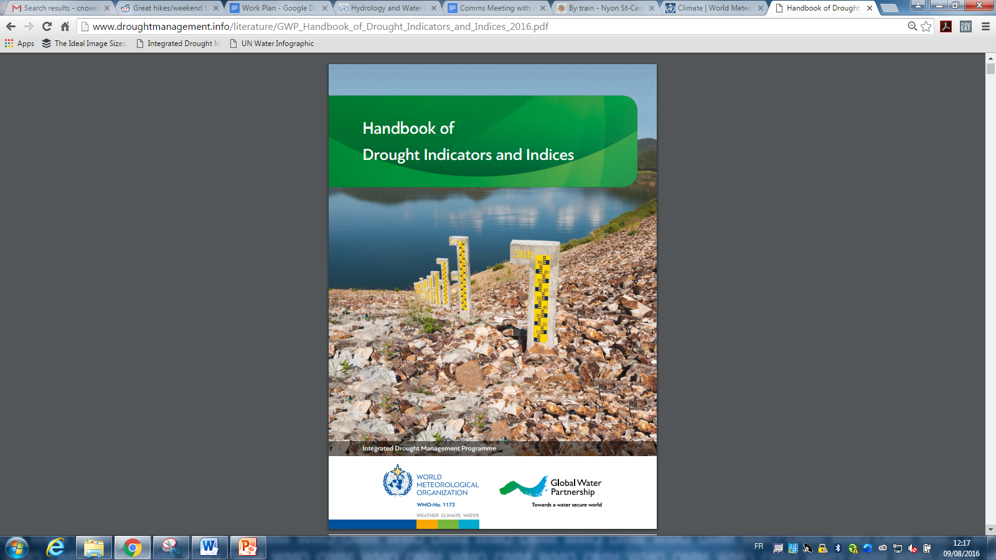
Handbook of Drought Indicators and Indices
Handbook is a resource to cover most commonly used drought indicators/indices
A starting point to describe and characterize the most common indicators and indices and their applications
Does not recommend a ”best” set of indicators and indices, given research requirements for appropriate application in location in question.
Notes:
Moving to the last part of this presentation to provide a snapshot of the guidance that is being developed by the IDMP: We launched this year the Handbook of Drought Indicators and Indices
Covers the most commonly used drought indicators/indices (48 currently – living document with an online tool where additional ones can be proposed and further information sought)
Intended for drought practitioners (NMHS, Resources Managers, decision makers such as public authorities)
A starting point: Indicators/indices available and in what places they are used
Designed with the drought riks management process in mind
Choice of indicator/index needs to be based on the specific characteristics of drought most closely associated with the drought impact of concern
Reference – providing an overview and guide to sources of further information

Slide 9
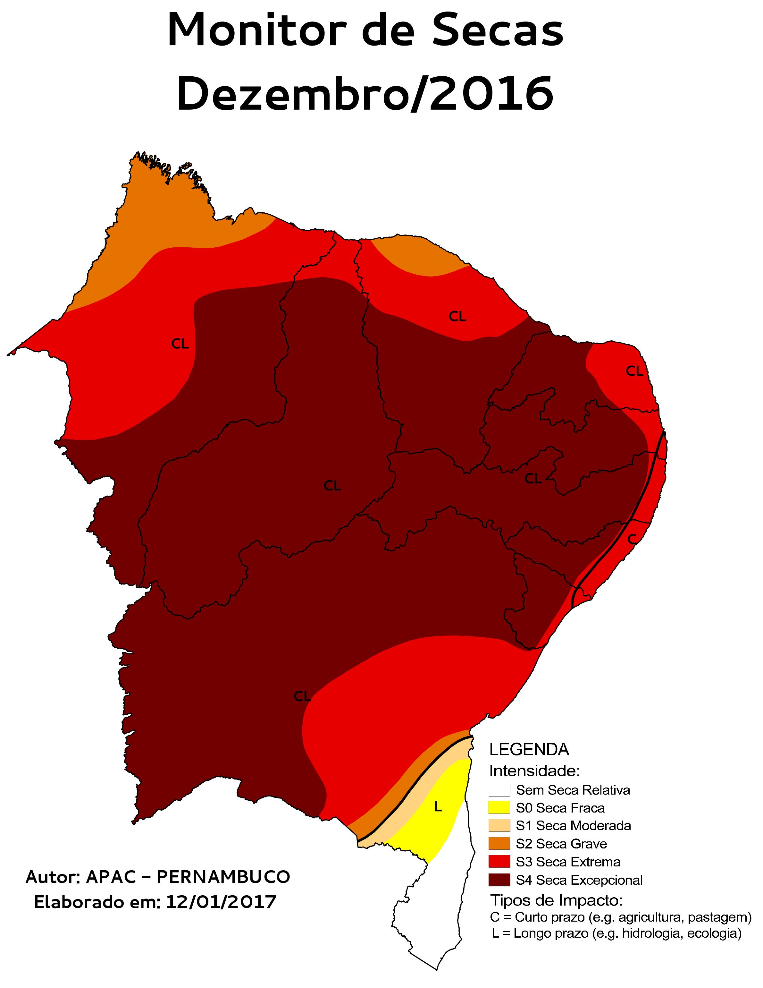
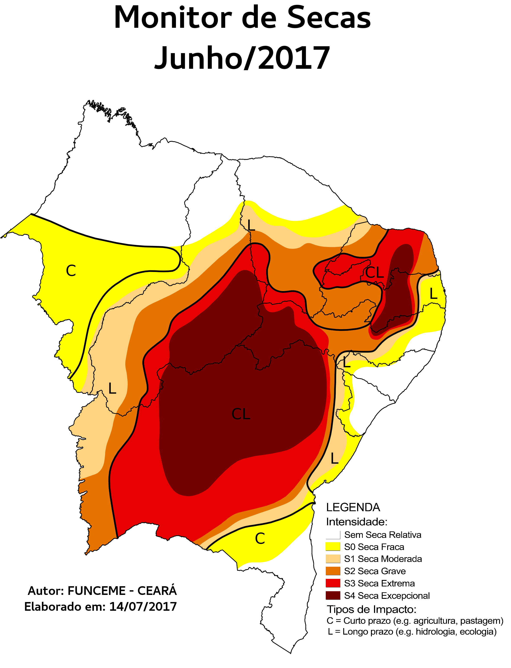
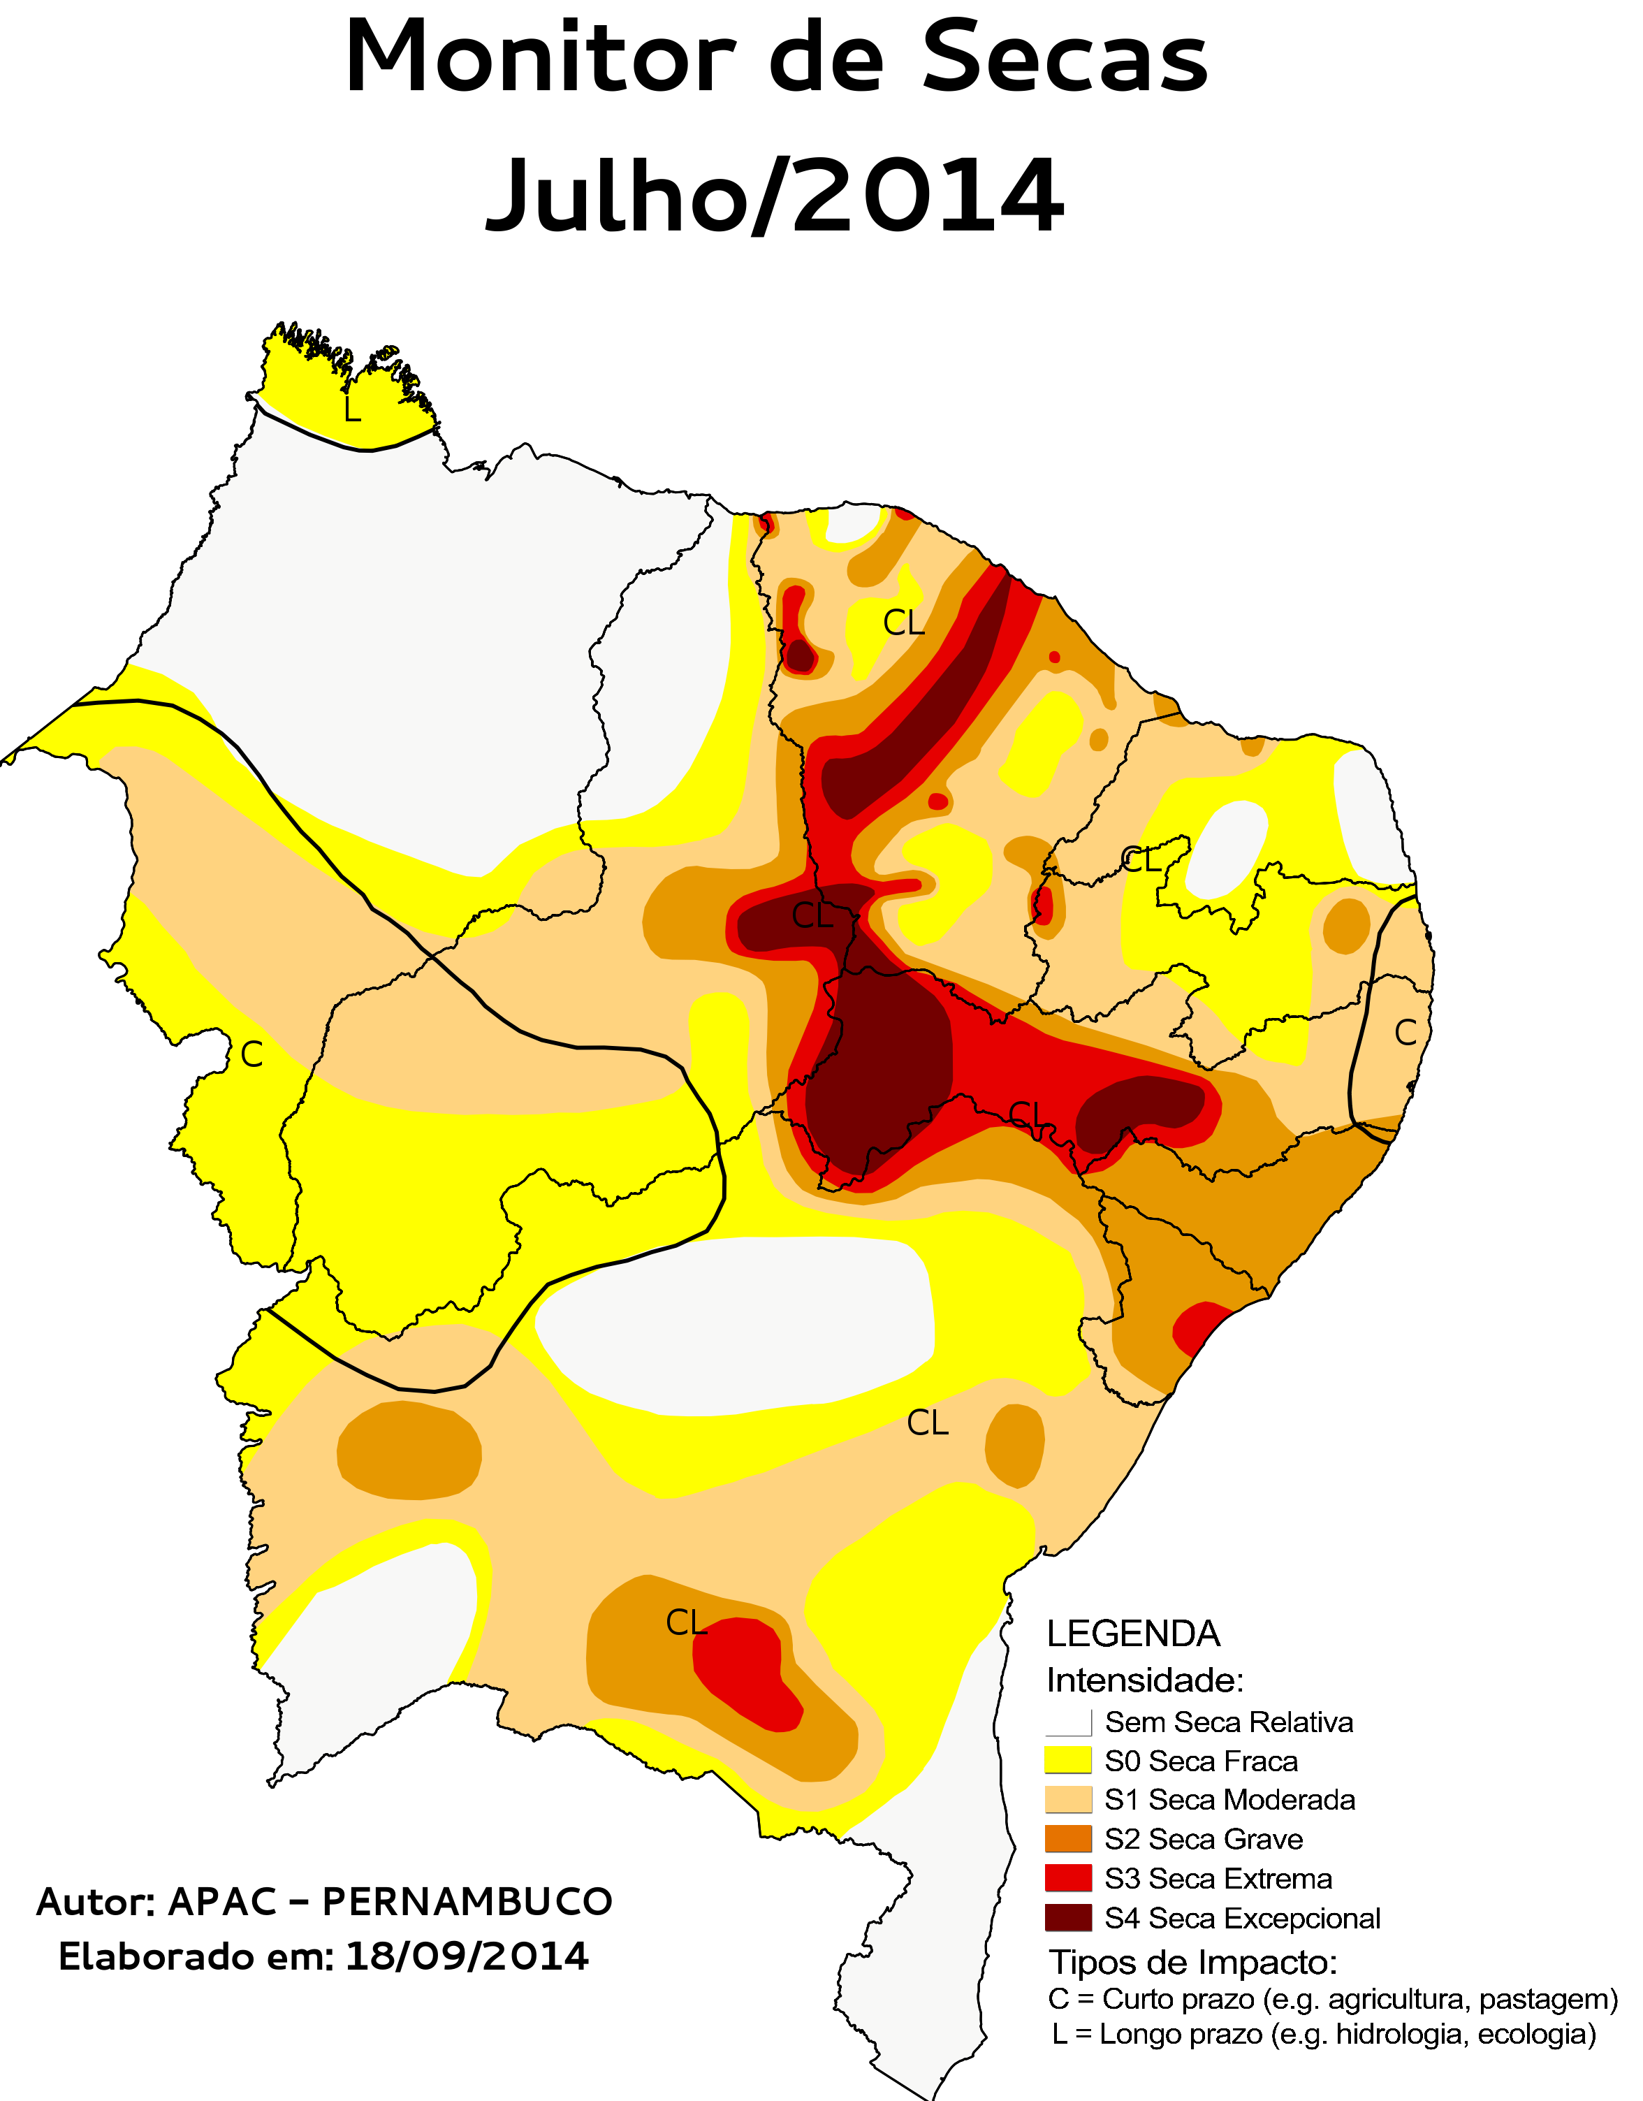
NorthEast Brazil Drought Monitor
Agência Pernambucana de Águas e Clima (APAC)
Fundação Cearense de Meteorologia e Recursos Hídricos (FUNCEME)
Instituto de Meio Ambiente e Recursos Hídricos (INEMA) do Estado da Bahia

Slide 10
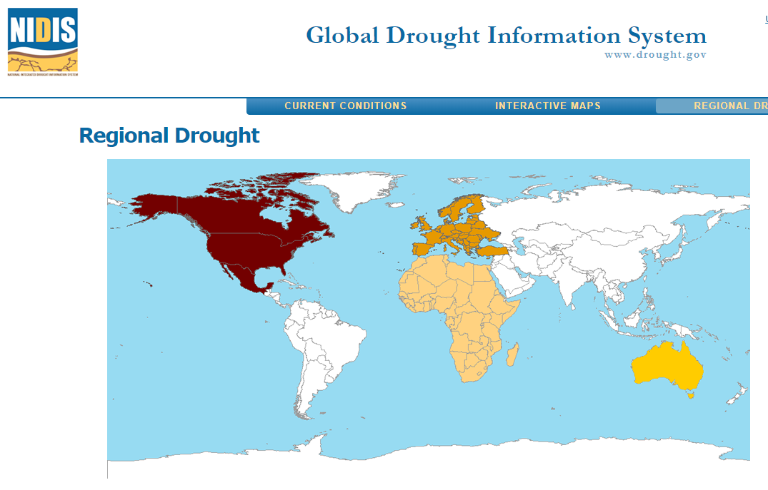
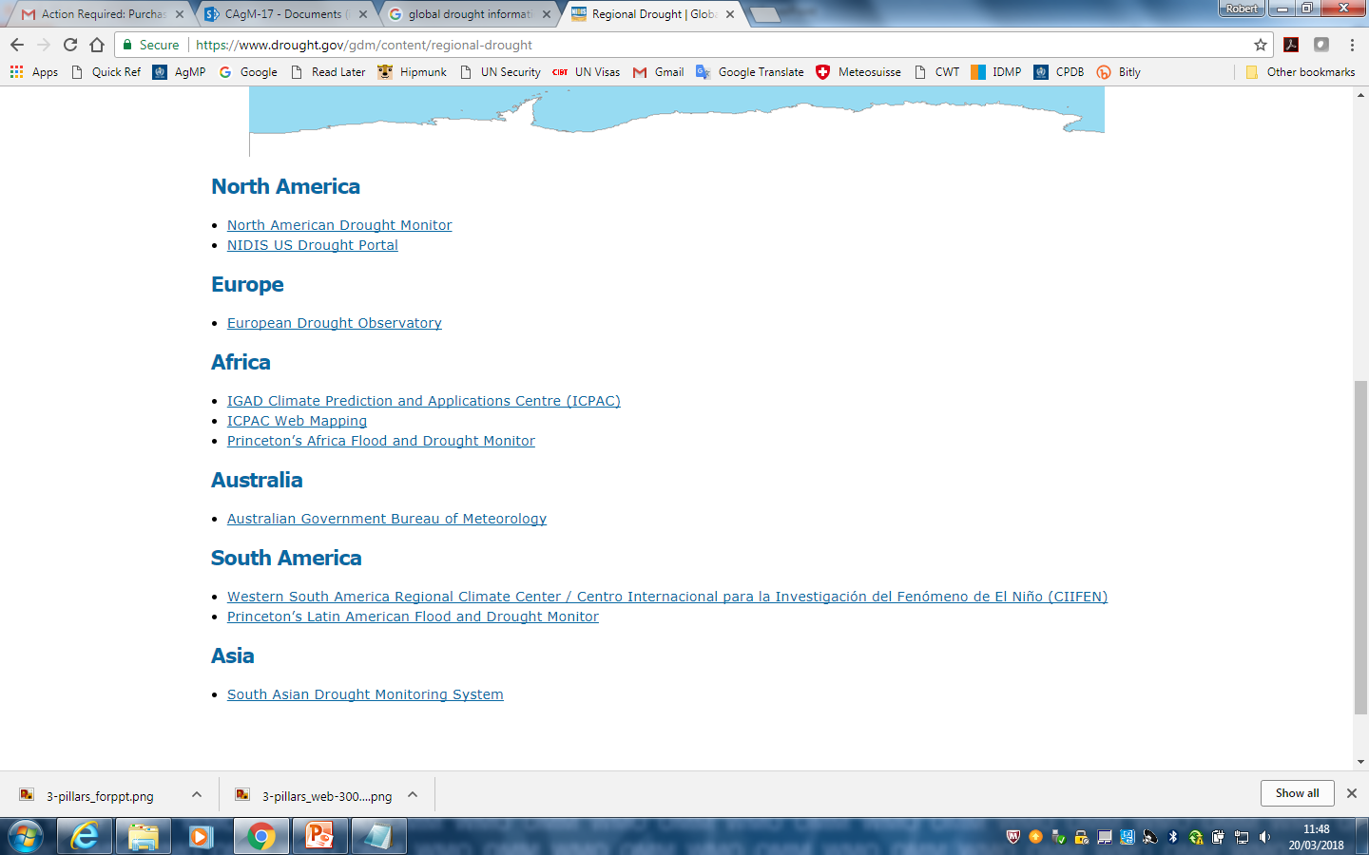
https://www.drought.gov/gdm/

Slide 11
Future Plans
WMO and IDMP to assist countries to integrate drought alerts based on meteorological indices into the regional MeteoAlarm and MHEWS systems
Working with UNCCD and FAO on developing National Drought Policies which includes arrangements on data issues
Interactions with FAO and UNCCD on Global Soil Carbon Issues Information System with Intergovernmental Technical Panel on Soils (ITPS)
Working group to develop guidelines for measuring, mapping, monitoring and reporting on SOC to monitor SOC stocks and stock changes to support management decisions

Slide 12

Thank you

