Slide 1



Importance of Human Adaptation to Climate Change in Cities and Identification of Appropriate Indicators for GCOS-TOPC
Nigel Tapper
School of Earth, Atmosphere and Environment and Co-Operative Research Centre for Water Sensitive Cities, Monash University, Australia; Member GCOS-TOPC; Co-Chair Task Team for a GCOS Surface Reference Network

Slide 2
Five Key Messages in Relation to Cities, Climate Change and Adaptation
Globally the process of urbanisation continues at an extraordinary rate
This urbanisation coincides with broadening acceptance of the reality of climate change and clear evidence in the climate record and impacts – extremes in heat and precipitation especially
Cities and urban areas are hotter than their rural surroundings and this heat is superimposed upon greenhouse-gas (GHG) induced climate change
Cities and urban areas are especially vulnerable in the face of climate change, especially in relation to heat, water scarcity and sea level rise
Although highly vulnerable, cities globally do provide unique opportunities for adaptation to climate change, including direct climate intervention. Strategies required immediately
These are critical considerations for urban dwellers in Australia and around the world and for those who manage, plan, design and build our cities

Slide 3
Possible Adaptation Indicators (1st cut tabled TOPC-20, March 2018)
Realm | Possible Indicator | Physical or Financial | Data Source | Scope (for global, need to consider their global representativeness)
Urban Environments | 1.Vegetation Fraction (Greenness) 2. Impervious Fraction 3. Complete Surface Fraction 4. Albedo 5. Urban air temperature mitigation | P P P P P | Satellite Satellite Satellite Satellite Weather station | Global Global Global Global Global
Agriculture and Forestry | 1. Shifting agricultural zones 2. Prescribed burning 3. Investment in fire suppression | P P F | Satellite (LULC) Satellite Fire Agencies | Global Country Country
Coastal Infrastructure | 1. Adapting existing infrastructure 2. Infrastructure for hazard management 3. Insurances - disaster relief | F and P F and P F | National agencies/ Satellite National agencies/Satellite Reinsurance companies/ national agencies | Country Country Global, country

Slide 4

Origins of the Monash Urban Cooling Initiative
The Australian “Millenium Drought” began in 1997 and lasted until 2009 – saw two of Australia’s largest cities (Melbourne and Brisbane) come perilously close to running out of water
Intense heat and associated mortality, dust storms and forest fires characterized the latter stages of the drought. Official temperatures approached 50°C during extreme heat events in Melbourne, Adelaide and Western Sydney.
In 2008 the Victorian State Government, as part of their climate change adaptation planning asked our research group to assist by developing a heat warning system

Slide 5
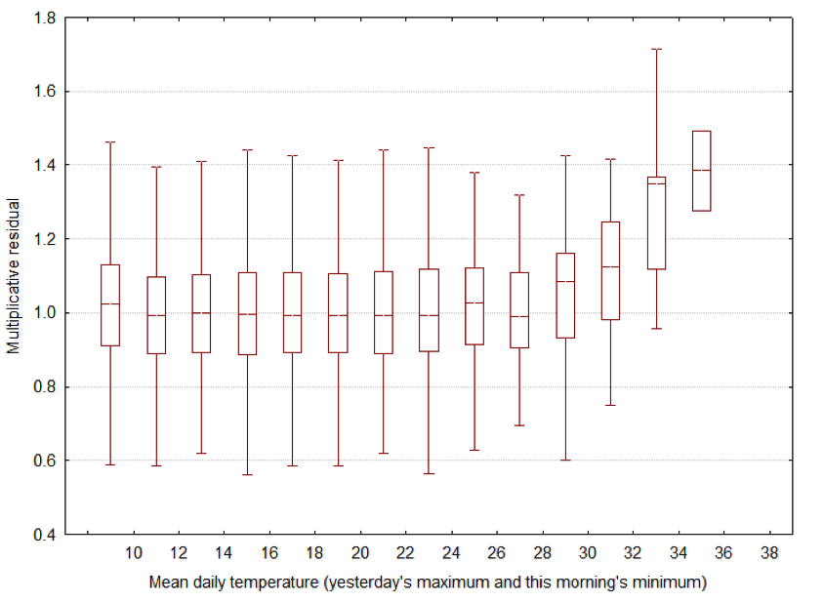

Melbourne – Heat Threshold for Excess Deaths in >64 year olds.
Suggested that even a slight temperature reduction (1-2° C) in extreme heat events (i.e. heat mitigation, a target to aim for) would be sufficient to save many lives
Mortality anomaly
Threshold Temperature
~17% excess
Nicholls, Skinner, Loughnan and Tapper, 2008

Slide 6
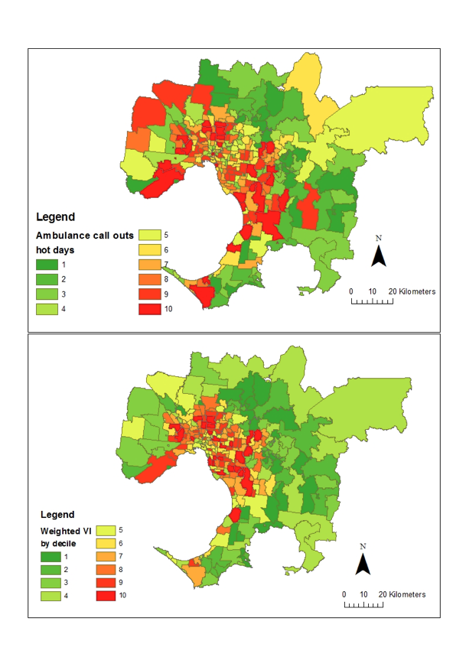
Mapping the Heat Vulnerability Index for Australian Cities
Critical risk factors identified ‘a priori’ from the literature
Hot days (EHEs) were defined for each city and associated adverse health outcomes (AHOs) identified
Stepwise regression used to select best variables (risk factors) for each city. Appropriately weighted values applied to define VI for each city postcode
An alternative, but similar VI for each postcode was defined using Principal Components Analysis PCA
Ability of both approaches to predict AHOs at the postcode level was assessed
Melbourne
Evidence suggests that excess deaths during extreme heat events were reduced by at least 50% between 2009 and 2015 Nicholls, Loughnan and Tapper, 2016 Climate Services for Health, WMO/WHO
Loughnan, Tapper and Phan, 2013

Slide 7
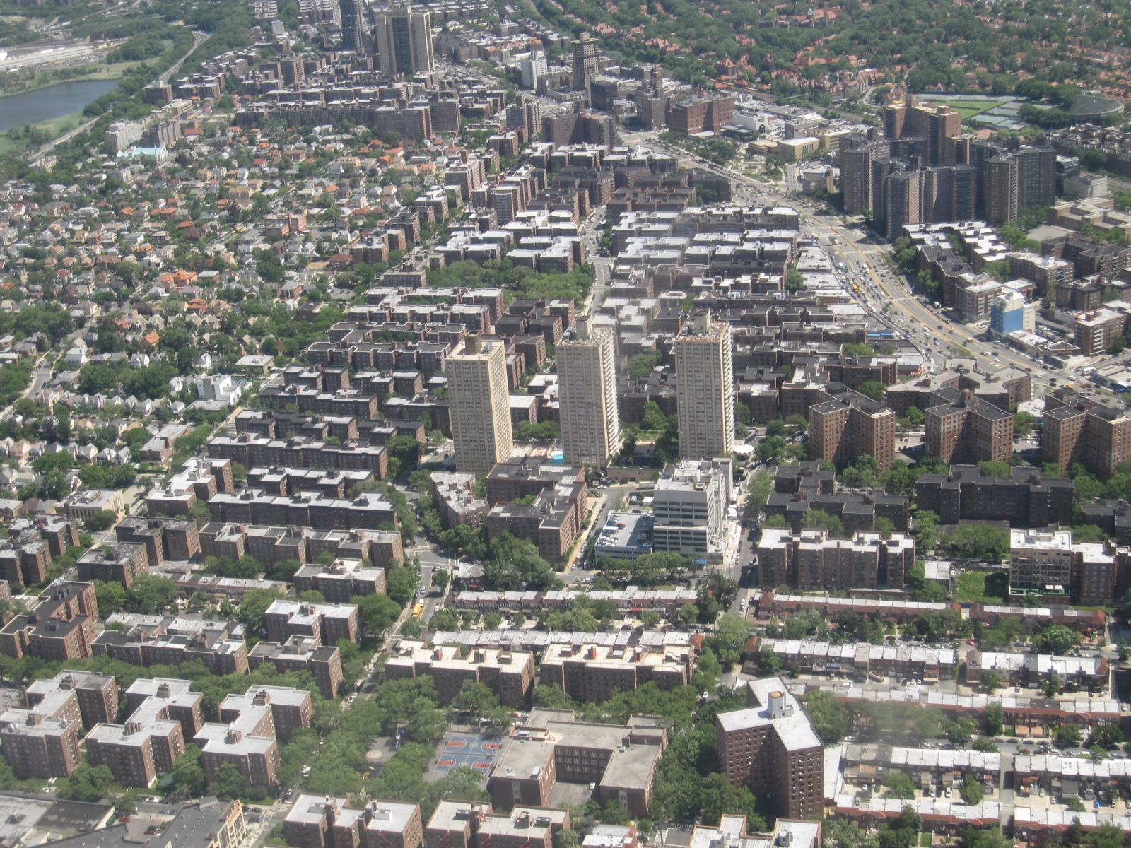
Controls on Urban Climates are linked to Adaptation
Materials
(radiative, thermal, moisture, aerodynamic)
Metabolism
(emissions of water, heat, pollutants)
Form:
Geometric structure
City Size
Surface Cover
(impervious, vegetated)
Notes:
From a physical climate standpoint, ECVs should be linked to the controls on urban climate.

Slide 8
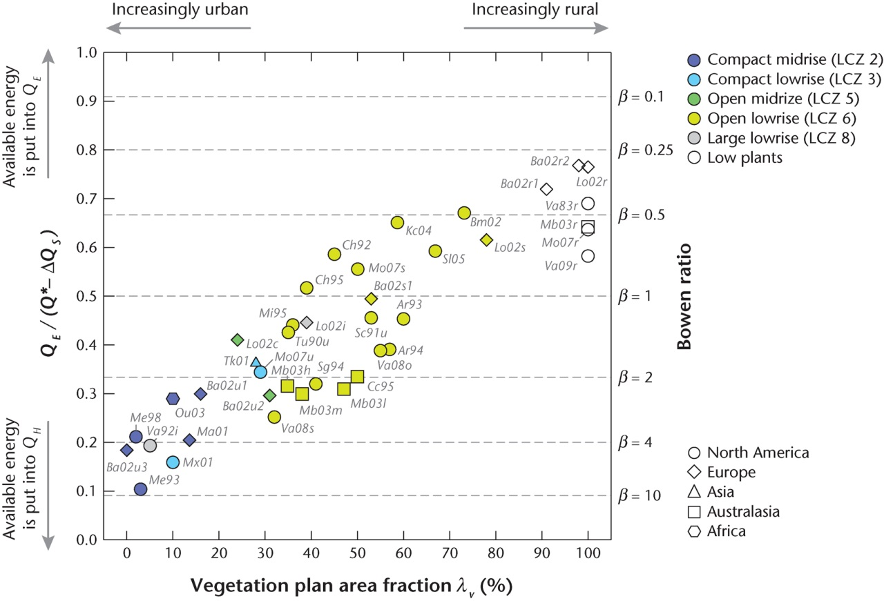
Surface Cover demonstrates Energy Balance Control
Consider also moisture
evaporative flux ratio
Oke et al. (2017)

Slide 9

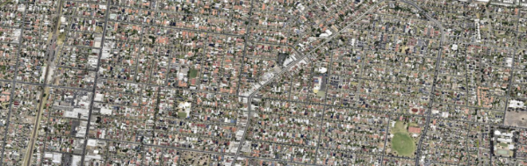
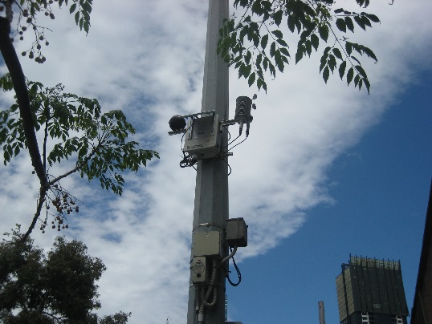
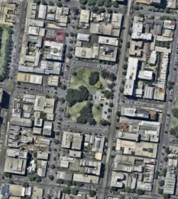
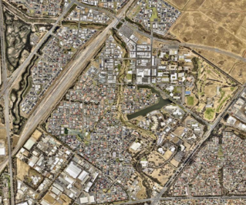
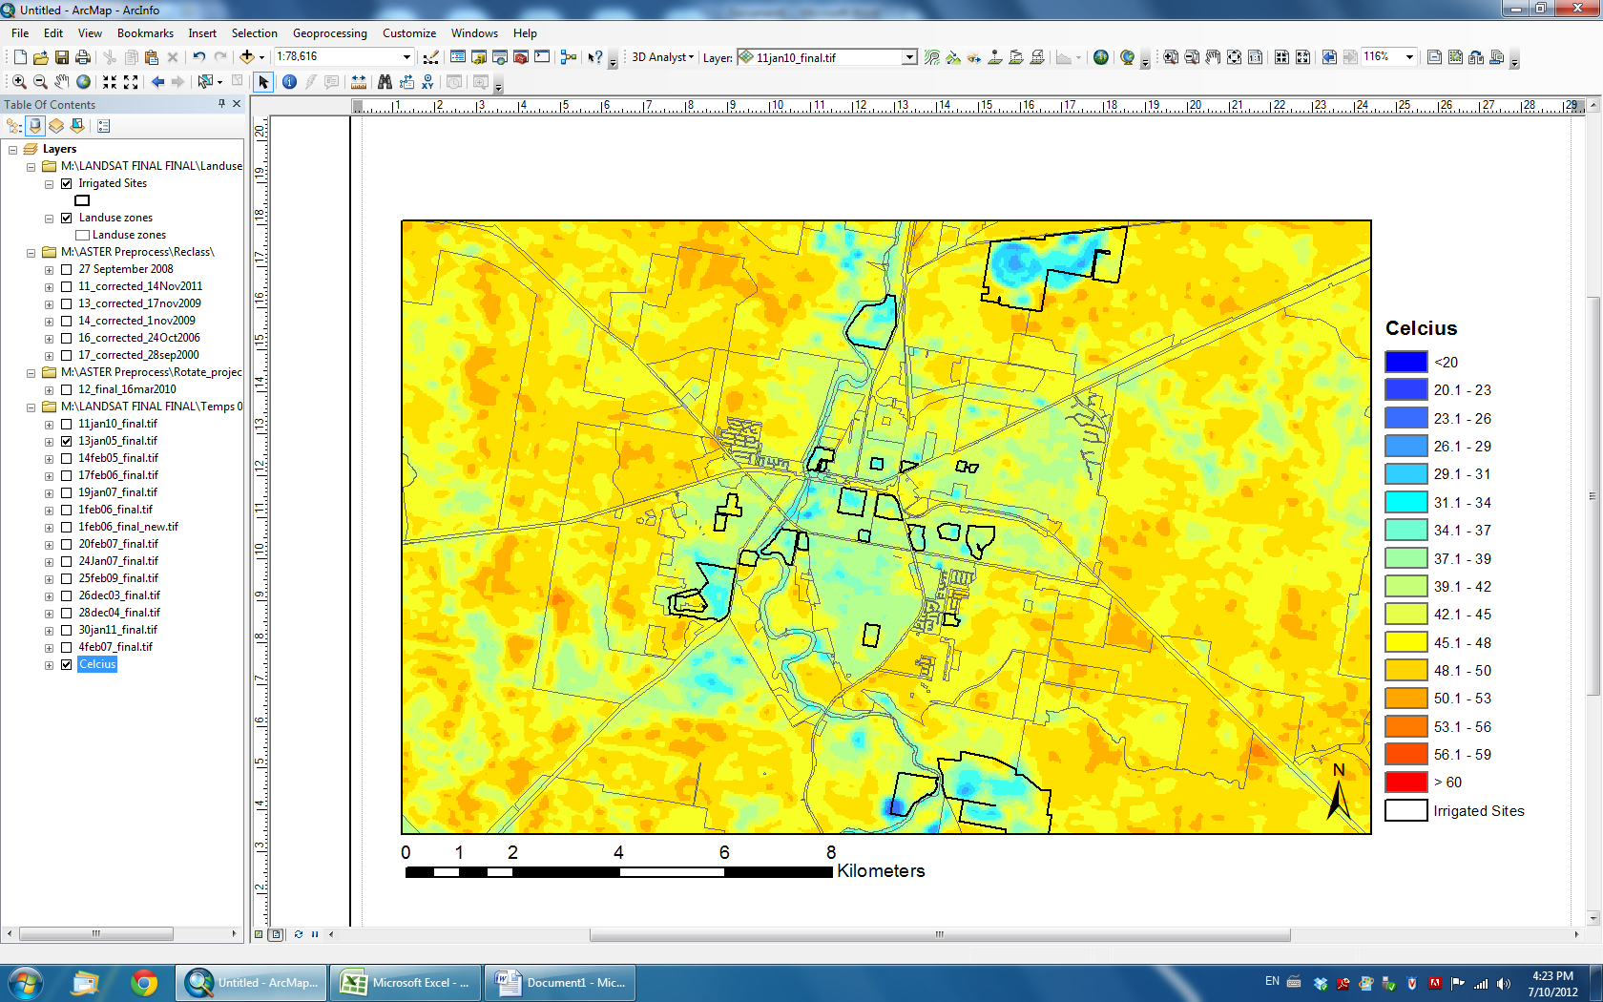
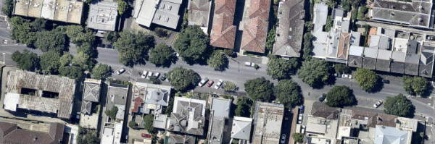
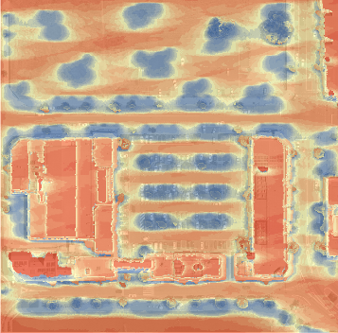
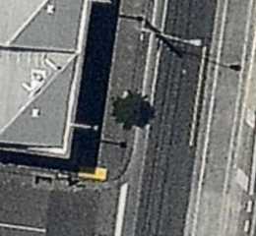
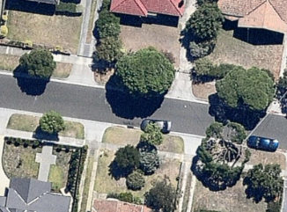
Towards 2°C Cooling : Research Questions and Approach For Our Urban Research Program
How effective are tree cover, green infrastructure and water sensitive urban design (WSUD technologies) in cooling urban climates at a range of scales?
What are the key configurations of the above required to reduce temperatures to save lives under heat wave conditions and to enhance human thermal comfort and livability?
Observations
Remote sensing
Numerical Modelling

Slide 10
Scale of Approach
Reduce local-scale air temperature
Limit heat-health impacts
Role of water and green infrastructure
Reduce micro-scale air temperature and radiant temperature
Improve human thermal comfort
Coutts, Tapper, Beringer, Loughnan, Demuzere (2013)

Slide 11
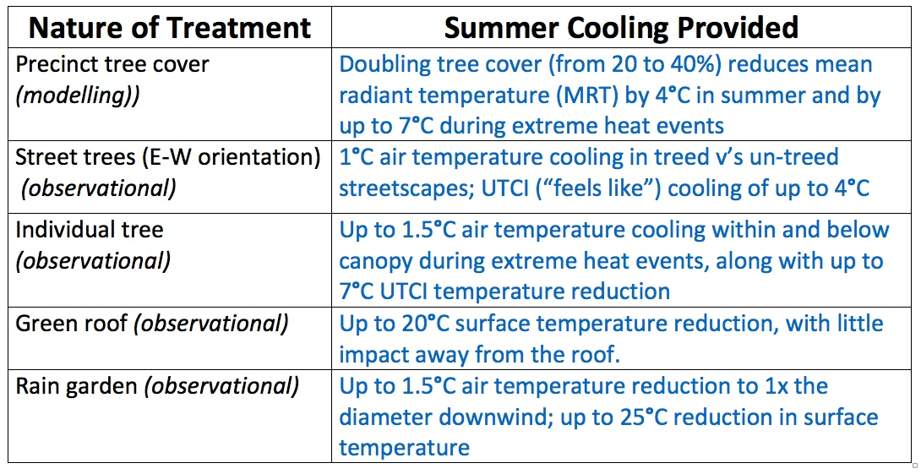
Summer Cooling at Microscale
Precinct canopy
“Realistic” optimal design
Typically - up to 4.0°C MRT
Heat wave - up to 7.0°C MRT
(Thom, Coutts, Broadbent and Tapper, 2016)
Green roof
Typically up to 20.0°C surface temp
(Coutts, Daly, Beringer and Tapper, 2013)
Streetscape
Typically – up to 1.0°C air temp
UTCI – up to 12.0°C
(Coutts, White, Tapper, Beringer and Livesley, 2015)
Rain-garden
Summer conditions
Surface temp – to 25°C
Air above and downwind (1x diameter) – up to 1.5°C
(Shu and Tapper, 2017)
Single tree
Typically – up to 1.2°C air temp below canopy
UTCI – up to 7.0°C below canopy
(Coutts, Moore, Thom, Tapper and White, 2017)

Slide 12
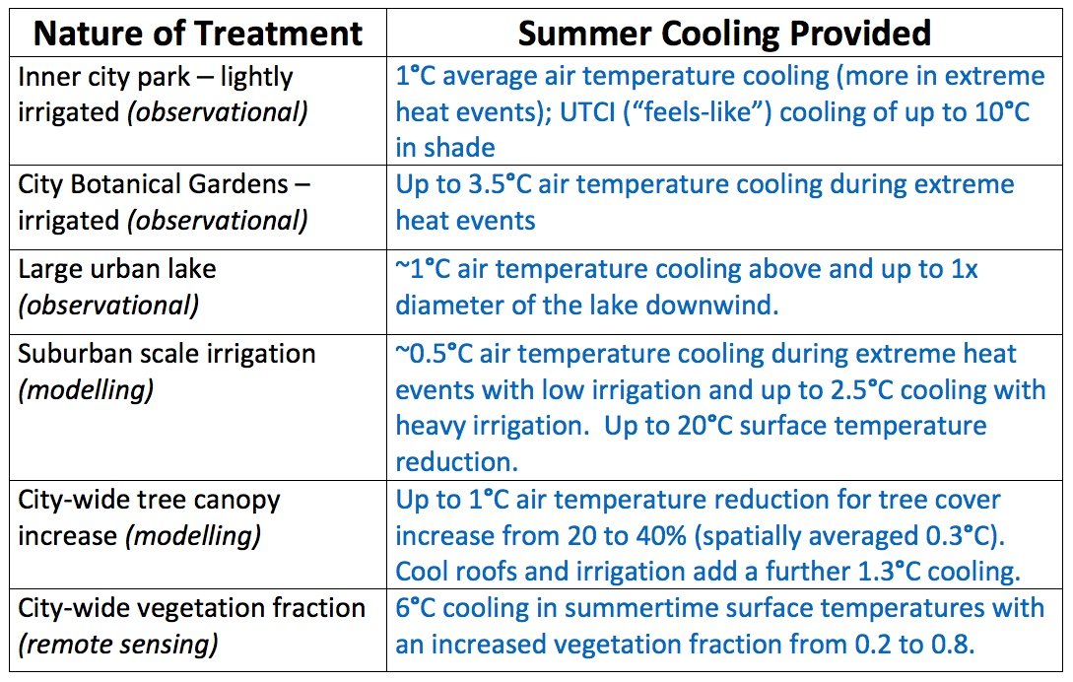
Summer Cooling at Local Scale (Suburban to City)
Heat wave
20% ➔40% - up to 1.0°C air temp (spatially averaged 0.3°C; adding cool roofs and irrigation up to 1.2°C spatially averaged) (Jacobs, Gallant and Tapper, 2018)
Typical summer
0.2 ➔0.8 fraction – up to 6.0°C surface temp
(Nury, 2016)
Botanic Garden Irrigation
Heat wave – up to 3.5°C air temp
(Lam, Gallant and Tapper, 2017)
Suburban heat wave
Low/mod irrigation - ~0.5°C air temp
Very heavy irrigation - up to 2.5°C air temp
Up to 20°C surface temperature
(Broadbent, Coutts, Tapper and Demuzere, 2017)
Park cooling
Typical – light irrigation ~1.0°C air temp
UTCI - up to 10.0°C
(Motazedian, 2016)
Typical summer
~1.0°C air temp above and downwind (1x diameter)
(Broadbent, Coutts, Tapper and Demuzere, 2017)

Slide 13
So…….
1. There is clearly a strong evidentiary basis for irrigated and unirrigated green infrastructure reducing temperatures sufficiently (i.e. up to 2 °C) to save lives during extreme heat events in southern Australian cities
2. Cooling can be enhanced with other treatments (cool pavements, albedo treatment, etc.)
3. In Australia and in many parts of the world urban greening is a discernible adaptation trend – therefore potentially an excellent adaptation indicator

Slide 14
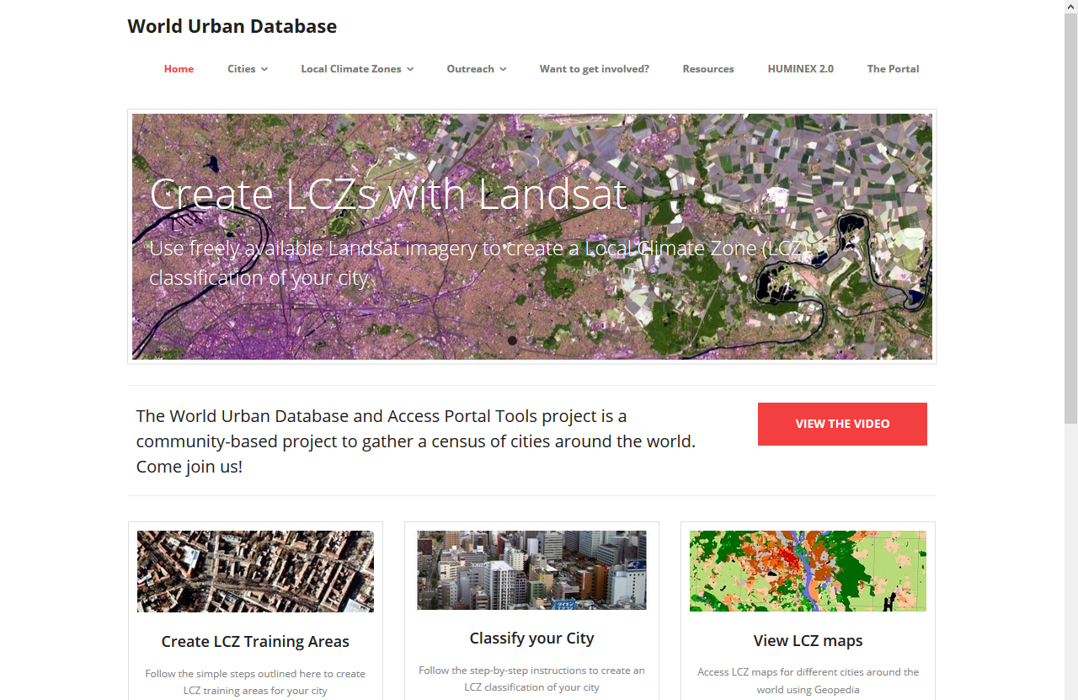
Urban Surface Characteristics & Remote Sensing: WUDAPT (World Urban Database and Access Portal Tools)
Workflow for identifying urban local climate zones via remote sensing using many of the characteristics described earlier.
ECVs: require a base year for comparison
Notes:
Consider scalable ECVs given the intra-urban variability.

Slide 15
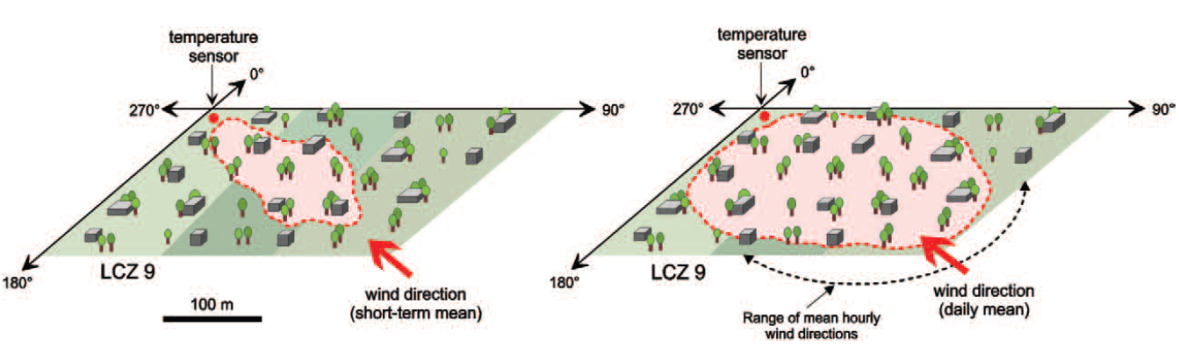
Urban Air Temperature Measurements?
Traditional WMO observing station
In urban environments, the source area characteristics can be linked to the neighbourhood (LCZ concept)
Oke et al. (2017)
Short-term (<1 h) source area
Mean daily source area
Stewart and Oke (2012)
Notes:
A fundamental climate variable. Changes to the urban surface / urban function should be reflected in changes to Tair.
The value of an ECV representing human adaptation to climate change in cities

Slide 16
Guidelines exist to measure urban T_{air}
Notes:
Can the guidelines be applied globally? Might depend on selecting a representative type LCZ?

Slide 17
Metadata are key for any urban meteorological observation
WMO (2008)
Notes:
An important logistic

