Slide 1
Observing Soil Moisture Changes and their Impact on Agriculture
Wolfgang Wagner
Department of Geodesy and Geoinformation (GEO) Vienna University of Technology (TU Wien)
Earth Observation Data Centre for Water Resources Monitoring (EODC)

Slide 2
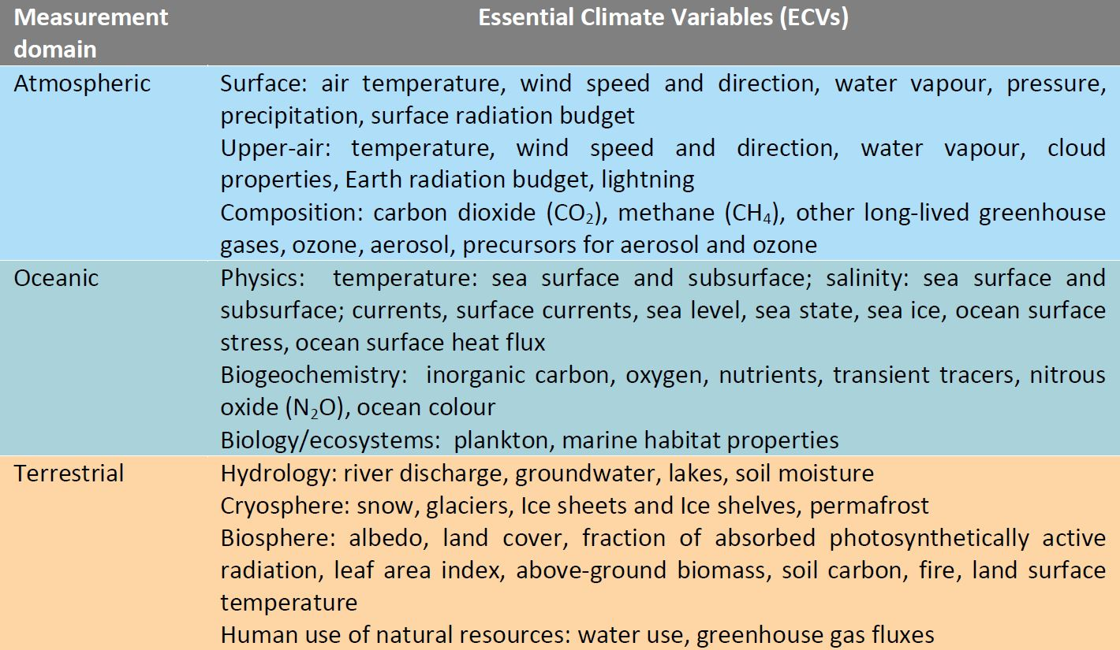
Global Climate Observing System

Slide 4
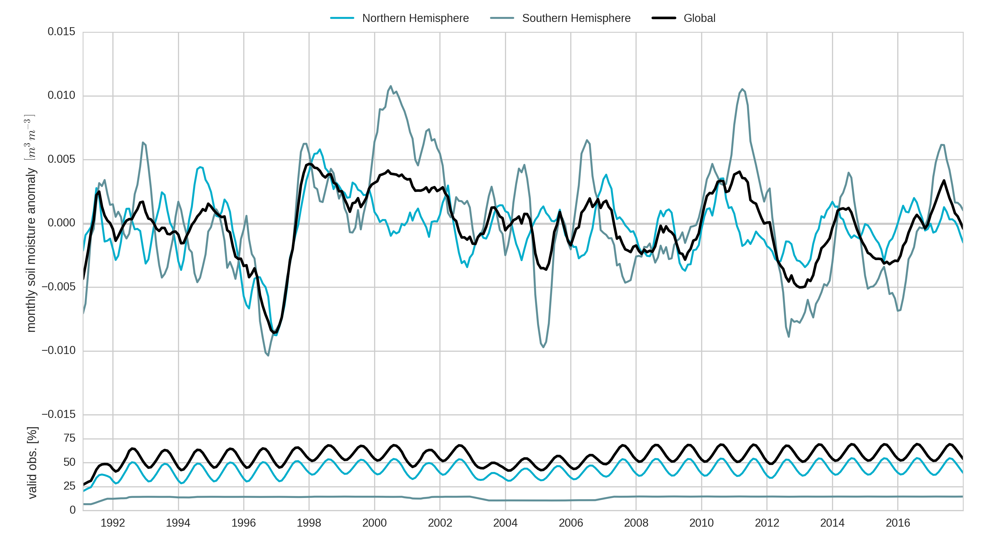
Global Soil Moisture Observations
Global average (land surfaces)
Northern hemisphere
Southern hemisphere
Soil moisture anomalies [m³m⁻³]
Dorigo et al. (2018) BAMS State of the Climate 2017, submitted.

Slide 5
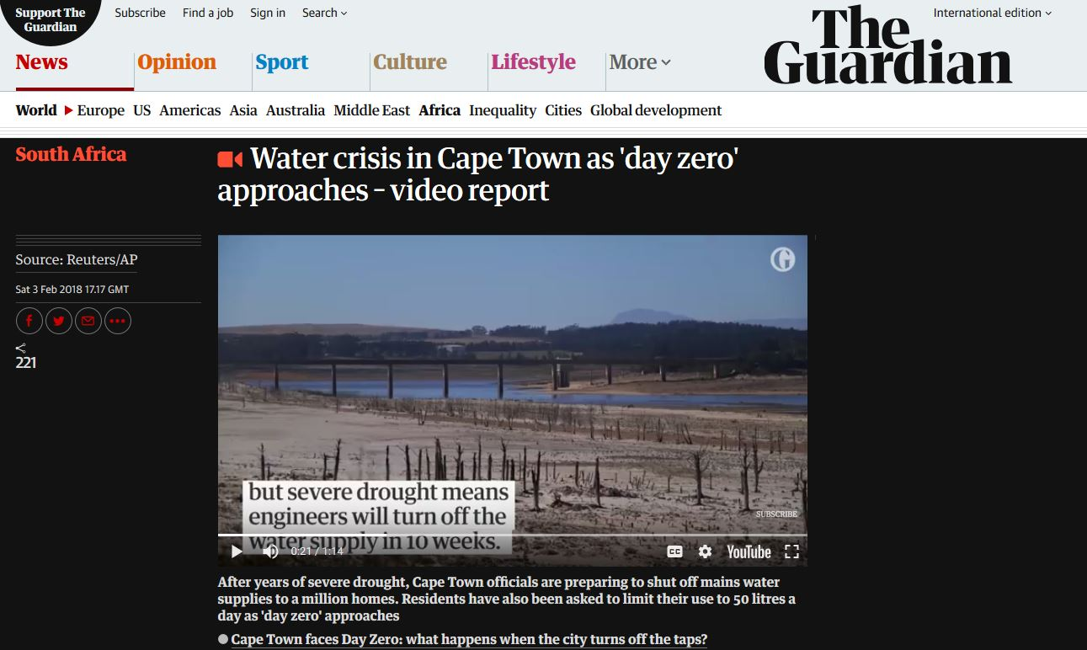
https://www.theguardian.com/world/video/2018/feb/03/cape-town-water-crisis-approaches-day-zero-video-report

Slide 6
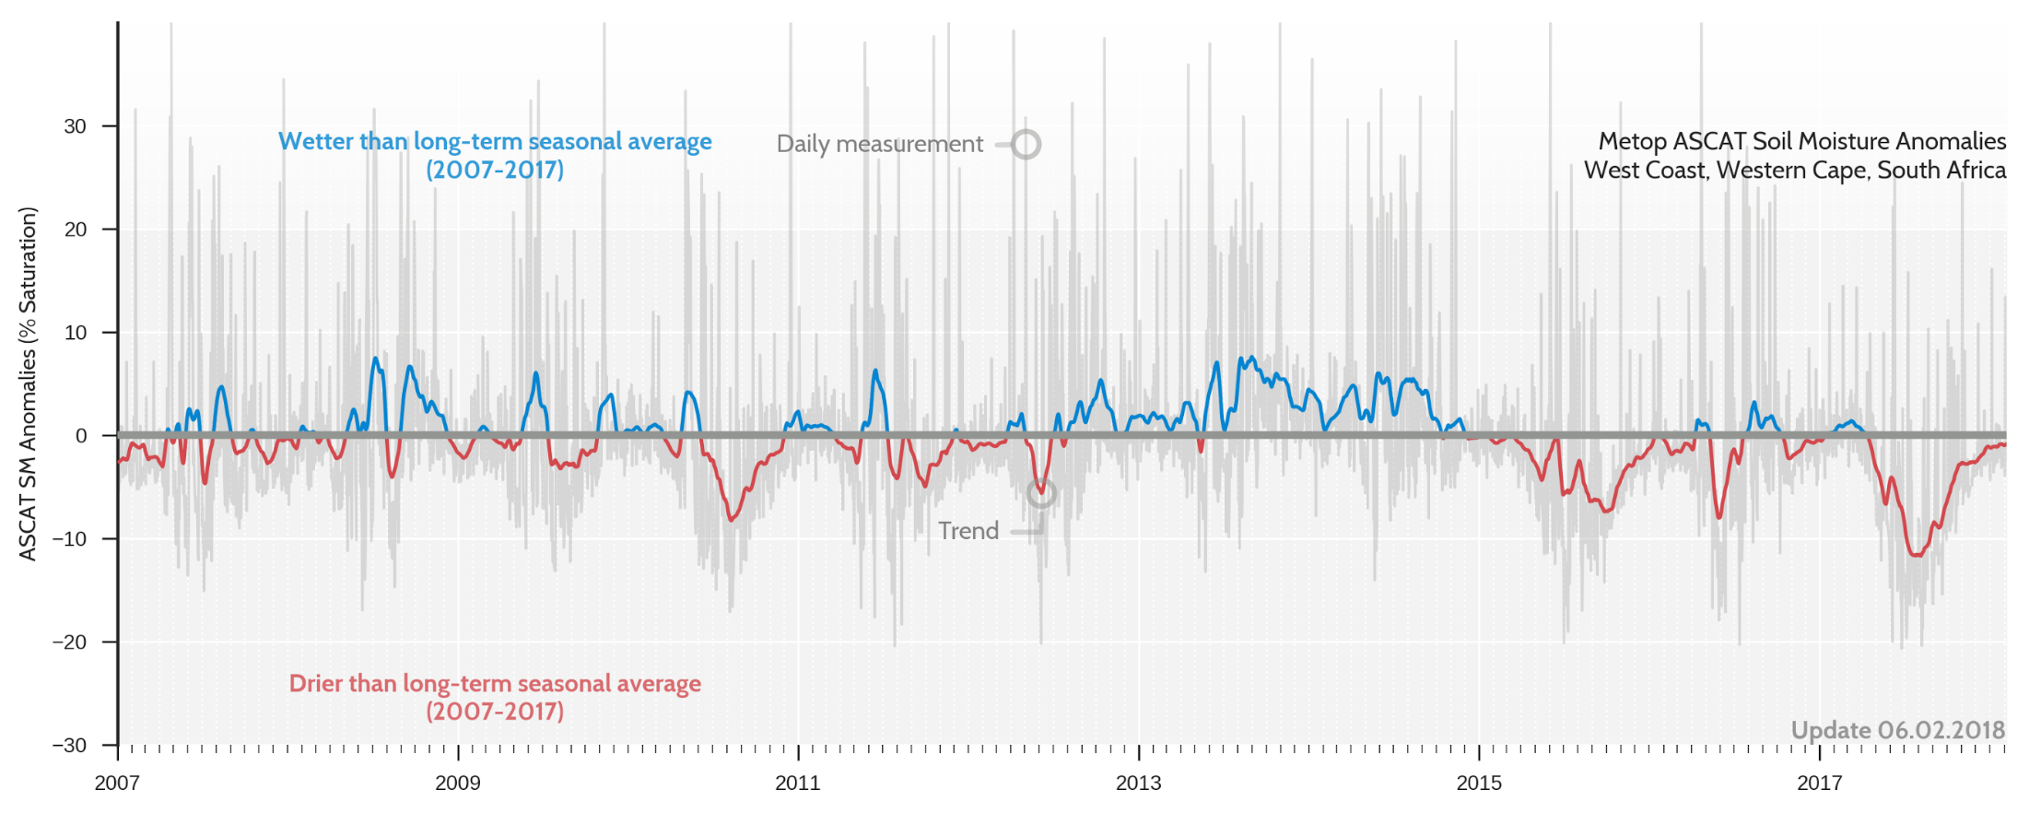
Water Crisis in Cape Town as seen by ASCAT

Slide 7
CCI Soil Moisture Users
Registered users > 5200 and more than 5 registrations per day
User statistics prepared by GeoVille
→ Increasing uptake from NGOs, private companies and public bodies

Slide 8
Social Benefit Areas of CCI Soil Moisture Data

Slide 9
Origin of CCI Soil Moisture Data
Increasing interest from users from Asia

Slide 10
Moving into the Cloud

Slide 11
↑40 %
per year
Doubling every two years
► Data Volume
► Number of transistors (Moore’s law)
► Disk
► CPU
Bandwidth
↑25 %
per year
Years

Slide 12
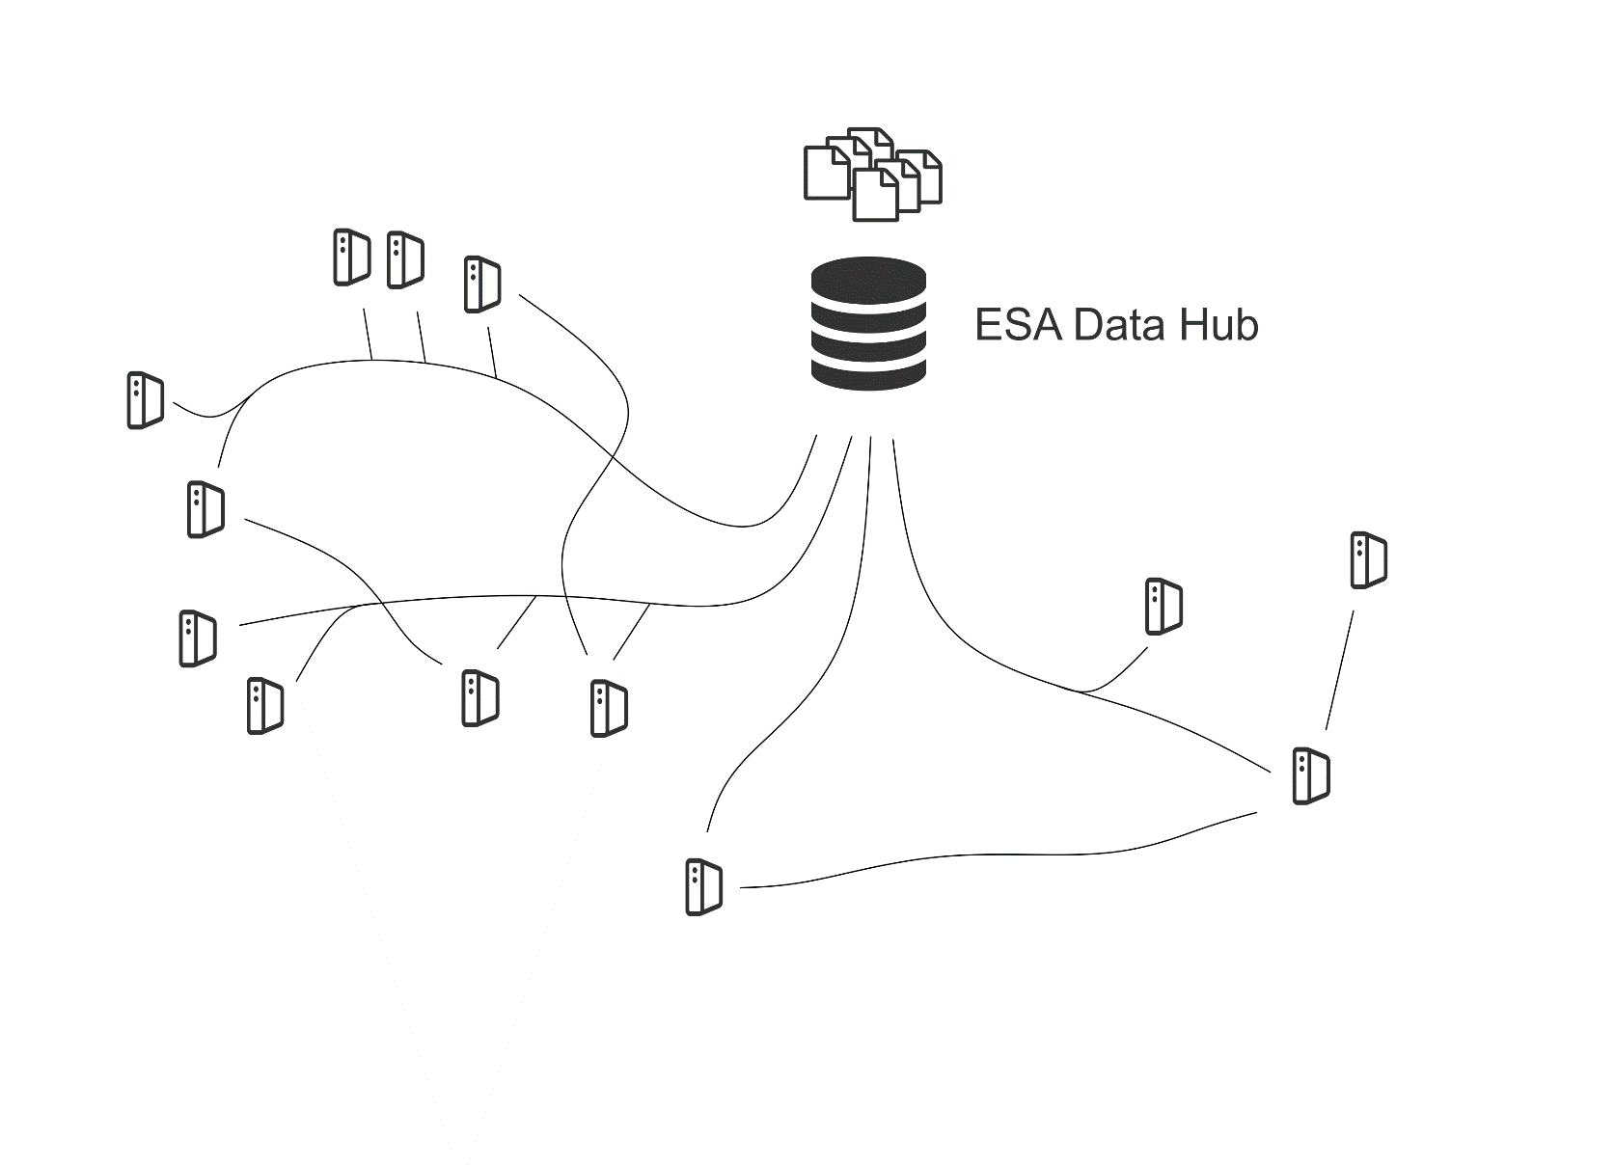
EO Ground Segment – The Past

Slide 13
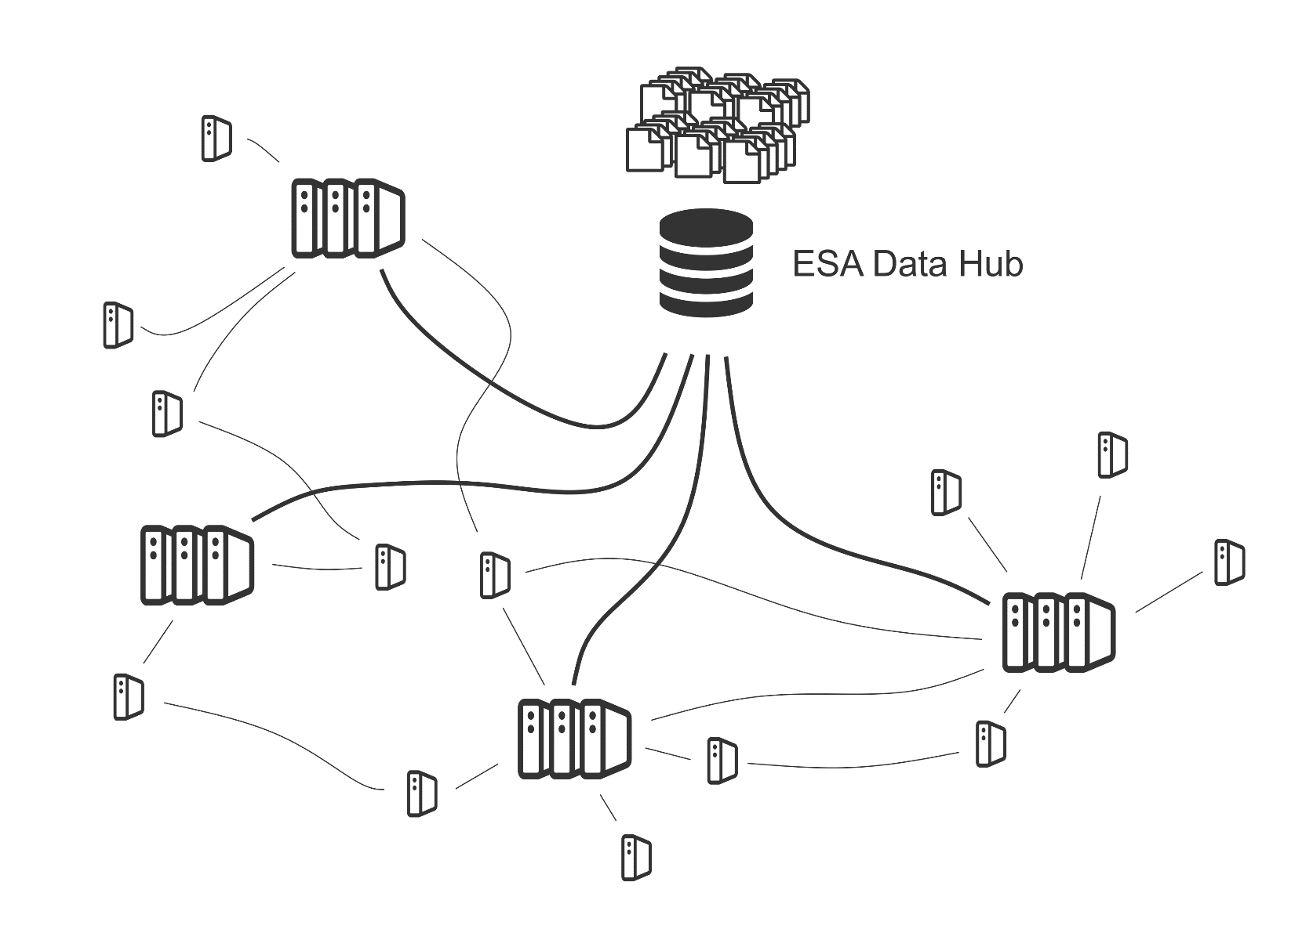
EO Ground Segment – The Future

Slide 14
The Formation of a Network of EO Cloud Platforms
Reaching a critical mass is essential for survival
How to scale up?
Venture capital → Google, Amazon, …
Public investments → CODE-DE, DIAS …
Cooperatives → EODC, Science Centres
Publicly-funded Data Centres
Cooperative Data Centres
Commercial Data Centres

Slide 15
Earth Observation Data Centre
Collaboration for Earth Observation
Building a federated multi-owner IT infrastructure for
Scientists
Public services
Innovators
Users are partners who participate in decision making
Development of collaborative services
From data to model predictions
Petabyte Storage
Supercomputing
Cloud Platform
https://www.eodc.eu/

Slide 16
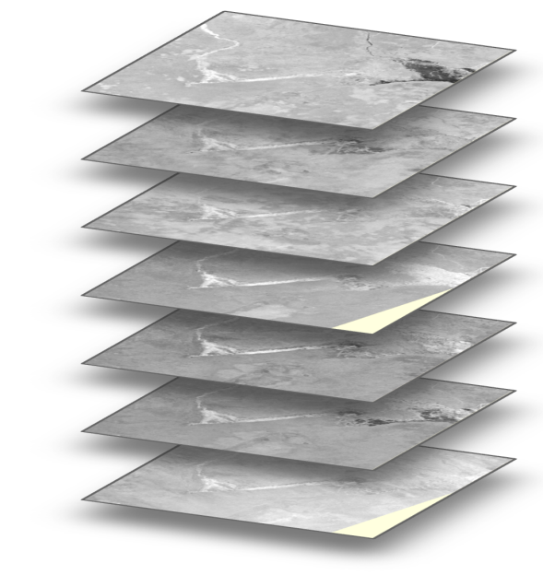
Earth Observation Data Centre
Sentinel Data Cubes
Up-to-date worldwide Sentinel data
Ready-to-use data cubes
Sentinel-1
Image mosaics
Water bodies
Soil moisture
Wetlands
Land cover
time
x
y
Agricultural area near Vienna as depicted by Sentinel-1

Slide 17
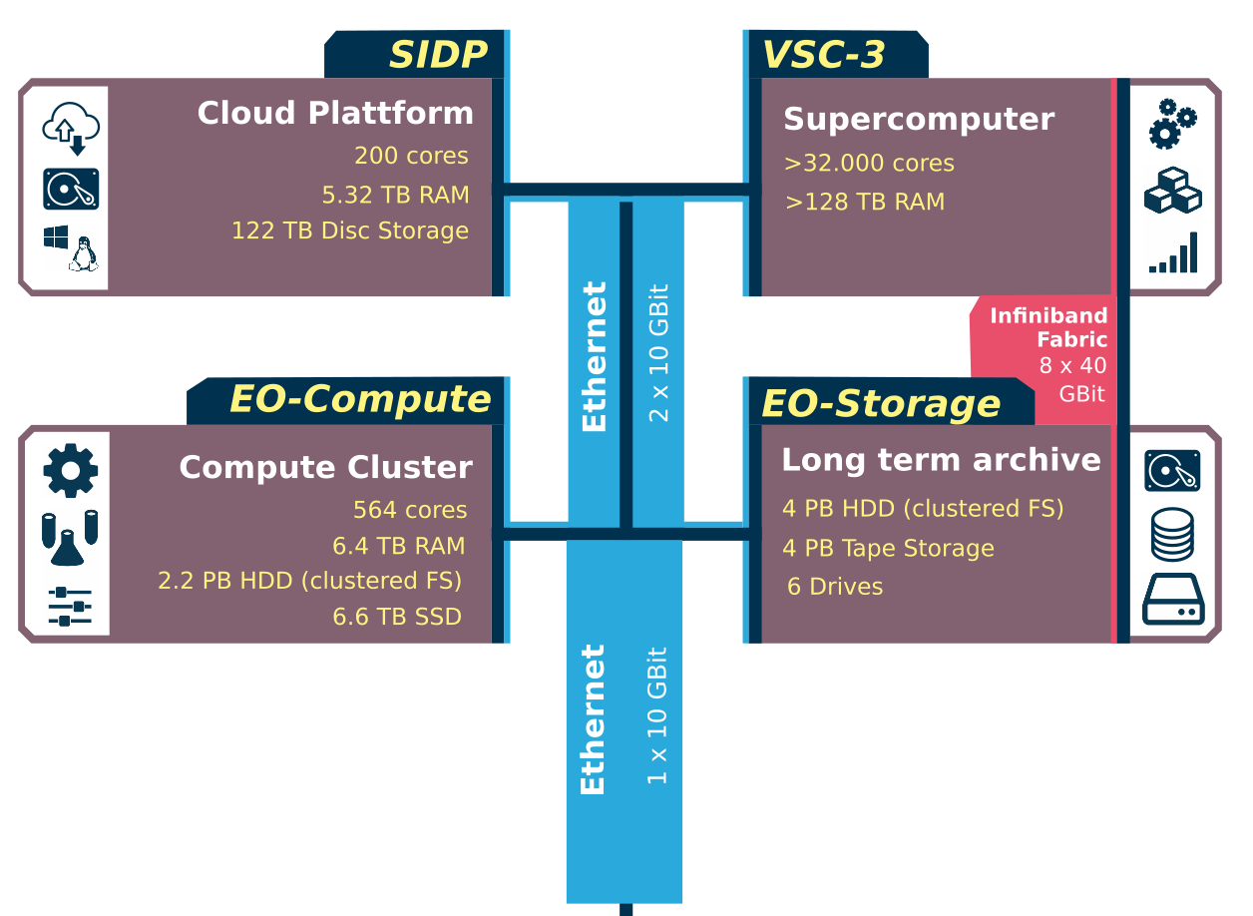
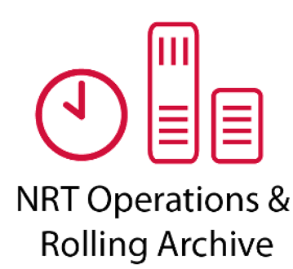
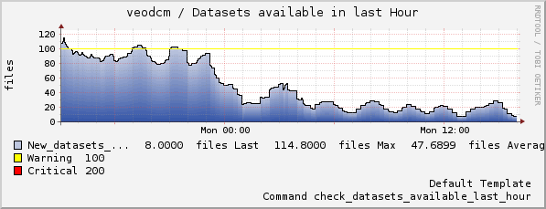
EODC: Creating a Multi-Owner Cloud Infrastructure
2 x 10 GBit
operated by

Slide 18
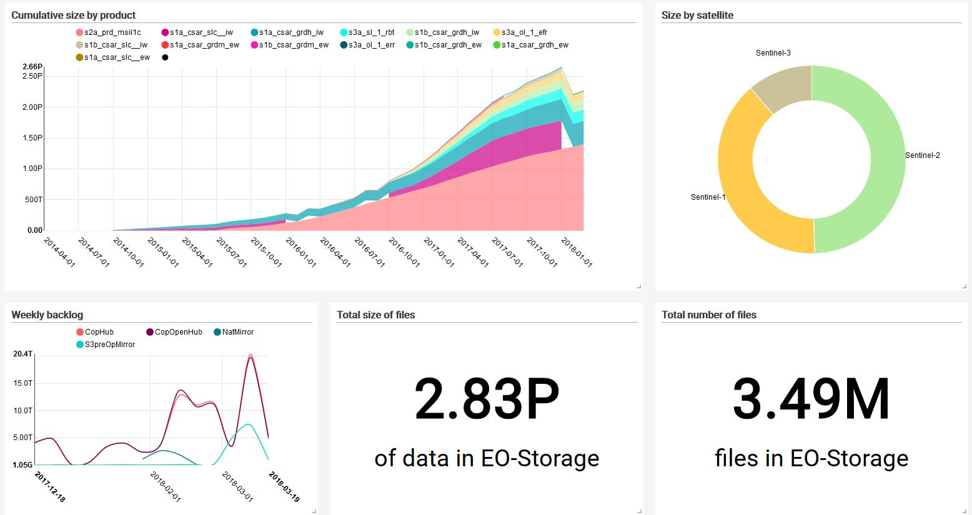
Data @ EODC
Data status: 21 March 2018

Slide 19
Use for Agricultural Monitoring

Slide 20
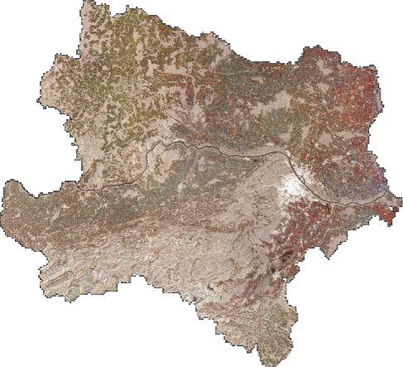
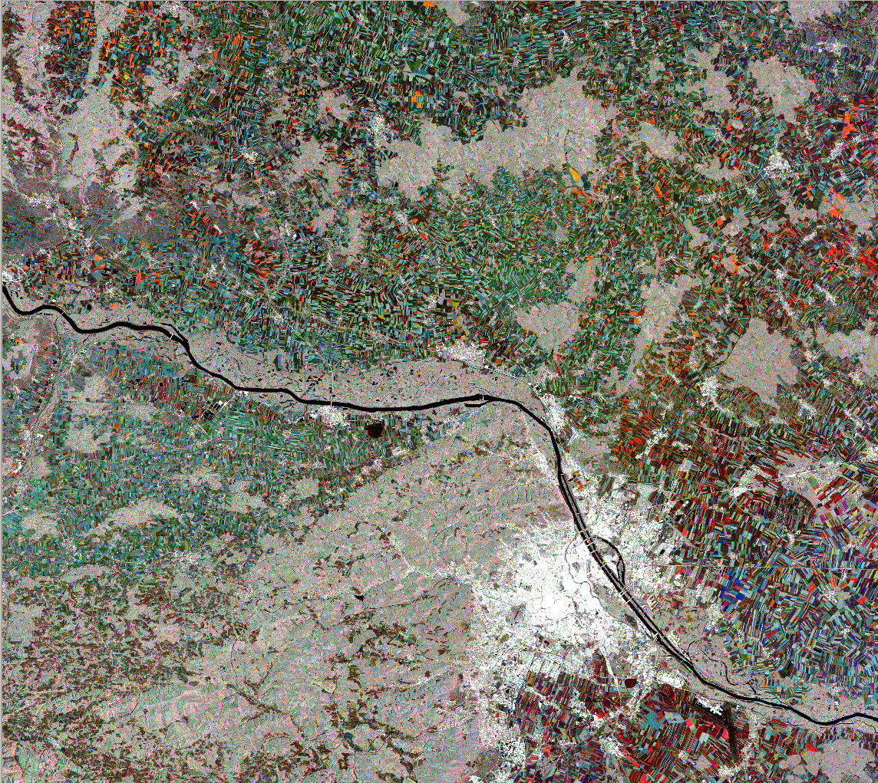
Vegetation Dynamics from Sentinel-1
Lower Austria
Red – June
Green – July
Blue – August
False colour composite of Sentinel-1 VH images acquired in 2015 over Vienna and surrounding areas

Slide 21
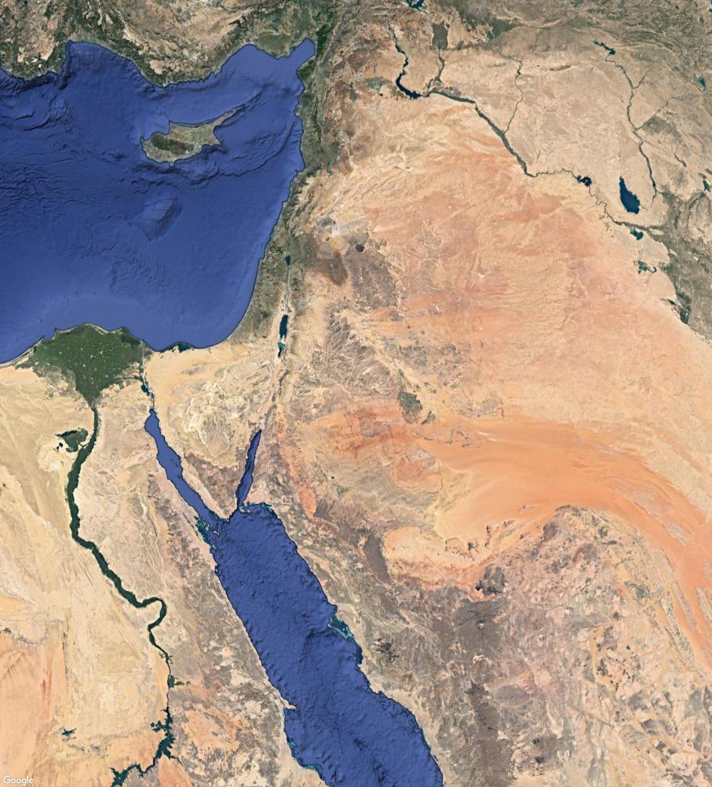
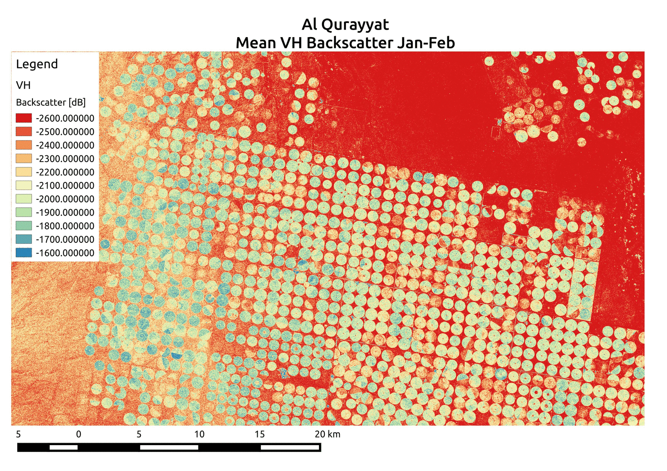
Food Production in the Desert
Saudi Arabia uses center pivot irrigation to grow crops like wheat and alfalfa
Al Qurayyat
Bi-monthly Sentinel-1 VH image mosaics for 2016

Slide 22
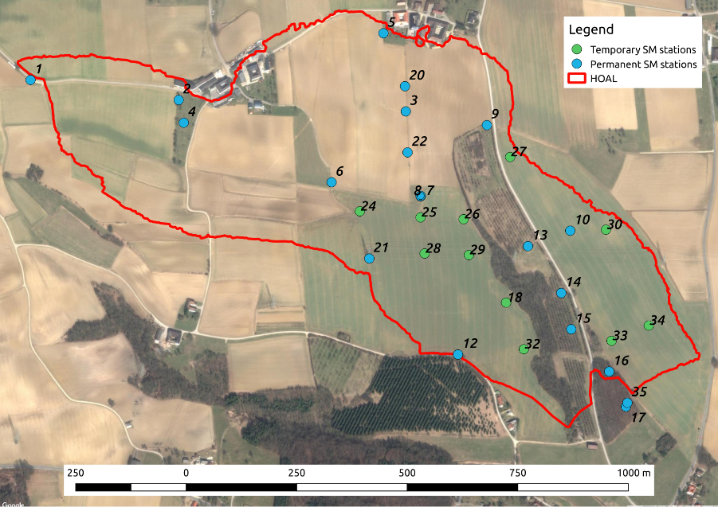
Satellite versus In Situ Soil Moisture Data over HOAL
CRNS: Cosmic Ray Neutron Sensor
HOAL: Catchment average of 31 TDT measurements
ASCAT: 25 km ASCAT soil moisture retrievals
S-1: 1 km Sentinel-1 soil moisture retrievals
Hydrological Open Air Laboratory (HOAL) in Petzenkirchen, Austria

Slide 23
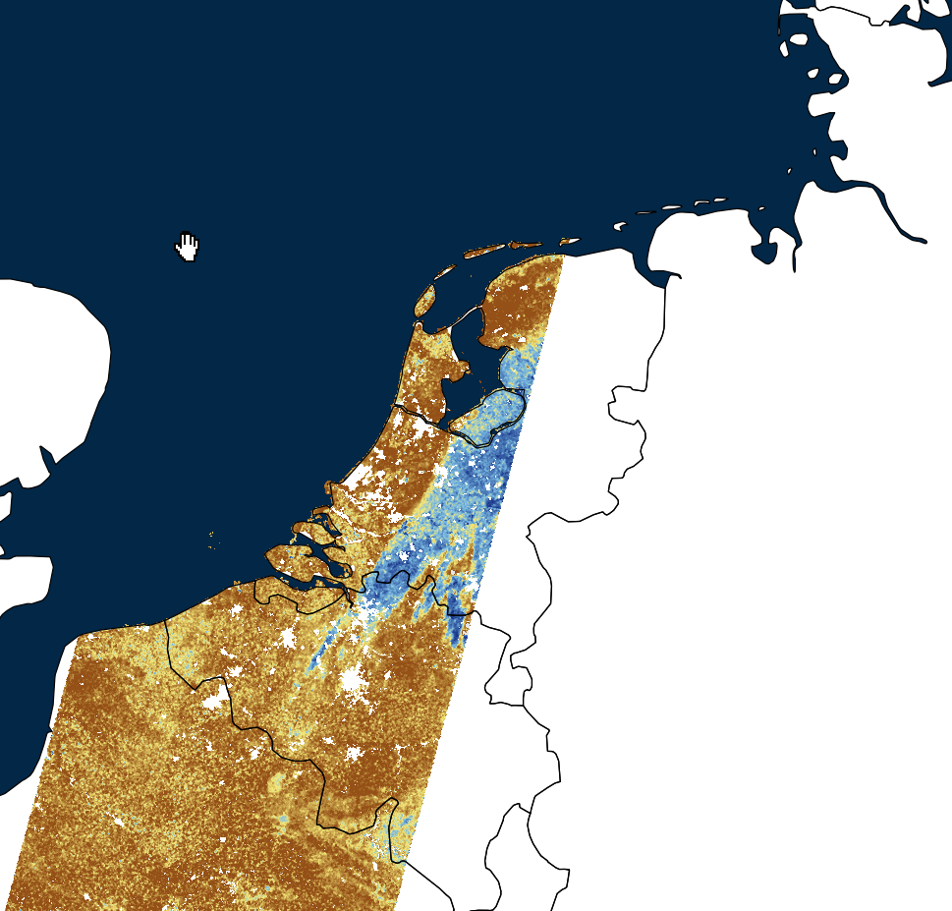
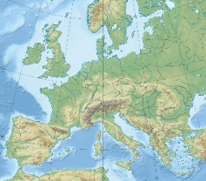
Sentinel-1 SSM & Precipitation Radar
2016-07-22 05:57:13

Slide 24
Irrigation Captured by Satellite Soil Moisture Data

Slide 25
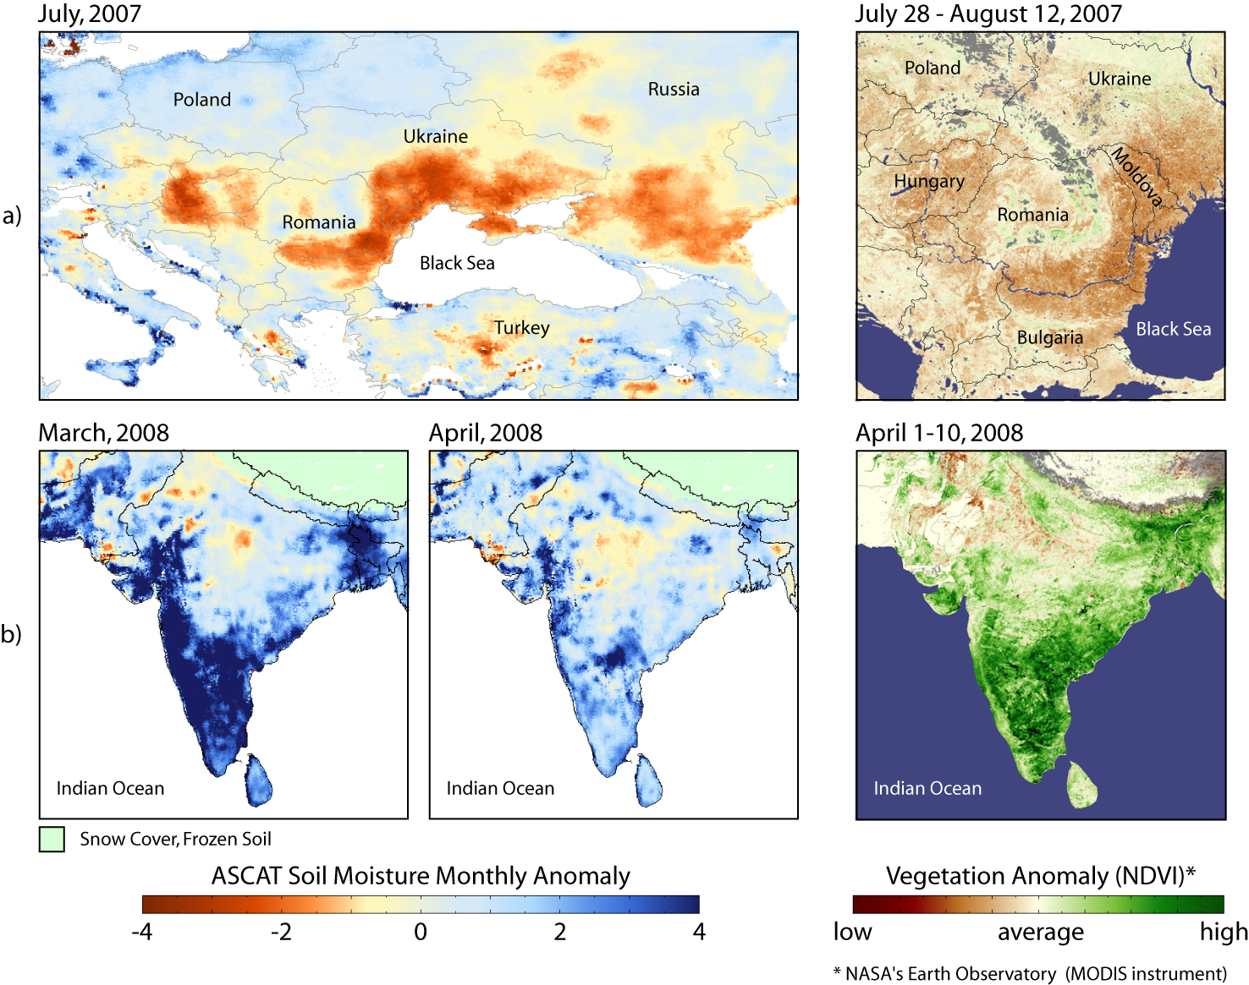
Soil Moisture and Vegetation
Drought
Eastern Europe
2007
Heavy Rainfall
India
2008
Naeimi, V., W. Wagner (2010). C-band Scatterometers and their Applications, Chapter 13 of "Geoscience and Remote Sensing New Achievements", Pasquale Imperatore and Daniele Riccio (Ed.), INTECH, Vukovar, Croatia, 230-246.

Slide 26
Conclusions
Earth Observation has entered a „Golden Era“
Unprecedented data availability and sensor diversity
Use of EO data still falls short of potential
Cooperative approaches may help individual players/users to contribute and benefit
Sharing of data, software and hardware
EODC is a cooperative where users have a voice in the decision making
Set priorities for hardware, data, software, and reach-out for new partners
Public partners guarantee stability – scientists and private partners drive innovation and scaling-up
Low costs: In an predictable environment it is much cheaper to develop and operate one’s own infrastructure
Acknowledgements
BMWFW: Kooperationsprojekt GEOCLIM Data Infrastructure Austria
European Space Agency: Projects „CCI Soil Moisture“, “TEP Business Model Validation”, and „Sentinel-1 Global Backscatter Model“
European Commission JRC: Framework contract 388533 “Copernicus Global Land”
Vienna Business Agency: ID-Nr. 1430171 “Sentinel Big Data Science Cluster”
Austrian Space Application Programme: „VegetationDynamics”

