Slide 1





The Global Observing System for Climate
IMPLEMENTATION NEEDS
Essential climate variables, indicators and actions in the
2016 GCOS implementation plan to support the Paris Agreement goals
GCOS Secretariat, WMO
Carolin Richter, Simon Eggleston, Valentin Aich, Tim Oakley

Slide 2
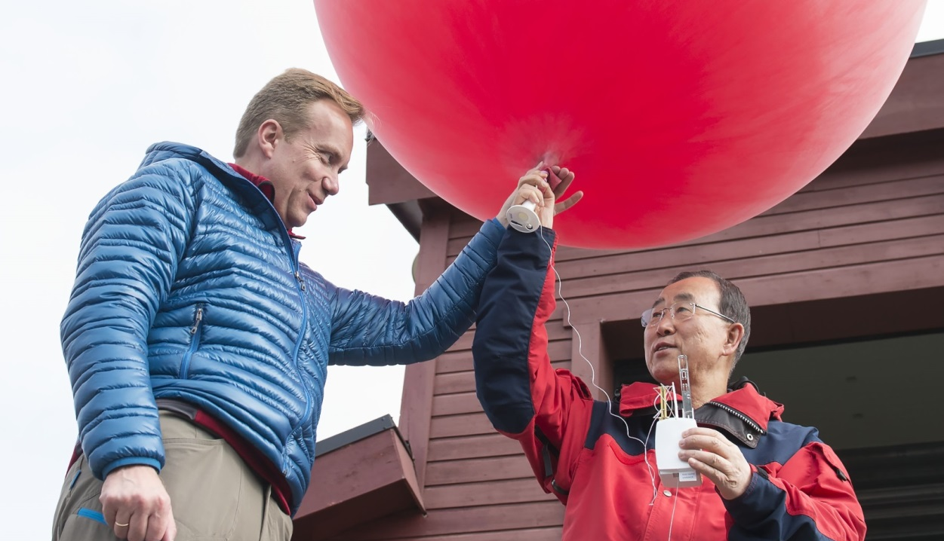
Notes:
No data – no climate science… it all started with a balloon…
UN Secretary-General Ban Ki-moon visited GRUAN site Ny-Ålesund, NO on 08 July 2015.
During his stay in Ny-Ålesund, the Secretary-General of the United Nations Ban Ki-moon and the Norwegian Minister of Foreign Affairs Børge Brende visited the AWIPEV base. They were informed about climate research and work at the AWIPEV Base (French - German Arctic Research Base at Ny-Ålesund / Spitsbergen).

Slide 3
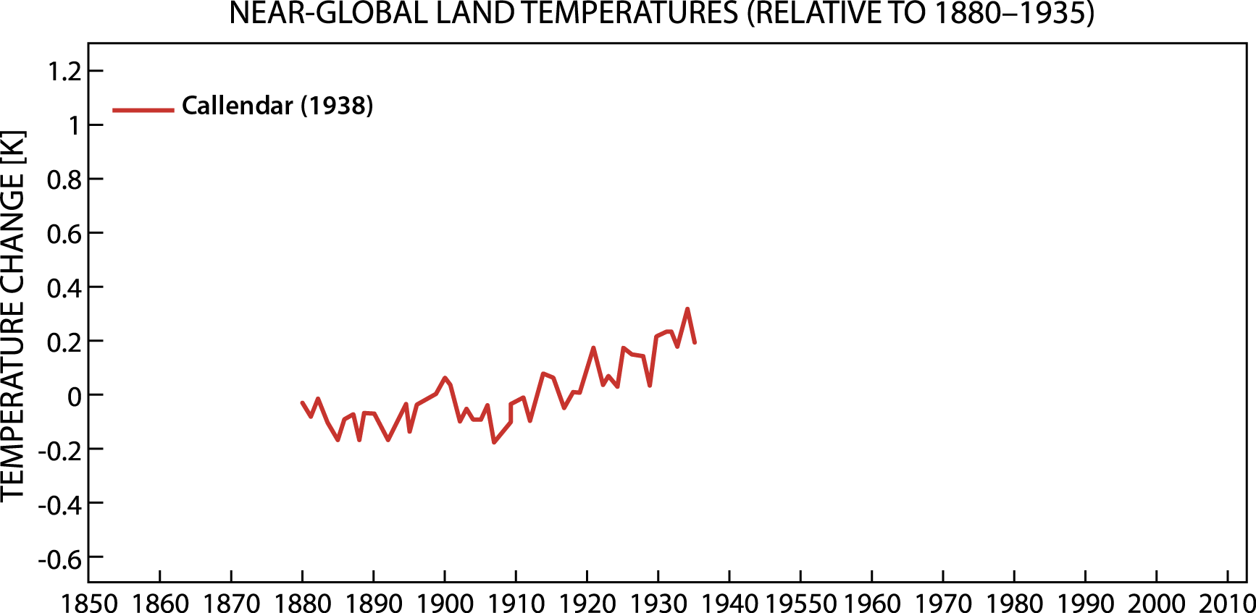

Global temperature records
Callendar Quarterly J. Royal Meteorological Society 64, 223 (1938).
Notes:
ANIMATED slide !
See www.alp.org/history/climate/20ctrend.html#L_0241
The first plot was made by GS Callendar and is 10 year running means based on 147 stations globally. He detected .5C rise between 1890 and 1935 and suggested
Paris Agreement Aim: increase in the global average temperature to well below 2 ⁰C above pre-industrial levels and to pursue efforts to limit the temperature increase to 1.5 ⁰C above pre-industrial levels,
this was due to increased CO2 levels.

Slide 4
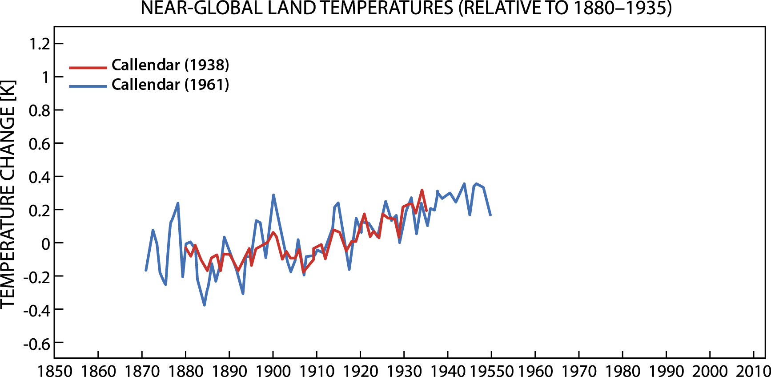
Global temperature records
Callendar Quarterly J. Royal Meteorological Society 64, 223 (1938).

Slide 5
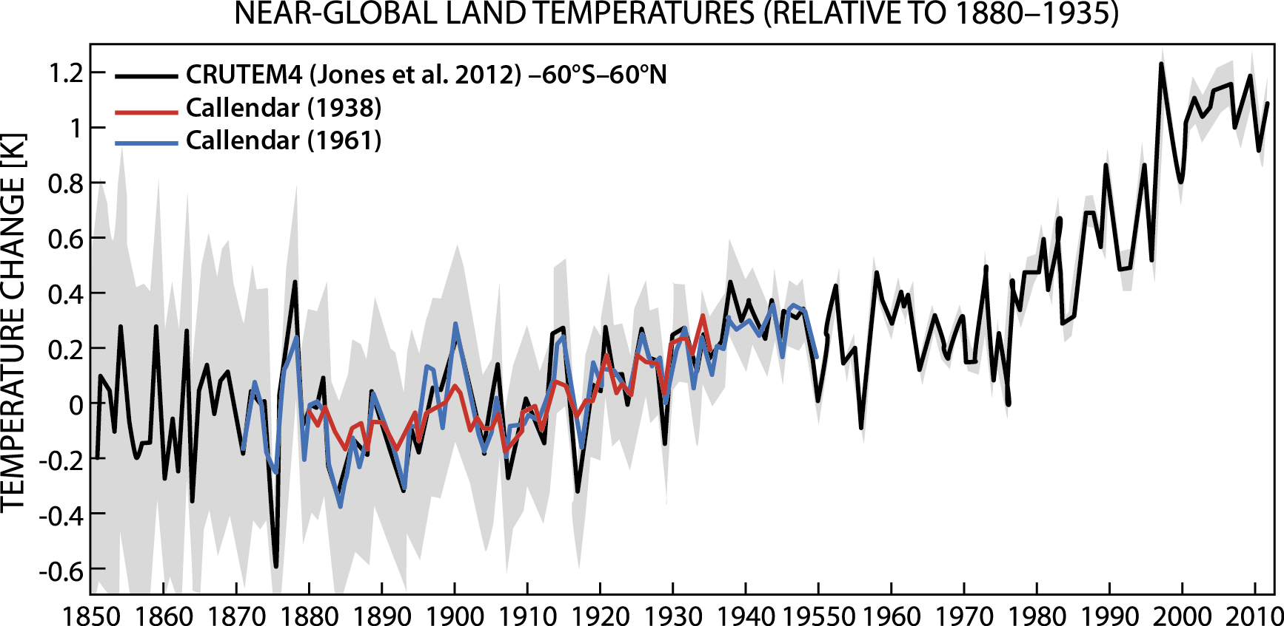
Global temperature records
Callendar Quarterly J. Royal Meteorological Society 64, 223 (1938).

Slide 6
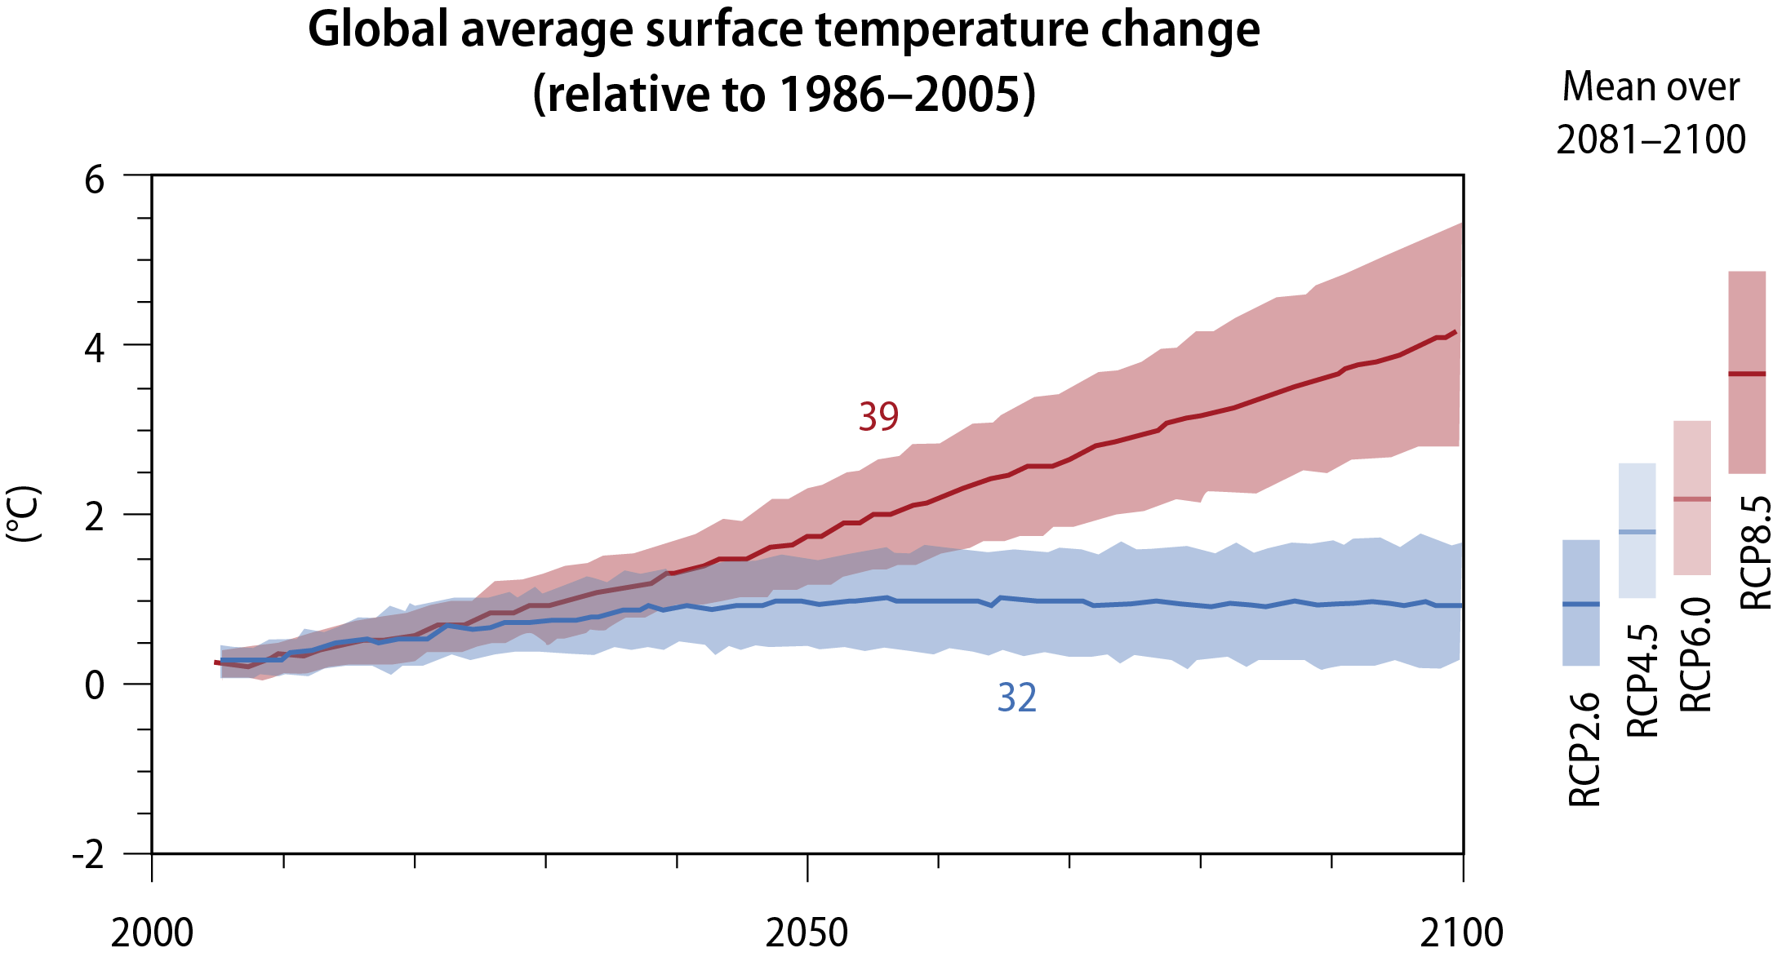
Global temperature records
Aim of Paris agreement is to limit temperature rise

Slide 7
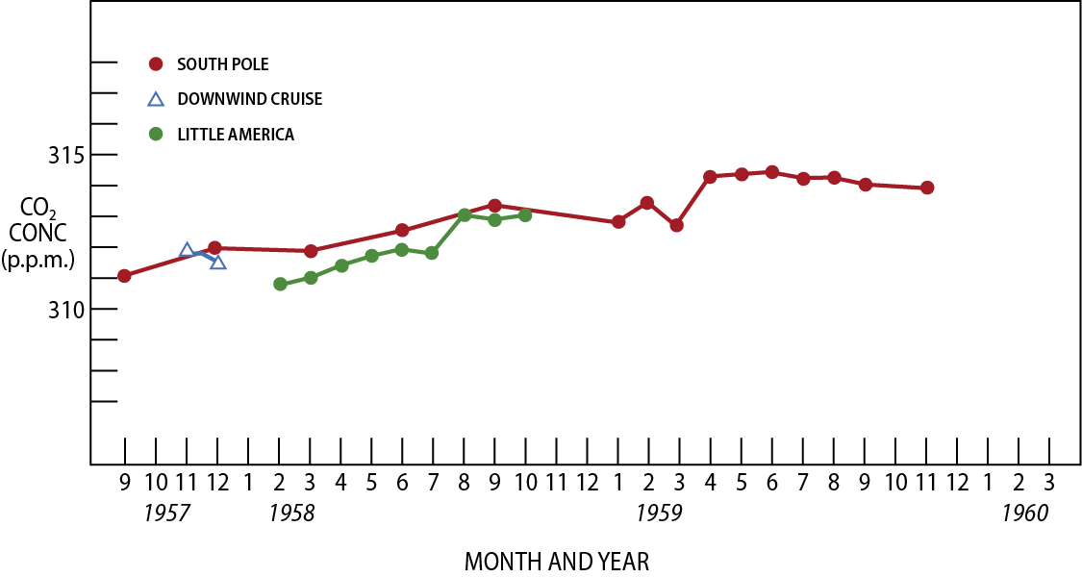
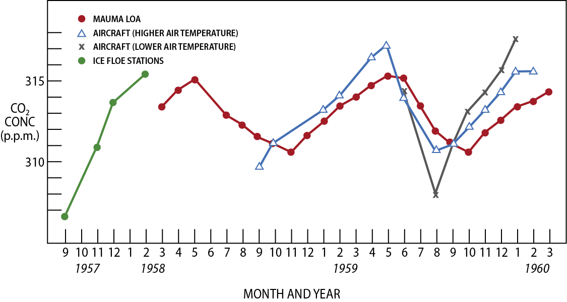
Notes:
ANIMATED slide !
The first two plots are the original measurements made by Keeling in 1957,8 and 9 in Antarctica and on top of Mauna Loa. These were made as part of the International Geophysical Year afte measurements made in California were too noisy (with local sources9. His aim was to measure a baseline but in fact captured the annual increase at the South Pole. Funding was found to continue at Mauna Loa (third Plot) although it stopped in Antarctica. The lack of funding resulted in the gap visible in the data in 1964 when the equipment broke down. Now there is a long time series (fourth plot) at Mauna Loa and the South Pole and with increase monitoring it is possible to monitoring the distribution of CO2 across all latitudes (see final picture) See www.alp.org/histroy/climate/Kfunds.htm

Slide 8
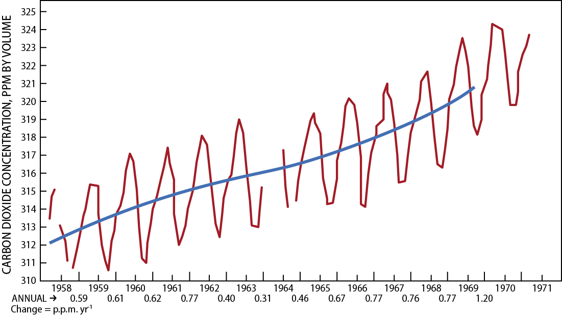

Slide 9
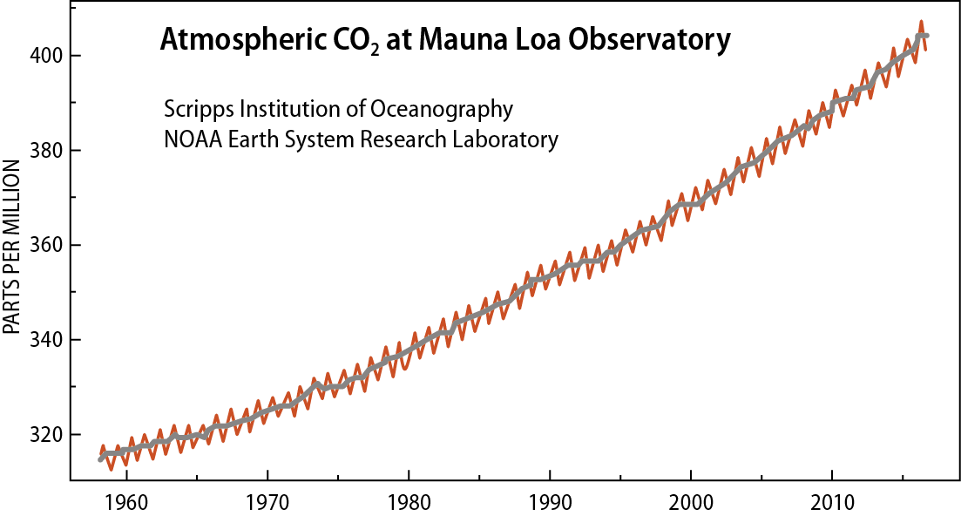

Slide 10
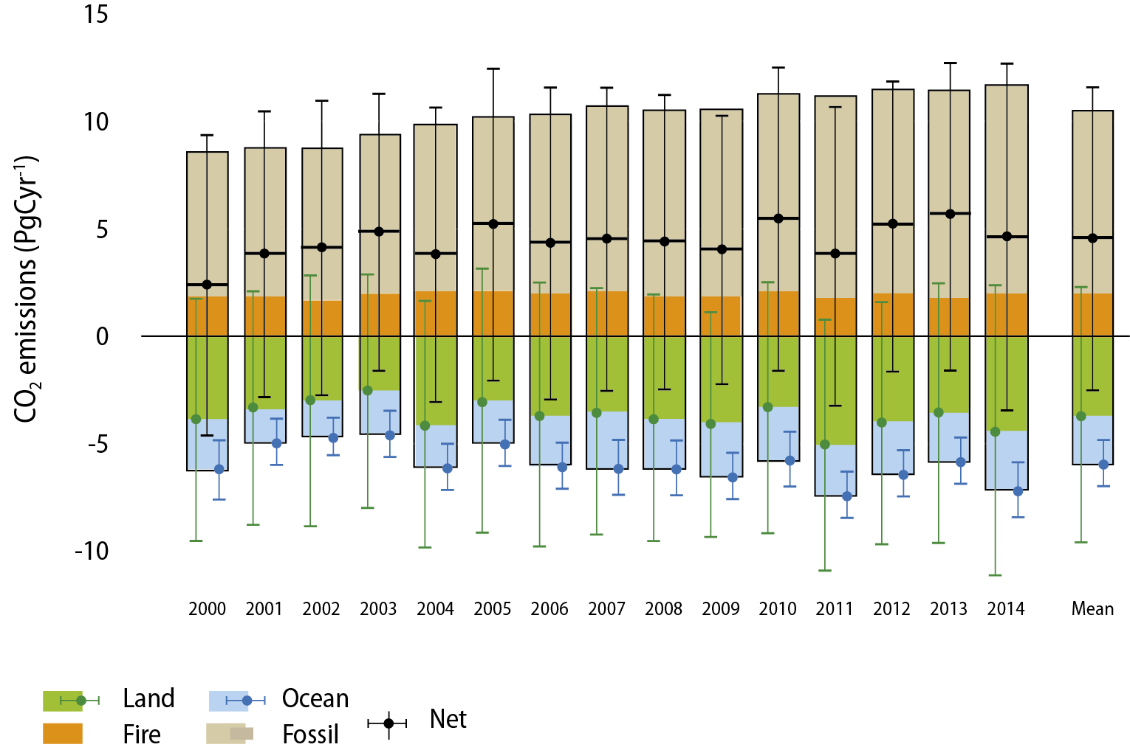
Global annual total emissions
Optimized
Use of concentration data being
developed to estimate Emissions

Slide 11
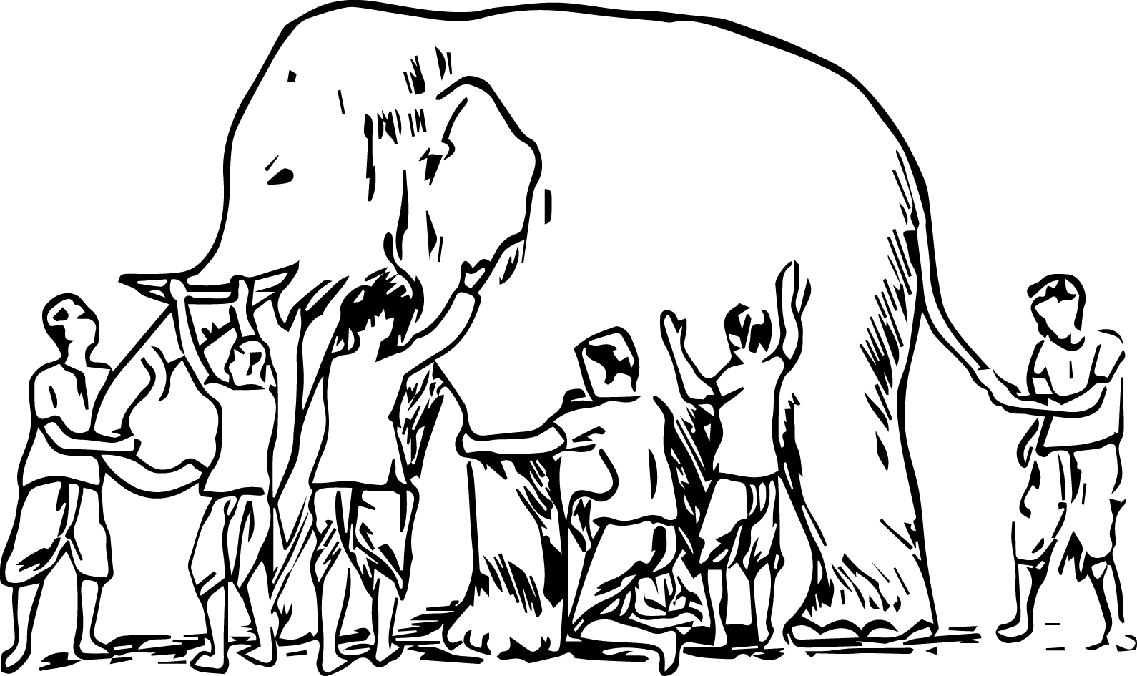
It was six men of Indostan
To learning much inclined,
Who went to see the Elephant
(Though all of them were blind),
That each by observation
Might satisfy his mind. [...]
And prate about an Elephant
Not one of them has seen!
(John Godfrey Saxe's)
Notes:
Indian story, poem of John Godfrey Saxe's (1873)
Example of how the audience should understand the climate system – and why we need a lot of complementary information to understand what is really looks like.

Slide 12
GHG
Ocean
currents
SST
In situ
Remote
Ice
sheets
Arctic
Tropics
Land
cover
Temperature
Notes:
No data – no climate science… it all started with a balloon…
UN Secretary-General Ban Ki-moon visited GRUAN site Ny-Ålesund, NO on 08 July 2015.
During his stay in Ny-Ålesund, the Secretary-General of the United Nations Ban Ki-moon and the Norwegian Minister of Foreign Affairs Børge Brende visited the AWIPEV base. They were informed about climate research and work at the AWIPEV Base (French - German Arctic Research Base at Ny-Ålesund / Spitsbergen).

Slide 13
Improved observations
lead to significant benefits
Successful adaptation and mitigation, reduced climate risks, enhanced livelihoods, and food & water security.
Climate Services, Risk Assessments, Early Warning & Disaster Risk Reduction Policies
Science, Assessments, Policy
Observations, Products, Open Data
ECV Requirements, Adequacy Reports, Plans
Notes:
GCOS produces ECV Requirements, Adequacy Reports, Plans
…. which lead to observations, products, open data
…. which inform science, assessments, policy
…..which are needed by climate services, risk assessments, early warning &disaster risk reduction policies
…..which lead to successful adaptation and mitigation, reduced climate risks, enhanced livelihoods, and food &water security.

Slide 14


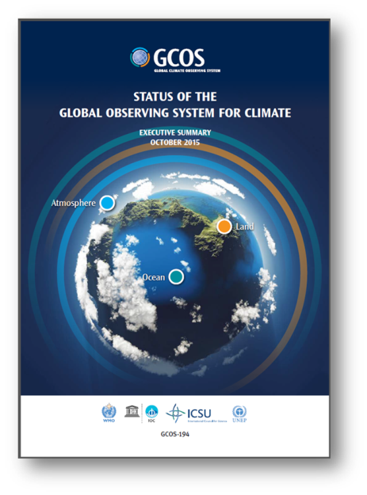
GCOS Reports and Plans
Adaptation
& Mitigation
I
Water, Energy and Carbon cycles
II
Status
2015
New Plan
2016
Additional Essential Climate Variables
III
Emphasis on more help for networks in developing countries
IV
Notes:
3rd plan
And the news here is that…we are supporting adaptation&mitigation and ensuring that the cycles are being supported
Emphasis on the need to support developing countries and their observing networks
The Status Report which we have been delivered to COP21 in Paris last year showed that there has been improvement in the adequacy of the existing observing networks since 2010, but for the next decade we have to look into
1. Adaptation & Mitigation
2. Water, Energy and Carbon cycles
3. Additional Essential Climate Variables
4. Emphasis on more help for networks in developing countries

Slide 15
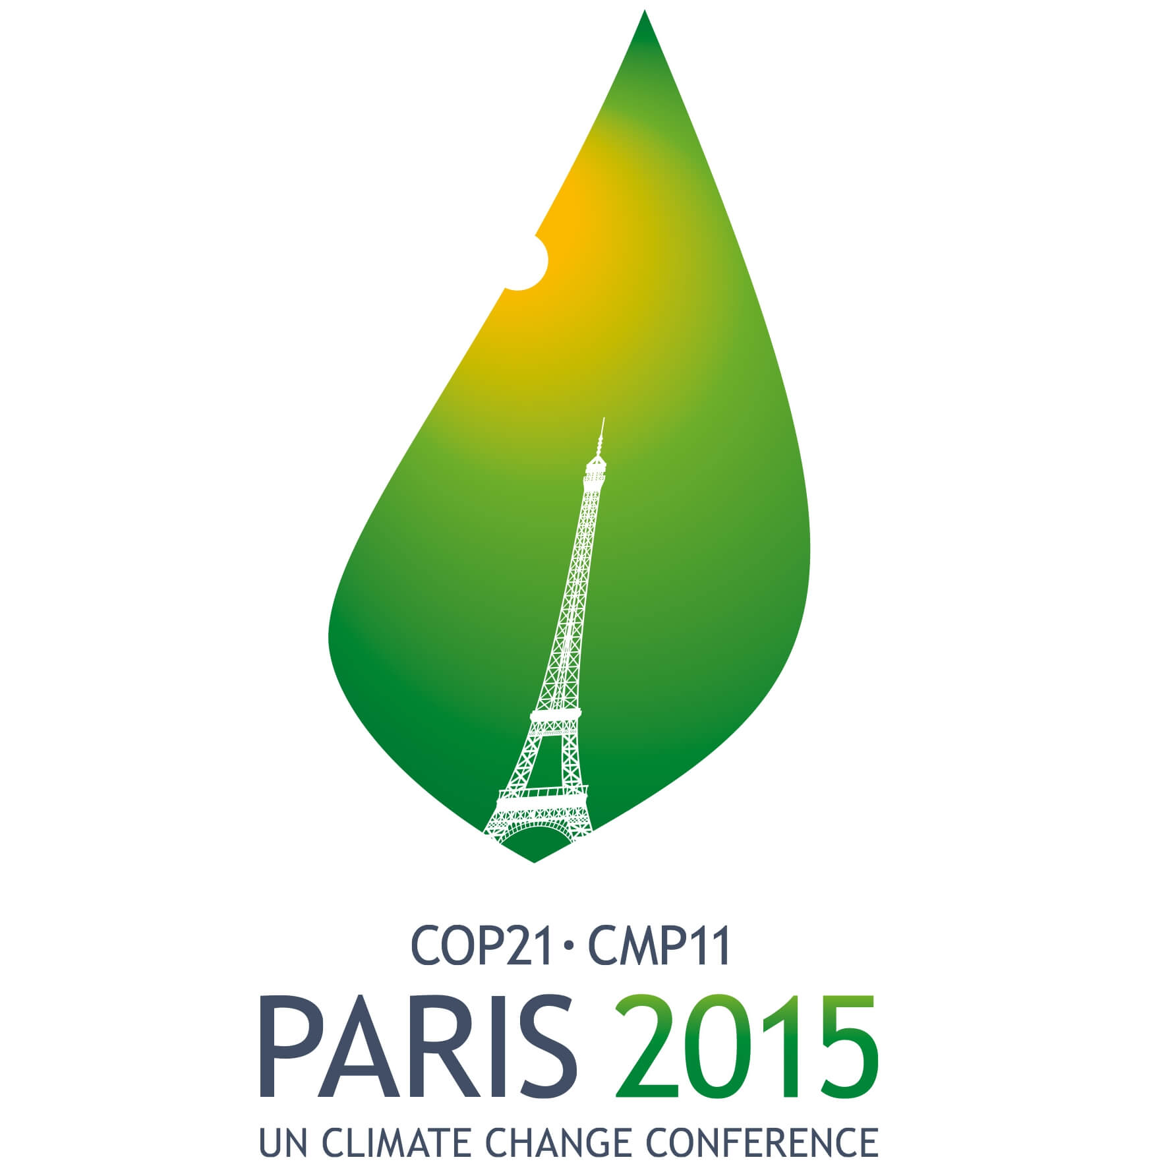
Art 4
Art 5
Art 7
Art 8
Art 9
Art 10
Art 11
Art 12
Art 13
Art 14
Art 7 (7c)
Paris Agreement Article 7 (7c): Strengthening scientific knowledge on climate, including research, systemic observation of the climate system and early warning systems.
Notes:
COP-21: Paris Agreement Article 7 (7c)
Strengthening scientific knowledge on climate, including research, systematic observation of the climate
system and early warning systems, in a manner that informs climate services and supports decision- making
Developing the Transparency Framework (the need to promote transparency, accuracy, completeness, consistency, and comparability, and environmental integrity)
Short Keys:
Art. 4. Nationally Determined Contribution
Art. 5. Mitigation (REDD+)
Art. 7. Adaptation & Early Warning Systems. Systematic Observations, Adaption planning
Art. 8. Loss and damage: Early warning systems, emergency preparedness, slow onset events etc.
Art. 9 Provide finance
Art. 10 Technology Transfer
Art. 11 Capacity Development
Art. 12. Improve Public Communications
Art. 13: para. 7 & 8. Reporting and transparency framework
Art. 14 Global Stocktake

Slide 16

gcos.wmo.int
@gcos_un
2016
GCOS Implementation Plan

Slide 17
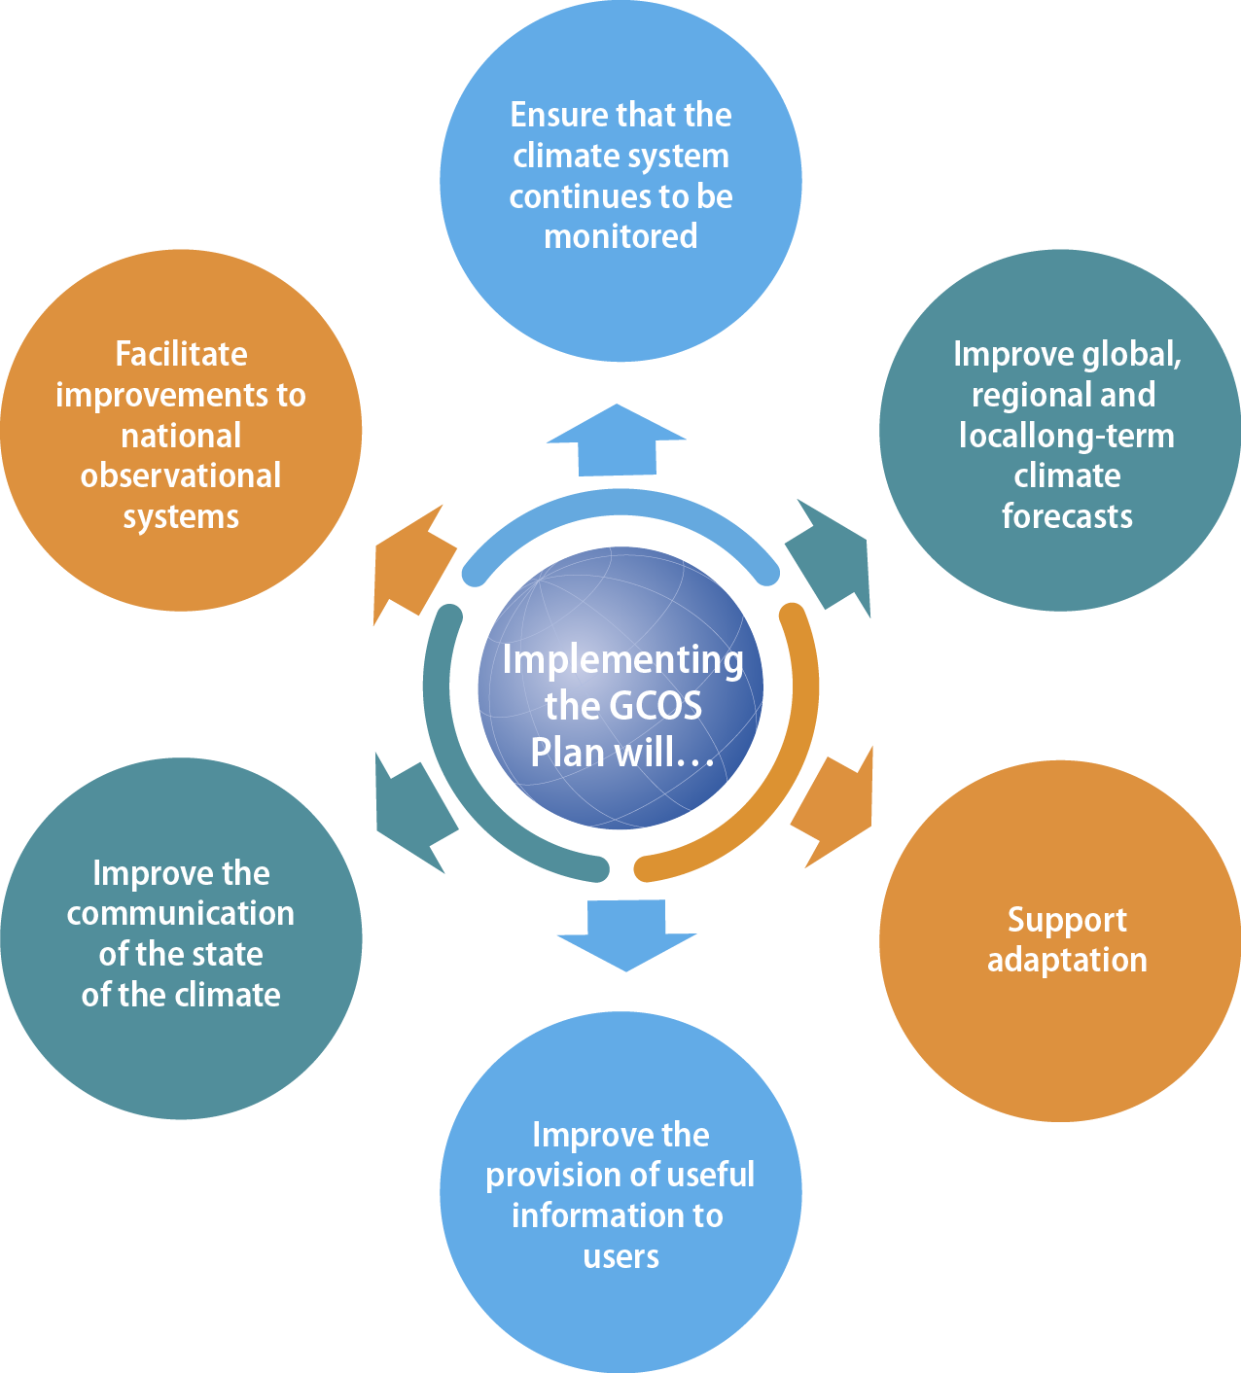
6
Implementation
Aims
Notes:
Part I - 2. Implementation will
Ensure that the climate system continues to be monitored
Improve global, regional and local long-term climate forecasts by; Filling gaps in network coverage; Refining ECV Requirements; Improving techniques; Addressing Global Cycles
Support adaptation
Improve the provision of useful information to users
Improve the communication of the state of the climate
Facilitate improvements to national observation systems.
The following slides will give examples regarding points 3, 4 and 6 (ECV, indicators and statement).

Slide 18
Annex A – Terrestrial ECV product requirements
ECV | Products | Frequency | Resolution | Required measurement uncertainty
Above- ground biomass | Maps of AGB | Annual | 500m-1km based on 100-200m observations | < 20% error for biomass values > 50 t/ha, and 10 t/ha for biomass values ≤ 50 t/ha
Land cover | Maps of land cover | Annual | 250m | 15% (maximum error of omission and commission in mapping individual classes), location accuracy better than 1/3 IFOV with target IFOV 250 m
 | Maps of high resolution land cover | 5 year | 10 - 30m | 5% (maximum error of omission and commission in mapping individual classes), location accuracy better than 1/3 IFOV with target IFOV 10-30 m
 | Maps of key IPCC land use, related changes and land management types | 1-10 years (incl. historical data) | 10-1000 m (depending on time period) | 20% (maximum error of omission and commission in mapping individual classes), location accuracy better than 1/3 IFOV with target IFOV
Notes:
6 Improve the communication of the state of the climate
Table with detailed information on observational requirements

Slide 19
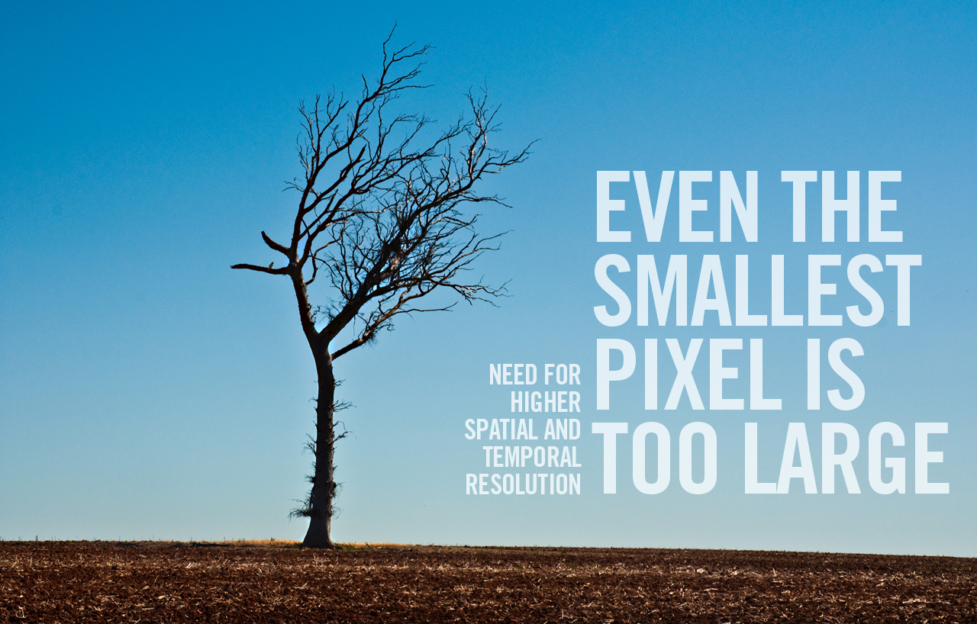
Adaptation, mitigation and climate indicators
Notes:
3 Support adaptation

Slide 20


support
Climate observations also

Slide 21

Precipitation, Cloud Properties,
Water Vapour Surface Temperature
Ocean Acidification
Carbon Dioxide,
Methane
Deforestation
Mitigation
Ecosystem Loss
Sea Level Rise
Fisheries
Water
Carbon
Sea Surface
& Subsurface Salinity,
Sea Level,
Sea Surface Temperature
Soil Moisture,
River ischarge,
Lakes, Groundwater, Cryosphere, Water use
Inorganic Carbon
Soil Carbon,
Above-ground Biomass, Fire, GHG Fluxes
Coral Bleaching
Agriculture
Human Health
Floods
Droughts
Water Resources
Storms
Radiation Budgets, Temperature Wind speed & direction
Systemic Risks
Security
Slow Economic Development
Energy
Ocean Surface Heat Flux, Sea Surface & Subsurface Temperature,
Albedo,
Latent and Sensible Heat fluxes, Land Surface Temperature
Global
Climate Cycles
Temperature
Heat waves
Notes:
ANIMATED SLIDE!
First, we have observations in the different domains: Land, Air and Oceans
They all contribute to the knowledge needed for the water energy and carbon cycle.
We need to know about these 3 cycles to get some information on Ocean acidification, Deforestation …..
Consistent Observations Across the Earth System Cycles
Current climate change is driven by the interaction of the gaseous phases of the carbon and nitrogen cycles and radiative properties of the atmosphere.
While the original ECVs were designed largely on the basis of individual usefulness, and maturity, in recent years many people have started to use the climate records based on ECVs to close budgets of energy, carbon and water, and to study changes in growth rates of atmospheric composition or interaction between land and atmosphere in a more integrated way.
Closing the Earth's energy balance and the carbon and water cycles through observations remain outstanding scientific issues that requires high quality climate records of key ECVs.
In this implementation plan latent and sensible heat fluxes over the ocean are a new ECV with actions on similar fluxes over land. Key state variables that were missing in previous plans can now also be observed, such as surface temperature over land.
For carbon fluxes, exchanges between the ocean and atmosphere need to be estimated as well as those between land and atmosphere, and between land and ocean through transport of organic material by rivers. The inclusion of a new ECV on anthropogenic fluxes of GHGs provides the key driver of changes of the carbon cycle in the form of fossil fuel combustion, cement production, land use and land-use change. There is a clear link to the fire disturbance, soil carbon, land use and above-ground biomass ECVs.

Slide 22
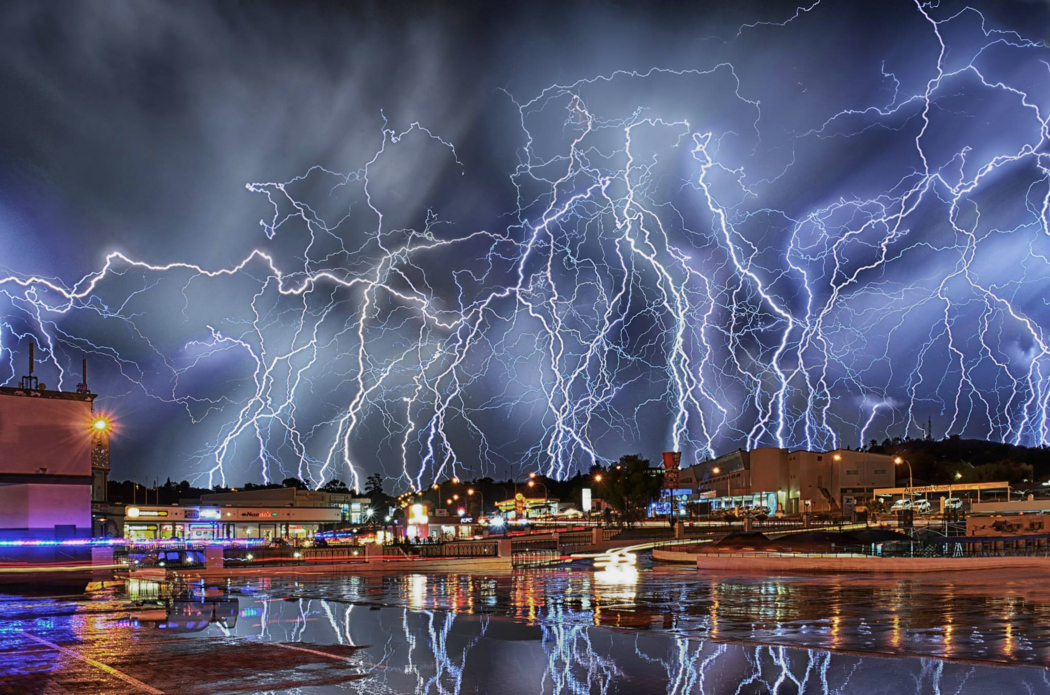
Wide scale monitoring of lightning is now possible and a proxy for severe weather events
Notes:
New Plan in now observing additional parameters. While most of the ECVs remain unchanged there are a few new ECVs that are now possible to observe and add to our understanding of climate change.
Example here:
Lightning. It is now possible to monitor lightning in a systematic and accurate way. This is important as the impact of increased storms are one topic that many countries are concerned about for adaptation planning. Systematic measurements will provide a baseline and monitoring changes in storminess.
Other new observations are:
GCOS has identified Anthropogenic Greenhouse Gas Fluxes and oceanic N2O as new ECVs. While a complete monitoring system for fluxes may take decades to develop and implement, atmospheric composition measurements (ground-based and satellite) are starting to be able to support existing emission estimates made for the UNFCCC.
Biology (marine habitat properties and adding Lake colour to the Lake ECV) – see following slide.
Land Surface Temperature (LST). This differs from surface temperature traditionally measured for weather prediction and used to track climate change (which is an air temperature about 2m above the ground). LST is measured by satellites: it is the radiant surface temperature and is important for vegetation and ecosystem modelling.
Two Ocean properties (ocean surface stress, ocean surface heat flux). These are needed to improve modelling of ocean systems, especially those that have a link to weather impacts such as El Niño and storms.

Slide 23

Monitoring of ecosystems is important for adaption (coastal protection, fisheries and biodiversity) as well as understanding changes in the carbon cycle
Notes:
Biology (marine habitat properties and adding Lake colour to the Lake ECV). Given the importance of fish (protein) to the human diet at a global level, improved monitoring of biological systems and how they are changing is vital.

Slide 24
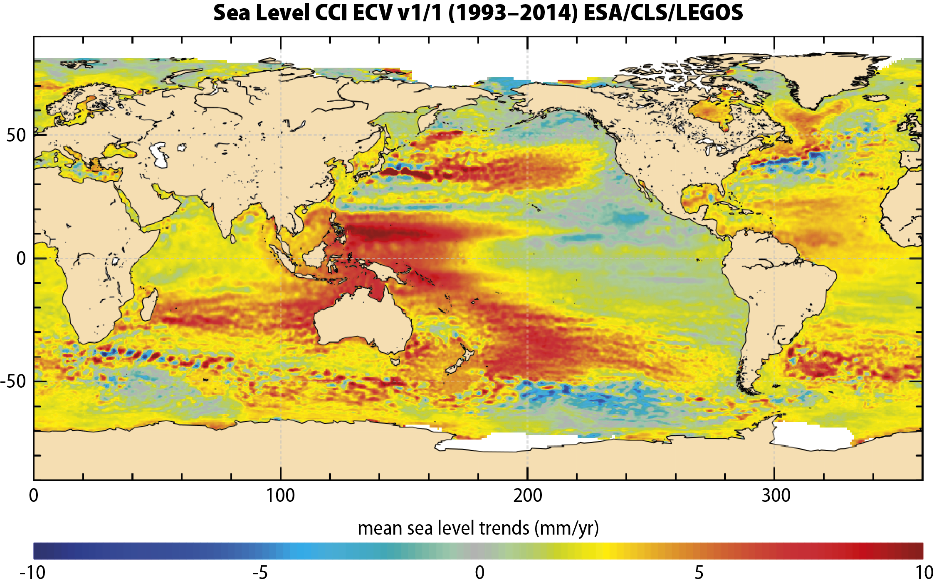
Regional distribution of many ECVs:
Satellites + ground stations = global picture
Notes:
Satellites, combined with ground stations, now allow a global picture the regional distribution of many ECVs, here sea level rise.
The ocean is a central component of Earth’s climate system, essentially carrying the climate memory from short to long temporal scales.
In the context of climate variability and climate change, the global ocean is singularly important due to its full-depth heat and freshwater storage capacity. The ocean warming has resulted in global and regional sea-level rise that has had a profound impact on coastal inundation and erosion.

Slide 25
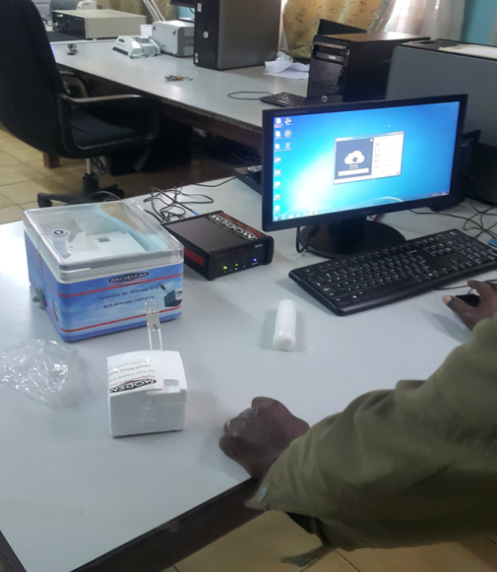
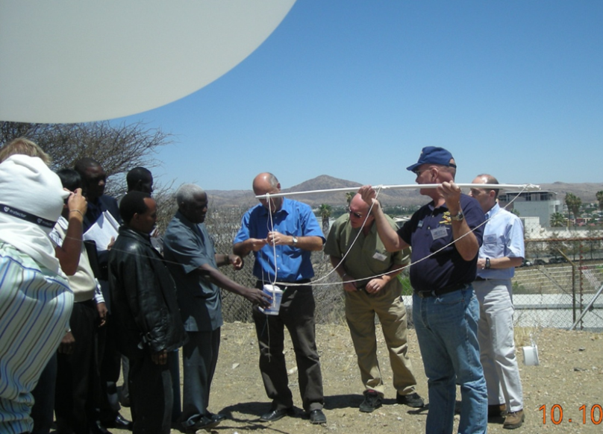
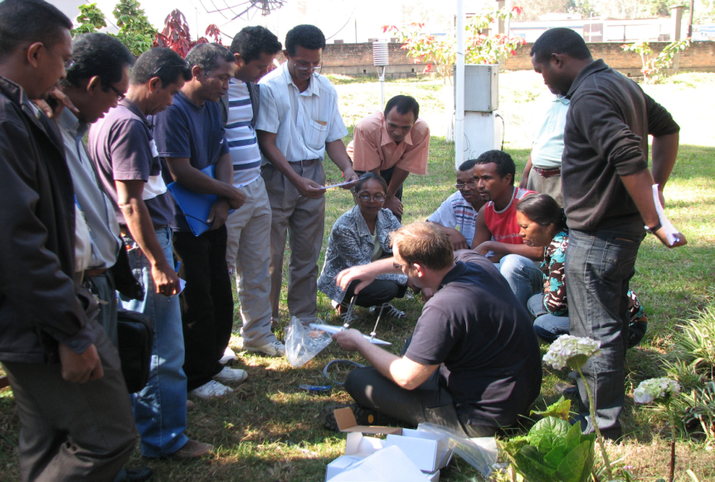
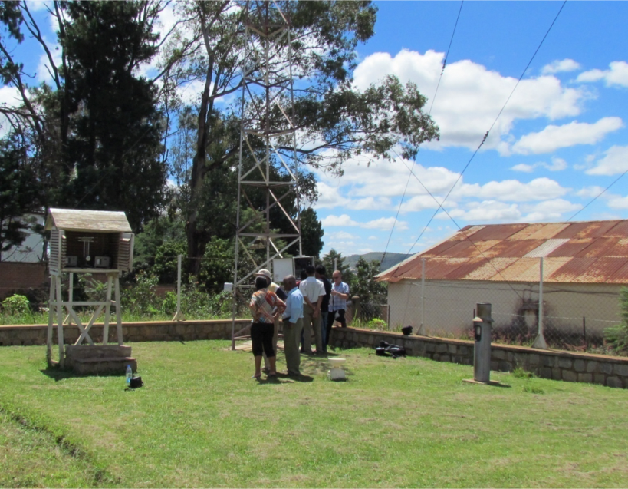
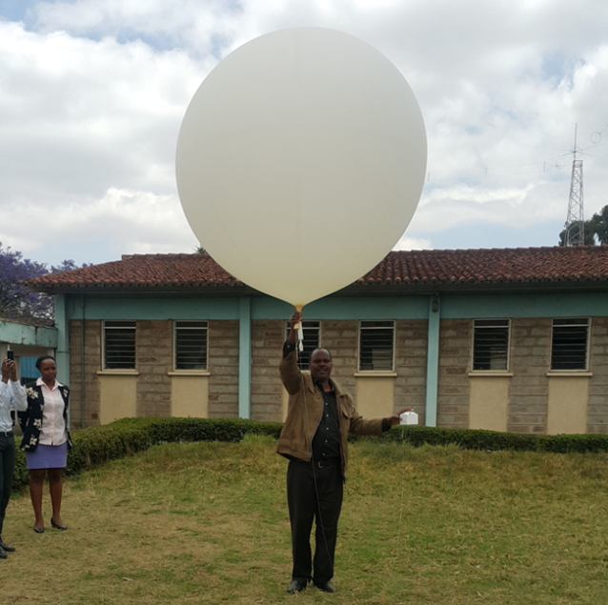
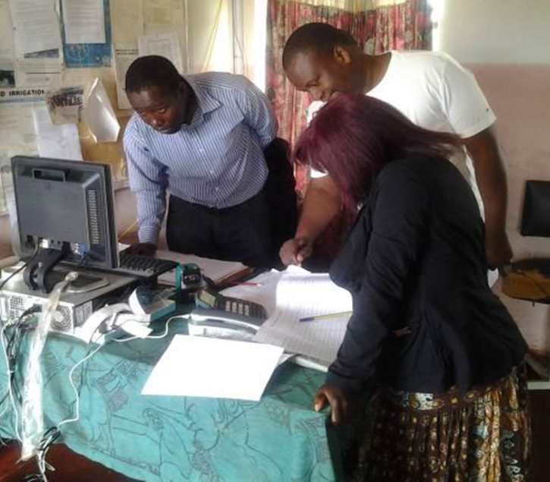
GCOS Cooperation Mechanism
Notes:
The GCOS Cooperation Mechanism (GCM) resulted from deliberations at seventeenth session of the UNFCCC Subsidiary Body for Science and technology (New Delhi, 2002), and was formalized in a decision of COP 9.
It was established to address the high-priority needs for stable long-term funding for key elements of global climate observations. The Mechanism consists of:
• The GCOS Cooperation Board as the primary means to facilitate cooperation amongst donor countries, recipient countries, and existing funding and implementation mechanisms in addressing high-priority needs for improving climate observing systems in developing countries; and
• The GCOS Cooperation Fund as a means to aggregate commitments and voluntary contributions from multiple donors (both in-kind and financial) into a common trust fund.
The GCM is intended to address priority needs in atmospheric, oceanic, and terrestrial observing systems for climate, including data rescue, analysis, and archiving activities.
However, the activities that it has funded to date have been mainly in the atmospheric domain. It is intended to complement, and work in cooperation with, existing funding and implementation mechanisms (for example, the WMO Voluntary Cooperation and GFCS Programme, the Global Environment Facility (GEF), the United Nations Development Programme (UNDP), and the many national aid agencies), many of which deal with GCOS-related activities and, in particular, support capacity-building. Support needs to be focussed on those in most need and where priority adaptation needs are identified.

Slide 26



Following the GCOS Implementation Plan by
securing and improving observation systems
supporting countries implement the appropriate observations
that meet their
needs and
priorities
providing open access to observations and data access
ensuring the delivery of high resolution global products
1
2
3
4
will contribute to successful adaptation and mitigation,
reduced climate risks, enhanced livelihoods, and food & water security

