Slide 1
ECV definitions
Mapping of ECV product with OSCAR variables
Annex A IP : ECV products in GCOS 200 https://library.wmo.int/opac/doc_num.php?explnum_id=3417
OSCAR variables: https://www.wmo-sat.info/oscar/variables/
GCOS Secretariat provided AOPC panel with a combined table
Comments and suggestions from AOPC collected:
Input received for surface wind,temperature, pressure, water vapour, precipitation, surface radiation budget, upper-air temperature, wind and humidity.
No input for the other ECV products.
Finalize tables
Definitions will be used to map the ECV products with OSCAR variables (first step for completing the requirements table in OSCAR for the Climate Application Area) and to complete the ECV fact sheets.

Slide 2
IP Annex A: ECV product requirement
Atmospheric ECV product requirements
ECV | Product | Frequency | Resolution | Required measurement uncertainty | Stability (per decade) | Standards/ references | Entity (see Part II, section 2.2)
 |  |  |  |  |  |  | Satellite | In situ
Surface wind speed and direction | Surface wind speed and direction | 3 h | 10 km/NA | 0.5 m/s and mean quadratic statistics to 10% of the locally prevailing mean wind speed, for speed >20 m/s | 0.05 m/s/decade | For stability: International Vector Winds Science Team Meeting (M. Bourassa) | WGClimate | WIGOS
Precipitation | Estimates of liquid and solid precipitation | Monthly (resolving diurnal cycles and with statistics of three-hour values) | 25 km/NA | 0.5 mm/h | 0.02 mm/decade | CMSAF requirements related to the HOAPS release 4.0 (CM-12611) | WGClimate | WIGOS
Temperature (surface) |  | Hourly | Site | 0.1 K | 0.02 K/decade | P. Jones |  | WIGOS
 |  | Daily Tx/Tn |  | 0.1 K |  |  |  | WIGOS

Slide 3
Temperature (upper-air) | Tropospheric temperature profile | 4 h | 25 km/1 km | 0.5 K | 0.05 K |  | WGClimate | WIGOS
 | Stratospheric remperature profile | 4 h | 100 km/2 km | 0.5 K | 0.05 K |  | WGClimate | WIGOS
 | Temperature of deep atmospheric layers | Monthly averages | 100 km/5 km | 0.2 K | 0.02 K |  | WGClimate | WIGOS
Cloud properties | Cloud amount | 3 h | 50 km/NA | 0.01–0.05 | 0.01/decade | ESA CCI CMUG tables | WGClimate
 | Cloud-top pressure | 3 h | 50 km/NA | 15–50h Pa | 3–15 hPa |  | WGClimate
 | Cloud-top temperature | 3 h | 50 km/NA | 1–5 K | 0.25 K/decade |  | WGClimate
 | Cloud optical depth | 3 h | 50 km/NA | 10% | 2% |  | WGClimate
 | Cloud water path (liquid and ice) | 3 h | 50 km/NA | 25% | 5%
 | Cloud effective particle radius (liquid + ice) | 3 h | 50 km/NA | 1 µm; | 1 µm/decade

Slide 4
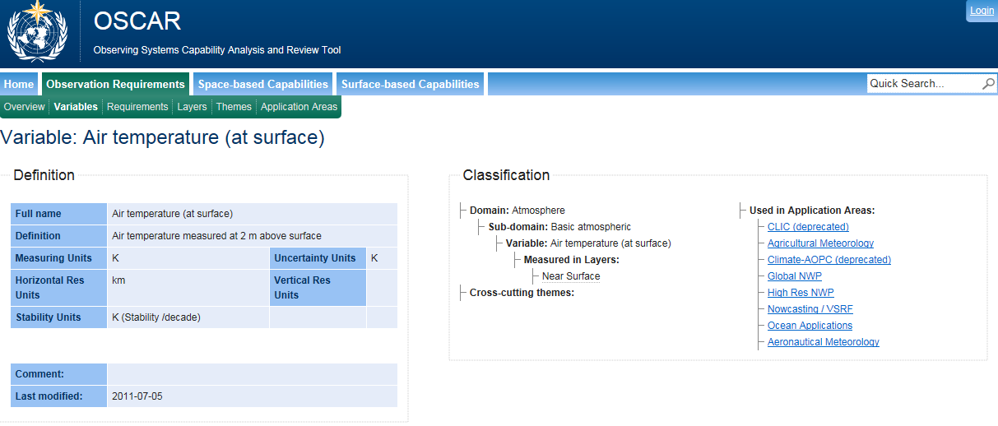
OSCAR

Slide 5
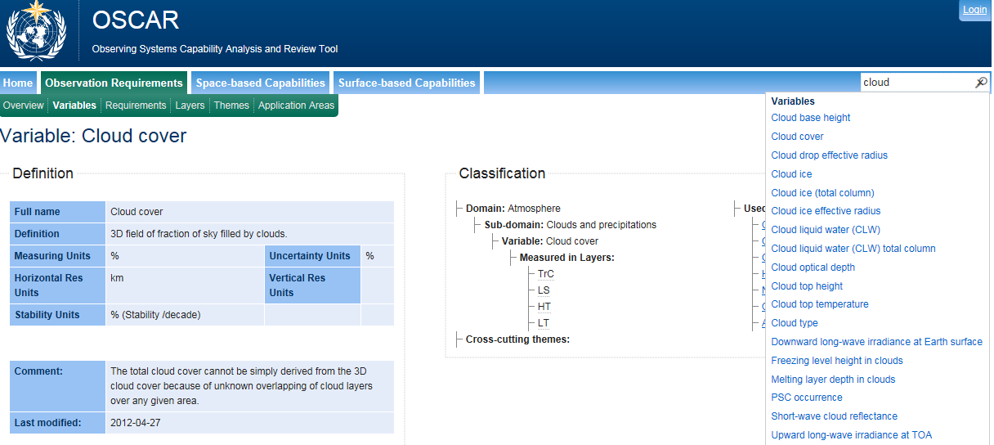
OSCAR
No cloud top pressure

Slide 6
Combined table
ECV | Product | Definition | Meas.units | OSCAR variable | Definition
Surface Wind Speed and direction (updated by Shinya, Imke and Liz) | Wind speed | Ratio of the distance covered by the air to the time taken to cover it. It is one component of wind velocity, the other being wind direction. Measured at 10m | m/s | Wind vector over the surface (horizontal) | Horizontal vector component (2D) of the 3D wind vector, conventionally measured at 10 m height.
 | Wind direction | Direction from which wind is blowing, measured clockwise from north | Degree N
Precipitation (updated by Phil) | Accumulated precipitation (over 24h) | Integration of precipitation rate reaching the ground over several time intervals. The reference requirement refers to integration over 24 h | mm | Accumulated precipitation (over 24h) | Integration of precipitation rate reaching the ground over several time intervals. The reference requirement refers to integration over 24 h
Temperature (surface) | Air temperature (at surface) | Air temperature measured at 2 m above surface | K | Air temperature (at surface) | Air temperature measured at 2 m above surface

Slide 7
Water vapour (surface) (updated by Roger) | Air specific humidity (at surface)(g/kg) | Air specific humidity measured at 2 m above surface. The specific humidity is the ratio between the mass of water vapour and the mass of moist air. | g/Kg
 | Dew Point Temperature (no corresponding variable in OSCAR) | temperature to which air must be cooled to become saturated with water vapor | K
Air specific humidity (at surface)(g/kg) | Air specific humidity measured at 2 m above surface. The specific humidity is the ratio between the mass of water vapour and the mass of moist air. | g/kg

Slide 8
Cloud Water Path (liquid and ice) | LWP: A measure of the weight of the liquid water droplets in the atmosphere above a unit surface area on the earth, given in units of kg m-2 |  | (no corresponding variable in OSCAR)
 |  |  | Cloud liquid water (CLW) total column | Field of atmospheric water in the liquid phase (precipitating or not).
 |  |  | Cloud ice (total column) | Field of atmospheric water in the solid phase (precipitating or not) as total column.
Cloud effective particle radius (liquid and ice) | In OSCAR only liquid. Needs a definition | μm | Cloud drop effective radius | Size distribution of liquid water drops, assimilated to spheres of the same volume. Considered as both a 3D field throughout the troposphere and a 2D field at the top of cloud surface.

Slide 9
Aerosols properties | optical depth | The AOD is the effective depth of the aerosol column from the viewpoint of radiation propagation | km | Aerosol Optical Depth | The AOD is the effective depth of the aerosol column from the viewpoint of radiation propagation: Vertical column integral of spectral aerosol extinction coefficient AOD = exp(-K. Δz) where K is the extinction coefficient [km-1 ] and Δz the vertical path [km]
 | single-scattering albedo | Missing def |  | (no corresponding variable in OSCAR)
 | layer height | Missing def |  | (no corresponding variable in OSCAR)
 | extinction coefficient profiles | 3D field of spectral volumetric extinction cross-section of aerosol particles |  | Aerosol Extinction Coefficient | 3D field of spectral volumetric extinction cross-section of aerosol particles

Slide 10
Summary of work so far:
1. Precipitation: Def: daily accumulated total: Integration of precipitation rate reaching the ground over several time intervals. The reference requirement refers to integration over 24 h.
Unit: mm. But should we add intensity to the product?
2. Wind: keep wind speed and wind direction rather than defining as 2D vector as in OSCAR. Ask to add this in OSCAR?
3. Surface pressure, temperature ,humidity and wind: height in definition to be discussed? Both Liz and Phil made comments on the fact that observations are taken at different heights.
4. Water vapour (surface): discuss whether to suggest to keep specific humidity and dew point temperature;
Water vapour ( upper-air) : Specific humidity could maybe sufficient? Review the need to keep 4 layers. Roger suggests 3 layers: lower troposphere, upper troposphere and stratosphere.
Temperature (upper-air): Peter suggested to change the vertical layers from troposheric, stratosphertic and deep stratosphere to temperature in the BL, free troposphere, tropopause layer and stratosphere.
Surface Radiation Budget: Liz suggests to add upward long-wave irradiance at earth surface, wavelength range and earth surface albedo (this is already in the terrestrial ECV). Adding products will need to be discussed at AOPC

