Slide 1
WIGOS RRR process:
User Requirements for Climate Monitoring
John Eyre
GCOS-AOPC; Darmstadt; 6-9 March 2018

Slide 2
The WIGOS RRR process:
User Requirements for Climate Monitoring
The WIGOS Rolling Review of Requirements (RRR) process
  Updating the User Requirements for Climate Monitoring
Vision for WIGOS in 2040 and …
WIGOS Implementation Plan
Summary: requests from WMO/CBS and WIGOS to GCOS
WIGOS = WMO Integrated Global Observing System

Slide 3
The WIGOS
Rolling Review of Requirements (RRR)
process

Slide 4
The WIGOS RRR process:
Rolling Review of Requirements
Observing capabilities
User requirements for observations
User requirements for observations
User requirements for observations
User requirements for observations
Gap Analyses
(Statements of Guidance)
Implementation Plan
Vision for global observing systems
Programmes of Members and Agencies

Slide 5
Global NWP
High-resolution NWP
Nowcasting
Sub-seasonal to Longer-range Forecasting
Aeronautical Meteorology
Forecasting Atmospheric Composition
Monitoring Atmospheric Composition
Atmospheric Composition info → services in urban and populated areas
Ocean Applications
Agricultural Meteorology
Hydrology
Climate Monitoring (GCOS) - now including GFCS requirements
Climate Science
Space Weather
RRR process: Application Areas

Slide 6
OSCAR (Observing Systems Capability Analysis and Review Tool)
User requirements: http://www.wmo-sat.info/oscar/requirements
Space-based capabilities: http://www.wmo-sat.info/oscar/spacecapabilities
Surface-based observing (under development): https://oscar.wmo.int/OSCAR/index.html#/
Gap Analyses (Statements of Guidance, SoGs) http://www.wmo.int/pages/prog/www/OSY/GOS-RRR.html#SOG
Vision: http://www.wmo.int/pages/prog/www/OSY/gos-vision.html
Implementation Plan: http://www.wmo.int/pages/prog/www/OSY/gos-vision.html#egos-ip
RRR process: documentation

Slide 7
Within the RRR process, Climate Monitoring is treated as an exception because of the great work done by GCOS!
RRR web page says:
“ Climate Monitoring (GCOS)
The following GCOS reports are considered as SoG :
- Status of the Global Observing System for Climate - GCOS 195
- The Global Observing System for Climate: Implementation Needs - GCOS 200 ”
RRR process: Statements of Guidance
= gap analyses

Slide 8
OSCAR/Requirements : http://www.wmo-sat.info/oscar/requirements
Organised by:
Application Area geophysical variable horizontal, vertical and temporal resolution; timeliness; uncertainty; stability
“maximum”=“goal”
“breakthrough”
“minimum”=“threshold”
RRR process: user requirements

Slide 9
“goal” or “maximum requirement”
- value above which further improvement gives gives no significant improvement in performance (for this application)
- cost of improvement would not be matched by a corresponding benefit
- likely to evolve as applications progress
“threshold” or “minimum requirement”
- value that has to be met to ensure that data are useful
- below this minimum, benefit does not compensate for additional cost
- cannot be stated in an absolute sense - assumptions needed concerning which other observing systems are likely to be available
“breakthrough”
- an intermediate level between “threshold” and “goal”
- would give a significant improvement (for this application)
OSCAR/Requirements – Definitions
(from detailed description of RRR process)

Slide 10
Requirements – “elasticity”
(from detailed description of RRR process)

Slide 11
Vision for WIGOS in 2040
and
WIGOS Implementation Plan

Slide 12
“Vision 2025”
Vision for global observing systems in 2025
(approved 2009)
General themes and issues
  Response to user needs
  Integration
  Expansion
  Automation
  Consistency and homogeneity
Space-based component
Surface-based component
System-specific trends and issues
(7 pages)

Slide 13
“Vision 2025”
Vision for global observing systems in 2025
(approved 2009)
Implementation Plan for the
Evolution of Global Observing Systems:
EGOS-IP 2025
(approved 2013)

Slide 14
WIGOS - what will it deliver?
Observing systems
“Applications”
Services
sondes
NWP
Weather
Water
Climate
aircraft
climate monitoring
sat.rads.
other
other
strong links and
“clean” observational data sets

Slide 15
The WIGOS RRR process:
Rolling Review of Requirements
Observing capabilities
User requirements for observations
User requirements for observations
User requirements for observations
User requirements for observations
Gap Analyses
(Statements of Guidance)
WIGOS Implementation Plan
Vision for WIGOS in 2040
Programmes of Members and Agencies

Slide 16
Vision for WIGOS in 2040: plan for drafting, review and approval
2014-16 Draft Vision 2040 Space developed
Nov 2015 Vision 2040 Space Workshop, Geneva
2016-17 Draft Vision 2040 Surface developed
        - input from new GCOS-IP noted
        - to be done for space-based component
Oct 2016 Vision 2040 Surface Workshop, Geneva
Nov 2016 Draft Visions (surface and space) → CBS
2017 Combined surface/space Vision drafted
Jan 2018 Progress reviewed by ICG-WIGOS-7
Early 2018 Combined surface/space Vision consolidated
2018-19 Consultation – all stakeholders
June 2018 Endorsed by WMO/EC-70
2018 Endorsed by CBS-Ext
2019 Approved by WMO Congress-18

Slide 17
WIGOS Implementation Plan
(WIGOS-IP)
Expectation
2019 WMO Congress-18 approves Vision for WIGOS
2019 WMO Congress-18 requests development of WIGOS-IP
2023 WMO Congress-19 approves WIGOS-IP
WIGOS-IP – main inputs:
Vision for WIGOS in 2040
EGOS-IP / 2025
IPs of partners: GCOS-IP, GCW-IP, etc.

Slide 18
Summary: Requests from
WMO/CBS and WIGOS to GCOS
Confirmation of “ownership” of the RRR Application Area “Climate Monitoring” (now including requirements from GFCS)
Update of references to GCOS documents that act as RRR Statement of Guidance (gap analysis) for Climate Monitoring
Update of content of OSCAR/Requirements for Application Area “Climate Monitoring”
Review of Vision for WIGOS in 2040
Review of contents of OSCAR/Space and /Surface - ongoing

Slide 19
Thank you! Questions?

Slide 20
WMO “Vision for global observing systems
in 2025”

Slide 21
Vision 2025
(approved 2009)
General themes and issues
  Response to user needs
  Integration
  Expansion
  Automation
  Consistency and homogeneity
Space-based component
Surface-based component
System-specific trends and issues
(7 pages)

Slide 22
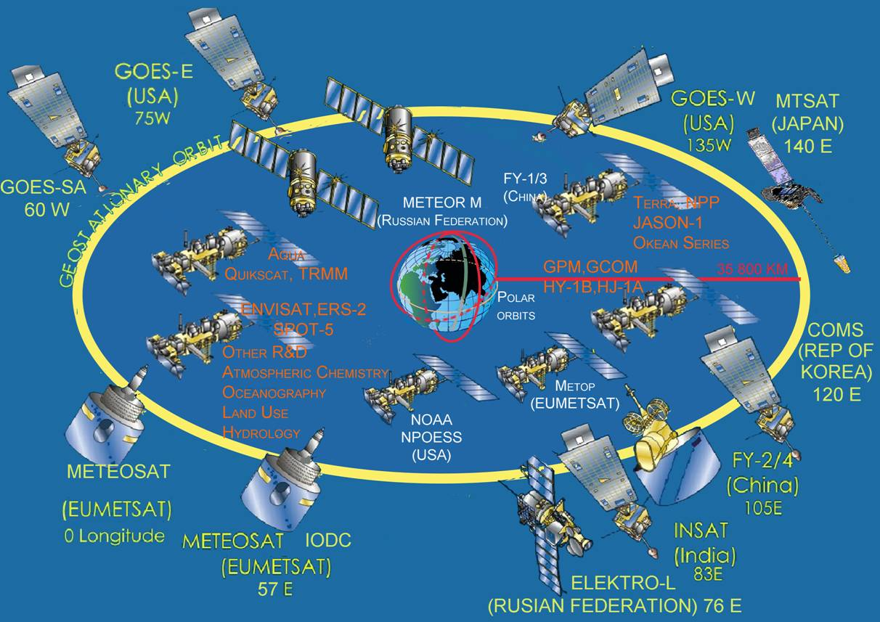
Vision 2025 - space-based component

Slide 23
Vision 2025 - space-based component
Operational geostationary satellites
Operational polar-orbiting sun-synchronous satellites
Additional operational missions in appropriate orbits
Operational pathfinders and technology demonstrators
Polar and geo platforms/instruments for space weather

Slide 24
Vision 2025 - surface-based component

Slide 25
Vision 2025 - surface-based component
Land – upper-air
  Upper-air synoptic and reference stations
  Remote sensing upper-air profiling remote stations
  Aircraft
  Atmospheric composition stations
  GNSS receiver stations
Land – surface
  Surface synoptic and climate reference stations
  Atmospheric composition stations
  Lightning detection system stations
  Application specific stations (road weather, airport/heliport weather stations, agrometstations, urban meteorology, etc.

Slide 26
Vision 2025 - surface-based component
Land – hydrology
  Hydrological reference stations
  National hydrological network stations
  Ground water stations
Land – weather radar
  Weather radar station

Slide 27
Vision 2025 - surface-based component
Ocean – upper air
  Automated Shipboard Aerological Platform (ASAP) ships
Ocean – surface
  HF coastal radars
  Synoptic sea stations (ocean, island, coastal and fixed platform)
  Ships
  Buoys – moored and drifting
  Ice buoys
  Tide stations
Ocean – sub-surface
  Profiling floats
  Ice tethered platforms
  Ships of opportunity

Slide 28
Vision 2025 - surface-based component
R&D and Operational pathfinders – examples
  UAVs
  Gondolas
  GRUAN stations
  Aircraft
  Instrumented marine animals
  Ocean gliders

