Slide 1
The Global Observing System for Climate
GUAN Task Team
(Document 6.4)
AOPC-23
6 – 9 March 2018
EUMETSAT, Darmstadt, Germany
GCOS Secretariat, WMO
Tim Oakley, GCOS Network Manager

Slide 2
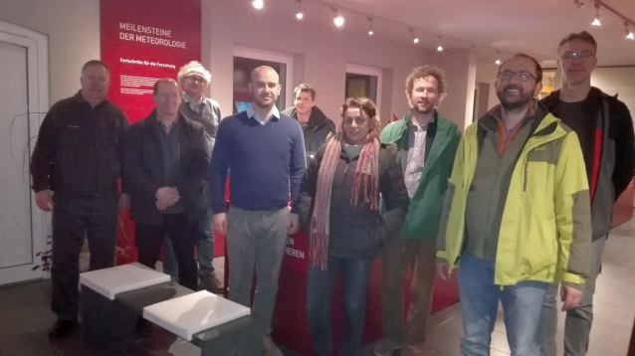
Task-Team GUAN
Membership
Chair (If no suitable candidate, agreed on a meeting by meeting basis)
AOPC Expert – Peter Thorne (peter.thorne@nuim.ie) – Maynooth University (Ireland)
GRUAN Expert – Richard Querel (Richard.Querel@niwa.co.nz) – NIWA (New Zealand)
NWP Expert – Bruce Ingleby (bruce.ingleby@ecmwf.int) – ECMWF (UK)
CBS/National Expert – Hiram Escabi (hiram.escabi@noaa.gov) – NWS (USA)
Satellite Expert – Marc Schroeder (Marc.Schroeder@dwd.de) – DWD (Germany)
National Expert – (Large GUAN contribution – China, Japan, Russia?)
GCOS Network Manager (Secretariat support) – Tim Oakley (toakley@wmo.int) (UK)
GCOS AOPC SO (Secretariat support) – Caterina Tassone (ctassone@wmo.int) (Switzerland)
CIMO expert team on upper air systems representative – Later meeting, if required
HMEI Observer – Later meeting, if required
First meeting in Lindenberg (DWD) 5th-6th December, 2017

Slide 3
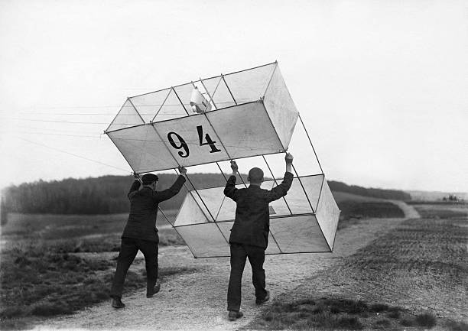

Slide 5
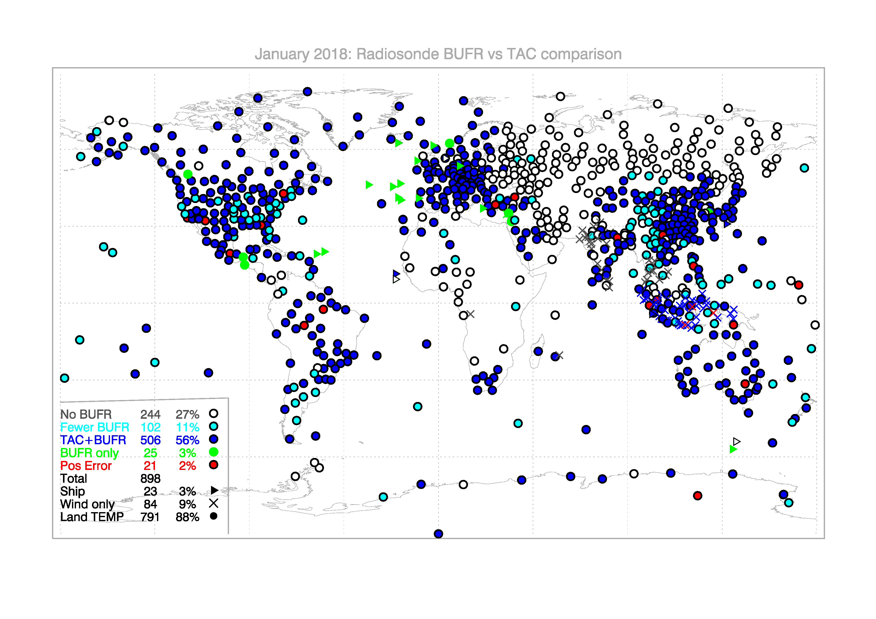

Slide 6
Vision for GUAN
Continuing under its current requirements is not an option
New focus on a guaranteed quality of observational data, according to updated requirements
A subset of the comprehensive network based on quality assurance rather than a fixed network of stations. Adopting a tiered-network approach (Comprehensive-GUAN-GRUAN), as described by GAIA-CLIM
Actively managed through a lead-centre, with a certification process, real-time monitoring and validated station list for the user community
Process to identify gaps in global/regional networks, both in data sparse areas and least develop countries, to allow targeted support projects, using relevant cooperation and funding mechanisms (i.e. GCM, GCF, national bi-lateral programmes).

Slide 8
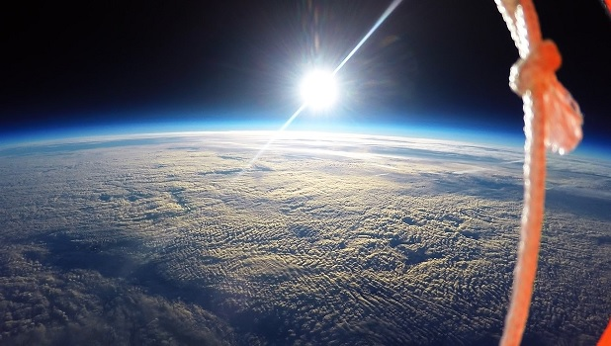
QUESTIONS
gcos.wmo.int
SOURCE: ESA

