Slide 1
Weather radar data requirements for climate monitoring
AOPC Task Team on the use of weather radar for climate studies

Slide 2
Overview of talk
Introduction and background of TT
Motivation
Results of survey on RADAR archives
Recommendation
Summary and next steps

Slide 3
GCOS AOPC 22 implemented task team
Member of TT Radar
Andreas Becker, Germany
Katja Friedrich, USA
Rainer Hollmann, Germany
Elena Saltikoff, Finland
Bernard Urban, France
Caterina Tassone, WMO

Slide 4
TT objectives
Terms of reference for TT
Define weather radar data requirements for climate monitoring, define relevant metadata, and define best practices. Propose key parameters to be used for climate monitoring. Identify procedures for quality control of radar data specifically for climate applications.
Archives: Assess the status of existing international and national archives, including their accessibility, extent and quality.
Provide guidance how to organize proper and standardized storage and user interface of local radar data and metadata for eventual reprocessing at a later stage to support climate monitoring.
Suggest procedures for handling historical data.
Raise awareness and promote co-ordination of use of radar data for climate monitoring.

Slide 5
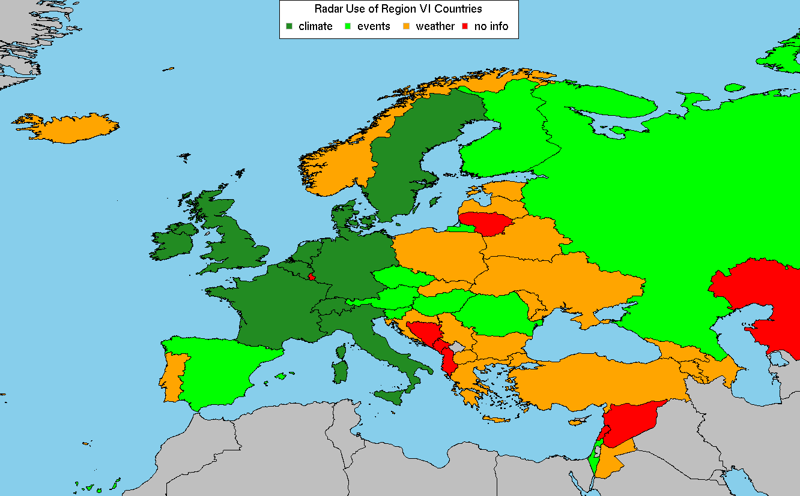
Motivation
During the last decade some activities took place to use RADAR to build climatologies (e.g. in Germany)
The WMO CCl TT URSDCM prepared an overview of existing climatologies
Doc v1.1 : Availability for Europe,
Later updates include other WMO regions

Slide 6
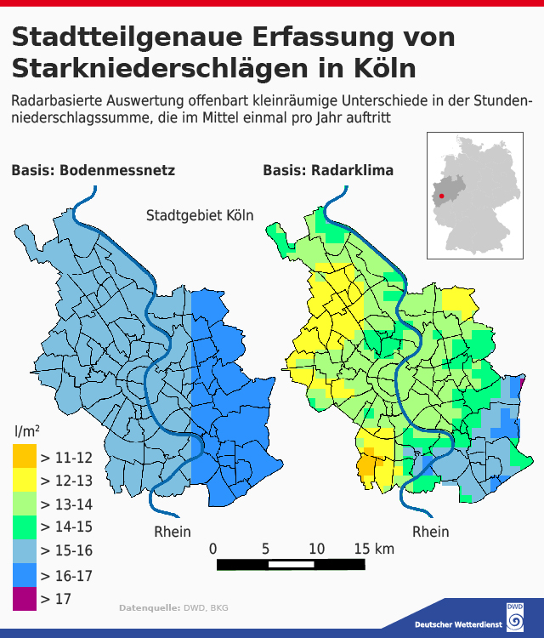
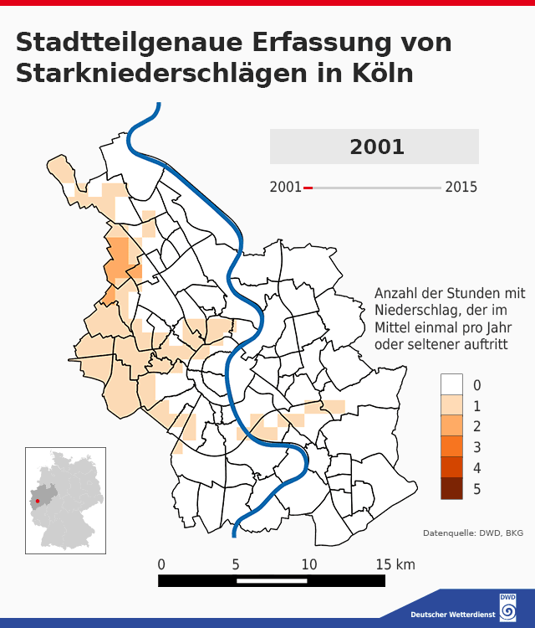
Motivation: Example Application (Germany)
Klimadaten und Darstellung: © DWD 2016
Geobasisdaten: © GeoBasis-DE/BKG 2014
Köln-PLZ-Gebiete: CC BY 3.0 DE, www.off enedaten-koeln.de
6

Slide 7
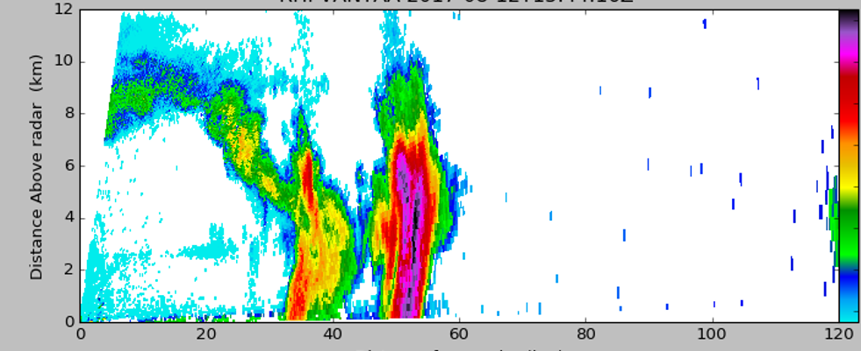
Motivation
During the last decade activities took place to use RADAR to build climatologies (e.g. in Germany)
The WMO CCl TT URSDCM prepared an overview of existing climatologies
Upgrades of RADAR systems itself allow now for much more applications than before
  To study 3D structure of the atmosphere, and phenomena such as hail and tornadoes

Slide 8
Definition: Level 2 for RADAR
Level 2 is defined as: ”Derived radar variables or moments (reflectivity, radial velocity, differential reflectivity, etc.) at full resolution after aggregation, after filtering.
Also, known as “volume scan data”.” by IPET-OWR.
It is acknowledged, that single polarization radars cannot provide ZDR, RhoHV or PhiDP and that VRAD and WRAD are available only for Doppler radars.

Slide 9
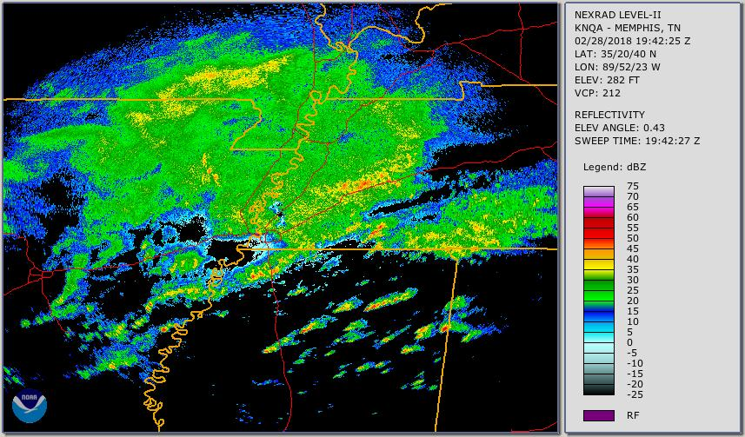
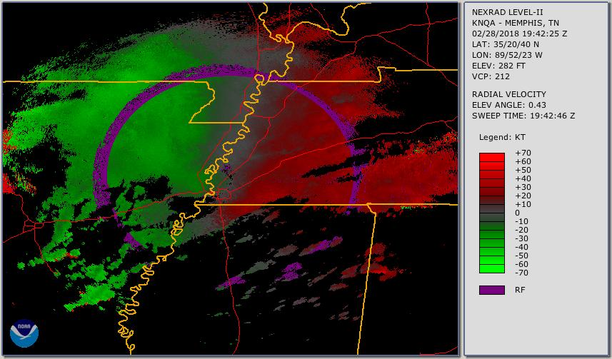
Definition of key parameters
Key parameters for Climate applications are:
  Horizontal Reflectivity (ZH)
  Radial Velocity (VRAD)
  Spectrum Width (WRAD)
  Differential Reflectivity (ZDR)
  Correlation Coefficient (RhoHV)
  Differential phase (PhiDP)

Slide 10
Metadata: Key issue
In general, the metadata needed for climate monitoring are no different from those for other applications. However, from the point of view of climate monitoring, it is crucial to keep track of the history of changes.
Two metadata sets could be defined:
  minimum requirement to enable adequate use,
  goal requirement which is recommended for any radar data intended for use in climate monitoring.
These need to be harmonized to IPET-OWR and TT-WRDE

Slide 11
History of metadata
Special attention should be paid for saving the history of metadata.
Because a lifetime of a radar is 10-20 years, most climatologically interesting time series would be containing data from different instruments at the same places.
Even if the instrument has not been replaced, typically several upgrades have been implemented, so the present metadata is not describing the oldest data.
Dates and types of major changes (such as from non-Doppler to Doppler, from single pol to dual pol) should be indicated carefully.

Slide 12
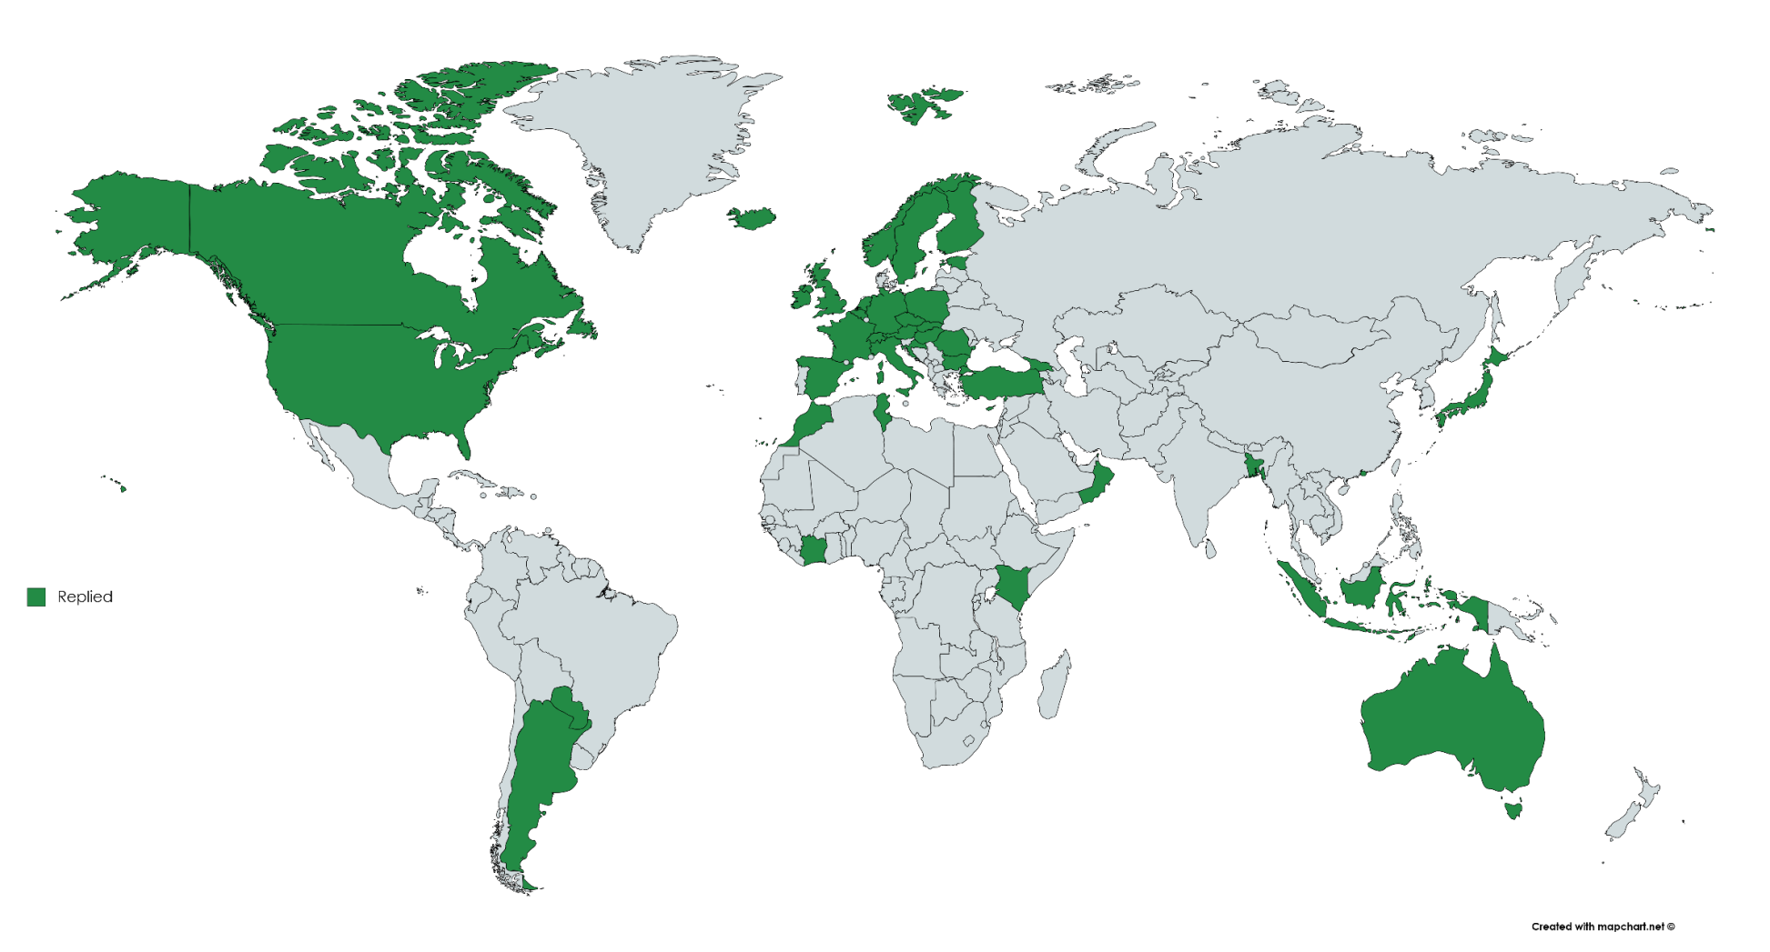
Survey performed
Responders

Slide 13
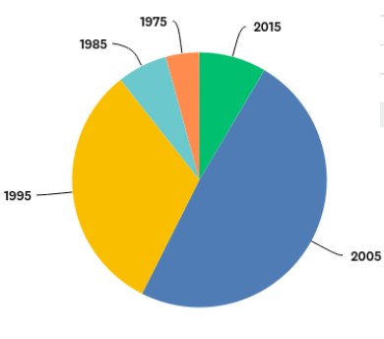
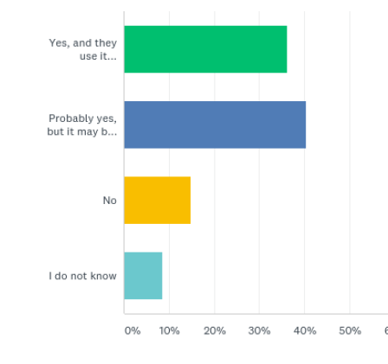
Results of Survey
Results of Survey
Do you have Radar data?
Is the data available for researcher outside your institute?
23 institutes have data since 2005
20 institutes have data even earlier
Yes, in nearly all cases (only 7 say „no“

Slide 14
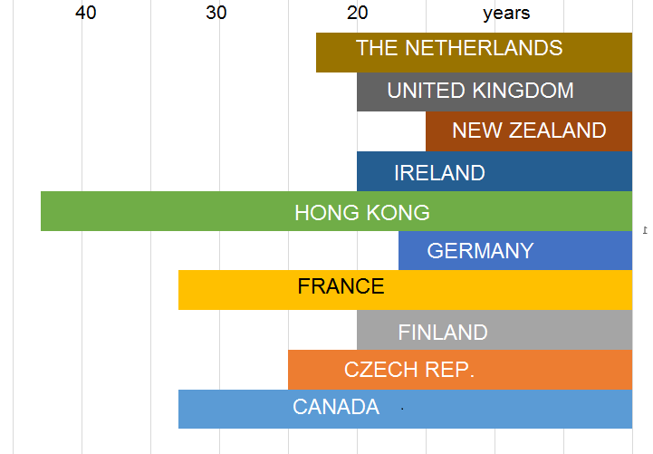
Results Survey (2)

Slide 15
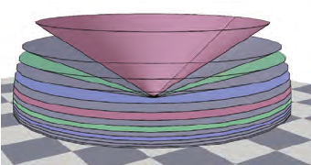
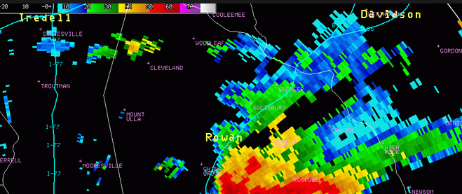
Recommendation: Save the full volume
To study 3D structure of the atmosphere, and phenomena such as hail and tornadoes
NOT THIS

Slide 16
Full volume information
Full volumes do not consume so much disk space
The atmosphere has lots of empty space, and it packs really well

Slide 17
Recommendation
GCOS AOPC is invited to discuss and endorse this recommendation for CBS TC and CCl (tbc)
Member of WMO should consider to save and archive the following RADAR parameters in first place to support future evolving climate applications
Radar parameters
(e.g., reflectivity in dBZ NOT accumulated rainfall rate in mm)
3-dimensional volume scans
in the highest resolution possible
History: Log of changes of important metadata
(e.g., upgrades to Doppler).

Slide 18
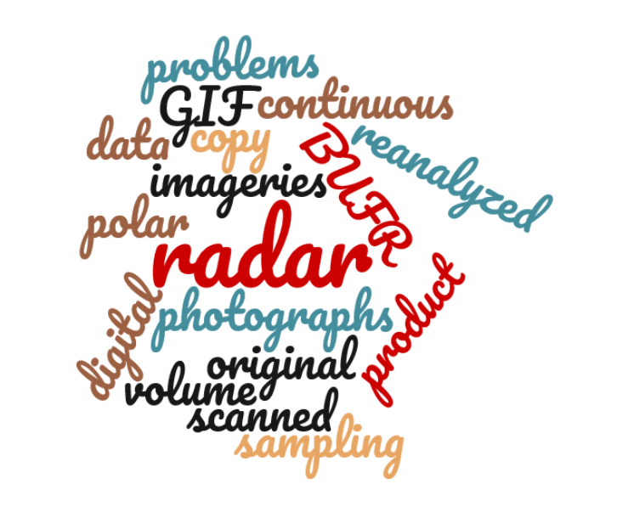
Summary and next steps
The task team is working of 4 other deliverables:
  Inventory of existing archives
  Guidance how to facilitate user access and preservation of data
  Recommendation how to handle historical data
  A manuscript for BAMS and or WMO Bulletin to raise awareness
Words from the comments of owners of log time series

