Slide 1
Preliminary Identification of Indicators (ECVs) to Represent Human Adaptation to Climate Change
Nigel Tapper
Acknowledgements: J. Voogt, UWO; M. Demuzere, U. Ghent; B. Bechtel, U. Hamburg; G. Mills, UCD; M. Stafford-Smith, CSIRO; H. Cleugh, CSIRO; K. Main, MIT; M. Giampieri, MIT; T. Brown, DRI
Notes:
When I first became involved in TOPC this time last year I was asked to take some responsibility for identifying possible ECVs that might represent human adaptation to climate change. I’m rather reluctant to call these ECVs at this time – partly because of the discussion we had on terminology on Monday, partly because most such indicators are sub-global in their scope, and partly because all of the indicators are related to human behaviour that is possibly a response to a range of drivers, including climate change.

Slide 2
Why the interest in such indicators (ECVs)?
1. Responsibilities of the GCOS Observations Panels are to liaise with relevant research and operational communities to identify measureable terrestrial properties and attributes which
      a. Control the physical, biological and chemical processes affecting climate in the various terrestrial realms
      b. Are themselves affected by, are indictors of, or provide information on impacts, mitigation or adaptation to climate change
      2. There is a pressing need moving forward for policymakers to be able to monitor the
      effectiveness of actions against climate change, both in terms of mitigation and adaptation
      3. Action T36 of the GCOS IP requires us to establish climate change indicators for adaptation using land ECVs at high resolution

Slide 3
Possible Adaptation Indicators (1st cut)
Realm | Possible Indicator | Physical or Financial | Data Source | Scope (for global, need to consider their global representativeness)
Urban Environments | 1.Vegetation Fraction (Greenness) 2. Impervious Fraction 3. Complete Surface Fraction 4. Albedo 5. Urban air temperature mitigation | P P P P P | Satellite Satellite Satellite Satellite Weather station | Global Global Global Global Global
Agriculture and Forestry | 1. Shifting agricultural zones 2. Prescribed burning 3. Investment in fire suppression | P P F | Satellite (LULC) Satellite Fire Agencies | Global Country Country
Coastal Infrastructure | 1. Adapting existing infrastructure 2. Infrastructure for hazard management 3. Insurances - disaster relief | F and P F and P F | National agencies/ Satellite National agencies/Satellite Reinsurance companies/ national agencies | Country Country Global, country

Slide 4

Essential Climate Variables to Reflect Human Adaptation to Climate Change in Cities
Part B of Session Urban Climate Information to Support Decision Making: from Local to Global
Convenor and Facilitator: Nigel Tapper
Monash University, Australia
WMO/GCOS Terrestrial Observation Panel for Climate (TOPC)

Slide 5


Facilitated Discussion – Panel 3-5 min pitches to initiate discussion, then open to the audience
Panel Members
Xuemei Bai (Australian National University), urbanization, urban system sustainability
Chao Ren (Chinese University of Hong Kong), urban design and climate
James Voogt (University of Western Ontario), physical urban climate
Panellists have been asked to briefly comment on 1. The value of an ECV representing human adaptation to climate change in cities 2. One or more possible ECVs representing human adaptation in cities 3. Logistical considerations (costs, who can provide, can the ECV be applied globally?)

Slide 6
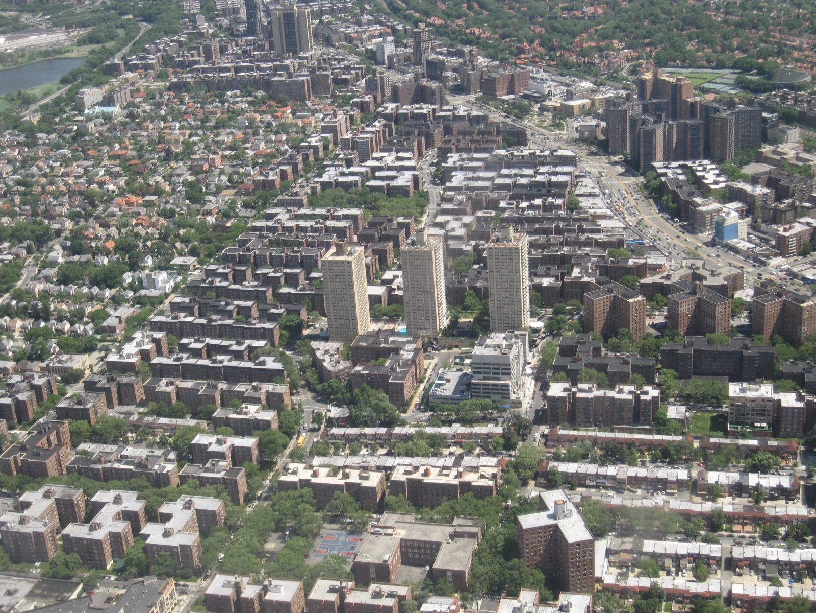
Controls on Urban Climates are linked to Adaptation
Materials
(radiative, thermal, moisture, aerodynamic)
Metabolism
(emissions of water, heat, pollutants)
Form:
Geometric structure
City Size
Surface Cover
(impervious, vegetated)
Notes:
From a physical climate standpoint, ECVs should be linked to the controls on urban climate.

Slide 7
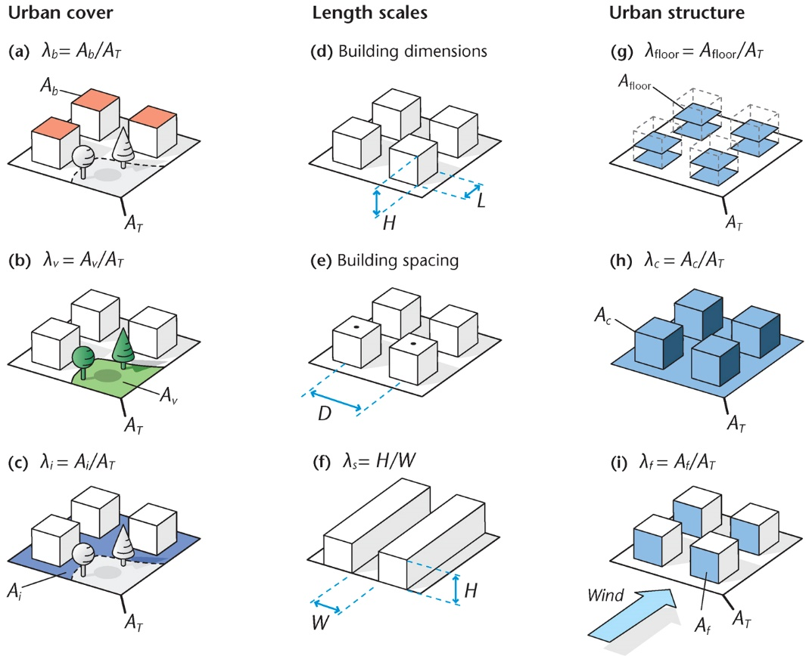
Urban surface cover and structure parameters
Potential ECVs
λ_{v} vegetation fraction
λ_{i} impervious fraction
λ_{c} complete surface
fraction (or H and λ _{b} )
Albedo
Are important controls on near-surface urban climates & hydrology
Can be provided by remote sensing
Oke et al. (2017)
Notes:
Impervious surface fraction, vegetation fraction are relevant to both hydrological and meteorological adaptation
Built form: perhaps expressed as the complete surface fraction could be useful (or at least building height along with urban cover ?)
Space borne photogrammetry may be maturing and able to give structure parameters?

Slide 8

Scale of Approach
Reduce local-scale air temperature
Limit heat-health impacts
Role of water and green infrastructure
Reduce micro-scale air temperature and radiant temperature
Improve human thermal comfort
Coutts, Tapper, Beringer, Loughnan, Demuzere (2013)

Slide 9
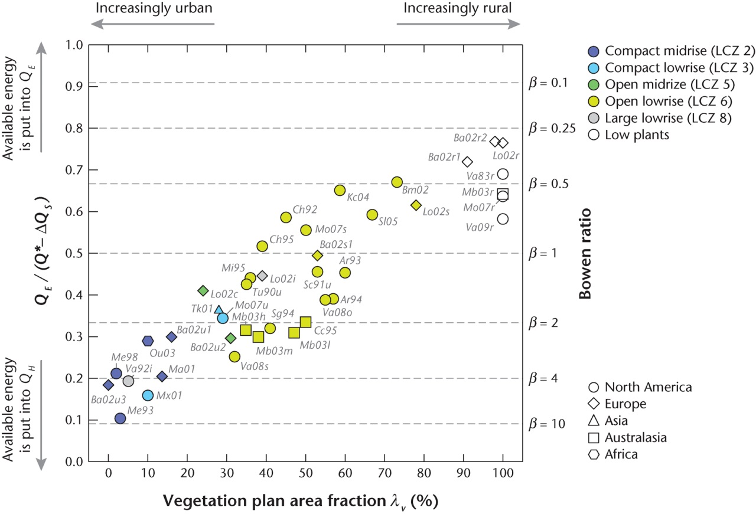
Surface Cover demonstrates Energy Balance Control
Consider also moisture
evaporative flux ratio
Oke et al. (2017)

Slide 10

Urban Surface Characteristics & Remote Sensing: WUDAPT (World Urban Database and Access Portal Tools)
Workflow for identifying urban local climate zones via remote sensing using many of the characteristics described earlier.
ECVs: require a base year for comparison
Notes:
Consider scalable ECVs given the intra-urban variability.

Slide 11
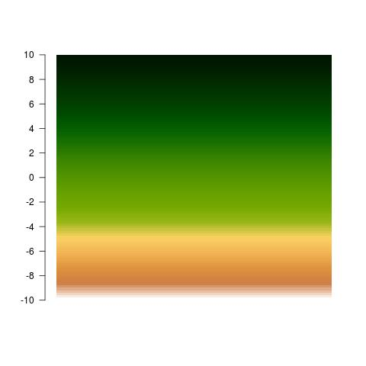
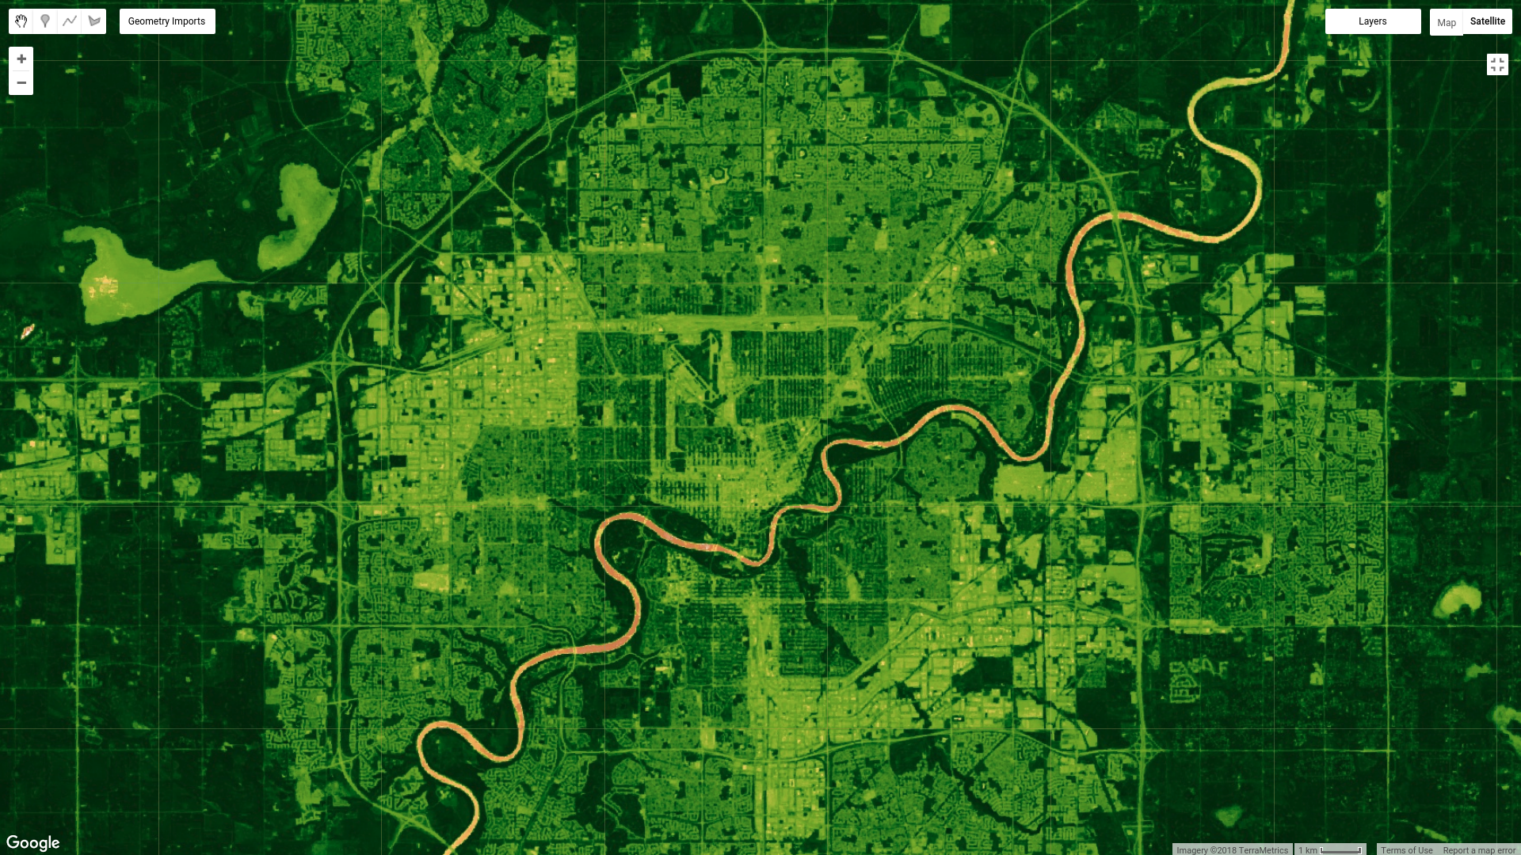
Landsat 8 maximum NDVI
Barren
Vegetated
Courtesy: M. Demuzere, U. Ghent; WUDAPT
Notes:
L8 maximumNDVI - 30m

Slide 12
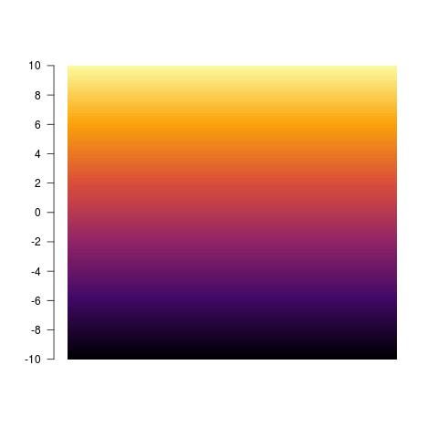
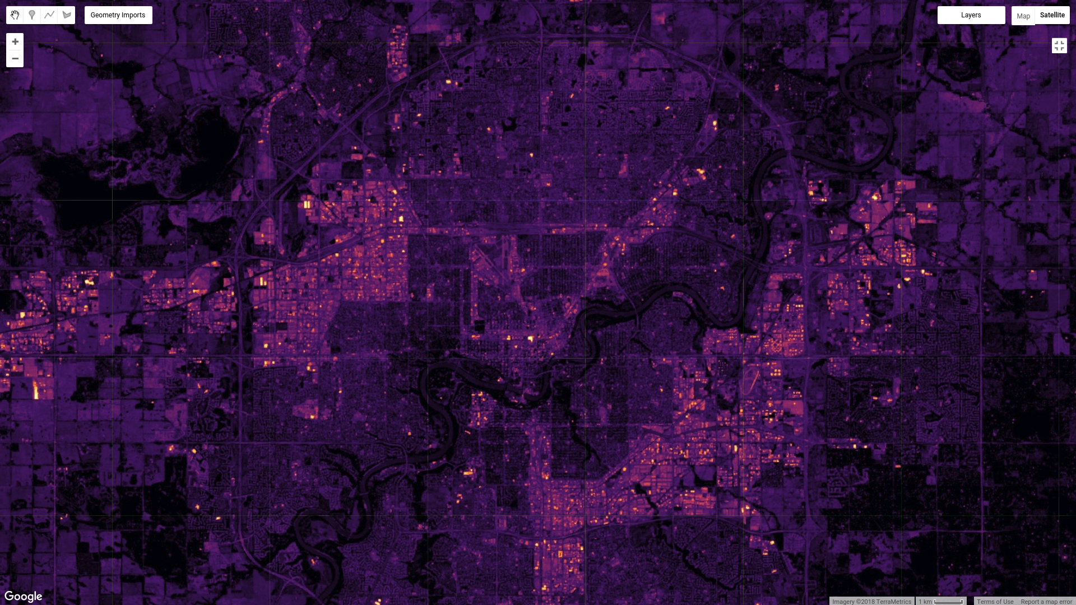
Landsat 8 ND impervious index
Pervious
Impervious
Courtesy: M. Demuzere, U. Ghent; WUDAPT
Notes:
L8 ND impervious index - 30m

Slide 13
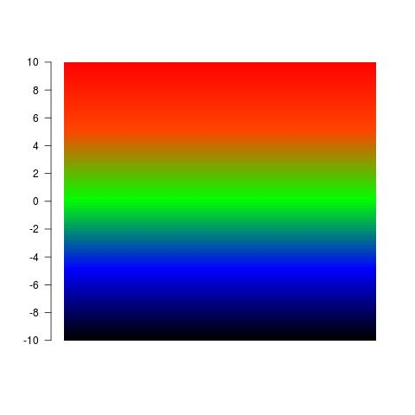
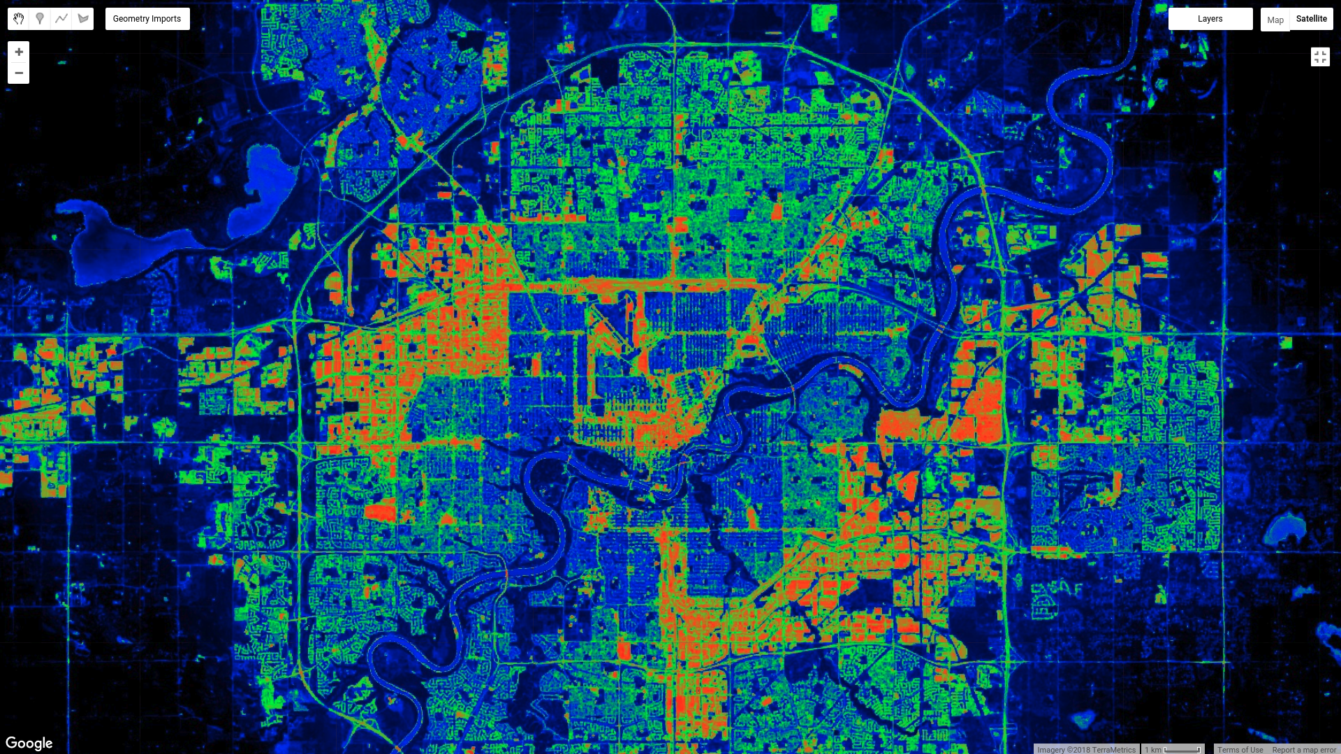
Landsat 8 ND urban index
non-built
built
Courtesy: M. Demuzere, U. Ghent; WUDAPT
Notes:
L8 ND urban index (also integrates night-time lights - 30m

Slide 14
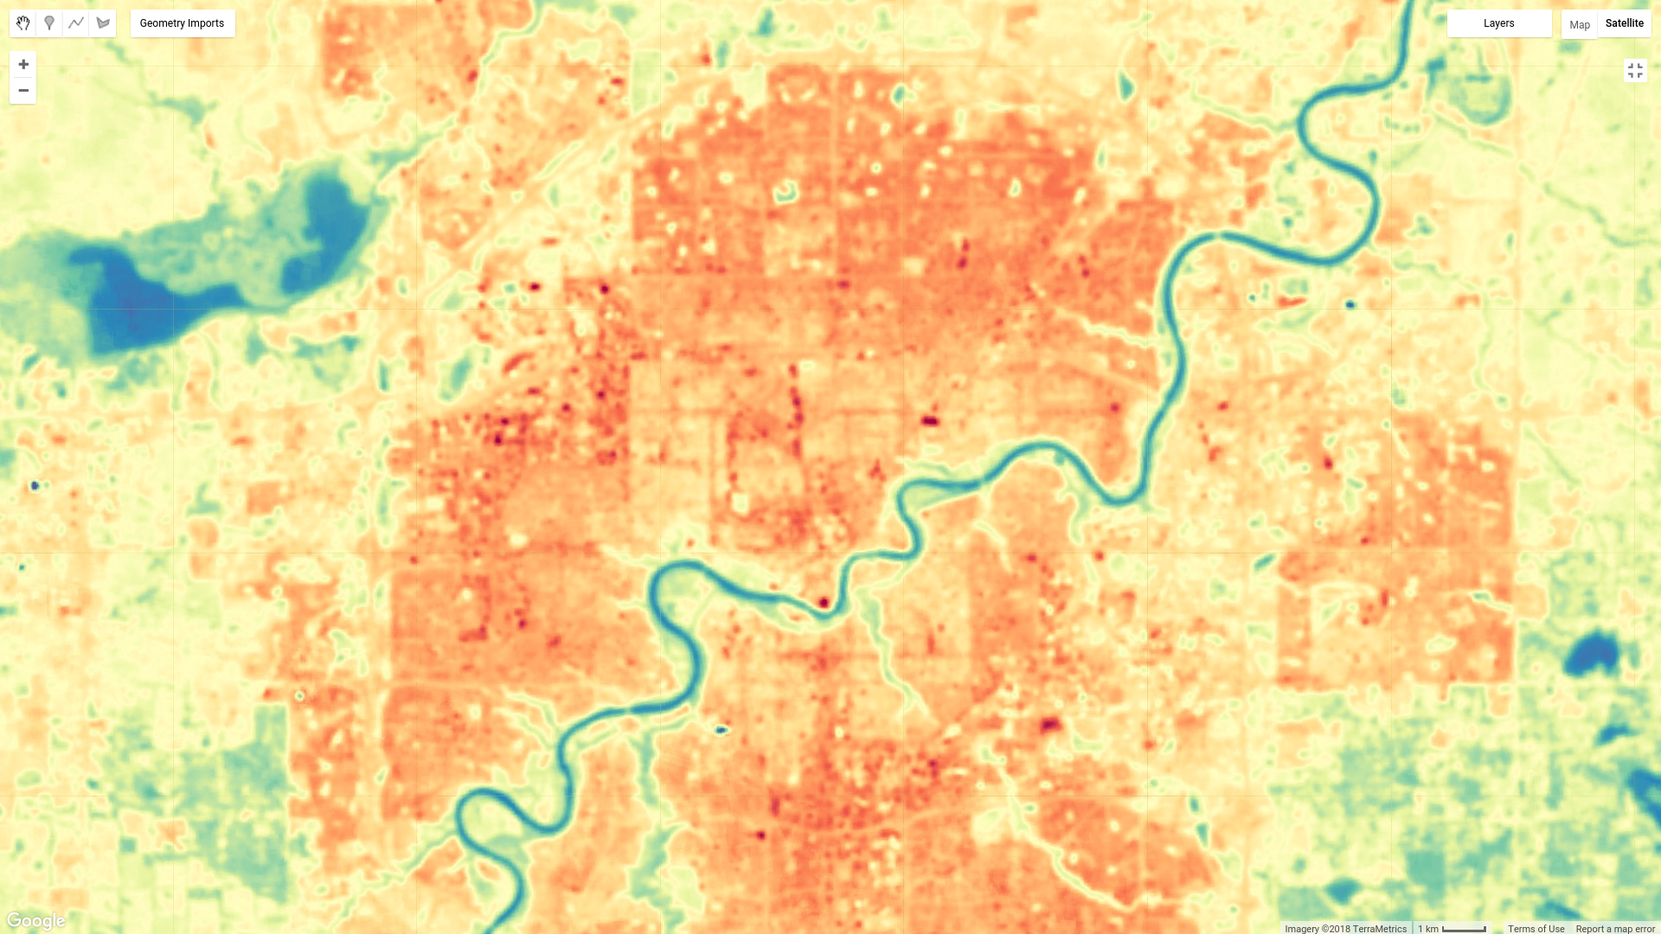
ECV: Urban Land Surface Temperature?
Already an ECV
A product of surface cover, material, and form.
Need higher spatial/temporal resolution for urban applications
Courtesy: M. Demuzere, U. Ghent; WUDAPT
Notes:
L8 mean LST map
Tsfc would show impacts of adaptations if they affected any measure influencing the surface energy balance. A sensitive measure.
But also quite sensitive to measurement and environmental conditions on short time scales – so may be a ‘noisy’ variable to track

Slide 15
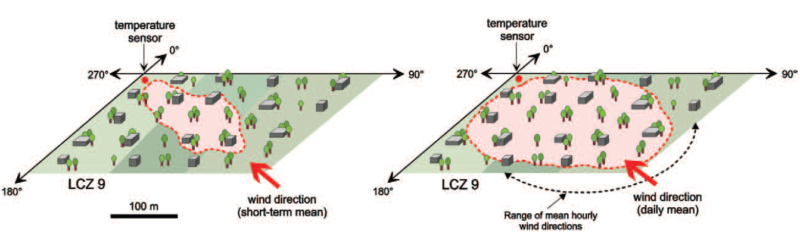
Indicator: Urban Air Temperature Measurements?
Traditional WMO observing station
In urban environments, the source area characteristics can be linked to the neighbourhood (LCZ concept)
Oke et al. (2017)
Short-term (<1 h) source area
Mean daily source area
Stewart and Oke (2012)
Notes:
A fundamental climate variable. Changes to the urban surface / urban function should be reflected in changes to Tair.
The value of an ECV representing human adaptation to climate change in cities

Slide 16
Guidelines exist to measure urban T_{air}
Notes:
Can the guidelines be applied globally? Might depend on selecting a representative type LCZ?

Slide 17
Metadata are key for any urban meteorological observation
WMO (2008)
Notes:
An important logistic

Slide 18
Where to start?
Start simple – but start?
Vegetation Fraction (Urban Greening) in cities is a probable candidate

