Slide 1
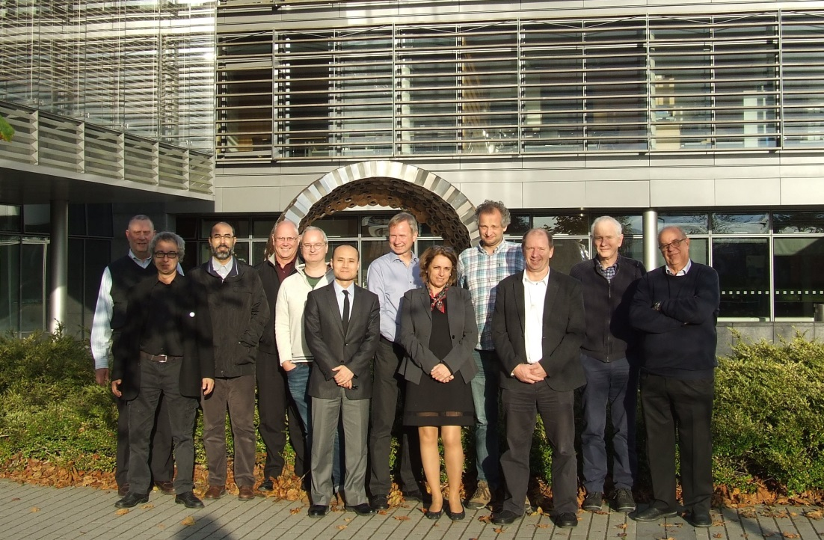
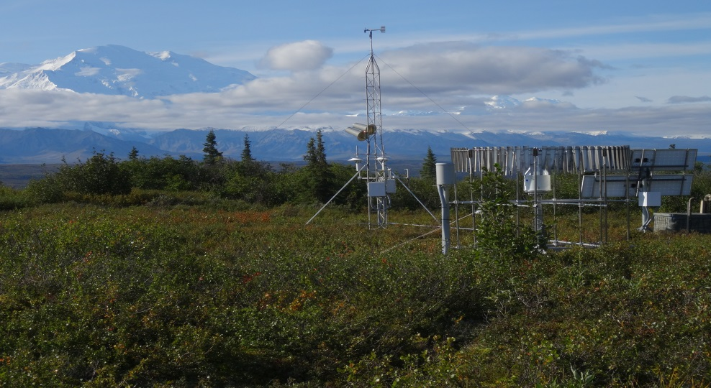
GCOS Surface Reference Network (GSRN) Task Team Brief Report to the TOPC-20 Meeting
21-March-2018; Geneva, Switzerland
GSRN TT Initial Meeting from 1-3 Nov 2017; Maynooth University; Dublin, Ireland
USCRN Station in Denali National Park Alaska
GSRN Task Team Co-Chairs – Howard Diamond (NOAA – USA) and Nigel Tapper,
(Monash University, Australia)

Slide 2
Background
AOPC-22 (Exeter, UK, March 2017) agreed on the creation of a dedicated task-team to scope a potential GCOS global surface reference network.
The potential for such a network has been proposed by GCOS AOPC and by the Commission for Climatology.
Build on paper accepted in the Intl Journal of Climatology, "Towards a global land surface climate fiducial reference measurements network"; DOI:10.1002/joc.5458; Thorne et al. (2018)] – Accepted February
This Task Team is charged with taking this forwards towards practical implementation providing a concrete roadmap as to what would be required and to canvas stakeholders.
Working models on which to base deliberations include the GCOS Reference Upper Air Network, US Climate Reference Network, and Global Cryospheric Watch.

Slide 3
GSRN Task Team Membership
Co- Chair – Howard Diamond – USA
Co-Chair and TOPC Rep – Nigel Tapper - Australia
AOPC Representative – Phil Jones – UK
GRUAN Representative – Peter Thorne – Ireland
GSN Representative – Tim Oakley – UK
CBS/WIGOS/CIMO Representative – Andrew Harper – New Zealand
NMHS Representative – Jiankai WANG – China
BIPM Representative – Andrea Merlone – Italy
Climate Scientist Representative – Victor Venema – Germany
Satellite – (Bojan Bojkov – Germany)
Region I Representative – Rachid Sebbari – Maroc
GCOS Secretariat – Caterina Tassone
WMO Secretariat – Peer Hechler

Slide 4
Scientific request from the AOPC
Create a scientifically robust basis for a proposed network spatial composition, taking into account fairness in national contributions and the need for globally representative measurements.
Accounting for stakeholder needs including inter-alia climate monitoring, process understanding and understanding remaining measurement requirements (including space-borne measurement systems), define a robust siting rationale.
Propose a phased implementation that ‘starts small, but starts’ and builds over time to a holistic set of measurements of all relevant ECVs (including from TOPC). at each site to the extent practicable.
Decide on a potential governance structure in collaboration with key stakeholders.
Propose one or more management options that undertake day-to-day operational oversight and ensures a globally traceable, comparable network of measurements, recruiting possible host institutions.
Provide indicative costings on the proposed solutions sufficient to inform a decision as to whether to move forwards
Address additional needs identified by the Task Team and agreed with AOPC (and TOPC) as they arise.

Slide 5
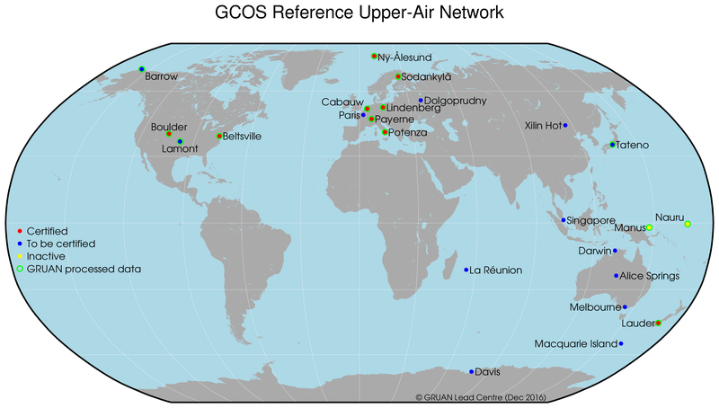
Guiding Principles
The task team shall exist for an initial period of two years.
The task team shall work primarily remotely, facilitated by GCOS secretariat, after the initial Nov 2017 meeting, any possible future meetings will be decided as required and as resources allow.
The task team shall work in conjunction with relevant groups within WMO to ensure broad buy-in.
The task team chairs shall be expected to report annually on progress to AOPC (and TOPC) by means of a brief written report and, if support available, verbal reporting in person.
The task team shall be expected to lead the production of a final report implementation plan) which may form the basis for a decision as to whether, and if so how, to proceed with a GCOS Surface Reference Network.
Build on paper accepted "Towards a global land surface climate fiducial reference measurements. network"; DOI:10.1002/joc.5458; Thorne et al. (2018)]
Uses as models the USCRN and GRUAN approaches
GRUAN Stations

Slide 6
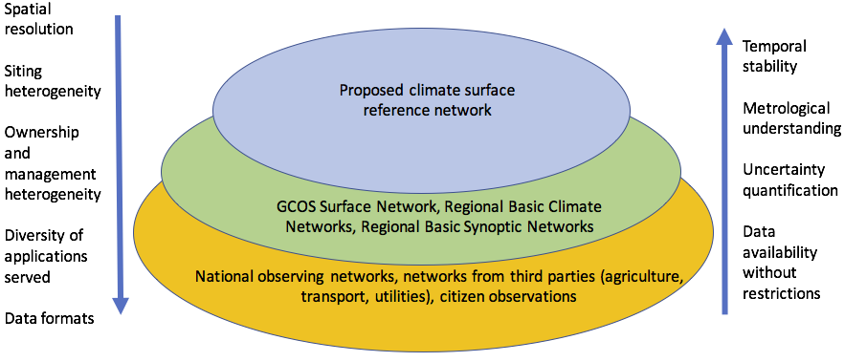
Report from the November 2017 TT Meeting
Benefits of a Global Climate Observing System
Specific Benefits of a GSRN
GSRN Requirements
Design Principles for a GSRN
Governance and Management
Preliminary List of ECVs to be Monitored
Tiered Network Approach
  The climate is observed by many networks, and the GSRN would be the stable backbone of this network of networks
Question of urban measurements clearly on the table – but will not be core to GSRN

Slide 7
Benefits of a GSRN
Relevance of “reference”-type measurements
  Having each single measurement traceable to an absolute standard allows moving from relative to absolute accuracy in measurements
  Defined and agreed measurement standards
Underpinning existing networks
  Validation of the GSN and broader surface networks and CDRs derived therefrom
  Long term homogeneous record will ensure better use of the data and serve to improve the quality of data from other networks
Capacity Building
  Exchange of knowledge and skills between institutes globally
Scientific value of answering questions about long-term nature of climate change
  Increased accuracy and confidence in observed changes will allow us to answer new questions and open still unknown new fields of research
  Better understanding of the Global Cycles (e.g. Water, Carbon and Energy)
Societal Benefits
  An initial focus on temperature and precipitation would support plans to adapt to climate change to heat waves, flooding and drought
Looking to the Future
  Supersites can contribute in research on the evaluation of emerging technologies, improved measurement procedures and measurement principles.

Slide 8
Preliminary List of ECVs to be Monitored (not every GSRN site would need to necessarily observe each ECV)
Atmospheric
  Air temperature
  Precipitation
  Pressure
  Wind speed and direction (10 m)
  Relative humidity
  Surface radiation (down and up)
Terrestrial
  Land Surface Temperature*
  Soil moisture (standard WMO depths)*
  Soil temperature (standard WMO depths)*
  Snow/Ice*
  Albedo*
  River discharge
  Ground water
  * In conjunction with satellite derived data to a certain degree

Slide 9
Work Plan and Path Forward
General Activities:
Rework of GCOS 112 into a GSRN document
Measurements requirements: what, how; frequency
Terminology documented
Identify climate zones – the most critical, sensitive ones (e.g., Galapagos Islands); perhaps a better approach than using WMO RAs; Dual Approach of existing stations and climate regions
Satellite requirements (e.g., Cal/Val) – Work with CEOS WG on Climate
Specific Near-Term Activities:
Briefings to GCOS/TOPC in 19-22 March 2018; WMO/CCl 11-12 April 2018
Possible benefits document to be included in a document for EC (June 2018)
Initial Version of a reworked GCOS-112 by the end of June 2018
Resourcing investigation – Linkages to adaptation and mitigation activities - bring in people to the TT experienced with such applications for funding (e.g., Green Fund, Foundations/NGOs, EU)
Draft of rework of GCOS 112 for GSRN: Interim version targeted for AOPC-24 in 2019
Final deliverable of Task Team – Rework of GCOS 112 for GSRN for AOPC-25 in 2020
Potential Implementation Plan Outline (depends on the existence of a Lead Centre): AOPC 2020
Canvassing of potential Lead Centre candidates and site candidates (ongoing)
Considerations of building into WMO technical regulatory documentation and framework (TBD)
Outreach activities (e.g., EOS article; next CIMO Commission Meeting; EURAMET Conference, side events at meetings of opportunity)

Slide 10
Summary
First Task Team Meeting was a successful meeting of the minds with some basic agreements to requirements, design principles, diversity of areas observed, and ECVs.
Builds on an initial whitepaper, now Thorne et al. (2018) accepted for publication that gives us a firm underlying scientific foundation.
Use existing reference observing systems (GRUAN and USCRN) as a model to begin from.
Draft a “GCOS-112-like” document to give the GSRN a firm technical foundation – this was successful for the GRUAN and we believe will serve a possible GSRN very well. May also help to consider regular in-person meetings on an annual basis once we have that in hand.
A number of related near-term activities over the next year, to be reported out at APOC-24, will be undertaken.
This is not a small effort, nor is there any thought that this will be easy to do. There are many obstacles in the way.
The job of this Task Team is to provide the documentation and work necessary to WMO members to decide if this is indeed something that the global climate community wants to take on.
The Task Team will do its best to deliver on the charter for the Task Team as laid out by the AOPC with a final deliverable by AOPC-25 in 2020.

