Slide 1
Terrestrial Actions in the GCOS Implementation Plan
Simon Eggleston

Slide 2
General
# | ECV | ACTION
1 | General | Improve coordination of terrestrial observations
2 | General | Develop joint plans for coastal zones
3 | General | Terrestrial monitoring sites
4 | General | Review of monitoring guidance
5 | General | Develop metadata
6 | General | Identify capacity development needs
7 | General | Exchange of hydrological data
21 | General | Encourage and enforce research projects to make their ECV-relevant observations available through the dedicated international data centres

Slide 3
Hydrology
# | ECV | ACTION
8 | Lakes | Lakes and reservoirs: compare satellite and in situ observations
9 | Lakes | Submit historical and current monthly lake-level data
10 | Lakes | Develop additional products derived from Lake water-leaving reflectance for turbidity, chlorophyll and coloured dissolved organic matter
11 | River discharge | Confirm Global Terrestrial Network for River Discharge sites
12 | River discharge | National needs for river gauges
13 | Groundwater | Establish a full-scale Global Groundwater Monitoring Information System (GGMS)
14 | Groundwater | Operational groundwater monitoring from gravity measurements
15 | Soil moisture | Satellite soil-moisture data records
16 | Soil moisture | Multi-satellite, soil-moisture data services
17 | Soil moisture | International soil-moisture network
18 | Soil moisture | Regional high-resolution soil-moisture data record

Slide 4
Cryosphere
# | ECV | ACTION
19 | Glaciers | Maintain and extend the in situ mass balance network
20 | Glaciers | Improve the funding situation for international glacier data centres
22 | Glaciers | Global glacier inventory
23 | Glaciers | Multi-decadal glacier inventories
24 | Glaciers | Allocate additional resources to extend the geodetic dataset
25 | Glaciers | Extend the glacier-front variation dataset both in space and in time
26 | Glaciers | Glacier observing sites
27 | Glaciers | Observations of glacier velocities
28 | Snow | Snow-cover and snowfall observing sites
29 | Snow | Integrated analyses of snow
30 | Ice sheets and Ice shelves | Ice-sheet measurements
31 | Ice sheets and Ice shelves | Ice-sheet model improvement
32 | Ice sheets and Ice shelves | Continuity of laser, altimetry and gravity satellite missions
33 | Permafrost | Standards and practices for permafrost
34 | Permafrost | Mapping of seasonal soil freeze/thaw

Slide 5
LAI, FAPAR and Albedo etc.
# | ECV | ACTION
35 | LAI, FAPAR and Albedo | Ensure the consistency of the various radiant energy fluxes
36 | LAI, FAPAR and Albedo | Climate change indicators for adaptation
37 | LAI, FAPAR and Albedo | Quality of ground-based reference sites for FAPAR and LAI
38 | LAI, FAPAR and Albedo | Improve snow and ice albedo products
39 | LAI, FAPAR and Albedo | Improve in situ albedo measurements
40 | LAI, FAPAR and Albedo | Production of climate data records for LAI, FAPAR and Albedo
41 | LAI, FAPAR and Albedo | Evaluate LAI, FAPAR and Albedo
42 | Land surface temperature | Land-surface temperature: in situ protocols
43 | Land surface temperature | Production of land-surface temperature datasets
44 | Land surface temperature | Reprocessing land-surface temperature
45 | Land surface temperature | Land-surface temperature in situ network expansion
46 | Land surface temperature | Land-surface temperature radiometric calibration
72 | LAI, FAPAR and Albedo | Prepare for a latent and sensible heat flux ECV

Slide 6
Biosphere
# | ECV | ACTION
47 | Land cover | Land-cover experts
48 | Land cover | Annual land-cover products
49 | Land cover | Land-cover change
50 | Land cover | Land-cover community consensus
51 | Land cover | Deforestation
52 | Above-ground biomass | Collaboration on above ground biomass
53 | Above-ground biomass | Above-ground biomass validation strategies
54 | Above-ground biomass | Above-ground biomass validation sites
55 | Above-ground biomass | Above-ground biomass data access
56 | Above-ground biomass | Above-ground biomass: forest inventories
57 | Soil carbon | Soil carbon: carbon mapping
58 | Soil carbon | Soil-carbon change
59 | Soil carbon | Soil carbon – histosols
60 | Fire | Historic fire data
61 | Fire | Operational global burned area and fire radiative power
62 | Fire | Fire maps
63 | Fire | Fire validation
64 | Fire | Fire disturbance model development

Slide 7
Anthropogenic use of resources
# | ECV | ACTION
65 | Water use | Anthropogenic water use
66 | Water use | Pilot projects: anthropogenic water use
67 | Greenhouse gas fluxes | Improve global estimates of anthropogenic greenhouse-gas emissions
68 | Greenhouse gas fluxes | Use of satellites for Land use, land-use change and forestry emissions/removals
69 | Greenhouse gas fluxes | Research on the land sink
70 | Greenhouse gas fluxes | Use of Inverse modelling techniques to support emission inventories
71 | Greenhouse gas fluxes | Prepare for a carbon-monitoring system

Slide 8
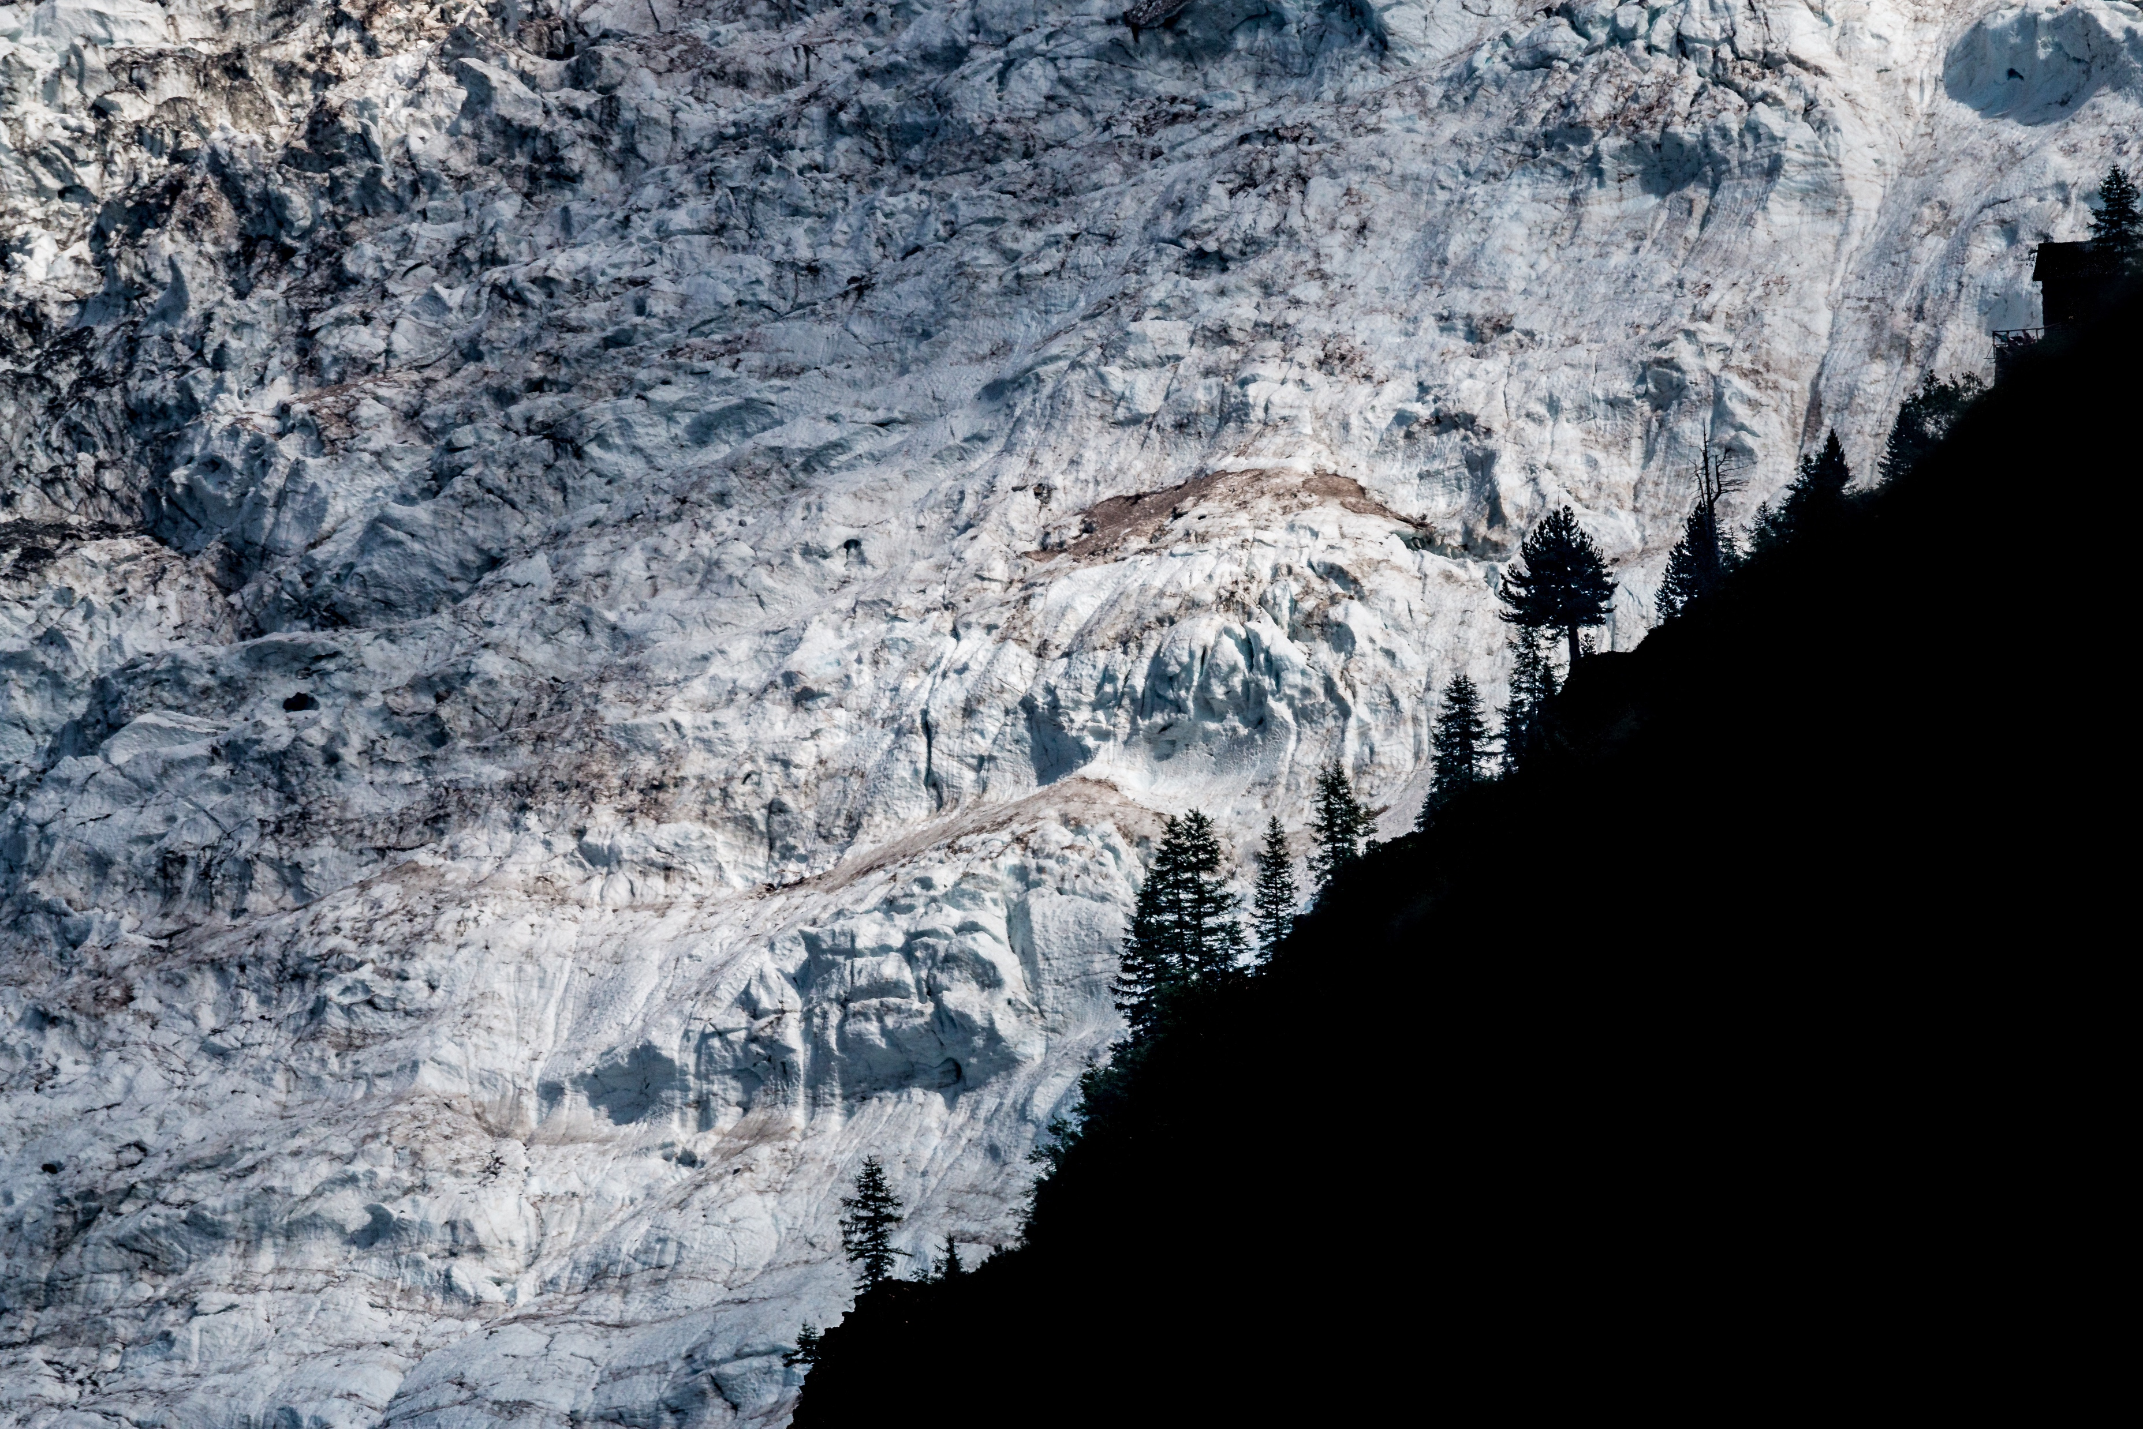
@gcos_un
gcos.wmo.int

