Slide 1
ECV Requirements
Wolfgang Wagner

Slide 2
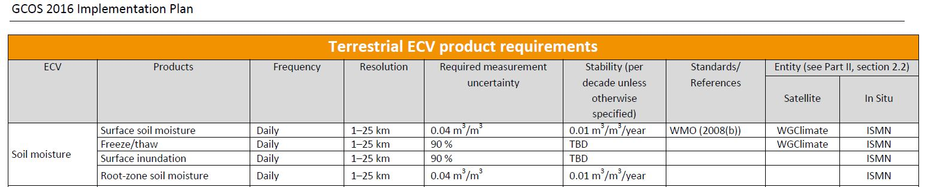
GCOS Requirements Table

Slide 3
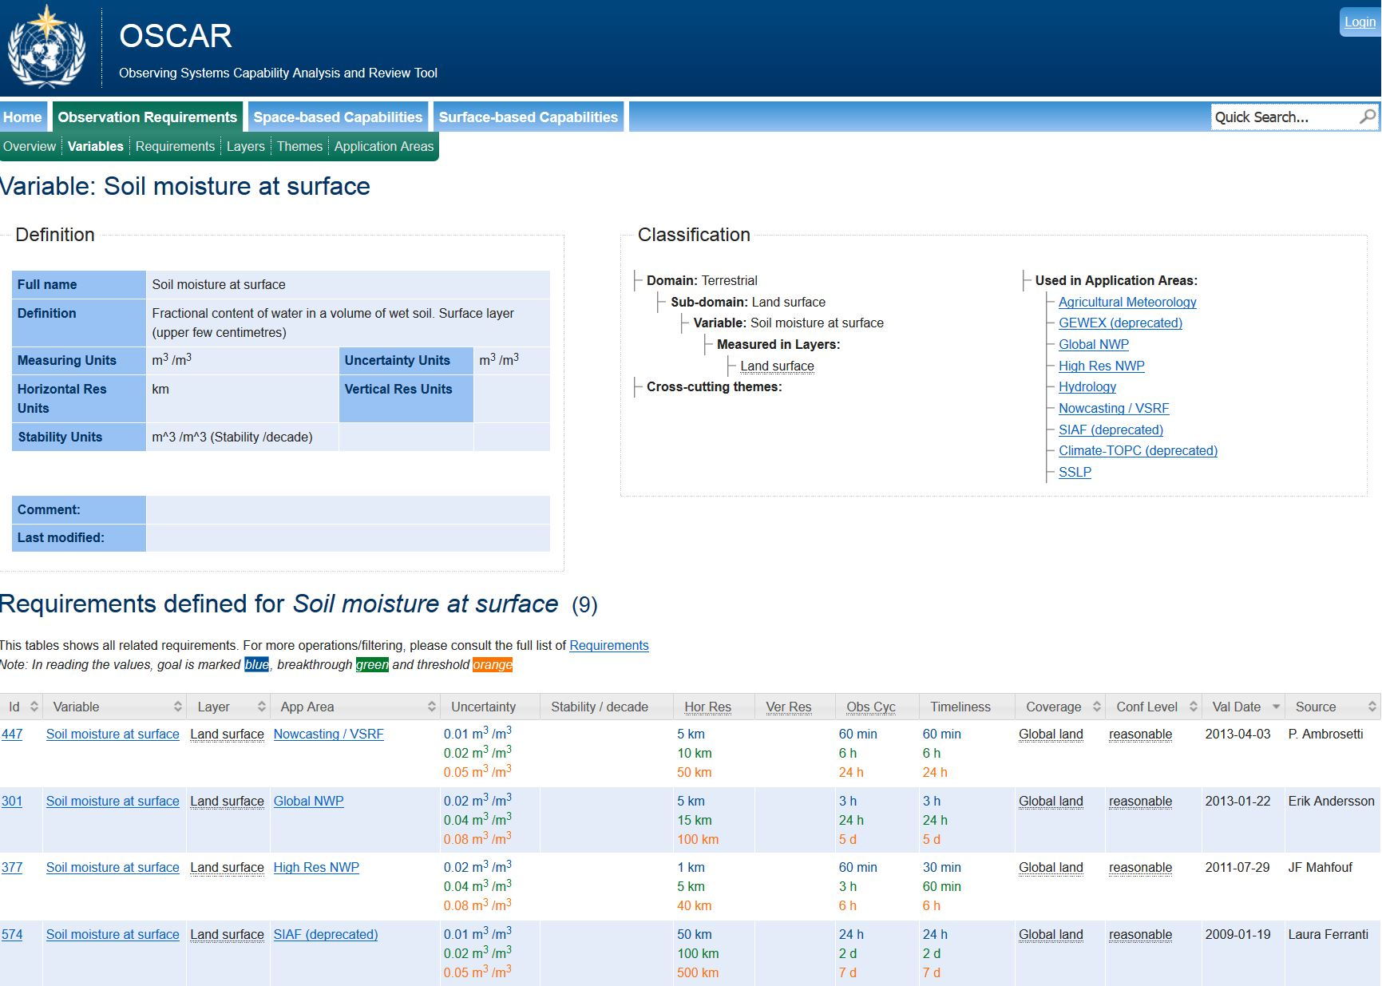
https://www.wmo-sat.info/oscar/variables/view/149

Slide 4
Proposal for Revised GCOS Table
DEFINITION
  NAME: Surface soil moisture
  DEFINITION: Surface soil moisture refers to
  the water content in the topmost soil layer (usually taken to be 0-5 cm)
  MEASURMENT UNIT: m³/m³ (volumetric soil moisture)
  UNCERTAINTY METRIC: Unbiased root mean square error
  UNIT OF UNCERTAINTY METRIC: m³/m³
  STABILITY METRIC: Maximum drift over reference period
  UNIT OF STABILITY METRIC: m³/m³ per reference period
REQUIREMENTS
  UNCERTAINTY
  STABILITY
  HORIZONTAL RESOLUTION
  VERTICAL RESOLUTION (may by NA)
  TEMPORAL SAMPLING
  TIMELINESS?
METHODS
  Uncertainty propagation
  Direct comparison with area-averaged in situ soil moisture over densely instrumented networks
All field require explanatory notes
Account for different climate applications by three levels approach?

Slide 5
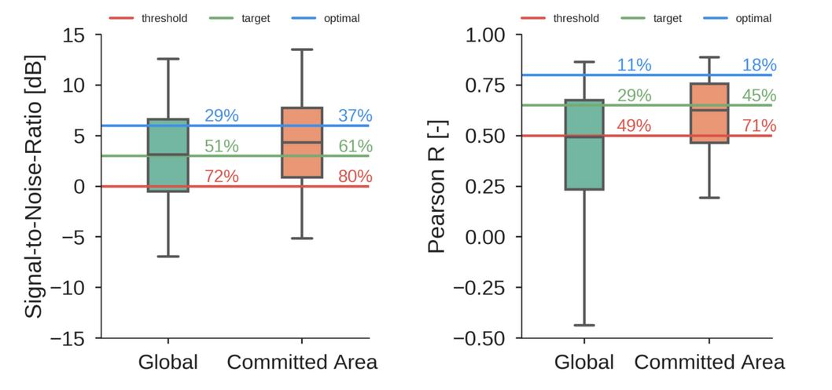
Terminology for 3-Level Approach
OSCAR: threshold – breakthrough – goal
EUMETSAT H-SAF: threshold – target - optimal
On-line Validation Report for H111 Metop ASCAT DR2017 SSM time series 12.5 km sampling
http://rs.geo.tuwien.ac.at/h-saf/H111/report.html

Slide 6
