Slide 1

ECV Requirements
How should we define ECV and their requirements?
Simon Eggleston

Slide 2
Essential Climate Variables (ECV)
are physical, chemical or biological variable or group of linked variables that critically contributes to the characterization of Earth’s climate.
provide the empirical evidence needed
  to understand and predict the evolution of climate,
  to guide mitigation and adaptation measures,
  to assess risks
  enable attribution of climatic events to underlying causes, and
  to underpin climate services.
must not be understood as a select group of stand-alone variables; they are part of a wider concept

Slide 3
ECV are:
Relevant:
  The variable is critical for characterizing the climate system and its changes;
Feasible:
  Observing or deriving the variable on a global scale is technically feasible, using proven, scientifically understood methods;
Cost-effective:
  Generating and archiving data on the variable is affordable, mainly relying on coordinated observing systems using proven technology, taking advantage where possible of historical datasets.
Schematic of the ECV concept (Source: Bojinski, et al, BAMS, 2014).

Slide 4

Precipitation, Cloud Properties,
Water Vapour Surface Temperature
Ocean Acidification
Carbon Dioxide,
Methane
Deforestation
Mitigation
Ecosystem Loss
Sea Level Rise
Fisheries
Water
Also need to monitor
changes in Ecosystems
Carbon
Sea Surface
& Subsurface Salinity,
Sea Level,
Sea Surface Temperature
Soil Moisture,
River Discharge,
Lakes, Groundwater, Cryosphere, Water use
Inorganic Carbon
Soil Carbon,
Above-ground Biomass, Fire, GHG Fluxes
Coral Bleaching
Agriculture
Human Health
Floods
Droughts
Water Resources
Storms
Radiation Budgets, Temperature Wind speed & direction
Systemic Risks
Security
Slow Economic Development
Energy
Ocean Surface Heat Flux, Sea Surface & Subsurface Temperature,
Albedo,
Latent and Sensible Heat fluxes, Land Surface Temperature
Temperature
Heat waves
Global Climate Cycles

Slide 5
Climate Cycle Targets
Closing the carbon budget
Targets | Quantify fluxes of carbon-related greenhouse gases to +/- 10% on annual timescales Quantify changes in carbon stocks to +/- 10% on decadal timescales in the ocean and on land, and to +/- 2.5 % in the atmosphere on annual timescales
Closing the global water cycle
Targets | Close water cycle globally within 5% on annual timescales
Explain changing conditions of the biosphere
Targets | Measured ECVs that are accurate enough to explain changes of the biosphere (for example, species composition, biodiversity, etc.)
Closing the global energy balance
Targets | Balance energy budget to within 0.1 Wm⁻² on annual timescales

Slide 6



Essential Climate Variables (ECVs) 2016
Atmospheric | Surface | Oceanic | Physics | Terrestrial | Hydrology
 | Air temperature, Wind speed and direction, Water vapour, Pressure, Precipitation, Surface radiation budget. |  | Subsurface temperature, subsurface salinity, Subsurface currents, Ocean surface stress, ocean-surface heat flux, sea-surface temperature, surface currents, sea-surface salinity, sea level, sea state, sea ice |  | River discharge, groundwater, soil moisture, lakes
 |  |  |  |  | Cryosphere
 |  |  |  |  | Snow, glaciers, ice sheets and ice shelves, Permafrost
 | Upper-air
 | Temperature, Wind speed and direction, Water vapour, Cloud properties, Earth radiation budget, Lightning |  |  |  | Biosphere:
 |  |  |  |  | Albedo, land cover, fraction of absorbed photosynthetically active radiation, leaf area index, above-ground biomass, fire, land-surface temperature, soil carbon
 |  |  | Biogeochemistry
 |  |  | Inorganic carbon, oxygen, nutrients, transient tracers, nitrous oxide (N₂O), ocean colour
 | Composition
 | Carbon Dioxide (CO₂), Methane (CH₄), Other long-lived greenhouse gases (GHGs), Ozone, Aerosol, Precursors for aerosol and ozone.
 |  |  | Biology/ecosystems
 |  |  | Plankton, marine habitat properties |  | Human use of natural resources:
 |  |  |  |  | Water use, Anthropogenic Greenhouse Gas fluxes

Slide 7
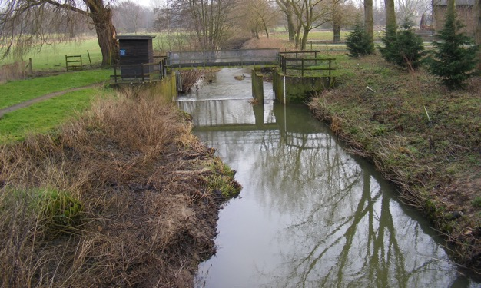
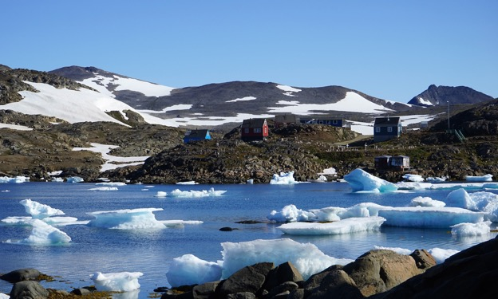
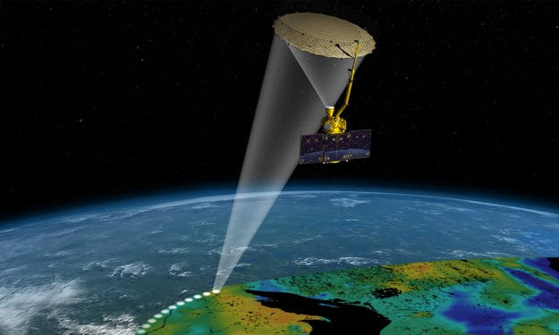
ECV | Products
River discharge | River discharge
 | Water Level
 | Flow velocity
 | Cross-section
Lakes | Lake water level
 | Water extent
 | Lake surface-water temperature
 | Lake-ice thickness
 | Lake-ice cover
 | Lake colour (Lake water-leaving reflectance)
Soil moisture | Surface soil moisture
 | Freeze/thaw
 | Surface inundation
 | Root-zone soil moisture
Are these all needed by users? Are some only used to derive river discharge?
GCOS Implementation Plan (GCOS-200, annex A) gives requirements for each ECV
In general there are more than one item to be observed for each ECV
  They were called ‘products’
  These are not always well defined
Are there any missing ECV needed to characterise the global climate cycles?
Are these all well defined?
How do ice thickness and ice cover differ?
Are these all well defined? What is surface inundation? Root zone?

Slide 8
ECV | Products | Frequency | Resolution | Required measurement uncertainty | Stability
River discharge | River discharge | Daily | Per river | 10 % (relative)
 | Water Level | Daily | 100 m | 10 cm | 1 cm/yr
 | Flow velocity | Few times per year | Per river | 10 % (relative)
 | Cross-section | Few times per year | Per river | 10 % (relative)
Lakes | Lake water level | Daily | 100 m | 3 cm for large lakes, 10 cm for the remainder | 1 cm/decade
 | Water extent | Daily | 20 m | 10 % (relative) 5% (for 70 largest lakes) | 5%/decade
 | Lake surface-water temperature | Weekly | 300 m | 1 K | 0.1 K/decade
 | Lake-ice thickness | Monthly | 100m | 1–2 cm
 | Lake-ice cover | Daily | 300 m | 10 % | 1 % /decade
 | Lake colour (Lake water-leaving reflectance) | Weekly | 300 m | 30 % | 1 %/decade
Soil moisture | Surface soil moisture | Daily | 1–25 km | 0.04 m³/m³ | 0.01 m³/m³/year
 | Freeze/thaw | Daily | 1–25 km | 90 % | TBD
 | Surface inundation | Daily | 1–25 km | 90 % | TBD
 | Root-zone soil moisture | Daily | 1–25 km | 0.04 m³/m³ | 0.01 m³/m³/year

Slide 9
GCOS
ECV Product Requirements
Processing observations into ECV Products
Data provided to users
Feedback
User Needs, assessed by science panels for feasibility and cost.
Observations
Feedback

Slide 10
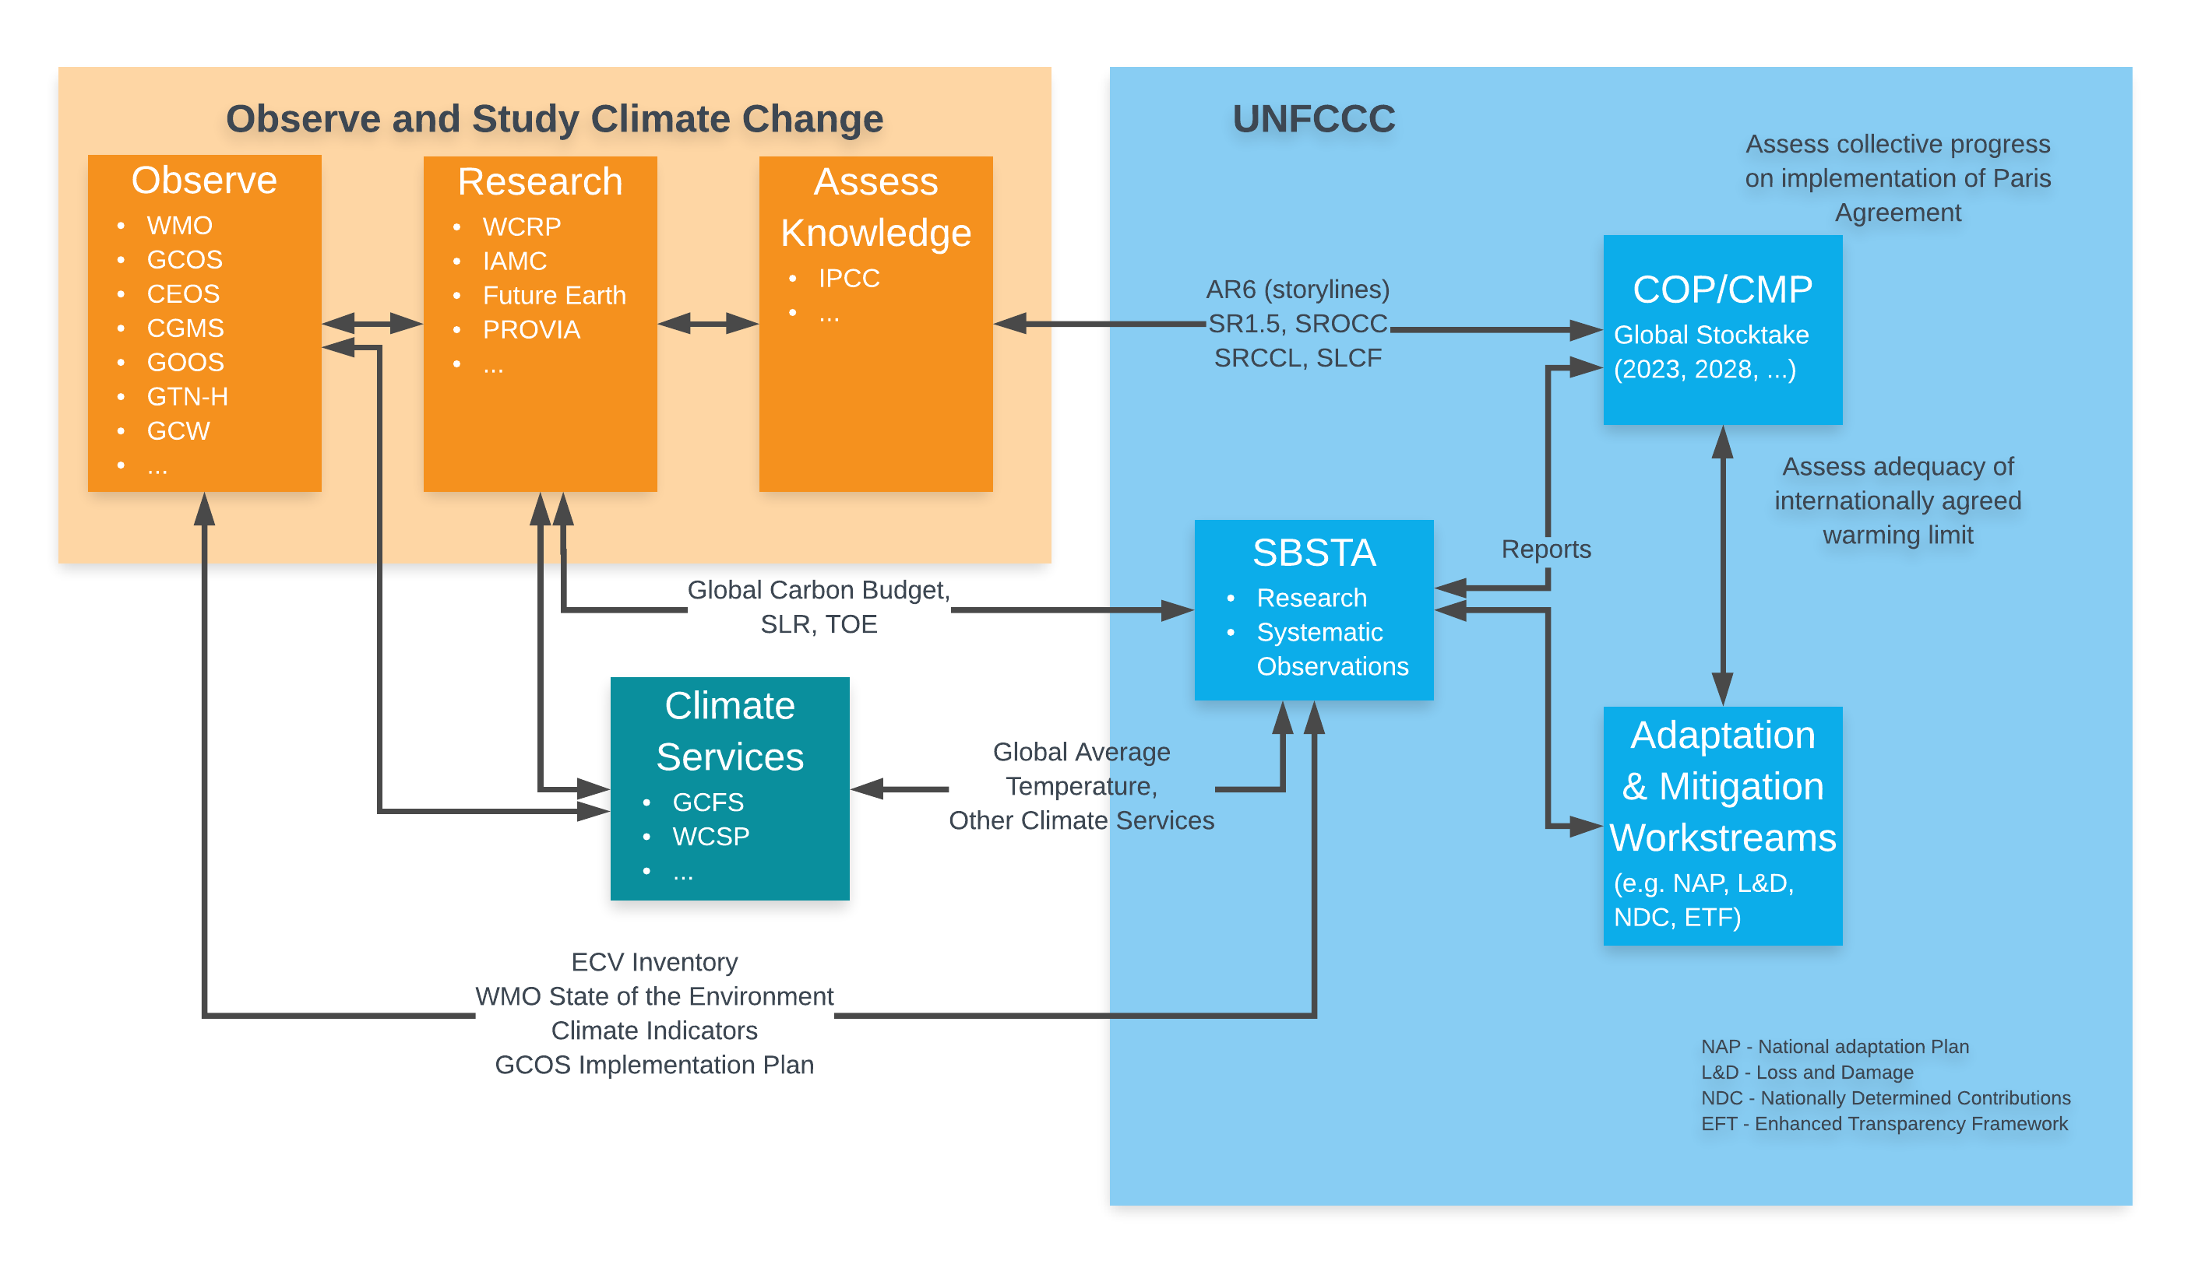
Information Exchange: Climate Observations to Policy and Action
Who are “users”?

Slide 11
Defining requirements in the future
 | Requirements for Climate Monitoring
The goal, the level to be aimed at where further improvements lead to little or no additional benefits. This would be sufficient for all climate applications | ✔
OSCAR has a third, intermediate level but the usefulness of this is unclear in climate monitoring where capabilities are changing and users needs being refined | Retain information on specific applications
The threshold: the minimum needed to produce useful climate information. This would be sufficient for some applications but not all. | ✔

Slide 12
Some Questions
Should the ECV what a user needs or what satisfies scientific curiosity?
Are the requirements what is measured now ar aspirational – what we think should be measured?
Is the ECV what is actually observed OR the parameter that is needed?
  Satellites generally measure optical or microwave radiation…
Is the ECV requirement what the user needs or what needs to be observed to achieve that requirement?
  A user may need gridded precipitation. Should the ECV be accuracy per grid cell, or accuracy per rain gauge?
  Should the resolution be the grid size needed by the user OR the spatial separation of the stations?
  A user may use outputs from reanalysis and/or models not observations directly
Climate cycles
  Would meeting the requirements achieve the targets for the climate cycles?
  Are there any missing ECV needed to characterise the global climate cycles?

Slide 13
Breakout Groups
 | Cryosphere | Biosphere | Hydrosphere
Wolfgang Wagner |  |  | XX
Nadine Gobron |  | XX
Mathew McCabe |  |  | X
Sassan Saachi |  | X
Kevin Tansey |  | X
Nigel Tapper |  |  | X
Stephan Dietrich |  |  | X
Hiroyuki Enomoto | X
Martin Herold |  | X
Philippe Schoeneich | X
Michael Zemp | XX
Pierre-Philippe Mathieu |  | X
Valentin |  |  | X
Simon |  | X
Tim | X

Slide 14


thank you
gcos.wmo.int
@gcos_un

