Slide 1
Air-sea heat flux and wind stress Ocean ECVs: relation to AOPC
Elizabeth Kent & Robert Weller

Slide 2
Atmospheric ECVs

Slide 3
September 16-20, 2019 Hawai’i Convention Center

Slide 4
September 16-20, 2019
Hawai’i Convention Center
Honolulu, HI, USA
For more info:
www.oceanobs19.net
info@oceanobs19.net
OceanObs’19: An Ocean of Opportunity:
1200 ocean observing scientists, program managers, policy experts, and users expected
7 continents represented, including solicitation and publication of conference white papers
3 organizing committees (Program, Sponsor, Local Organizing)
Conference Themes*
Goal
Charting the next decade of ocean observing
“Connecting observers with users”
Interacting with the observing community through
planning teams and call for papers (18 Dec 2017)
Input
Building on the Framework for Ocean Observing
(FOO) developed at OceanObs’09
Framework
Registration in Fall 2018.
Check website for updates
Register

Slide 5
Conference Overview
Hawai’i Convention Center
16-20 September 2019 (571 Days!)
Anchor Sponsor: NASA
Co-Sponsors: WMO, IOC, ICSU, GEO, GCOS, NSF, NOAA, ESA, MERCATOR, SOA, IMOS and growing!
Main goal/s: Further develop effective strategies for a sustained, multidisciplinary, and integrated ocean observing system, and to better connect user communities and observers.
User communities: Engage operational users, national and local authorities as well as researchers in both the public and private sectors in all aspects of ocean observing.
International engagement: Closer interaction to improve governance arrangements, support observing networks, data flows and derived products and their use in ocean affairs.

Slide 6
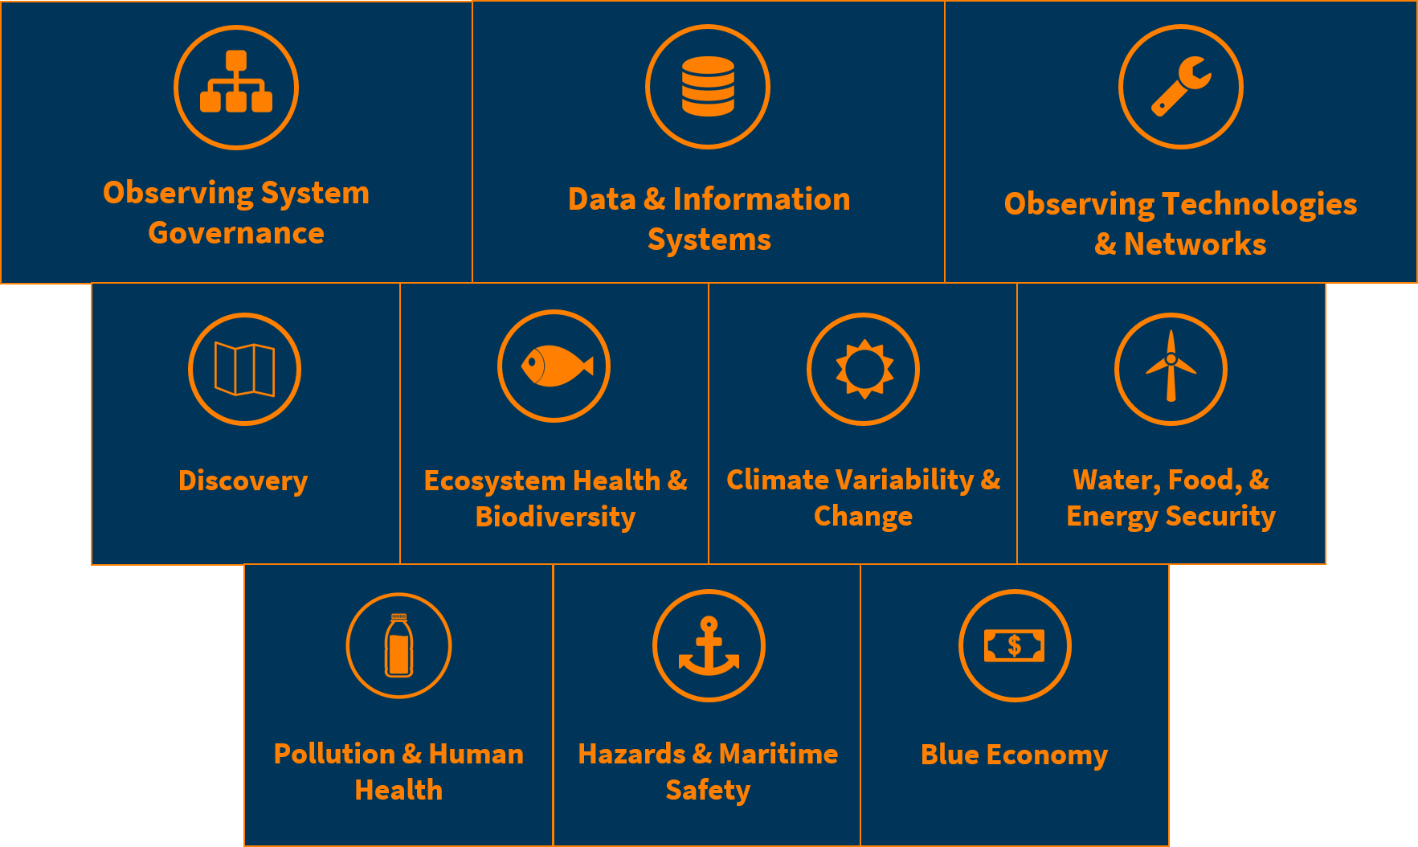
Conference Themes (Preliminary)
The societal benefit themes will be examined by their relationship to Ocean Observing and how information products can be best supported through the observing system themes.
Overarching Themes
Societal Themes

Slide 7
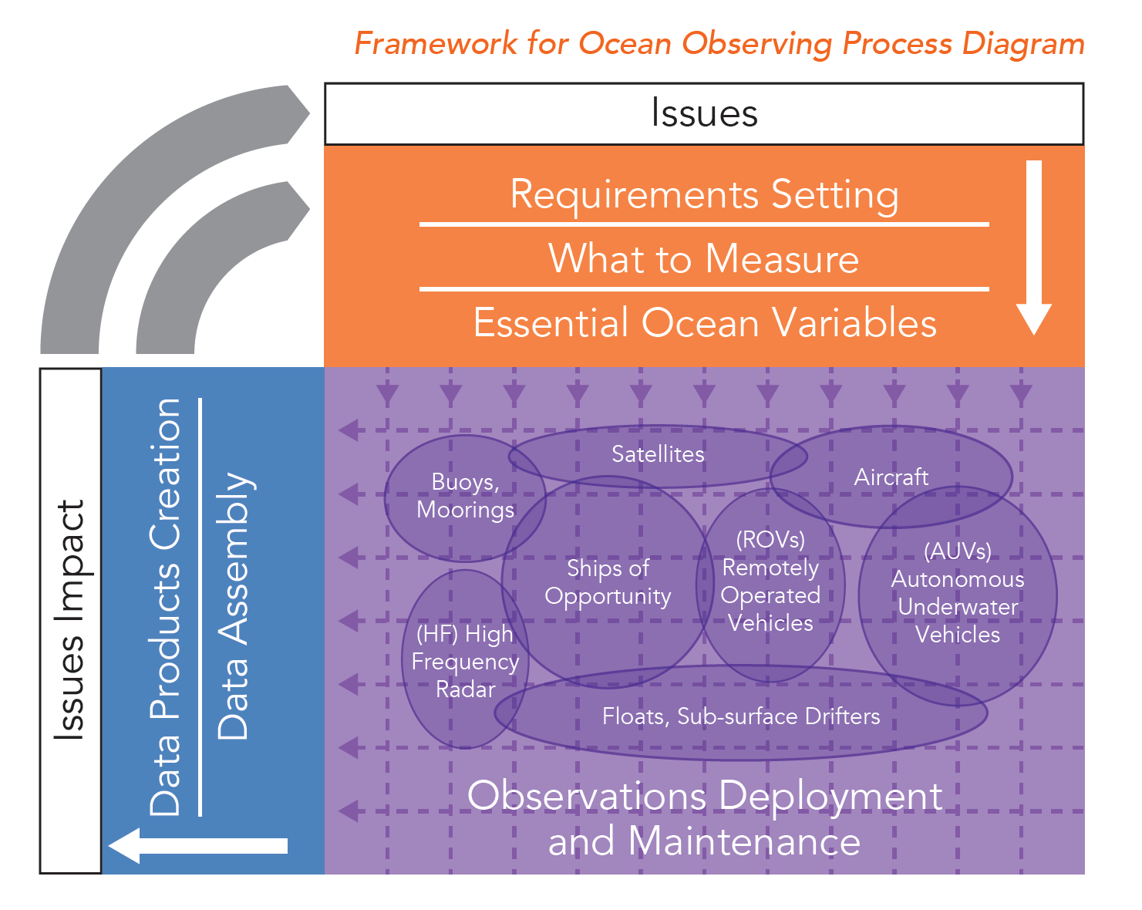
Framework for Ocean Observing (FOO)
OceanObs’19 will build on the success generated by the Framework developed at OceanObs’09.
Experts will work during the lead up to the conference to identify opportunities and drawbacks, which will be articulated prior to, and during OceanObs’19.
We expect to develop a number of follow-up activities including update of existing processes.

Slide 8
OceanObs19 abstracts planned
Include ..
Air-sea fluxes
Observations for surface marine climate records
Marine climate data system
Also decadal vision statements for each of JCOMM observing networks

Slide 9
JCOMM working to establish climate KPIs
The WMO RRR approach has proved problematic:
swift delivery isn't always important for climate data products
not always desirable to combine all types of observations
may want in situ only, or to withhold some high quality data for validation
widely spaced observations/platforms give good coverage but make it hard to assess quality through e.g. "buddy checks"
Need requirements for accurate large space and time averages (e.g. global, hemispheric and basin annual means with good stability over time)
need assessments of data uncertainty for each ECV and obs. type
recognise need for multi-variate observations with metadata
understand the roles of different types of marine observations
Feed back requirements and assessments to GCOS

Slide 10
Air-sea fluxes – surface heat flux and wind stress on a global basis: is it possible?
From: R. Weller, WHOI
TOGA Coupled Ocean Atmosphere Response Experiment lessons from an air-sea flux perspective (Weller et al., 2004).
You can bring diverse platforms and heterogeneous sensors together and close upper ocean heat and freshwater budgets, with accurate surface fluxes being one component.
To do so you should:
Make high quality in-situ observations from long-term moorings (surface flux reference sites) and from ships;
Commit to dedicated in-situ intercomparison periods, especially of ships and moorings;
Commit to pre and post-deployment calibrations, and additional studies as needed to resolve cross-platform differences;
Continue intercomparisons and evaluations of flux products from different sources;
Have ongoing interaction between the NWP centers and these sources of high quality surface observations both to improve and validate the models;
Conduct further field work in the ocean and atmospheric boundary layers, especially in regimes (low wind and high wind) not yet well sampled and continue flux algorithm development; and
Continue support for compilation of flux datasets and for efforts to identify and correct biases.

Slide 11
Air-sea fluxes – surface heat flux and wind stress on a global basis
From: R. Weller, WHOI
Strategy relies on ‘surface flux reference sites’ at critical and representative sites
Accurate, high time resolution
Sustained
Co-located observation of upper ocean T(z), S(z), U(z)
Dedicated intercomparisons, calibrations, improvements to establish/improve accuracy
Direct turbulent fluxes & waves at select sites; algorithm development
Q_{net} may include compensating errors in its components
Observe all components
Blended, hybrid, satellite products require regional ‘tuning’
Marine stratus, large scale atmospheric subsidence, cold/dry, Saharan dust,….
Critical areas – high amplitude, small spatial scale, strong temporal signal
Critical areas – data sparse, large disagreements in products
Ongoing comparisons of in-situ vs model/remote sensing/blended/hybrid fields drive improvement and delivery of fluxes as EOV

Slide 12
Air-sea fluxes – surface heat flux and wind stress on a global basis: developing the strategy
From: R. Weller, WHOI
The background report captured two sets of requirements, for the broad scale and high resolution, recognizing special regions
Global , broad scale sampling
High resolution sampling

Slide 13
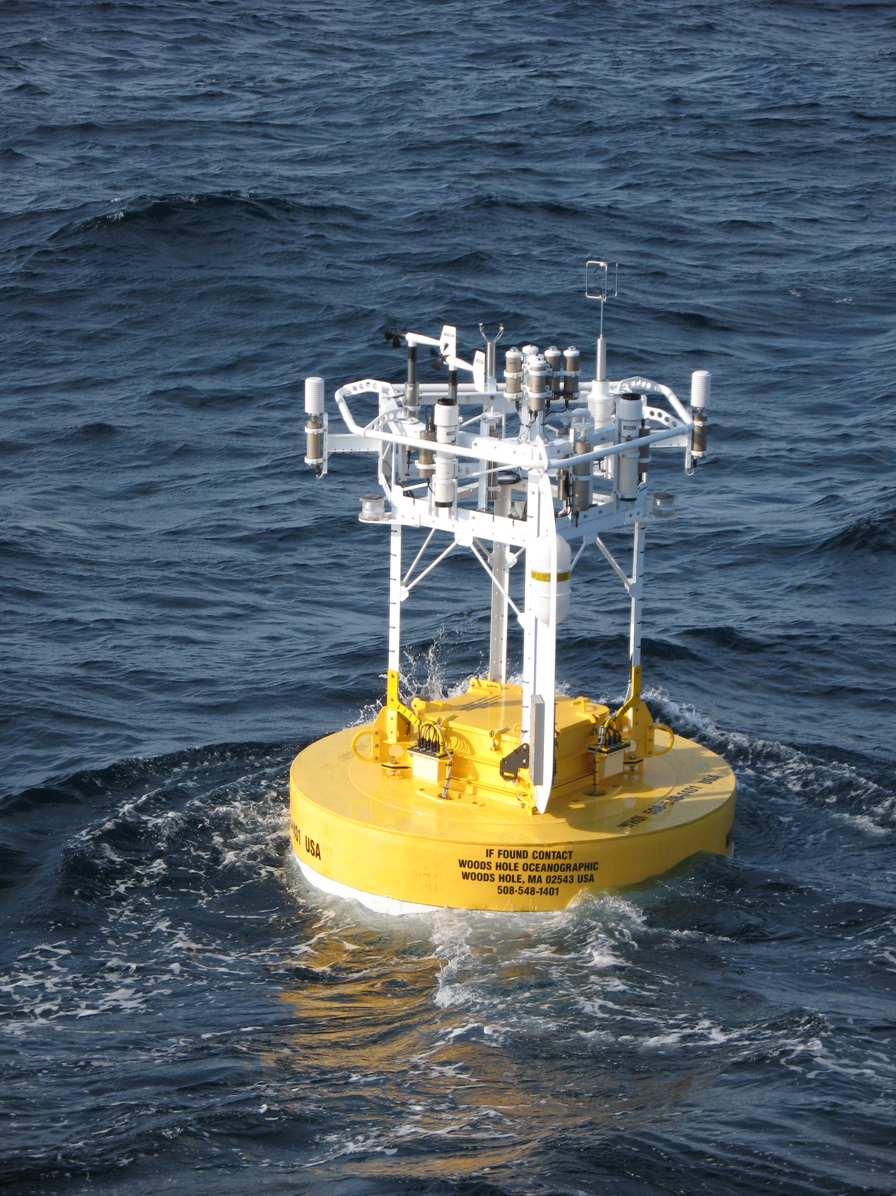
Air-sea fluxes – surface heat flux and wind stress on a global basis: enabling progress
From: R. Weller, WHOI
Continuing improvements to bulk formulae, to in-situ sensing
Present – once per minute surface meteorology, 2 to 3 redundant systems plus Direct Covariance Flux
Developing – increased power generation and directional antenna for 2-way, higher bandwidth telemetry

Slide 14
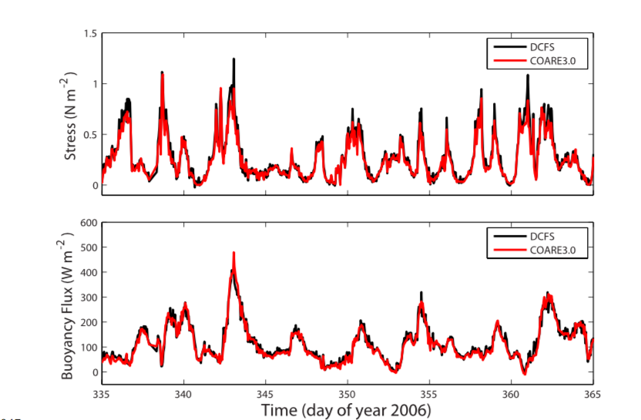
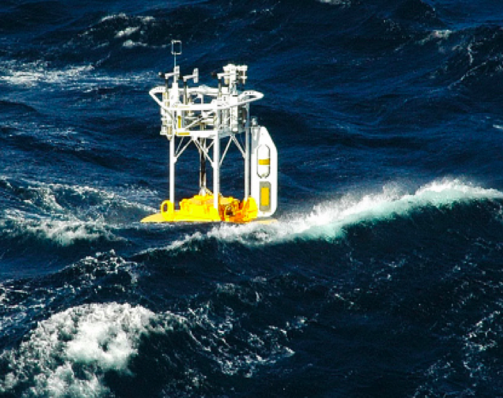
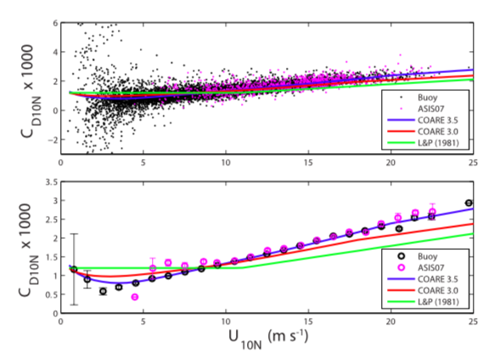
Air-sea fluxes – surface heat flux and wind stress on a global basis: enabling progress
From: R. Weller, WHOI
Continuing improvements to bulk formulae, to in-situ sensing, to integration of Direct Covariance Flux Systems (DCFS)
Buoy bulk stress and buoyancy flux with COARE 3.0 vs DCFS stress and buoyancy flux
Drag coefficient versus wind speed (top); changes to drag coefficient for COARE 3.5
Surface buoy in Gulf Stream
Bigorre et al. (2013)

Slide 15
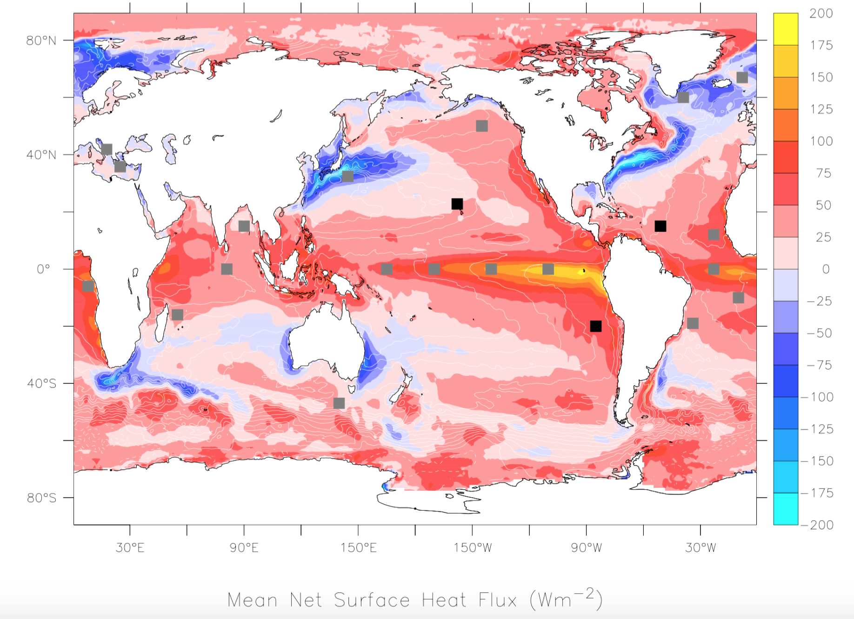
Air-sea fluxes – surface heat flux and wind stress on a global basis: enabling progress
From: R. Weller, WHOI
Improvements to mooring technology enabling deployments not only in challenging regimes such as western boundary currents but also at higher latitudes

Slide 16
Air-sea fluxes – surface heat flux and wind stress on a global basis: elements of the strategy
From: R. Weller, WHOI
Surface flux reference sites
Time series moorings, sustained, high temporal resolution
Representative and critical sites, ~10 per ocean basin
Well-instrumented VOS
Include supply ships going to polar regions
Select upgraded routes for spatial structure and representativeness of flux reference sites
Gridded products (reanalysis, satellite, blended)
Tuned/validated against flux reference sites
Ongoing, facilitated comparisons
Attention to quality, improvement
Dedicated in-situ comparisons
Sensor and bulk formulae improvements
Hybrid products with assimilation and/or constraints

