Slide 1
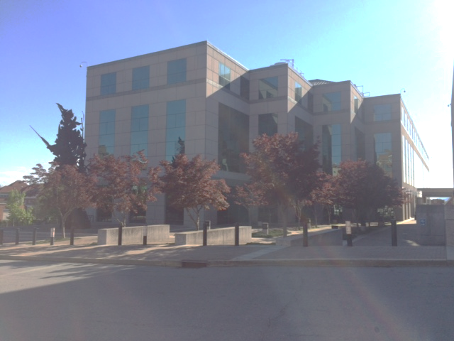
Informational Presentation
Imke Durre
NOAA National Centers for Environmental Information, Asheville, North Carolina, USA
NOAA Satellite and Information Service | National Centers for Environmental Information

Slide 2
What is NCEI?
Steward of oceanic, atmospheric, and geophysical data
Responsible for preserving, monitoring, assessing, and providing public access

Slide 3
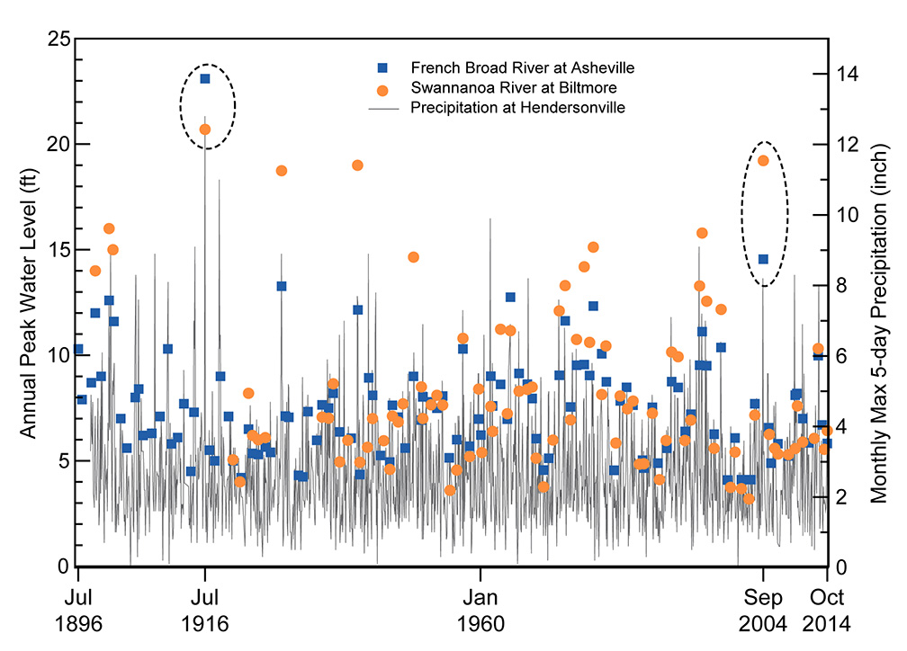
Description of Historical Events Using Multiple Sources
Annual Peak Water Level (ft)
The annual peak water level at Asheville and Biltmore and monthly maximum 5-day precipitation at Hendersonville from 1896 through 2014. The 1916 and 2004 flood events
are circled.

Slide 4
Description of Historical Events Using Multiple Sources
The Progression of the Charleston Storm

Slide 5
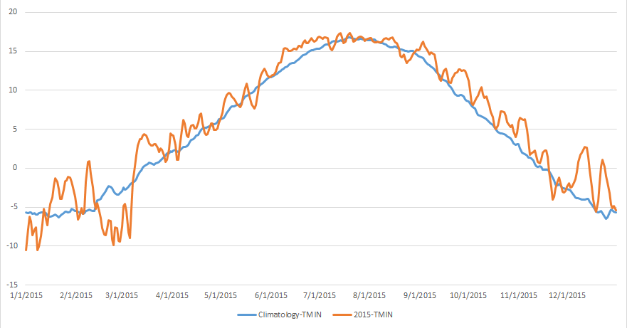
Sub-monthly Monitoring

Slide 6
Monitoring Data Reports: Daily Precipitation

Slide 7
End-to-End Data Processing
AOPC-23, Darmstadt, Germany, March 6-9, 2018

Slide 8
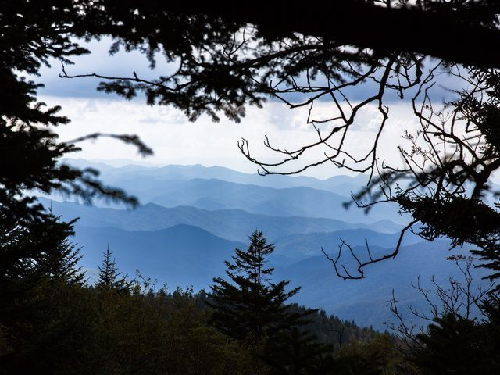
Blue Ridge Mountains

Slide 9
Monitoring Data Reports: Daily Max and Min Temperature

Slide 10
Monitoring Data Reports : Daily Average Temperature

Slide 11
Monitoring Data Reports : Sub-daily Synoptic Reports

