Slide 1


Anomalous Behavior of Lower Stratospheric O₃ and H₂O
Dale F. Hurst
Senior Research Scientist
NOAA ESRL/Global Monitoring Division, Boulder, Colorado
& CIRES, University of Colorado
AOPC 23 Darmstadt Mar 6-9, 2018

Slide 2
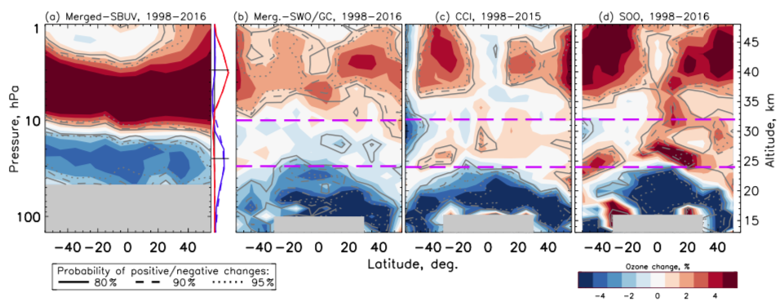
Trends in Stratospheric Ozone: 1998-2016
Zonal-average changes based on four merged satellite-based ozone records
SAGE II
Ozone_cci
OMPS
SAGE II
OSIRIS
OMPS
SBUV-NASA
SBUV-NOAA
SWOOSH
GOZCARDS
from Ball et al., ACP, 2018
AOPC 23 Darmstadt Mar 6-9, 2018

Slide 3
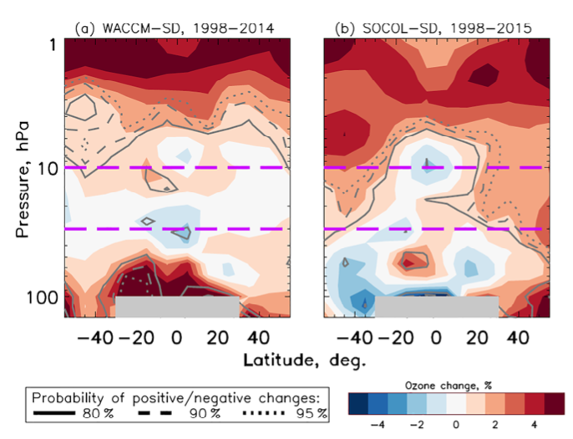
Trends in Stratospheric Ozone: 1998-2016
Zonal-average changes based on two Chemistry-Climate Models
WACCM-SD
SOCOL-SD
from Ball et al., ACP, 2018
AOPC 23 Darmstadt Mar 6-9, 2018

Slide 4
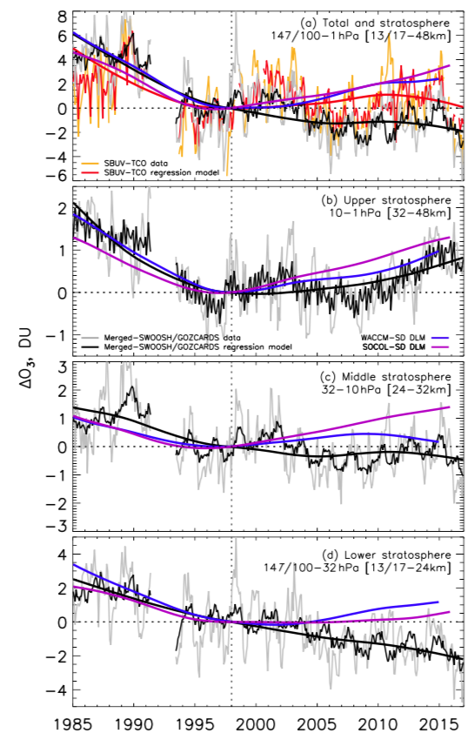

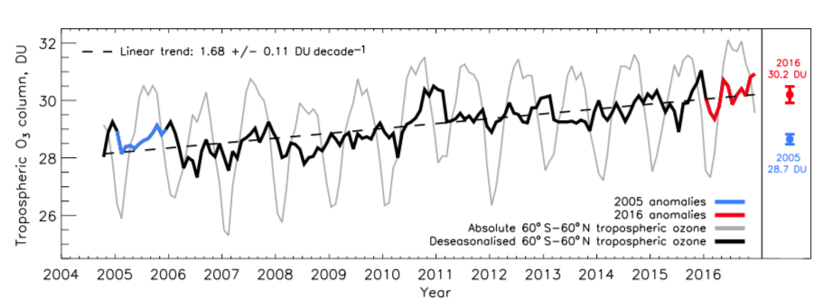
Trends in Stratospheric Ozone: 1998-2016
60°S – 60°N
Ball et al., ACP, 2018
Stratospheric Column
SWOOSH/GOZCARDS
WACCM-SD
SOCOL-SD
Total Column
SBUV
Middle Stratosphere
SWOOSH/GOZCARDS
WACCM-SD
SOCOL-SD
Upper Stratosphere
SWOOSH/GOZCARDS
WACCM-SD
SOCOL-SD
Tropospheric Ozone Column
Lower Stratosphere
SWOOSH/GOZCARDS
WACCM-SD
SOCOL-SD
-0.1 DU yr-1
AOPC 23 Darmstadt Mar 6-9, 2018

Slide 5
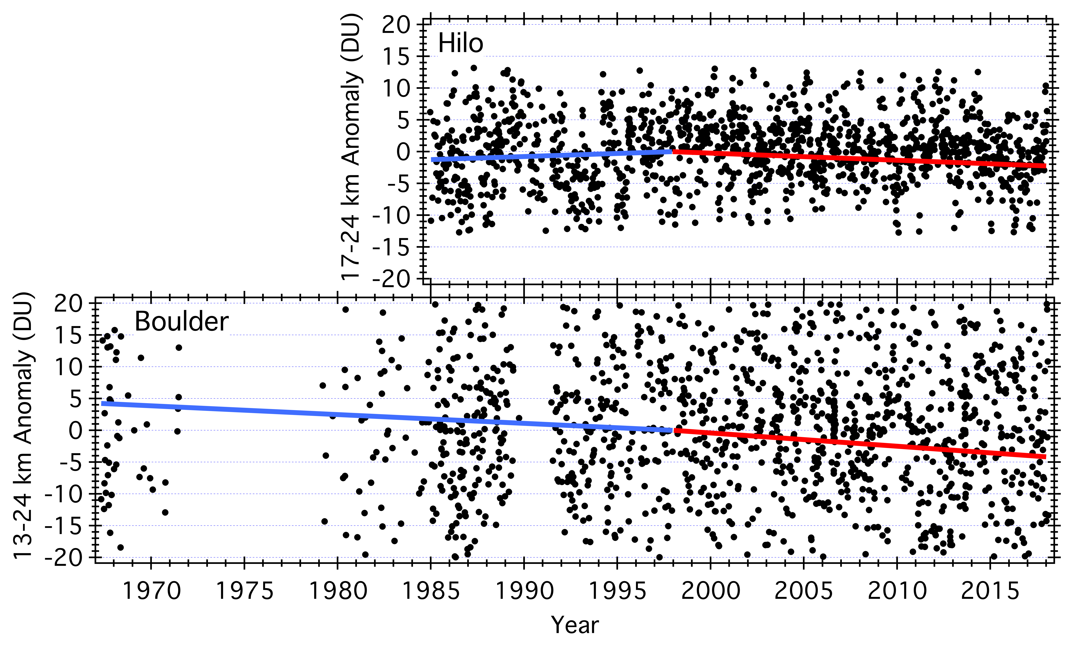
Verification of Downward Trend: ECC Ozonesondes
-0.11 ± 0.07
DU yr⁻¹
-0.21 ± 0.15
DU yr⁻¹
AOPC 23 Darmstadt Mar 6-9, 2018

Slide 6
Attribution
Strengthening of the shallow branch of the Brewer-Dobson circulation?
O₃-poor air
O₃-poor air
Mid-Lat
EQ
Mid-Lat
Mid-Lat
EQ
Mid-Lat
AOPC 23 Darmstadt Mar 6-9, 2018

Slide 7
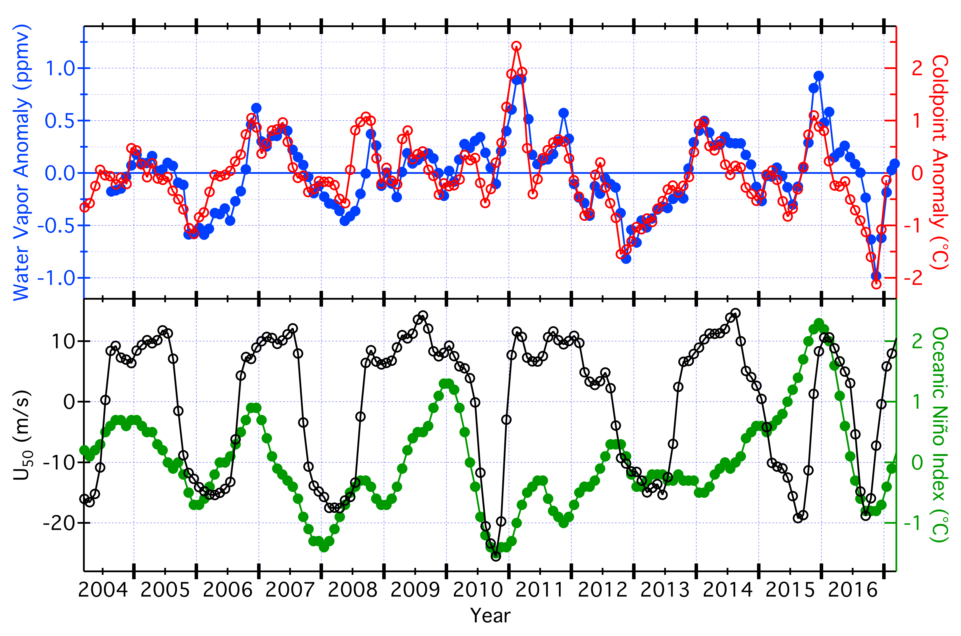
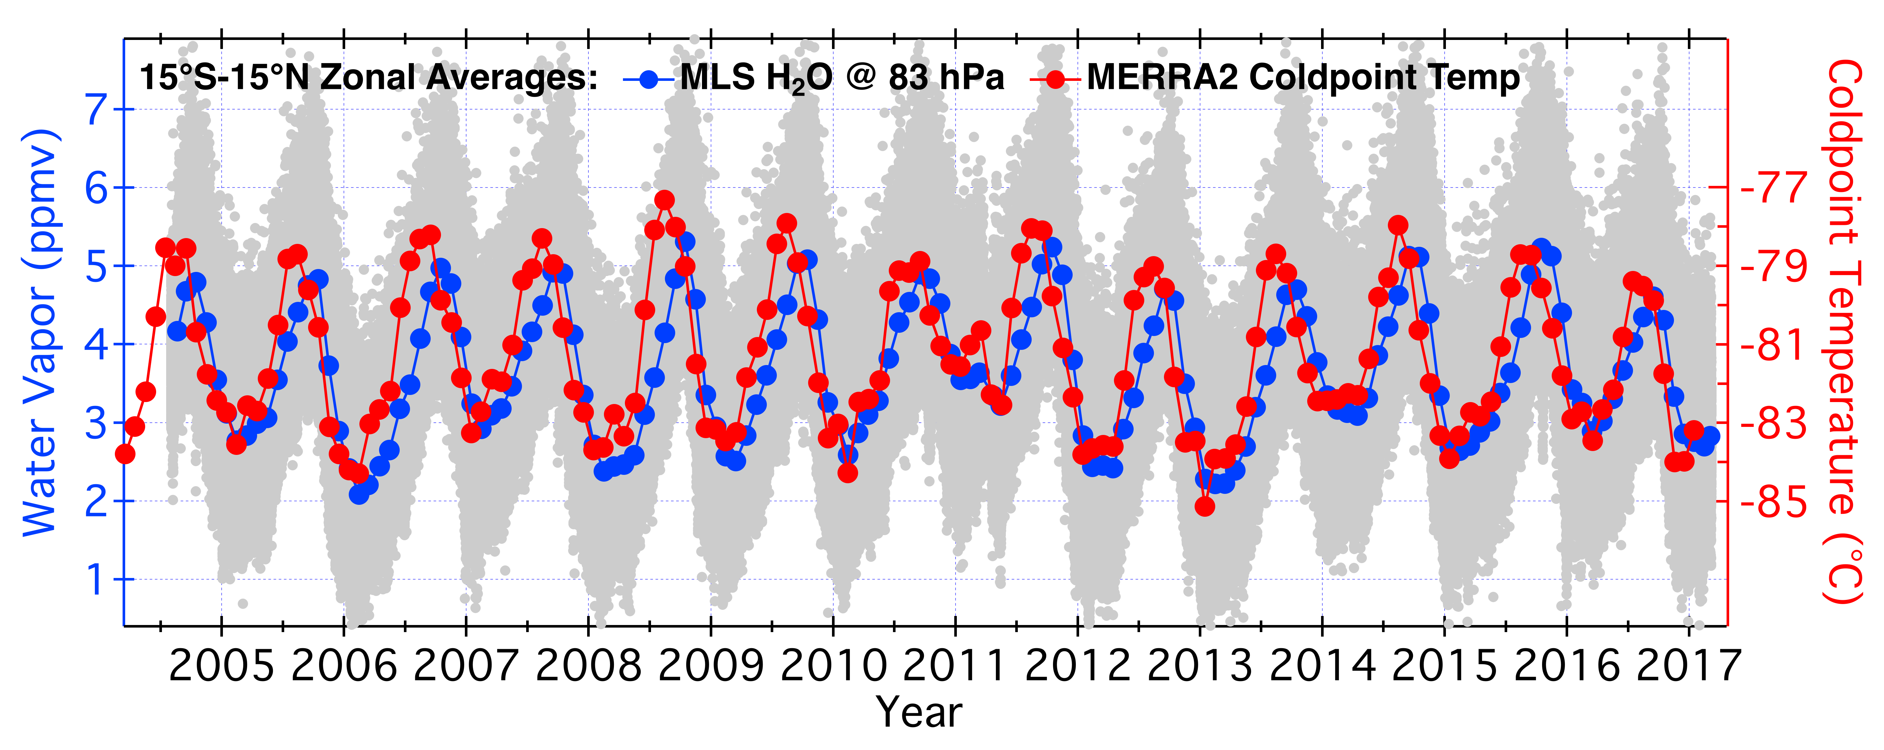
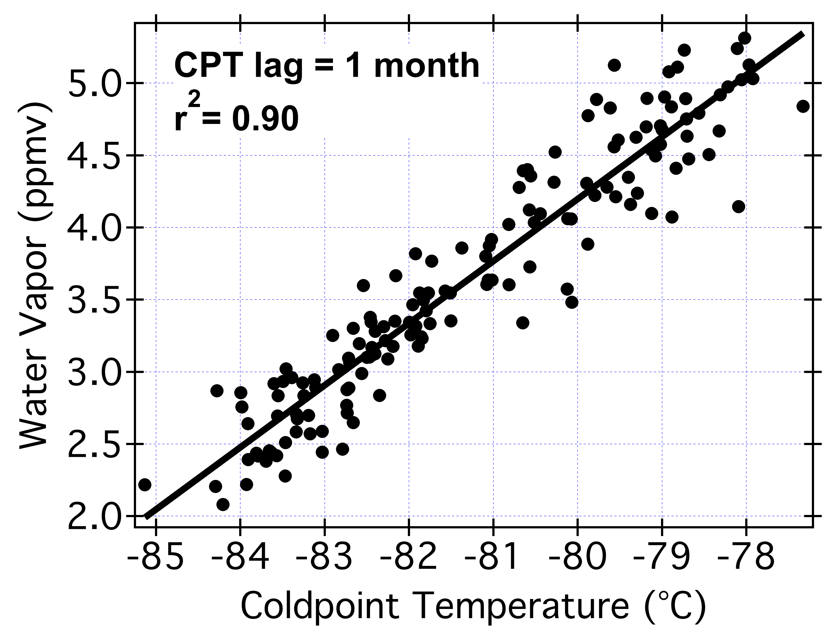
Monthly Avg Tropical Mean (15°S-15°N) Anomalies
What controls the amount of WV in the stratosphere?
ΔH₂O = -1.9 ppmv
ΔCPT = -3.1 °C
AOPC 23 Darmstadt Mar 6-9, 2018

Slide 8
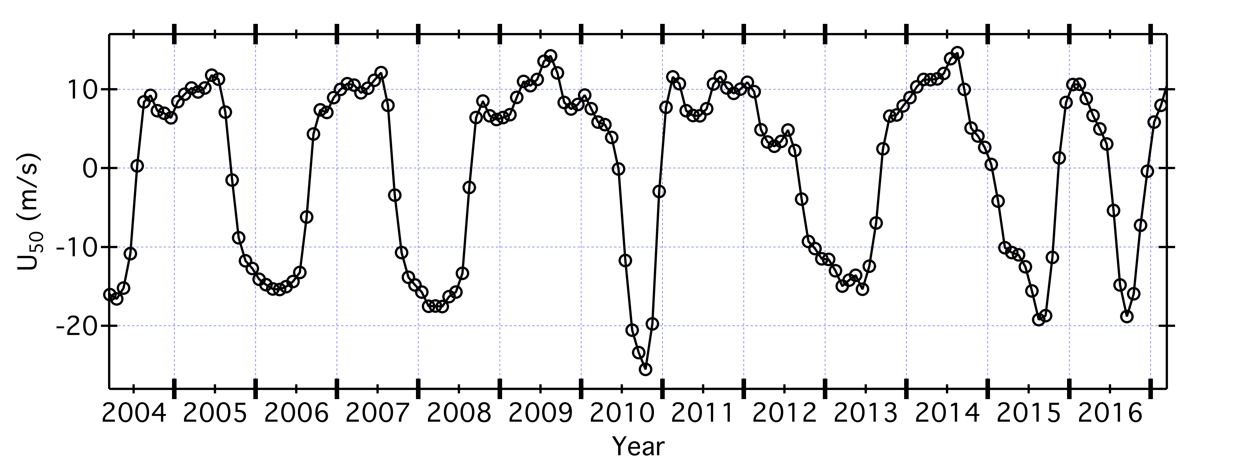
Tropical Mean Anomalies: QBO and ENSO
1
2
3
4
5
6
warm
cold
QBO Cycle
AOPC 23 Darmstadt Mar 6-9, 2018

Slide 9
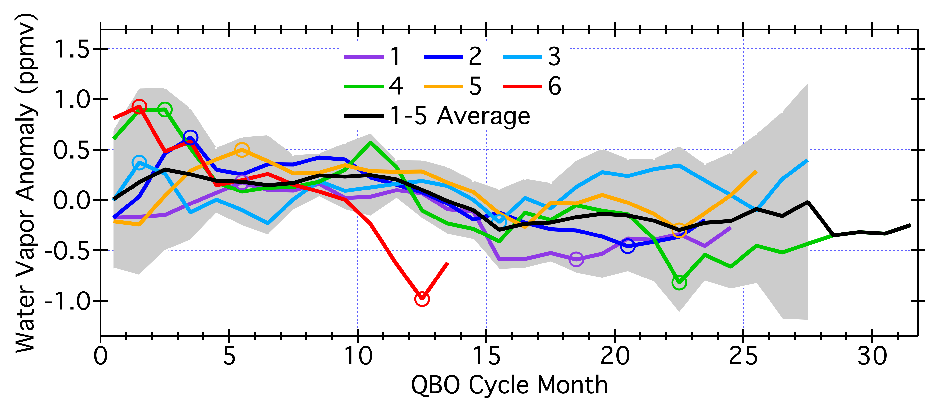
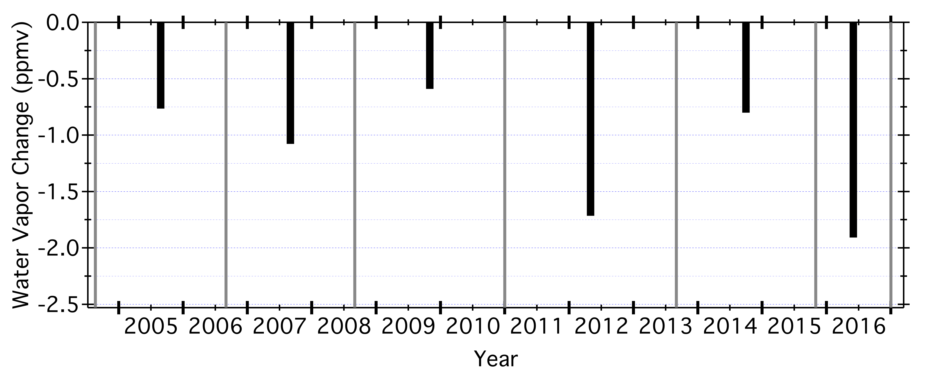
Decreases in Tropical Mean WV Anomalies, QBO cycles 1-6
Cycle 6 ΔH2O_{anom}
-1.9 ppmv in 11 mo
~50% of burden!
1
2
3
4
5
6
AOPC 23 Darmstadt Mar 6-9, 2018

Slide 10
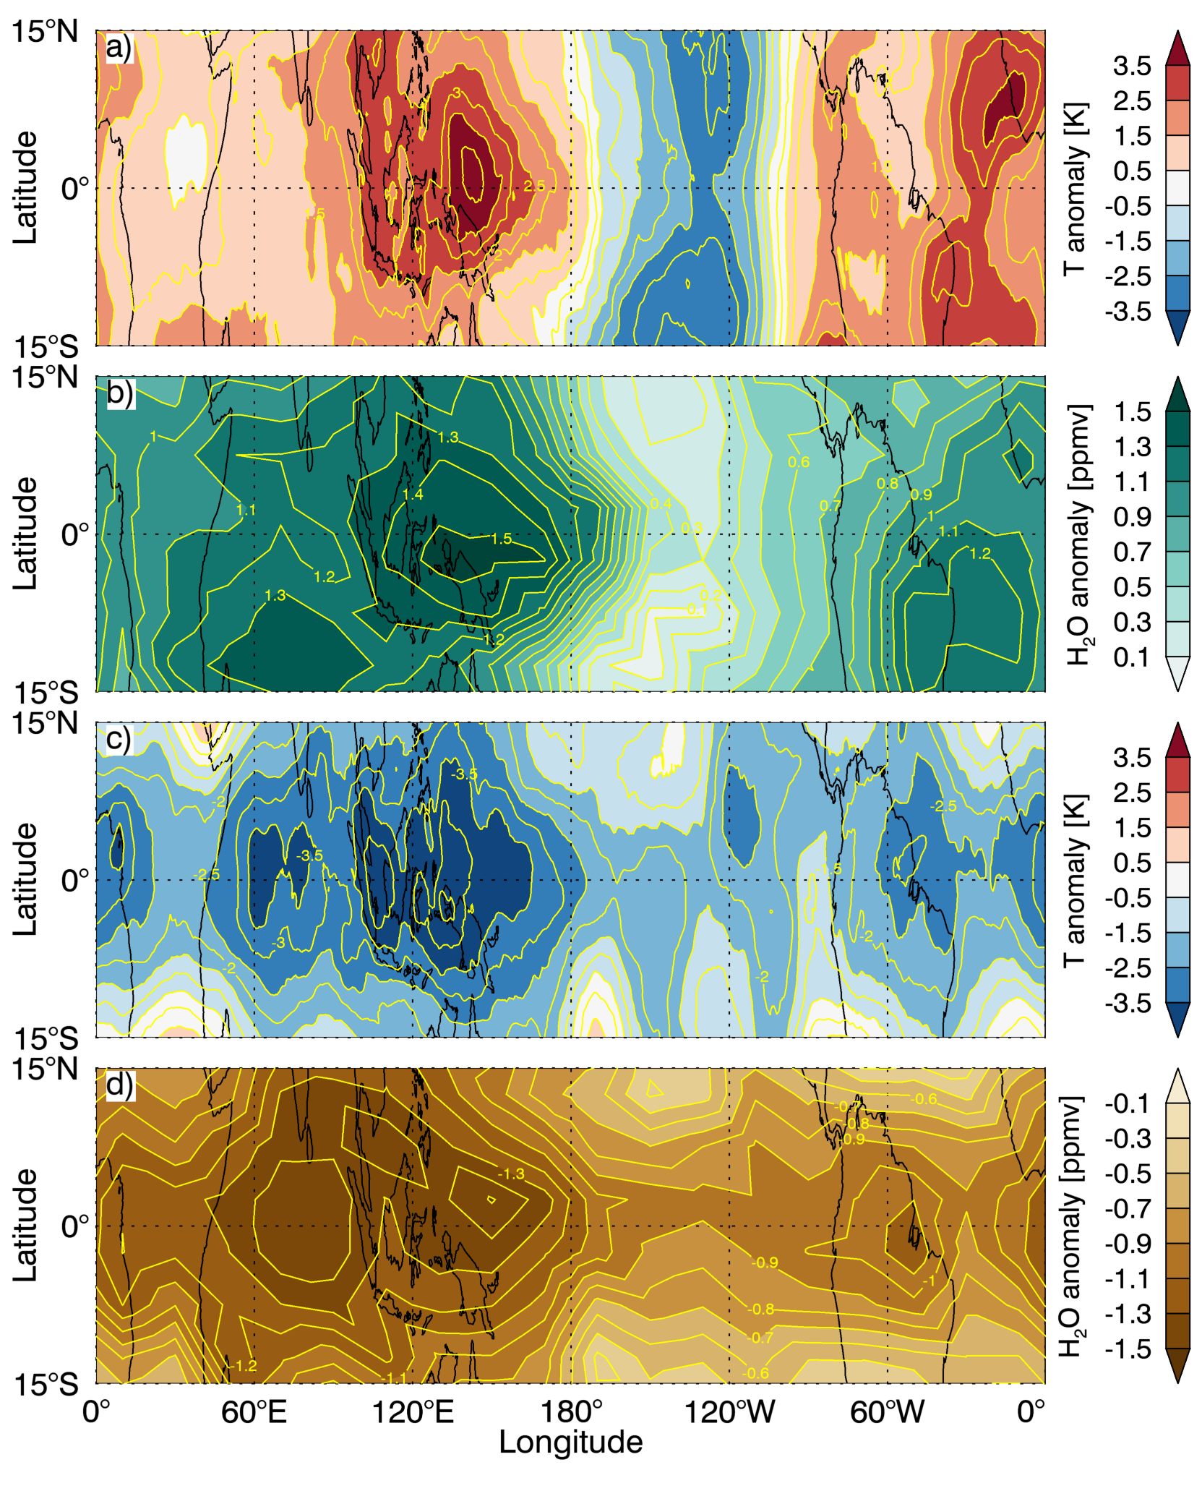
Tropical Coldpoint Temperature Anomalies: Dec 2015 & Nov 2016
Strong El Niño
QBO Warm
La Niña
QBO Cold
AOPC 23 Darmstadt Mar 6-9, 2018

Slide 11
Tropical Water Vapor Anomalies: Dec 2015 & Nov 2016
QBO Warm
E1
E2
W1
W2
QBO Cold
AOPC 23 Darmstadt Mar 6-9, 2018

Slide 12
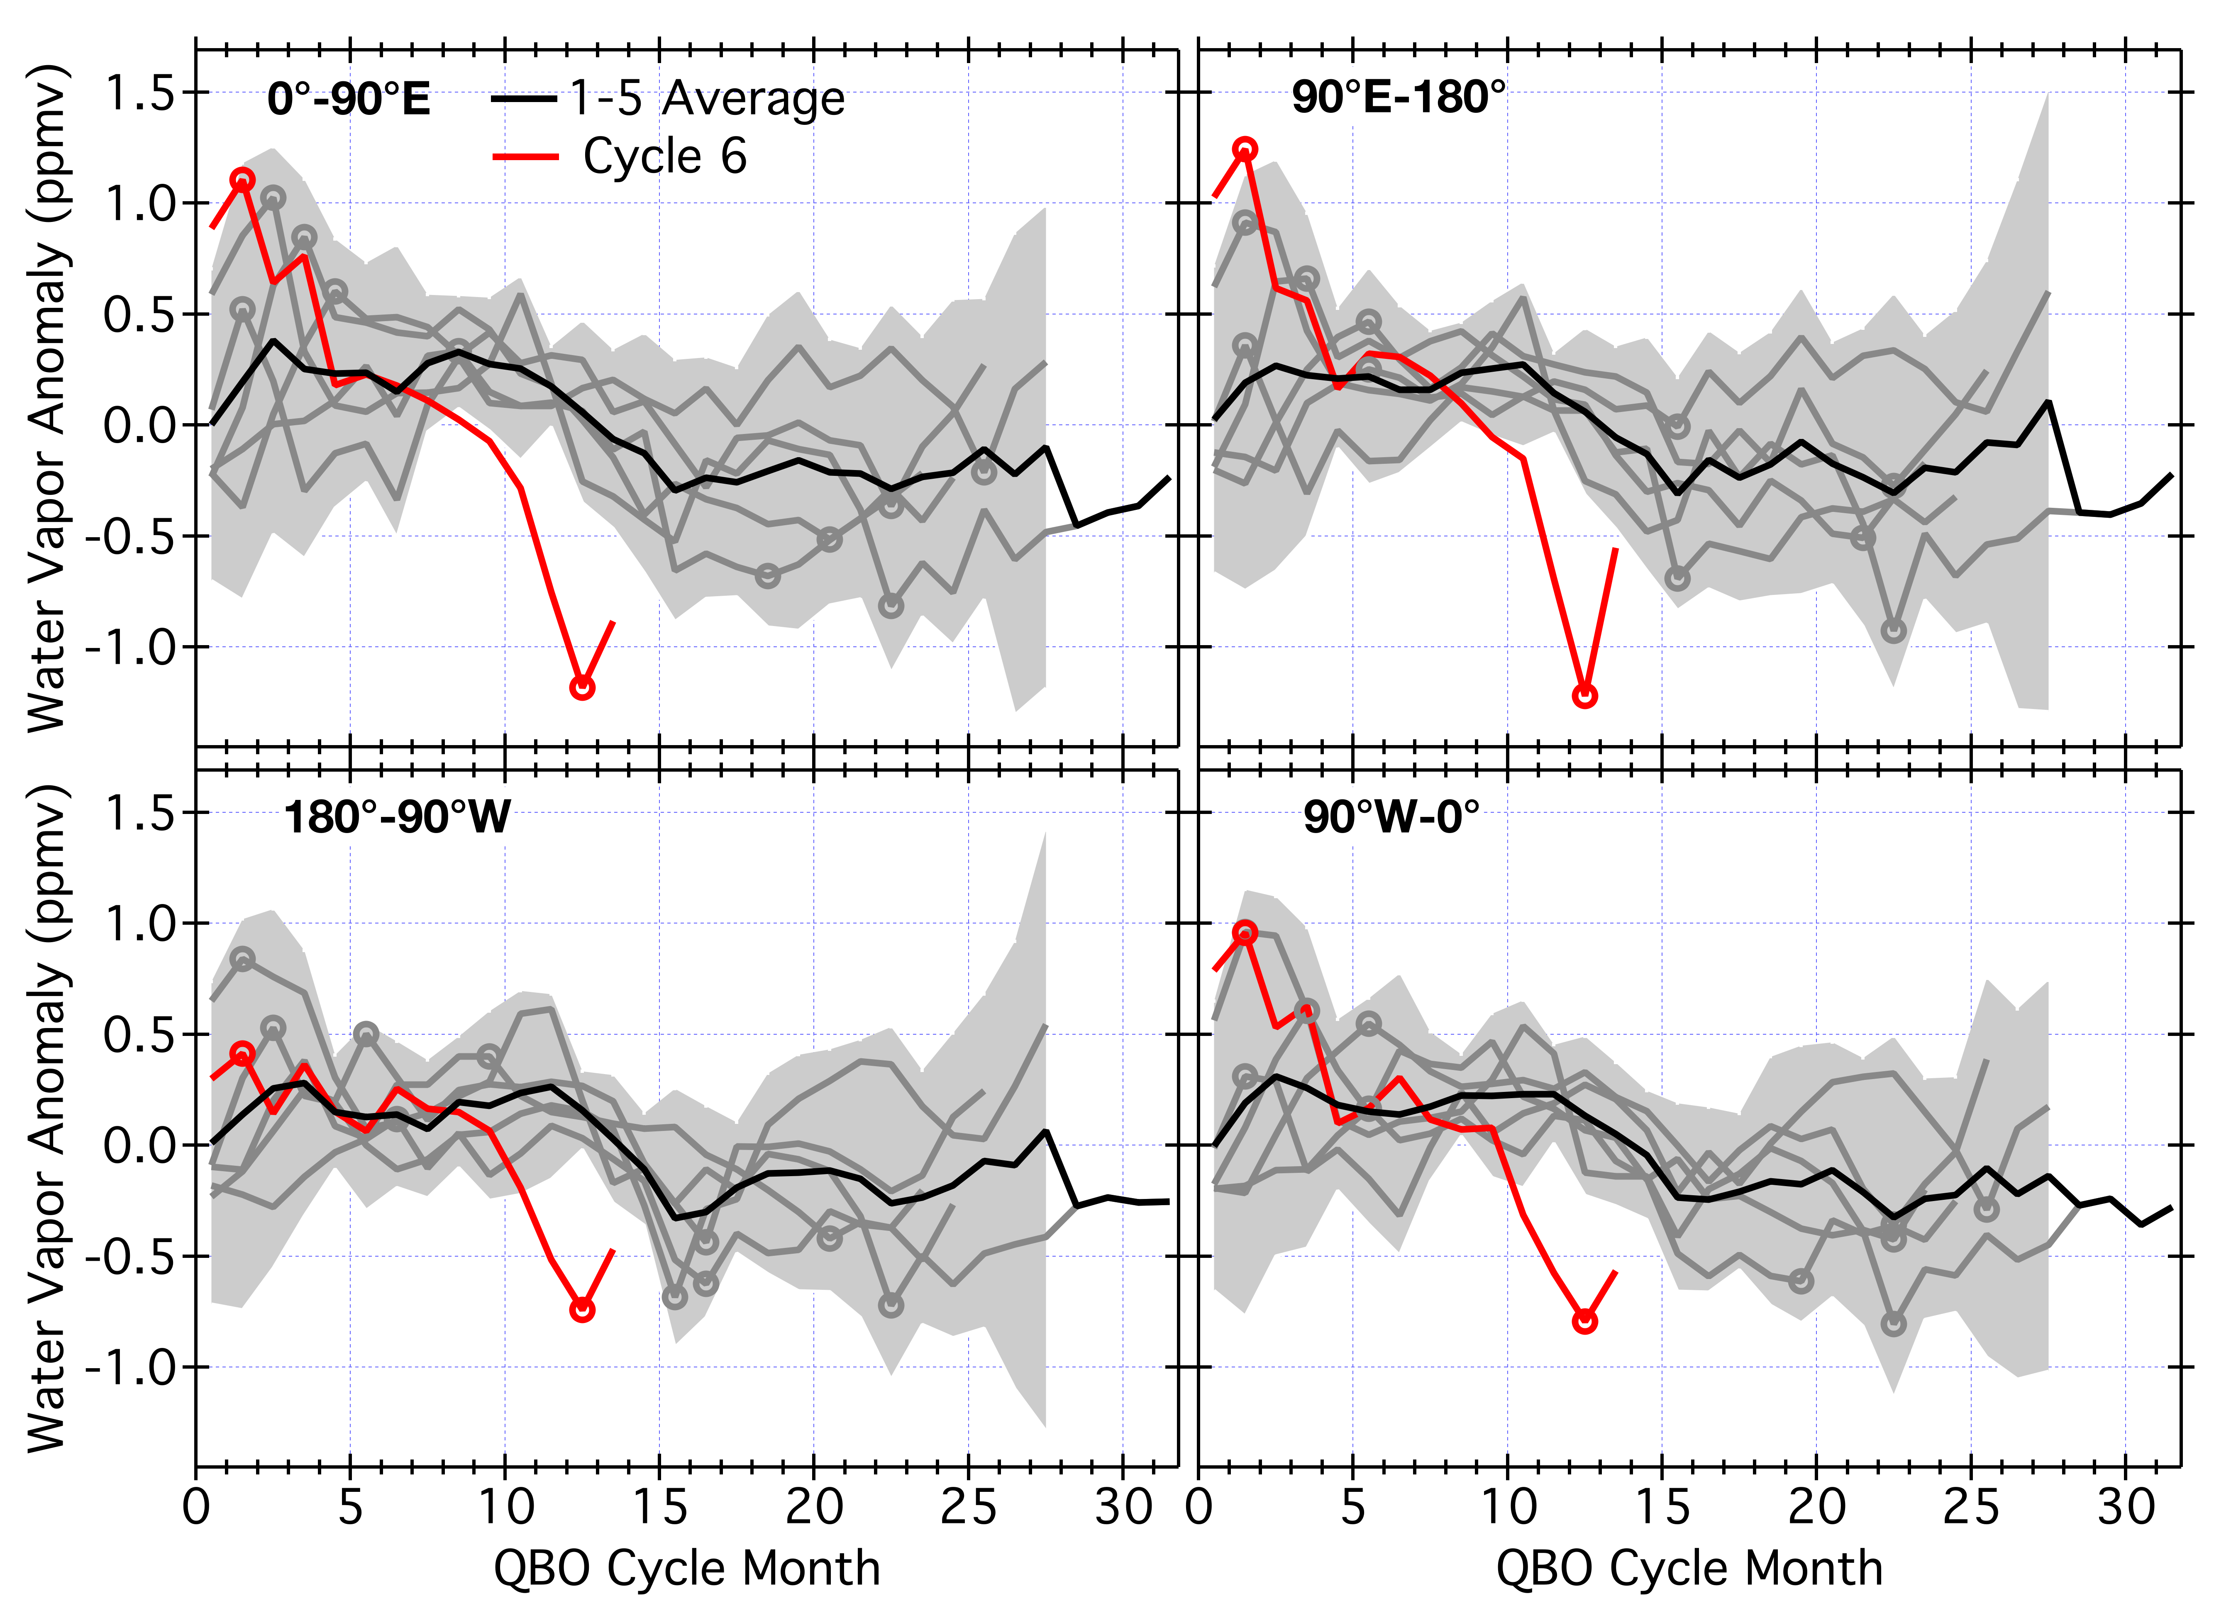
Decreases in Tropical WV Anomalies, QBO cycles 1-6
E1
E2
ΔH₂O = -2.3 ppmv
ΔH₂O = -2.3 ppmv
ΔH₂O = -2.4 ppmv
W1
W2
ΔH₂O = -1.2 ppmv
ΔH₂O = -1.7 ppmv
AOPC 23 Darmstadt Mar 6-9, 2018

Slide 13
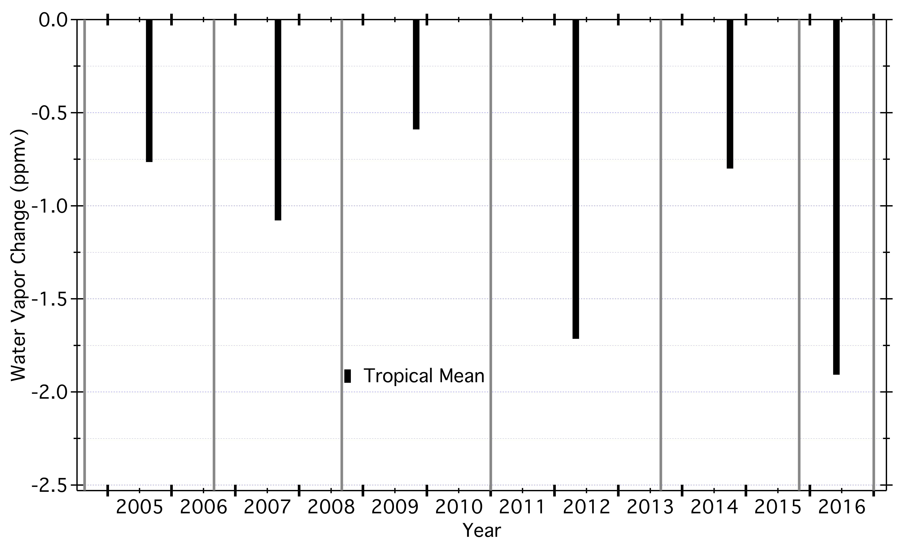
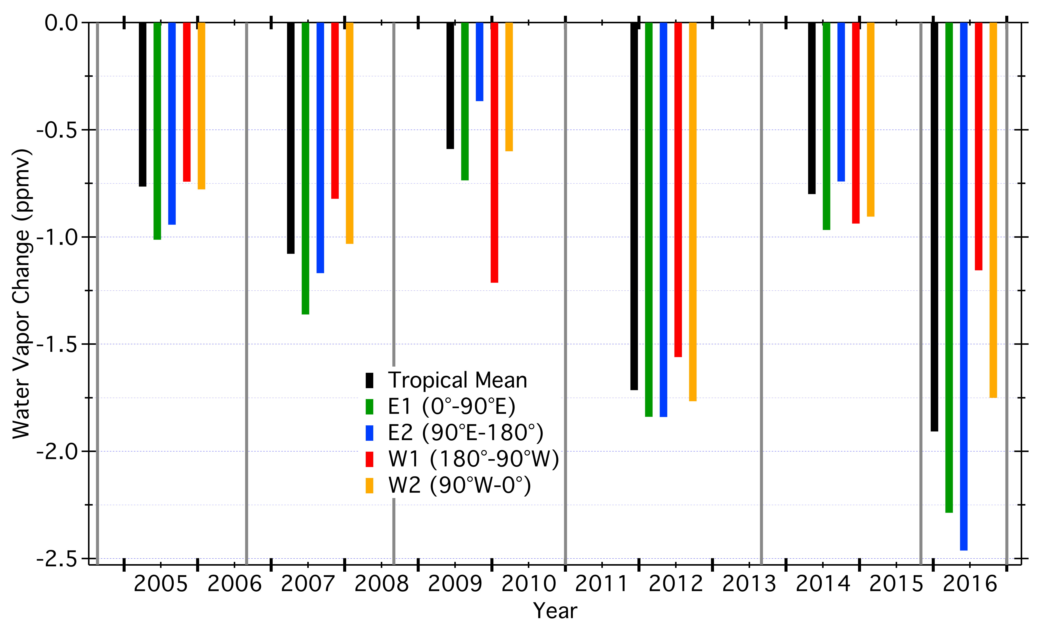
Decreases in Tropical WV Anomalies, QBO cycles 1-6
AOPC 23 Darmstadt Mar 6-9, 2018

Slide 14
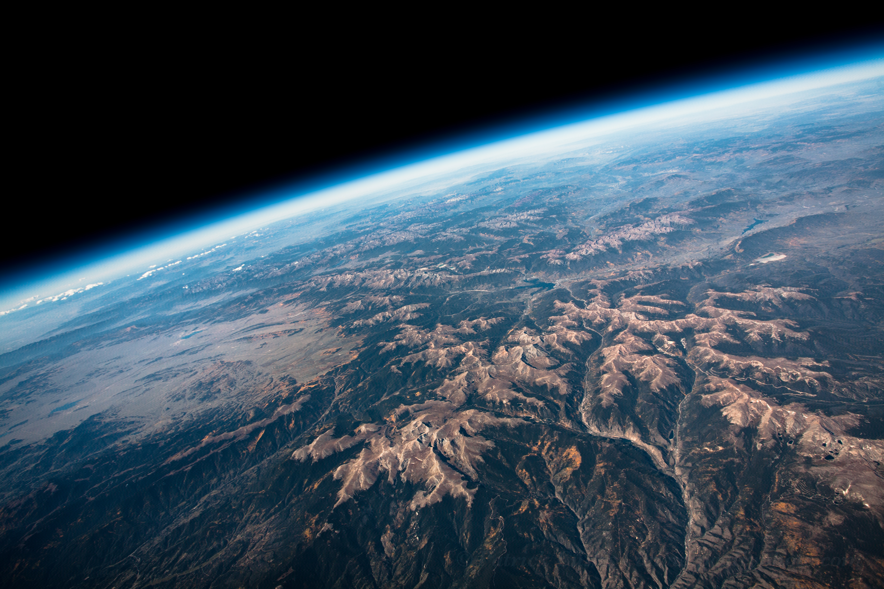
Photo by Patrick Cullis, CIRES
AOPC 23 Darmstadt Mar 6-9, 2018

