Slide 1
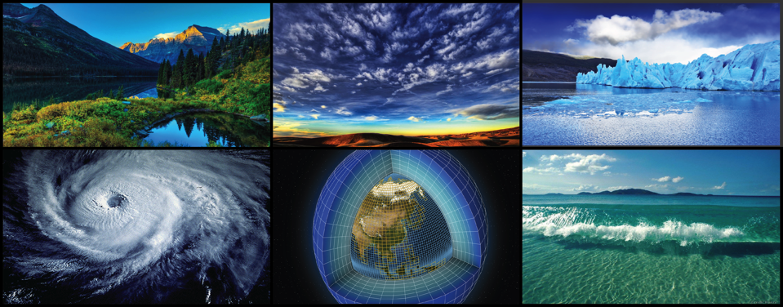
WORLD CLIMATE RESEARCH PROGRAMME
Update
Michel Rixen for WDAC
TOPC-20, 19-21 March 2018
WMO, Geneva, Switzerland

Slide 2
WCRP’s mission
... is to facilitate analysis and prediction of Earth system variability and change for use in an increasing range of practical applications of direct relevance, benefit and value to society.
The two overarching objectives of WCRP are:
to determine the predictability of climate
to determine the effect of human activities on climate

Slide 3
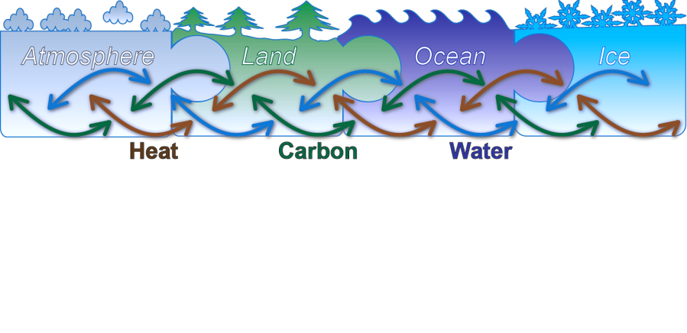
Scope of WCRP
Models
Observations
Reanalyses
Week
Season
Decade
Century

Slide 4
WCRP Structure
Our link to GCOS
Observations are critical across the entire WCRP enterprise, from process studies, to model development, initialization and verification, etc
CLOUDS, CIRCULATION AND CLIMATE SENSITIVITY NEAR-TERM CLIMATE PREDICTION
REGIONAL SEA-LEVEL CHANGE AND COASTAL IMPACTS MELTING ICE AND GLOBAL CONSEQUENCES
CARBON FEEDBACKS IN THE CLIMATE SYSTEM WATER FOR THE FOOD BASKETS OF THE WORLD
UNDERSTANDING AND PREDICTING WEATHER AND CLIMATE EXTREMES

Slide 5
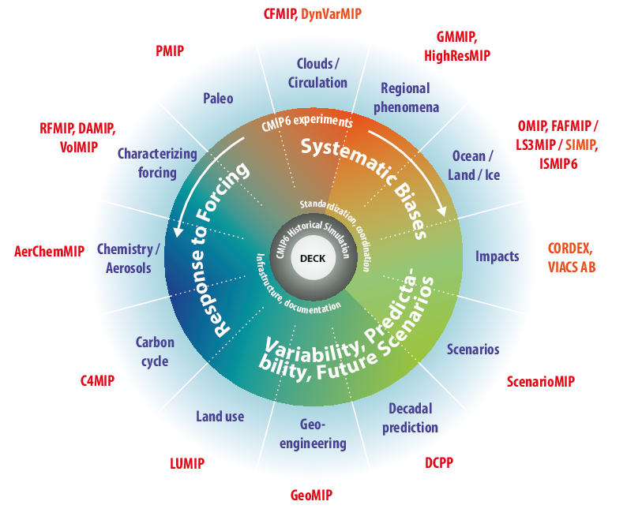
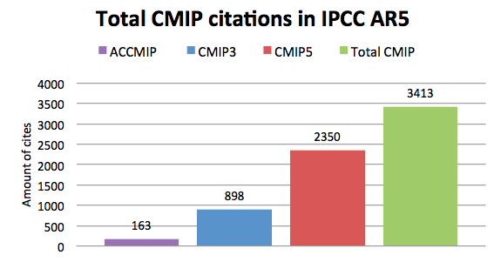
CMIP
Coupled Model Intercomparison Project
CMIP is a project of WCRP’s Working
Group on Coupled Modeling (WGCM)
CMIP has led to an improved understanding of past, present and future climate change and variability in a multi-model framework
CMIP defines common experiment protocols, forcings and output
21 CMIP6-Endorsed MIPs

Slide 6
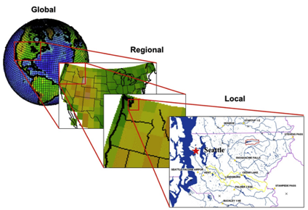
CORDEX
COordinated Regional climate Downscaling Experiment
Advancing the science and application of regional climate downscaling, for improved regional climate information
CORDEX scientific challenges:
Added value of downscaling, scales, bias and uncertainties, user-oriented metrics
Understanding and simulating human elements, e.g. land use, urban development, climate and coastal cities
Coordination of regional coupled modeling
Precipitation, e.g. convective systems, monsoon
Local wind systems

Slide 7
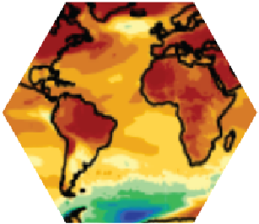
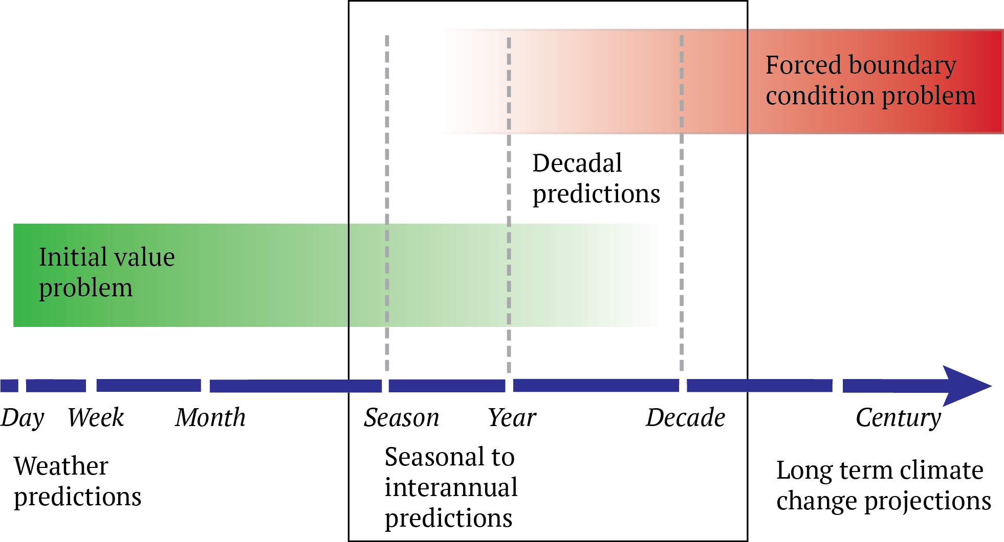
Seamless Climate Predictions
How can we enhance the understanding of sources of predictability?
How can we transition research outcomes into operations?
Pilot “Decadal Climate Outlook“
Contribution to GDPFS manuals
Contribution to IPCC SR 1.5 Deg
Explore contribution to Global Stocktake
“s2D Conference”, Sep ‘18, Boulder

Slide 8
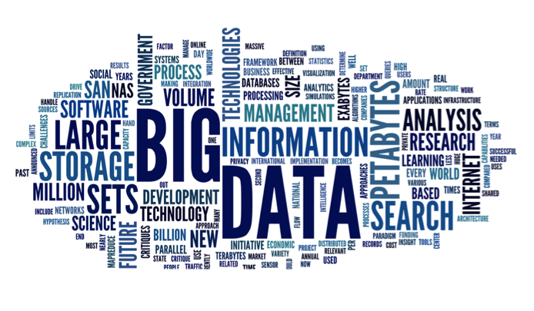
WCRP vision for a data infrastructure
Earth System Grid Federation
Observations+ε
Simulations
+ε
Reanalyses
+ε

Slide 9
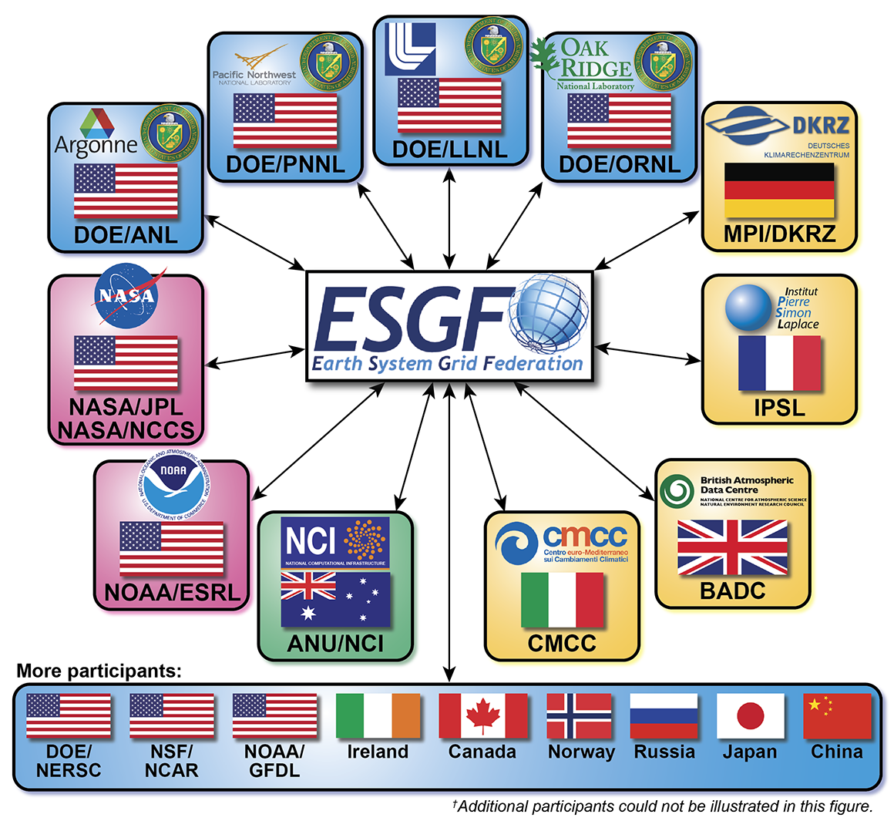
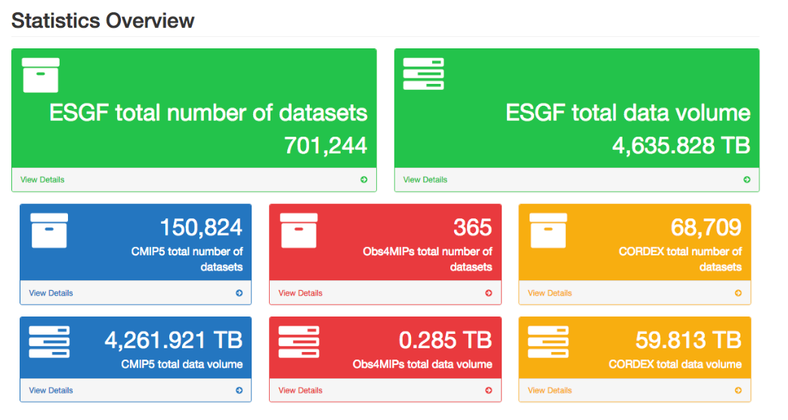
Data accessibility for WCRP projects
Earth System Grid Federation (ESGF) used for CMIP (and, increasingly, many observations/reanalysis/predictions and projections at global and regional scale)
obs4MIPs/ana4MIPs: data records with contributions from many major agencies (ESA, EUMETSAT, ECMWF, NASA, NOAA, JMA, etc)

Slide 10
5th International Conference on Reanalysis

Slide 11
Key messages from the discussions at ICR5
Reanalysis production
As production centers move toward coupled Earth-system reanalyses, they should embrace the notion of families of products designed to support a variety of research and applications spanning multiple decades to centuries.
Observations for reanalysis
Supporting the use of observations for reanalysis (rescue, reprocessing, recalibration …) is key to enhance the scope and range of reanalyses, by allowing datasets to be extended back in time with high-quality observations.
Methods for reanalysis
There is a general gap in research funding to design data assimilation and coupling methods across the Earth System specifically designed for reanalysis.
Evaluation of reanalyses
Evaluation activities should be promoted, taking stock of successful examples of ocean (and atmosphere) reanalysis intercomparison projects.
Applications of reanalyses
The proper quantification and communication of the quality of reanalyses must be promoted and would broaden their usage in operational services and policy making.

Slide 12
WCRP Task Team for the Intercomparison of ReAnalysis (TIRA)
Co-chaired by Dr Bosilovich (NASA/GMAO), Dr Fujiwara (Hokkaido University) and Dr Keller (HErZ)
The primary charge is to develop a reanalysis intercomparison project plan that will attain the following objectives.
To foster understanding and estimation of uncertainties in reanalysis data by intercomparison and other means
To communicate new developments and best practices among the reanalyses producing centers
To enhance the understanding of data and assimilation issues and their impact on uncertainties, leading to improved reanalyses for climate assessment
To communicate the strengths and weaknesses of reanalyses, their fitness for purpose, and best practices in the use of reanalysis datasets by the scientific community

Slide 13
WCRP observational requirements: update for TOPC
Input from WGSIP (Working Group on Subseasonal to Interdecadal Prediction) (1/2)
Major volcanic eruption impacts on decadal and seasonal forecasts
The Decadal Climate Prediction Project (DCPP) has developed guidelines for incorporating influences of a sudden major volcanic eruption
Will use measurements of volcanic aerosols coordinated by WCRP SPARC SSiRC (Stratospheric Sulphur and its Role in Climate) www.sparc-ssirc.org
Requires observations of SO2 amount, injection height, dispersion in stratosphere

Slide 14
WCRP observational requirements: update for TOPC
Input from WGSIP (Working Group on Subseasonal to Interdecadal Prediction) (2/2)
Blended multi-product datasets for sparsely observed climate variables
Important climate forecast variables for which direct measurements are sparse and/or uncertain include soil moisture and snow water equivalent (SWE)
Multi-product blends of analyses and other gridded datasets may have higher overall quality than individual products, e.g. Mudryk et. al. (2015, doi:10.1175/JCLI-D-15-0229.1) dataset for SWE
Can exploit climate forecasts to assess the quality of global observational datasets, e.g. Massonnet et al. (2016, doi:10.1126/science.aaf6369), Sospedra-Alfonso et al. (2016, doi: doi.org/10.1175/JHM-D-16-0027.1)

Slide 15
Evolving context and challenges
Research is pulled into a new and broader
“operational/service/policy” landscape
IPCC Assessment Reports
UNFCCC Paris Agreement and Global Stocktake
Global Framework for Climate Services
Sendai Framework for Disaster Risk Reduction
…
Yet:
Fundamental science is seriously underfunded
Many products developed on best effort basis

Slide 16
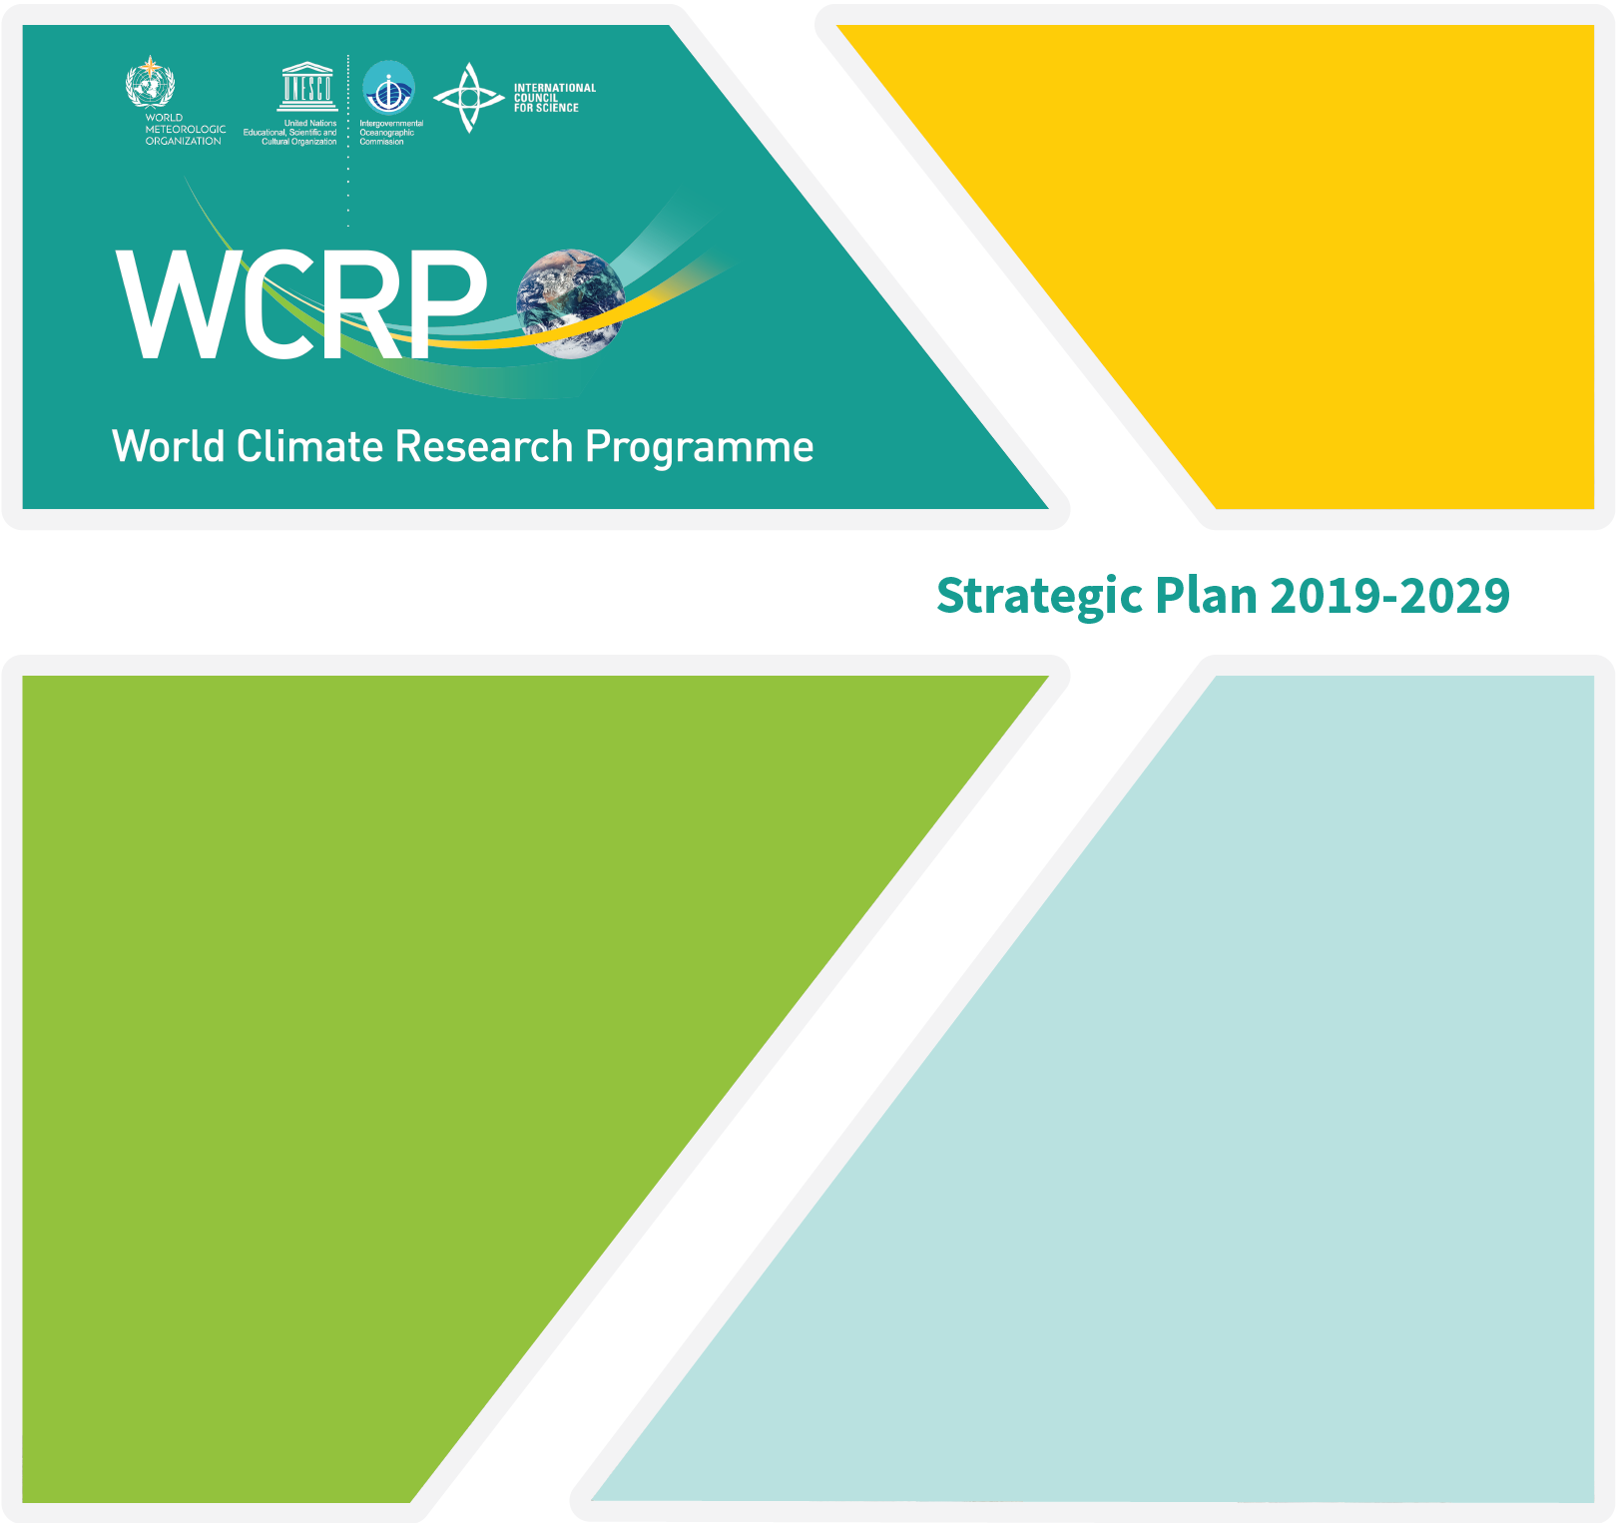
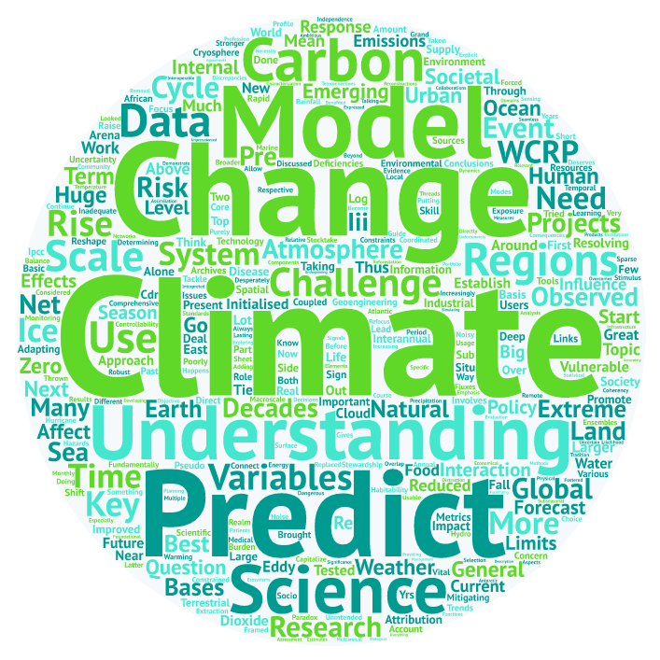
WCRP New Strategy
WCRP is developing a new Strategic Plan, covering a 10-year time horizon (2019-2029)
Takes into account the outcomes of the co-sponsors review (expected final by June ‘18)
Importance of bedrock science, seamless approach (time, space, ESM, R-O) and links to services and policy emphasised
SWOT analysis and initial (internal) consultations done
Extensive consultation with WCRP community Mar 2018 and stakeholders Apr-Jun 2018
5-year Implementation Plan also being developed
Both aimed be finalised end 2018
Notes:
Esm = Earth System Models
R-O : Research to Operations

Slide 17
WCRP New Strategy: overarching objectives
1. Processes / understanding / analyze
What are the processes, across scales, that critically determine the reservoirs and fluxes of energy, water, carbon and other constituents within, and between, the components of the Earth System?
2. Predictability / seamless prediction / skill
What are the uncertainties and predictabilities inherent in the range of space and time scales of the Earth system?
3. Projectability / projections / sensitivity
How does the Earth system respond, through feedbacks and interactions, across space and time scales, to natural variability and forced change?
4. Science for Society / policy and services
Improve the generation and use of decision relevant climate information and knowledge about the evolving Earth system, across space and time scales, to natural variability and climate change.
Notes:
These are the new

Slide 18
WCRP New Strategy and GCOS
Explicit reference in current draft Strategic Plan to:
sustained observing systems and innovation
international coordinated field experiments
open data policies and interoperability
high-end data infrastructures
stronger WCRP-GCOS strategic alignment
Implementation Plan: will address WCRP-GCOS governance
WDAC7, 26-27 March, Geneva: main focus on SP and IP discussions

Slide 19
Thank You
www.wcrp-climate.org

