Slide 1


Programme
Update
for AOPC-23 6 March 2018, EUMETSAT, Darmstadt, Germany
Steering Committee Chair & GCOS Secretariat, WMO
Stephen Briggs, Carolin Richter

Slide 2
Climate Indicators
GCOS contribution to the Global Stocktake
GCOS Strategy, incl. Communication Strategy and tag line
Joint GCOS panel meeting in March 2019
Time Plan 2018 – 2023: including timing for
  revision of status report and
  revision of implementation plan
  2nd Science Conference
  regional workshops

Slide 3
Climate Indicators
The GCOS Implementation Plan 2016:
Action G3: Development of indicators of climate change:
Devise a list of climate indicators that describe the ongoing impacts of climate change in a holistic way. Consider the work of the WMO, IPCC and others.
Action G4: Indicators for Adaptation and Risk:
Promote definition of and research supporting the development of indicators linking physical and social drivers relating to exposure, vulnerability and improved resilience, in line with national requirements
.

Slide 4
Reported to UNFCCC
Subsidiary Body for Scientific and Technological Advice (SBSTA),
FCCC/SBSTA/2017/7, VIII, 53 and 54:
The SBSTA noted the efforts undertaken by GCOS and the wider science community on the development of climate indicators, including global surface temperature, global atmospheric carbon dioxide and glacier change, and by WMO on the categorization of extreme events.
The SBSTA noted the importance of ocean-related climate indicators, including ocean heat content, ocean acidification, sea level rise, and Arctic and Antarctic sea ice extent, for informing on the state of the global climate.

Slide 5

The process towards the indicators
1
1st Climate indicator workshop (Dec. 2016)
2nd Climate indicator workshop (Feb. 2017)
2
3
Climate indicators discussed and refined in science panels 2017
4
First set of indicators agreed by GCOS Steering Committee 2017 and recommended to WMO
Copernicus agreed to provide products for indicators
5
6
Joint meeting with WMO Climate Statement ET for further discussions on 19 Feb 2018

Slide 6
Criteria for physical indicators
Relevance: Each should be a clear, understandable indicator of global climate change, which has broad impact for a range of audiences. Some indicators will also have national and regional values.
Representativeness: Indicators as a package should provide a representative picture of changes to the earth system related to climate change.
Traceability: The Indicators should be calculated using an internationally agreed (and published) method.
Timeliness: Should be calculated regularly (at least annually) with a short lag between the end of the period and publishing the data.
Limited number: To allow clear, concise, communication the number of indicators should be limited to less than 10.

Slide 7
Global Climate Indicators
Temperature and Energy
Atmospheric Composition
Ocean and Water
Cryosphere
Surface Temperature
Atmospheric CO₂
Ocean Acidification
Glacier Mass Balance
Ocean Heat
Sea Level
Arctic and Antarctic Sea Ice Extent
The Indicators are meant be used to tell stories about climate change in a way that can be understood by non-experts
The Indicators are not limited to specific datasets or certain storylines

Slide 8
Subsidiary Indicators
Temperature and Energy
Atmospheric Composition
Ocean and Water
Cryosphere
Top-of-Atmosphere Energy Balance
Methane
Heavy Precipitation
Snow Extent
N₂O
Heat Waves
Droughts
Fluorinated GHG

Slide 9
Next steps
TOPC to discuss indicator for “Vegetation”, probably on phenology and greenness
AOPC to discuss if “Extremes” should be an indicator
Copernicus will publish the European State of Climate for 2017 (ESoC) in April 2018, including
        Temperature
        Sea Ice
        Sea level
        Glaciers
        Copernicus will implement missing indicators in 2018
        Situation for ocean acidification not clear, most likely solution in partnership with the the Global Ocean Acidification Observing Network (GOA-ON)

Slide 10
GCOS contribution to the Global Stocktake
Ad hoc Working Group on the Paris Agreement (APA), which consists of all 196 Parties to the UNFCCC, met for first time in May 2016, will discuss the details of the Paris Agreement.
One of the items on the agenda of the APA is to discuss “matters relating to the global stocktake,” the collective moment of review every five years, beginning in 2023.
The stocktake is at the heart of what has become known as the ambition mechanism of the Paris Agreement, which is an ongoing process, intended to inform successive Nationally Determined Contributions (NDCs) and strengthen action in a regular and timely way.
.
Notes:
Context to Global Stocktake

Slide 11
Global Stocktake – Paris Agreement, Article 14
Article 14, Paris Agreement:
1. The Conference of the Parties serving as the meeting of the Parties to this Agreement shall periodically take stock of the implementation of this Agreement to assess the collective progress towards achieving the purpose of this Agreement and its long-term goals (referred to as the "global stocktake"). It shall do so in a comprehensive and facilitative manner, considering mitigation, adaptation and the means of implementation and support, and in the light of equity and the best available science.
2. The Conference of the Parties serving as the meeting of the Parties to this Agreement shall undertake its first global stocktake in 2023 and every five years thereafter unless otherwise decided by the Conference of the Parties serving as the meeting of the Parties to this Agreement.
3. The outcome of the global stocktake shall inform Parties in updating and enhancing, in a nationally determined manner, their actions and support in accordance with the relevant provisions of this Agreement, as well as in enhancing international cooperation for climate action.
.
Notes:
Context to Global Stocktake

Slide 12
What is the Global Stocktake?
What information should feed into the global stocktake?
Assessment of progress made towards achieving the purpose of the Paris Agreement and its long-term goals.
It should be informed by science, progress made in implementation, an assessment of how far is left to go, and what opportunities or potential exists for enhanced action.
The COP has requested that the APA determine the specific inputs that could provide this information for the stocktake.
Reference: http://www.wri.org/blog/2016/05/insider-4-key-questions-design-global-stocktake
.
Notes:
Context to Global Stocktake

Slide 13
What is the Global Stocktake
What information should feed into the global stocktake?
One of the first steps that countries can take is to develop a list of existing information sources, including national reports, reports from UNFCCC subsidiary bodies and scientific inputs (i.e. the IPCC report on 1.5C). The UNFCCC Secretariat could be charged with compiling such a list, assessing potential gaps in information and requesting Parties to submit their views on the list. Parties might also want to consider how to incorporate information from other UN organizations and civil society.
Reference: http://www.wri.org/blog/2016/05/insider-4-key-questions-design-global-stocktake
.
Notes:
Context to Global Stocktake

Slide 14
What is the Global Stocktake
How should the global stocktake operate?
It is meant to be a periodic assessment of collective progress. It must be comprehensive and facilitative, and consider mitigation, adaptation, means of implementation and support. It must do all of this in light of equity and the best available science. The APA has been requested to develop the modalities (essentially the way that the global stocktake will work) in order to achieve this mandate.
Outputs from the global stocktake could consist of analysis or reports, recommendations to the meeting of the Parties to the Paris Agreement (known as CMA) from UNFCCC bodies (e.g., SBSTA) and decisions of CMA itself. When these outputs will be produced, whom they will be directed at, and how they will be made publicly available are also key questions.
Reference: http://www.wri.org/blog/2016/05/insider-4-key-questions-design-global-stocktake
.
Notes:
Context to Global Stocktake

Slide 15
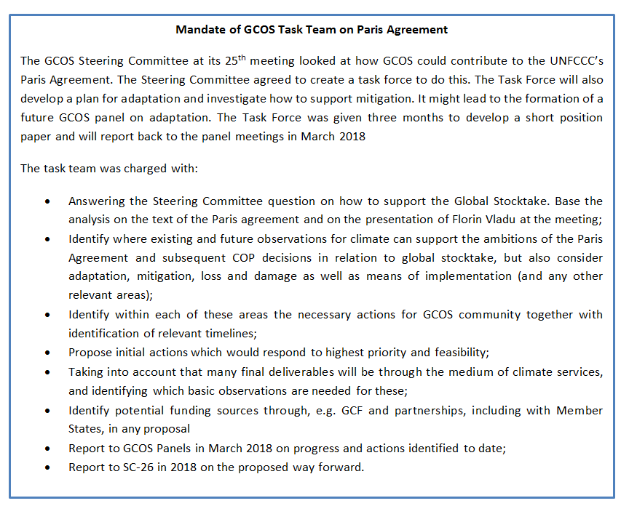
GCOS & the Global Stocktake
.
Notes:
Mandate of GCOS Task Team on Paris Agreement

Slide 16
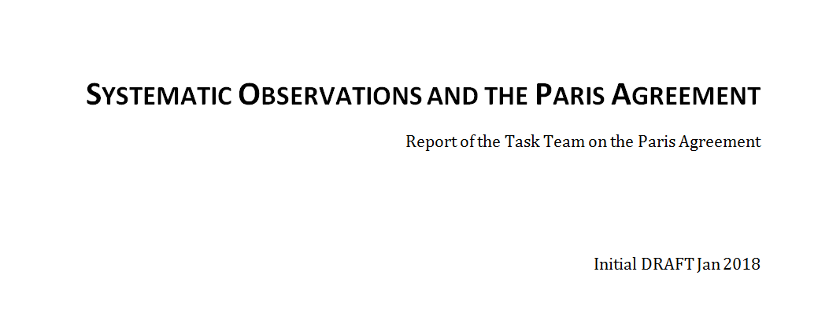
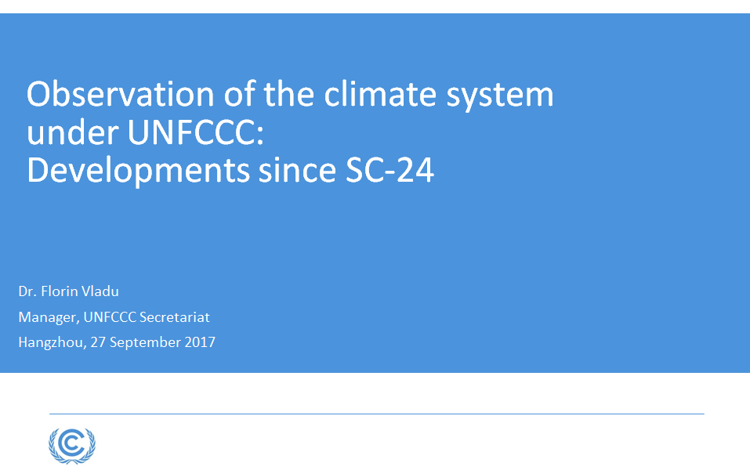
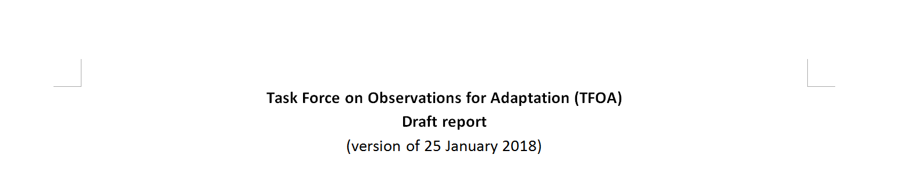
GCOS & the Global Stocktake – draft documents
Report from GCOS Secretariat
Report from F. Vladu (UNFCCC)
Contribution to Steering Committee from
F. Vladu (UNFCCC)
.
Notes:
Where are we in preparing input ?

Slide 17

Art 4
Art 5
Art 7
Art 8
Art 9
Art 10
Art 11
Art 12
Art 13
Art 14
NDCs
FINANCE
MITIGATION
TECH TRANSFER
COMMUNICATIONS
GLOBAL STOCKTAKE
LOSS & DAMAGE, EWS,..
CAPACITY BUILDING
ADAPTATION, EWS, RSO…
REPORTING/TRANSPARENCY
Art 7 (7c)
*Paris Agreement Article 7 (7c): Strengthening scientific knowledge on climate, including research, systemic observation of the climate system and early warning systems.
Notes:
COP-21: Paris Agreement Article 7 (7c)
Strengthening scientific knowledge on climate, including research, systematic observation of the climate
system and early warning systems, in a manner that informs climate services and supports decision- making
Developing the Transparency Framework (the need to promote transparency, accuracy, completeness, consistency, and comparability, and environmental integrity)
Short Keys:
Art. 4. Nationally Determined Contribution
Art. 5. Mitigation (REDD+)
Art. 7. Adaptation & Early Warning Systems. Systematic Observations, Adaption planning
Art. 8. Loss and damage: Early warning systems, emergency preparedness, slow onset events etc.
Art. 9 Provide finance
Art. 10 Technology Transfer
Art. 11 Capacity Development
Art. 12. Improve Public Communications
Art. 13: para. 7 & 8. Reporting and transparency framework
Art. 14 Global Stocktake

Slide 18
Advocate for open access to data and data sharing
Support continued forest and land cover monitoring
Advocate for extended forest and land cover monitoring. Monitor: Encroachment of buildings/agriculture on forests Adaption of forest industry to climate change
Develop plans for adaptation-focused urban monitoring
Encourage urban monitoring at a global scale. Monitor Adaptation in the built environment Track the land footprint of renewables Near ground level wind speed Heat loss from groups of buildings
Finalise and implement the output of the Task Team on Radar observations
Finalise and implement the output of the Task Team on Lightning observations
Develop indicators for extreme events
Establish a process to determine the requirements for observations to support early warning systems and adaptation.
Develop indicators to support adaptation
Promote and assist the development of international activities to use atmospheric concentration measurement to assist national emission inventories.
Improve the monitoring of the global carbon, considering the targets for this cycles in the GCOS Implementation Plan
Support the continued monitoring of global temperature, in particular, to ensure long-term observations and data availability into the future. Improved understanding of pre-industrial to 1880 temperature changes needed.
Identify observation gaps in global energy fluxes and develop plans to fill them. Consider if requirements and targets in GCOS Implementation Plan are adequate and specify any changes.
Develop plans to improve the monitoring the hydrological cycle. Considering developing targets for a future GCOS Implementation Plan. Aim to improve data sharing.
Develop plans to improve the monitoring of ecosystems response to climate change. Considering developing targets for a future GCOS Implementation Plan.
Provide support to the GCOS Cooperation Mechanism (GCM)
Identify the gaps at a global level that would most support adaptation (e.g. by improving models and reanalysis) and the capacity development needed to fill these gaps
Actions to support the Paris Agreement: grey shading indicates topics in the GCOS IP
Notes:
We have identified actions supporting Article 14, Paris Agreement.

Slide 19
Supporting the Paris Agreement
Many actions in the Implementation Plan will also support the Paris Agreement
New areas identified for consideration are:
  Monitoring of urban areas – this is where people are and impacts felt
  Monitoring the impacts of adaptation
    Adaptation in the built environment (changing patterns of urbanisation)
    Track the land footprint of renewables
    Near ground level wind speed (e.g. for wind power)
    Track changes in heat loss from groups of buildings
  Track encroachment of buildings/agriculture into forests
  Track adaptation in forest management
  Design other urban based adaptation observations
  Consider improvements to pre-1880 temperature records
.
Notes:
Many come from the GCOS Implementation Plan, but the Task Team also identified new areas.

Slide 20
GCOS & the Global Stocktake: next steps
Report to panels in March 2018,
→ Incorporating suggestions from Panels,
Consolidation of draft documents.
Identifying input:
MoU between WMO and UNFCCC which designs specific projects of relevance to this task;
National Adaptation Plans (NAPs);
Upcoming UNFCCC SBSTA meeting: research dialogue in May 2018
COP24, SBSTA in December 2018; Earth Info Day (TBD);
GFCS guidelines for national implementation of climate services.
.
Notes:
Where does the document will need to go to be picked up by a body (SBSTA?) which will report to the APA?

Slide 21
GCOS Strategy – track record
Draft Versions
Version 1.8.2 | This version has been drafted by the GCOS Secretariat. |  | 19 Feb 2018
 | Circulated to all GCOS Steering Committee members. | Deadline for comments | 1 March 2018
Version 1.9 | This version will have comments from SC members included and will be circulated for comments to sponsors. | Deadline for comments | 12 March 2018
Version 2.0 | This version will include comments from all sponsors
 | Submission to WMO Executive Council | Deadline for submission | 15 March 2018
 | Submission to IOC Executive Council
.
Notes:
Where are we with regard to the GCOS strategy?

Slide 22
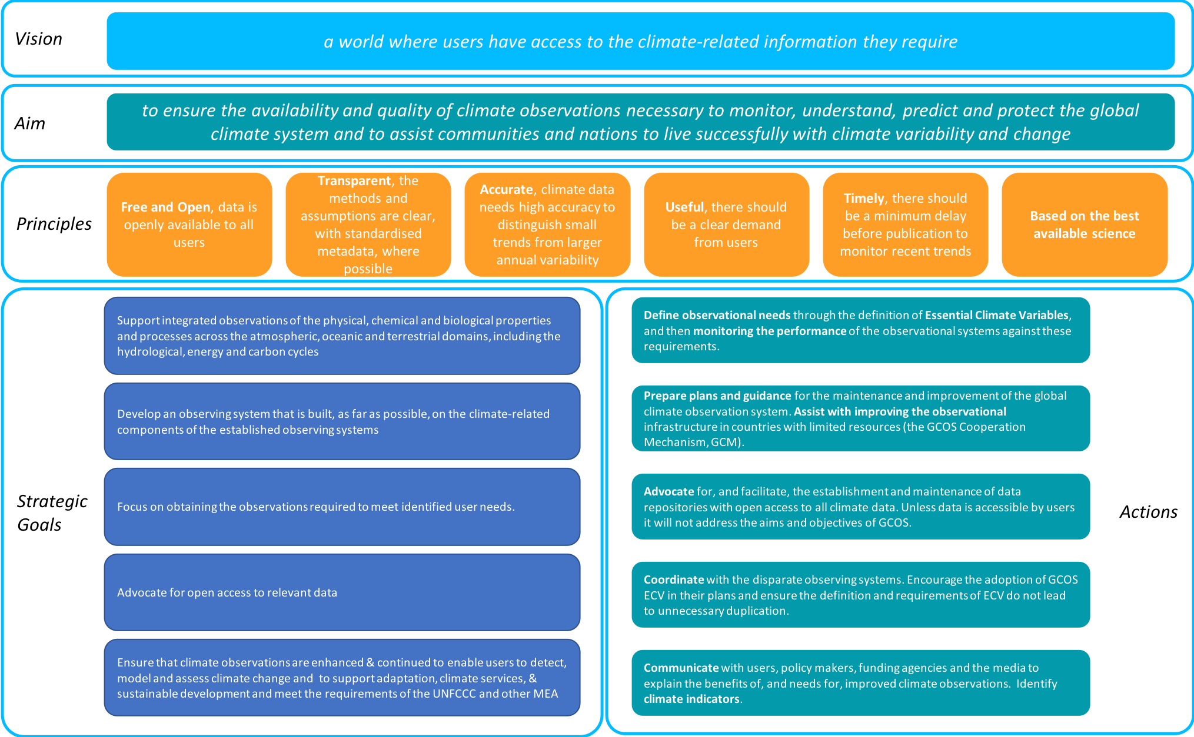
.
Notes:
GCOS strategy in a nutshell.

Slide 23
AIMS
Ensure GCOS is responsive to the needs of its users, by proposing and promoting observational approaches that meet those needs
Ensure an understanding of the needs for global climate observations by policy makers and those who fund observations.
Provide the basis for communication of the state and rate of change of the climate system by the media to the public.
Encourage support (funding and in kind) for GCOS and the GCOS Cooperation Mechanism
.
MAIN CHANNELS
OTHERS: Mailing List, Social Media, Handouts etc.
Scientific Contacts (Formal & Informal, ].)
Events (UNFCCC, Conferences, Workshops etc.)
GCOS Web Site
`
`
`
`
USERS: those who need and user the data collected by the global climate observations
Target Audiences
GCOS Communication Strategy
OBSERVERS: Those making Climate Observations
Policy Makers and Funding Agencies
MEDIA (for public)
Notes:
Communication strategy in a nutshell.

Slide 24
GCOS Communication Strategy – Tag Line
1. A) Watching over Earth /
B) Watching over our Climate /
C) Watching over Earth’s Climate
2. Keeping Watch over our Climate → currently has most of the votes
3. Watch, Tell, Act
4. Your Data, Your Climate
5. Watching our Planet change
Online poll with SC members and Panel chairs.
.
Notes:
Tag Line – as one of the 20 recommendations coming out of the communication strategy.

Slide 25
Joint GCOS Panel meetings in March 2019
Will need clear objectives.
For the shared GOOS/GCOS OOPC: GOOS is supportive and will identify the most suitable ocean experts from all the GOOS panels who can contribute and support the GCOS planning and joint meeting.
The panels will need to agree on future plans and the timing for the revision of the Status Report and of the Implementation Plan. The assessment cycle of the GCOS adequacy/status report and the plan is about every 5-6 years.
We have identified a time slot which might be suitable to gather:
Option 1: 18 - 22 March 2019
Option 2: 11 - 15 March 2019
Option 3: 25 - 29 March 2019
Proposed location: Africa, Morocco, NOT Casablanca, Essaouira ? ; Marrakesh ?
.

Slide 26
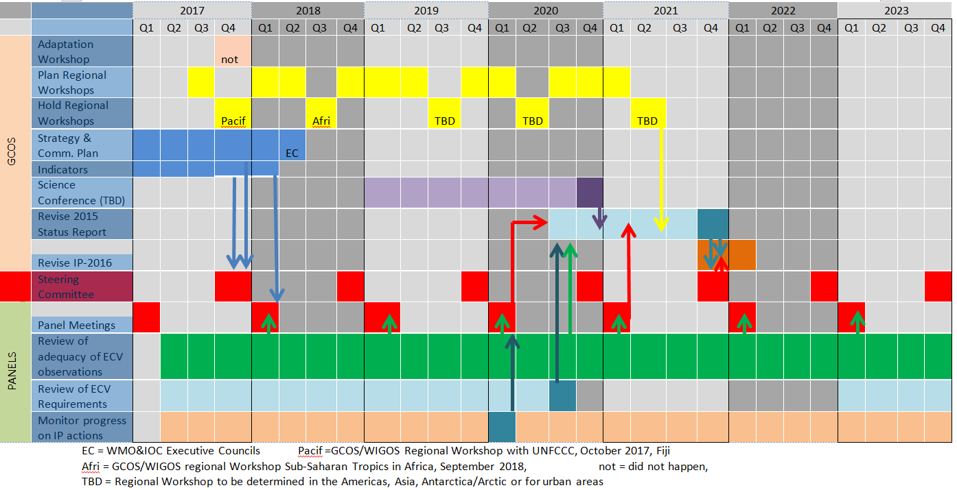
Time Plan
.

Slide 27




Thank you!
gcos.wmo.int

