Slide 1
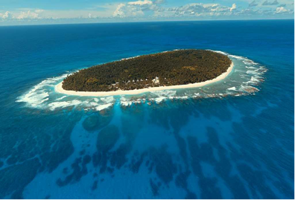
Joint GCOS – WMO Integrated Global Observing System Workshop for the Pacific Small Island Developing States (SIDS)
9-12 October 2017, Nadi, Fiji.
GCOS Secretariat, WMO

Slide 2
2016 UNFCCC considered the GCOS Implementation Plan
decision 19/CP.22
the need to maintain, strengthen and build capacities for climate observations…
Encourages Parties to work towards the full implementation of the [GCOS] implementation plan …
Invites United Nations agencies and international organizations to support the full implementation of the [GCOS] implementation plan…
SBSTA 45 conclusions (FCCC/SBSTA/2016/4)
noted the need for regional workshops, as identified by the GCOS 2016 implementation plan, […] and invited the GCOS to organize such workshops, taking into consideration the benefit of organizing these workshops in collaboration with relevant partners
also encouraged Parties and relevant organizations to strengthen and maintain observation networks and capabilities in all countries, especially in developing countries, including the LDCs and small island developing States

Slide 3
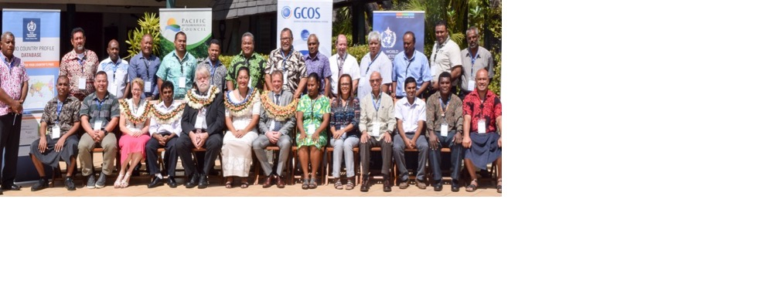
Participation
From most islands nations
Held jointly with the WMO Integrated Global Observing System (WIGOS)
Hosted by the Fiji Meteorological Office
Supported by The Secretariat of the Pacific Region Environment Programme (SPREP)

Slide 4
Meeting Focus
Upper Air measurements
Systematic upper air observations, lead to global benefits, underpinning forecasting and climate reanalyses which form the basis of much of our understanding of climate and climate change;
These observations in the Pacific region have the highest impact, of all ground-based measurements, on the global quality of weather and climate analysis and prediction.
Both the spatial density and observing frequency currently fall short of GCOS and WMO requirements and a beyond the resources of SIDS.
Precipitation
Changes in extreme events are significant impacts of climate change
Water related issues are significant adaptation challenges in most countries (floods, droughts, storms, and in islands rising sea level and salt water intrusion)

Slide 5
Pacific Islands
 | Land Area | Area of EEZ | Population | GDP | GDP per km² | Population Density including EEZ
 | km² | million km² including land area | thousands, UN Estimate for 2017 | World Bank. 2016, US$ | US$ per km² | km² per person
Cook Islands | 240 | 1.80 | 17 | 311 ª | 0.00017 | 0.01
Federated States of Micronesia | 702 | 3.00 | 106 | 322 | 0.00011 | 0.04
Fiji | 18,274 | 1.30 | 906 | 4632 | 0.00360 | 0.70
Kiribati | 811 | 3.44 | 116 | 166 | 0.00005 | 0.03
Marshall Islands | 181 | 1.99 | 53 | 183 | 0.00009 | 0.03
Nauru | 2 | 0.31 | 11 | 102 | 0.00033 | 0.04
Niue | 26 | 0.39 | 2 | 10^{b} | 0.00003 | 0.00
Palau | 535 | 0.60 | 22 | 293 | 0.00048 | 0.04
Papua New Guinea | 45,258 | 2.87 | 8,251 | 16929 | 0.00590 | 2.88
Samoa | 283 | 0.13 | 196 | 786 | 0.00600 | 1.50
Solomon Islands | 2,799 | 1.62 | 611 | 1202 | 0.00074 | 0.38
Tonga | 72 | 0.66 | 108 | 395 | 0.00060 | 0.16
Tuvalu | 3 | 0.75 | 11 | 34 | 0.00005 | 0.01
Vanuatu | 12,300 | 0.68 | 276 | 774 | 0.00110 | 0.41
Total above | 81,486 | 20 | 10,687 | 26,139 | 0.00130 | 0.55
USA | 9,525,067 | 11.35 | 325,958 | 18,569,100 | 1.60 | 28.72
Japan | 377,930 | 4.48 | 126,670 | 4,939,384 | 1.10 | 28.28
Tuvalu
Solomon Islands
Cook Islands

Slide 6
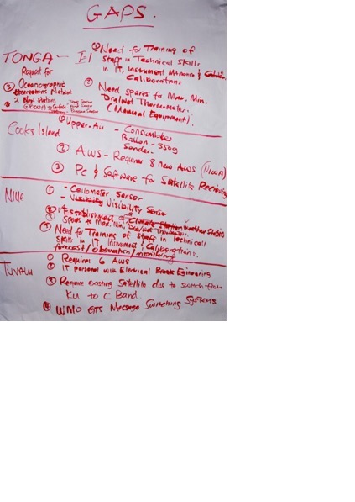
Findings
Upper air
Some upper air observations have ceased (the radiosondes now operational apart from Fiji are those with external funding)
Main reason for stopping is lack of resources for consumables and maintenance.
Precipitation
Precipitation measurements may not be representative and more sites are needed to cover all islands to address drought and floods
Remoteness of many islands increases costs, makes maintenance more difficult and exacerbates communication issues
Procurement is a issue with lack of expertise, relatively small quantities and remote locations all increasing the costs
Capacity building needs to be addressed
Vanuatu

Slide 7
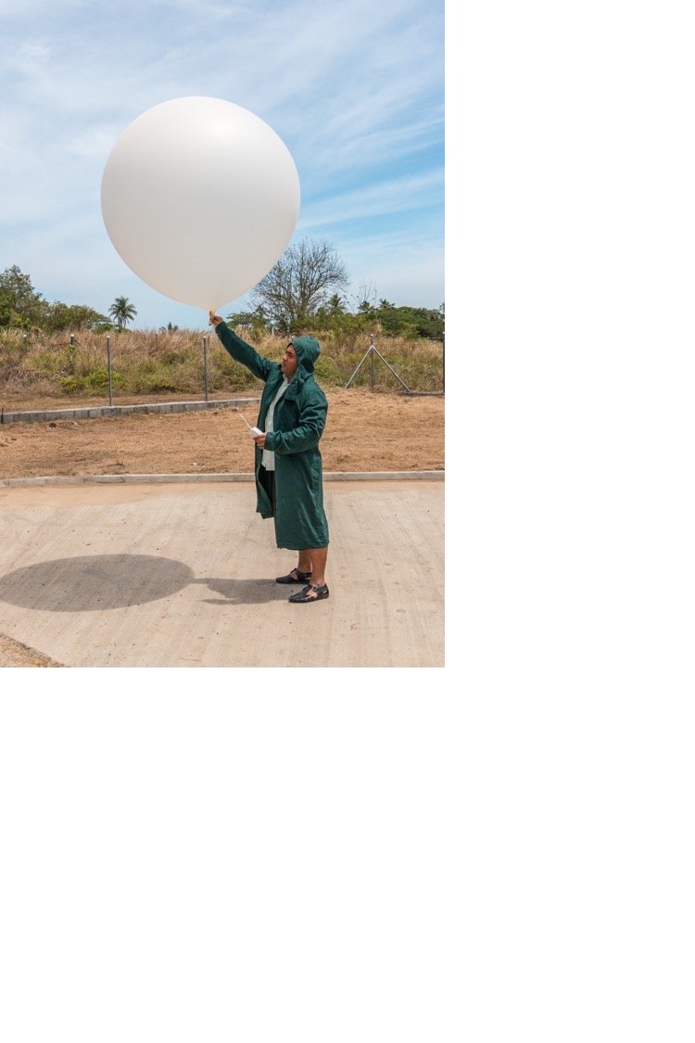
Global importance of upper air observations
The ECMWF Deputy Director of Forecasts noted in September 2017 regarding the potential value of rehabilitating the upper air network over Papua New Guinea:
“Radiosondes in PNG can … help predict when Rossby wave trains may be triggered from that area, and then propagate across the Pacific to N. America, and where they influence the mid-latitude storms tracks and ultimately the weather in Europe”
“Isolated radiosondes are individually much more valuable and bring much more benefit to forecast quality than observations in a dense network (benefit per station that is!)”

Slide 8
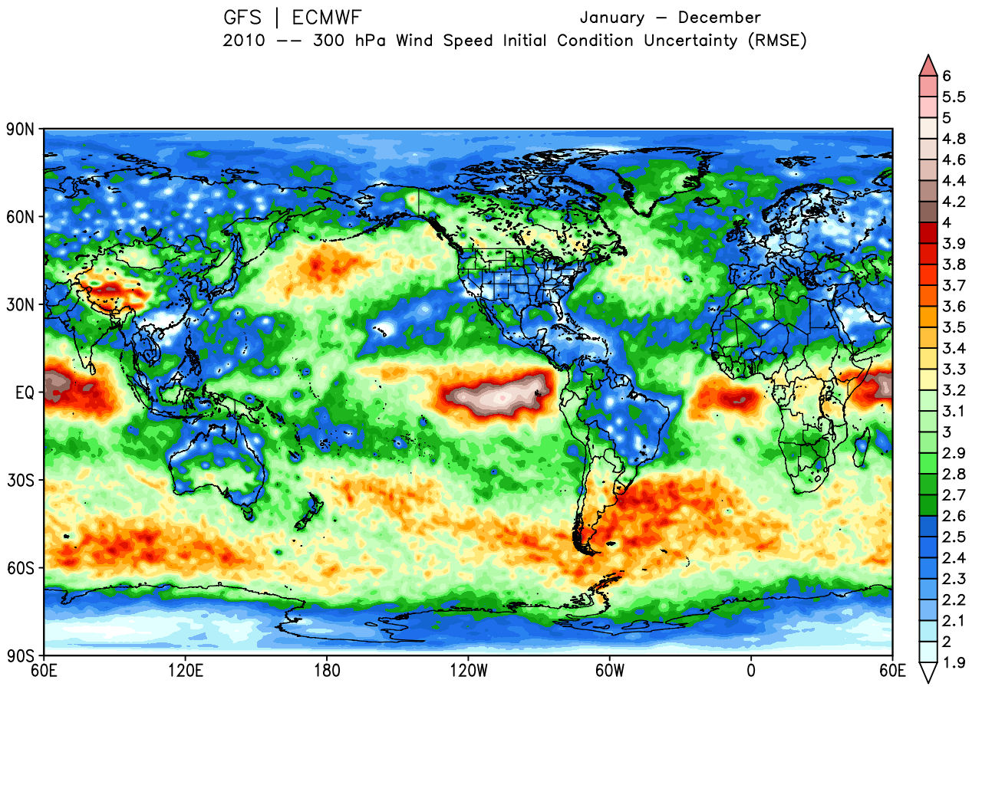
Root-Mean Square of Analysis Differences: 300mb Wind Speed
Jan – Dec 300mb Wind Speed (2010) GFS / ECMWF
Note the very significant effect of in-situ wind observations:
Radiosondes and Commercial Aircraft
ms⁻¹
SOURCE: Langland et al.; from 5th WMO Impact Workshop, Sedona 2012

Slide 9
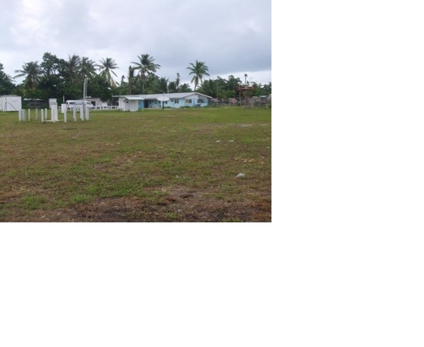
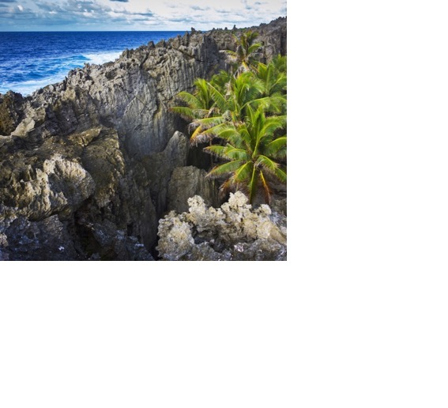
Key Outcomes
Systematic upper air observations, lead to global benefits, underpinning forecasting and climate reanalyses which form the basis of much of our understanding of climate and climate change;
These observations in the Pacific region have the highest impact, of all ground-based measurements, on the global quality of weather and climate analysis and prediction.
Both the spatial density and observing frequency currently fall short of GCOS and WMO requirements and a beyond the resources of SIDS.
These observations are a global good and therefore the upper air network over the South Pacific therefore needs sustained international support.
Support should be based on transparent processes and a commitment to free and open data sharing in accordance with WMO Resolutions 40 and 60 and the GCOS Monitoring Principles.
Ensuring sustainability is of paramount importance.
The draft plan will be developed by GCOS and WMO in collaboration with Secretariat of the Pacific Regional Environmental Programme (SPREP), the Pacific Islands Communication and Infrastructure Panel (PICI), and Pacific Meteorological Council, and submitted to COP 24.
Kiribati
Niue

Slide 10
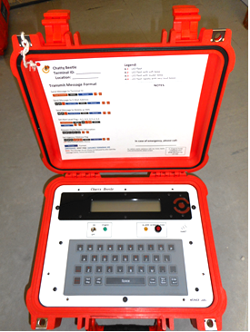
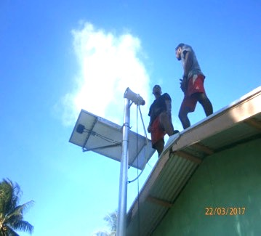
Considerations to be included in the plan
Sustainable funding for upper air measurements is needed, acknowledging this is beyond the capabilities of the individual countries in the region and will provide global benefits
Communications. Many of the islands are remote and communications are not straightforward. “Chatty Beetles” provide a suitable option and their use should be encouraged.
Transport. The distances involved and the need to use infrequent ships mean that repairs and maintenance are often delayed and the distances lead to additional costs.
Precipitation is an important parameter both in mountainous islands where issues include flooding and drought, and atolls where drought and sea water intrusion are large concerns.
National precipitation observations and often insufficient and unrepresentative. Typical metrological stations do not reflect the variable nature of precipitation on many islands and simpler, cheaper voluntary observing systems should be considered to address some of these needs.
Assistance in procurement to ensure cost-effective solutions are purchased that meet requirements specified by WMO is needed. A joint purchase of equipment and consumables for several countries is may be part of the solution.
Training is a vital part of ensuring sustainability. Suitable facilities to do this are available in Samoa (SPREP) and Fiji (the Metrological Office).

Slide 11
Next Steps
Development of a plan to address these issues for COP 24 and for WMO.
Highlight the global benefits of these observations and need for continuing support
Identification of potential sources of funding
Next year the programme of regional workshops will continue in other regions
We will look to collaborate with suitable partners globally and regionally

Slide 12
@gcos_un
gcos.wmo.int
SOURCE: ESA

