Slide 1
Global Climate Indicators
Temperature and Energy
Atmospheric Composition
Ocean and Water
Cryosphere
Surface Temperature
Atmospheric CO₂
Ocean Acidification
Glacier Mass Balance
Ocean Heat
Sea Level
Arctic and Antarctic Sea Ice Extent
The Indicators are meant be used to tell stories about climate change in a way that can be understood by non-experts
The Indicators are not limited to specific datasets or certain storylines

Slide 2
Subsidiary Indicators
Temperature and Energy
Atmospheric Composition
Ocean and Water
Cryosphere
Top-of-Atmosphere Energy Balance
Methane
Heavy Precipitation
Snow Extent
N₂O
Heat Waves
Droughts
Fluorinated GHG

Slide 3
Climate Indicators for Extremes
Heavy Precipitation: 95% percentile of rain (Klein-Tank et al.: Guidelines on Analysis of extremes in a changing climate in support of informed decisions for adaptation. Clim. Data Monit. 2009, 72.)
Droughts: GPCC Drought Index (Ziese et al.: The GPCC Drought Index – a new, combined and gridded global drought index. Earth System Science Data, 2014)
Heatwaves: Heat Wave Magnitude Index (Russo et al.: Magnitude of extreme heat waves in present climate and their projection in a warming world. J. Geophys. Res. Atmos. 2014, 119, 12,500-12,512.)

Slide 4
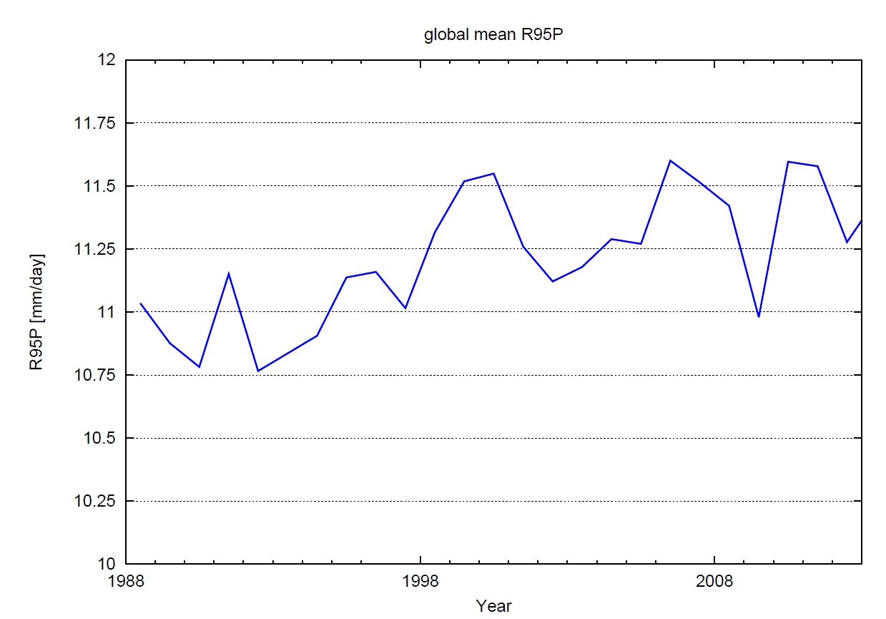
Global Mean Trend of Heavy Precipitation (courtesy of M. Ziese, GPCC)
Based on 95th percentile of daily rainfall of days 0.1mm (Standard measure for heavy precipitation e.g. for the EU)

Slide 5
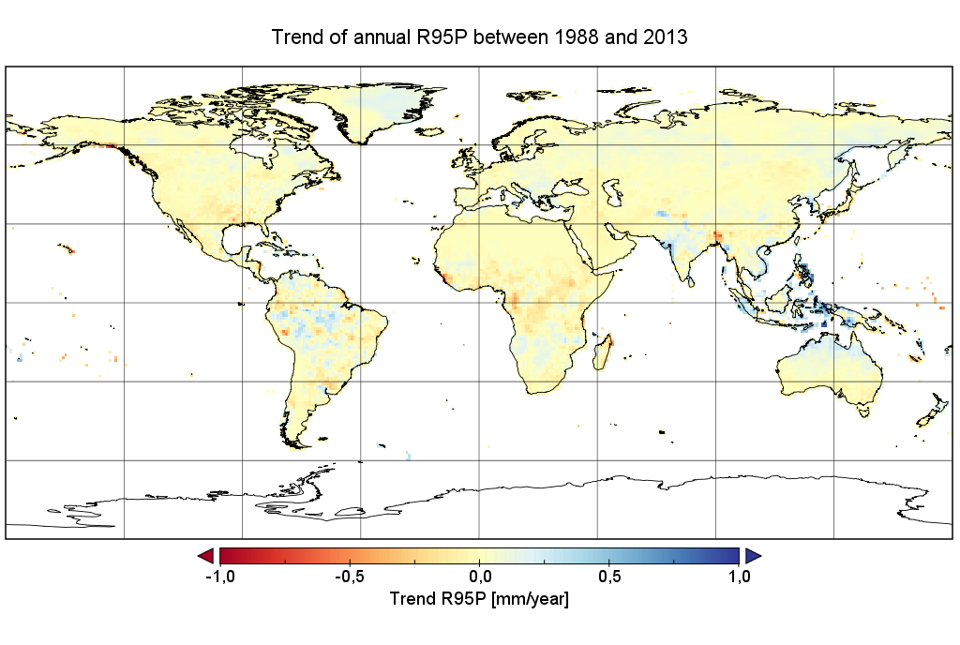
Global Trends of Heavy Precipitation (courtesy of M. Ziese, GPCC)

Slide 6
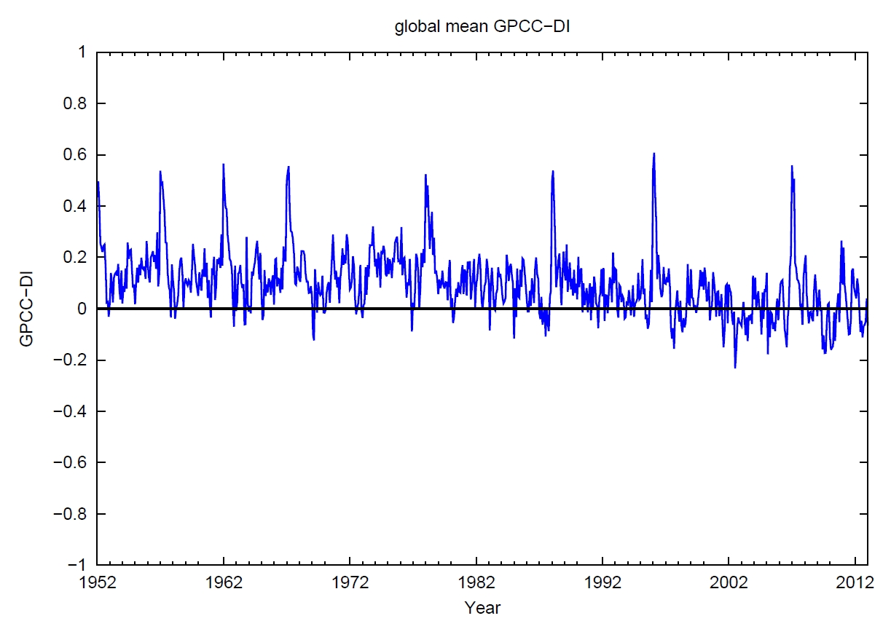
Global Mean Trend of Droughts (courtesy of M. Ziese, GPCC)
Based on the Standard Precipitation Index (SPI) and the Standardized Precipitation and Evaporation Index (SPEII), a decrease of the Index means an increase of droughts and vice versa.

Slide 7
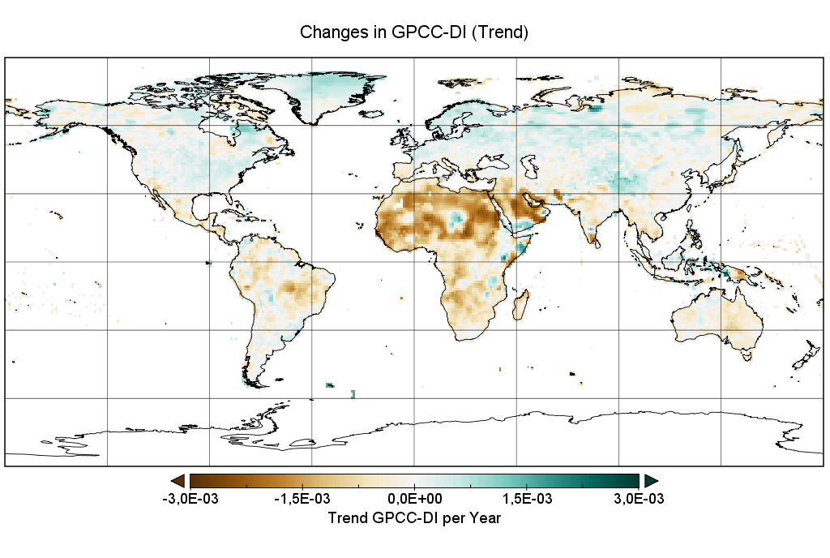
Global Trends of Drought (courtesy of M. Ziese, GPCC)

Slide 8
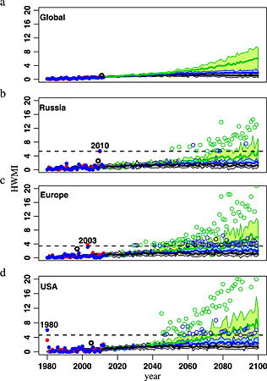
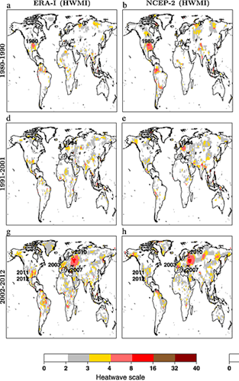
Global heat wave trends
Based on the analysis of daily maximum temperature integrating length and magnitude of heat wave.
Russo et al.: Magnitude of extreme heat waves in present climate and their projection in a warming world. J. Geophys. Res. Atmos. 2014, 119, 12,500-12,512

