Slide 1
GAIA-CLIM
Peter Thorne / Joerg Schulz
8/3/18

Slide 2
GAIA-CLIM key objectives
From call (paraphrased):
Improve the utility of non-space component to characterize the satellite comnponent of EO
Develop tools and techniques
Provide advice on what next steps are required.

Slide 3
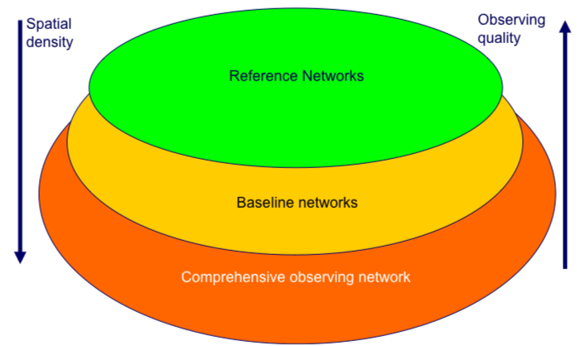
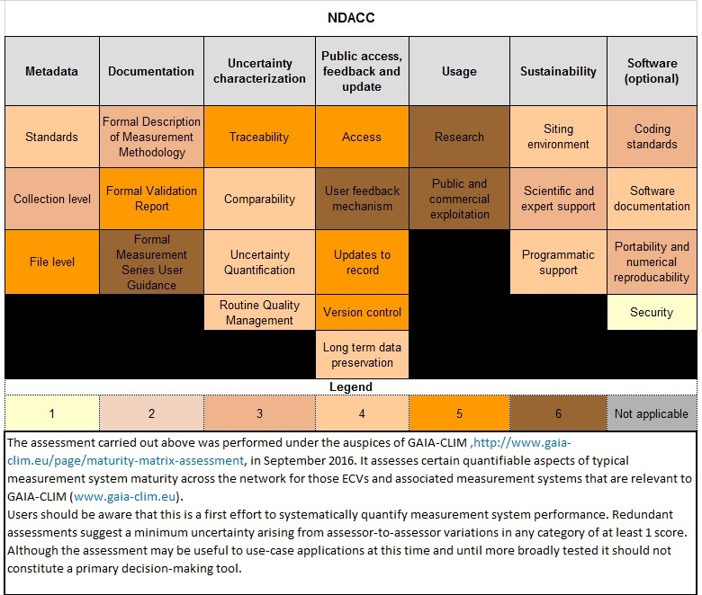
System of systems approach
Key innovation – a defensible means to assign to tiers
Published in peer review literature
Disseminated to WMO and used in subsequent H2020 INTAROS

Slide 4
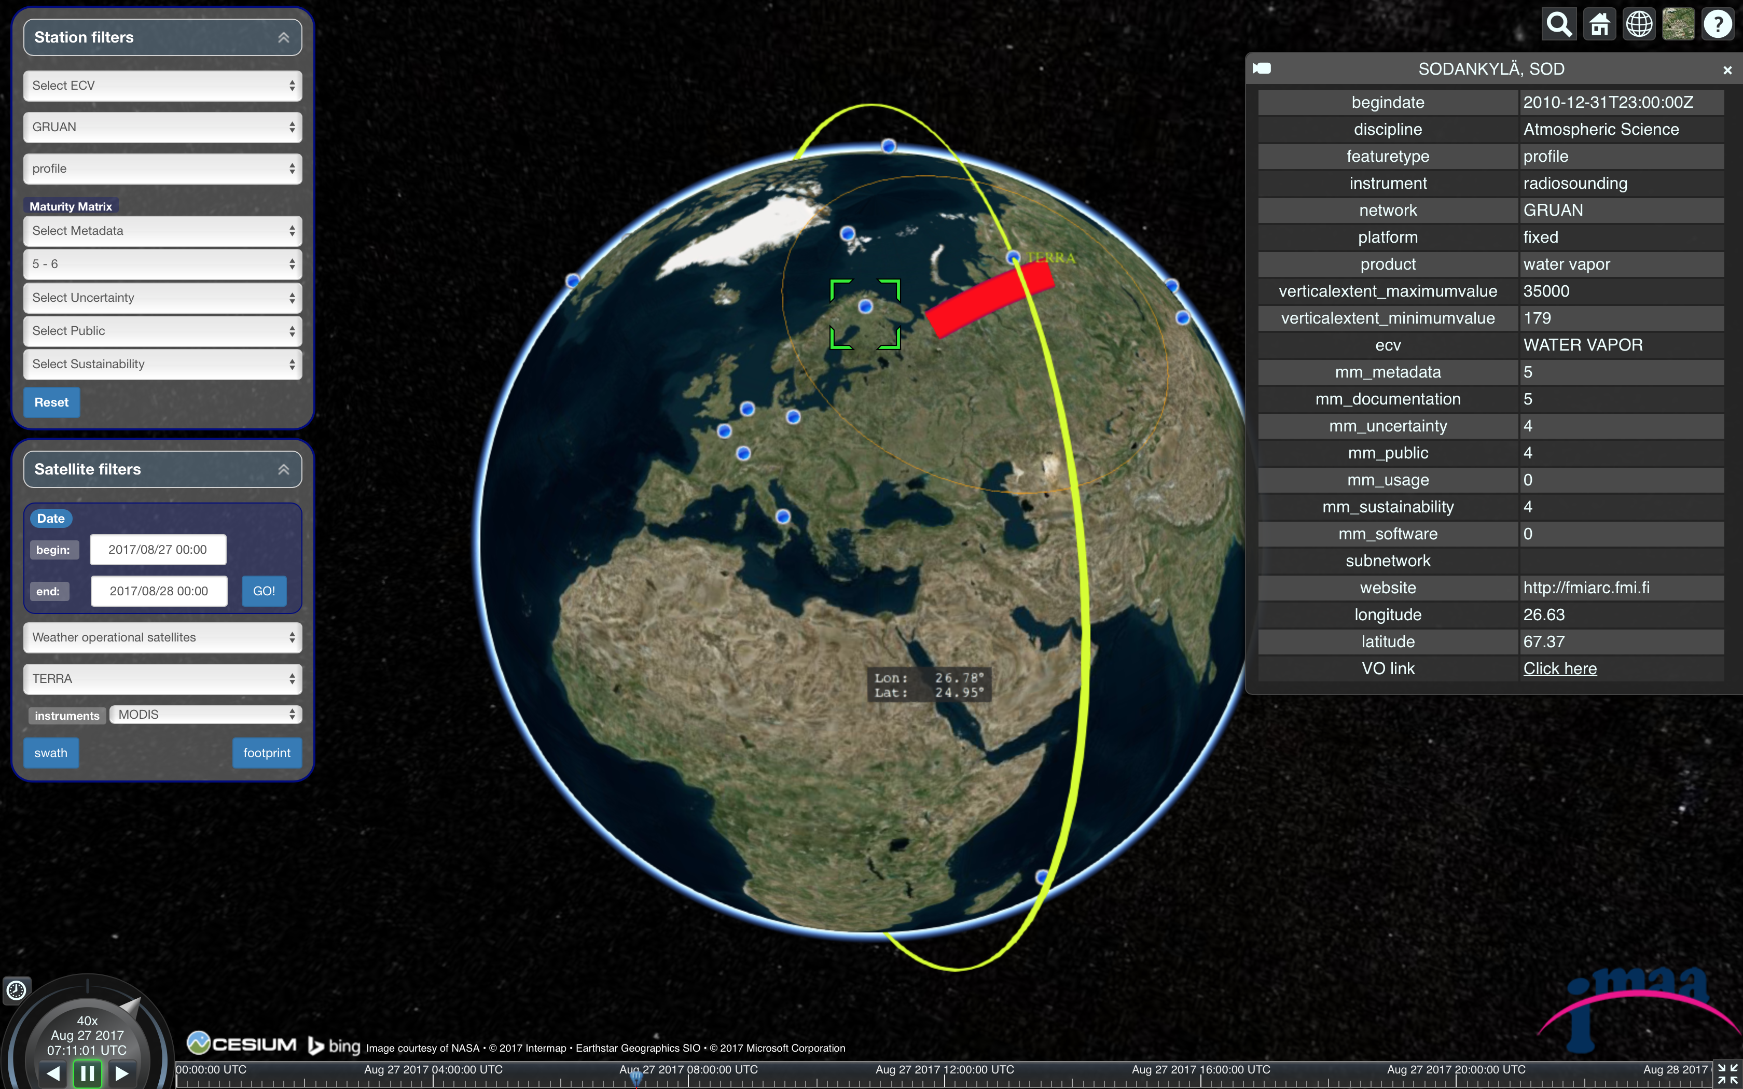
Visualisation of measurement metadata
Metadata visualization tool shall be maintained by CNR
The underlying metadata has been shared with WMO to help populate OSCAR Surface database
The collected metadata is key input to C3S 311a Lot 3 led by GAIA-CLIM partners

Slide 5
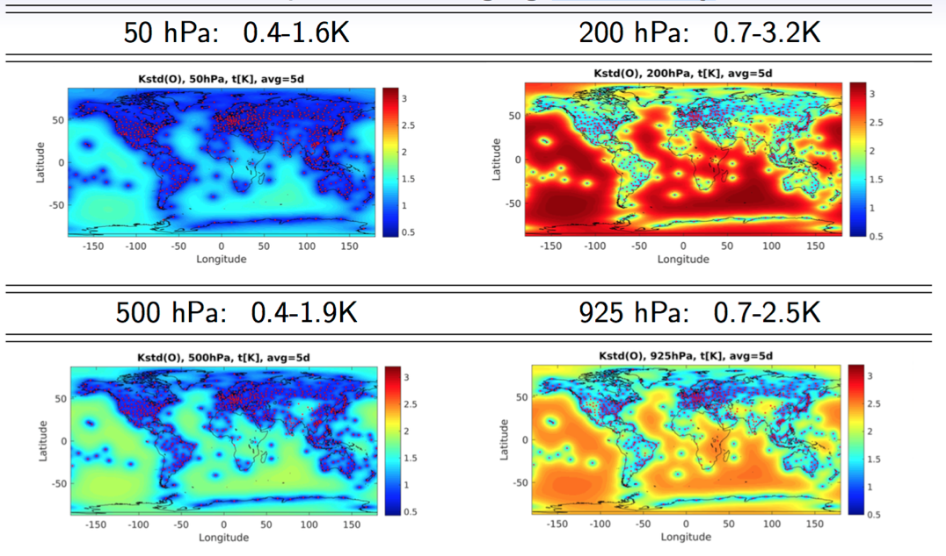
Better understanding of where missing non-satellite observations are limiting

Slide 6
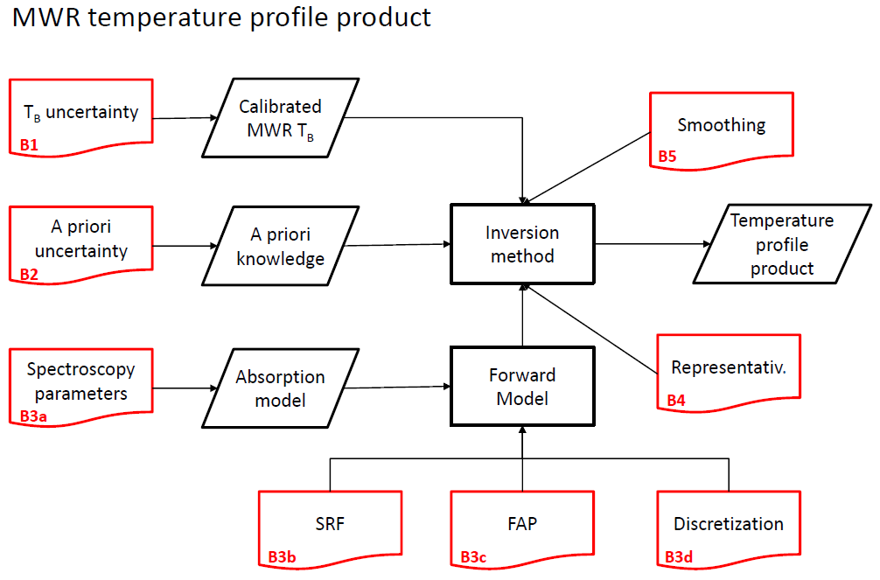
Improved metrological understanding
For six measurement techniques substantive progress towards metrologically traceable fiducial reference quality measurements.
Working with QA4ECV and FIDUCEO within a common framework that should allow interoperability

Slide 7
PTU documents
Provide a consistently structured documentation of understanding across diverse measurement techniques
  Could be extended to other techniques and e.g. the ESA FRM program
Highlight where further work and investigation are warranted
All PTU documents we produced are hosted on the project website. Open to a much more long-term solution if felt useful.

Slide 8
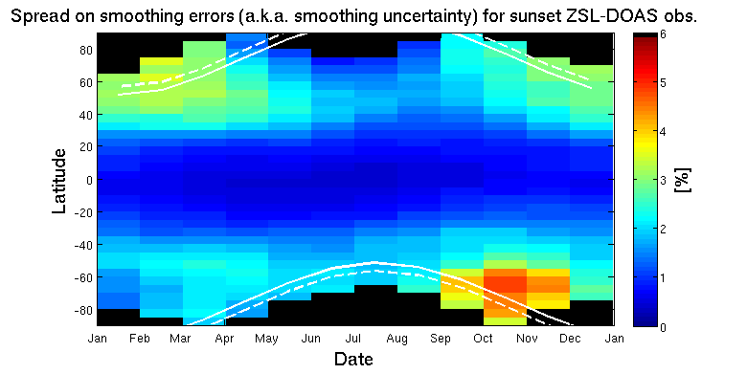
Improved understanding of co-location effects
Use of statistical and modelling based approaches to better understand all facets of sampling mis-match in space and time.
A set of look-up tables produced.
Work towards an operational provision would be possible in future

Slide 9
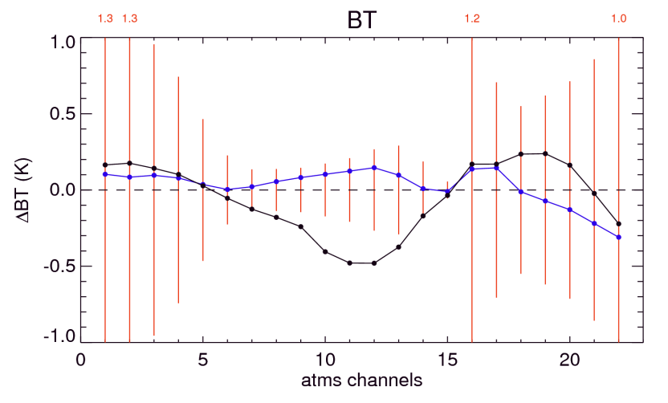
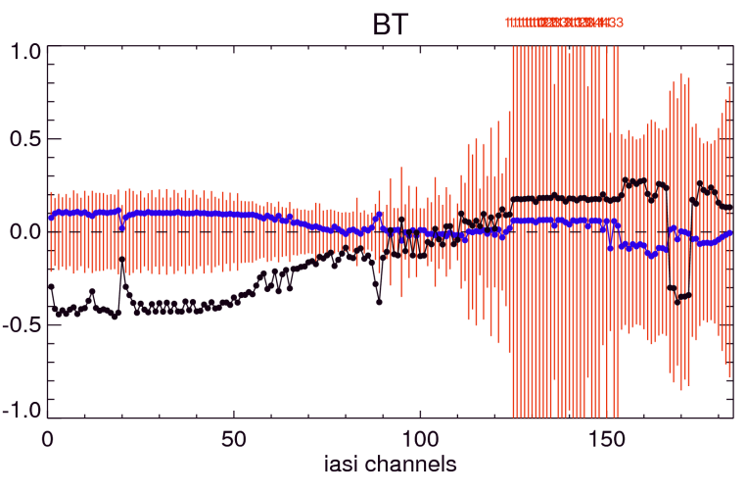
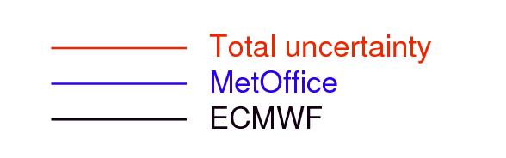
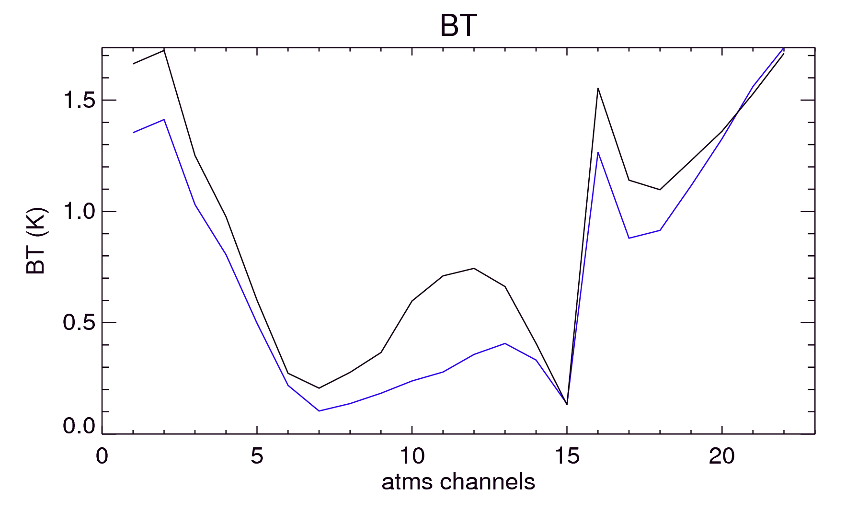
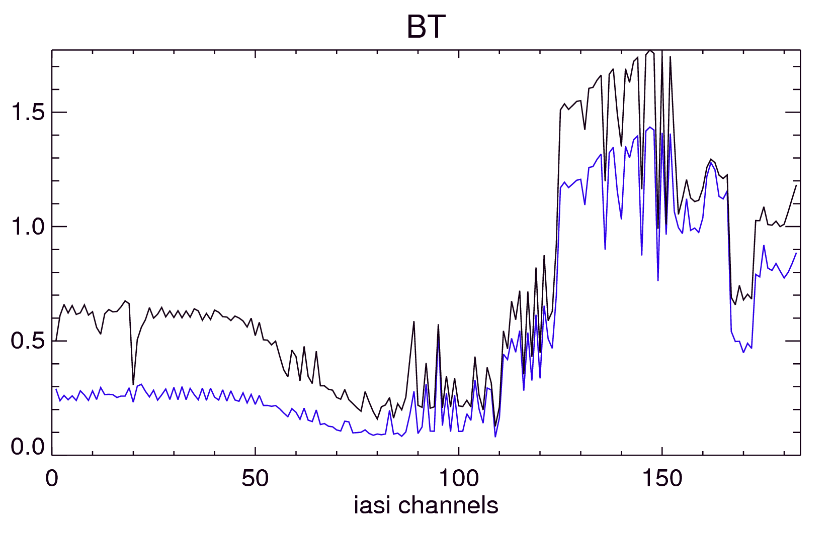
Comparisons at level 1b – the GRUAN processor
Simulated ATMS frequencies
Simulated IASI frequencies
NWP - GRUAN
Lindenberg, 2013
1297 profiles
Surface
Temperature
Humidity
Temperature
Surface
Humidity
Standard deviation of the difference

Slide 10
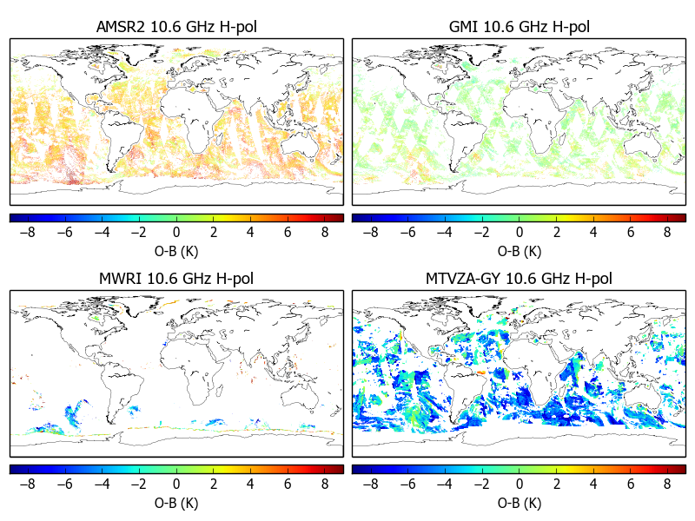
Better quantification of the role of data assimilation
GMI mean bias 0.9 K
AMSR2 mean bias 3.9 K
MTVZA mean bias -3.9 K

Slide 11
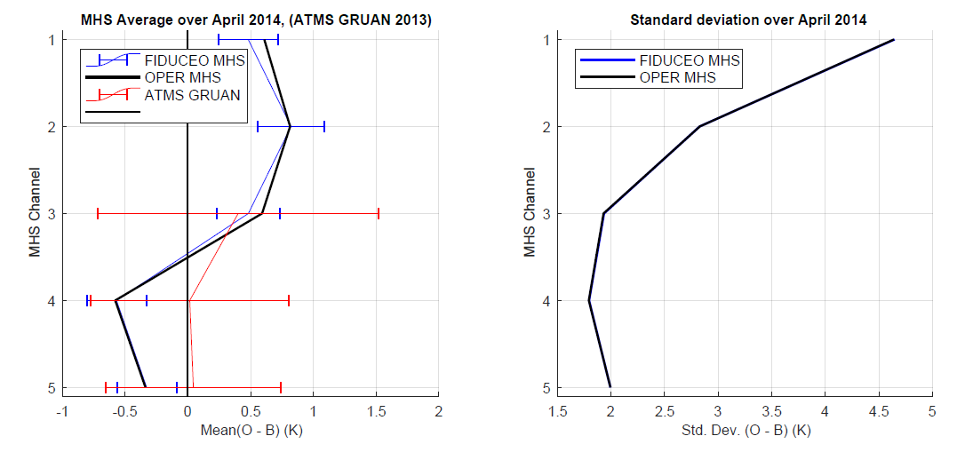
Towards a metrological closure comparison with FIDUCEO

Slide 12
Over to Joerg …

Slide 13
GAIA-CLIM Virtual Observatory
The Virtual Observatory makes co-located non satellite reference and satellite data available via the internet;
It supports the exploitation of ground-based reference data for satellite product validation at Level 1 and 2;
It allows users to interrogate multiple data sources in a seamless way, and permits limited remote data analysis;
Increases awareness among users of satellite and non satellite data on the concept of traceable uncertainty estimates;
Provides a facility that has the potential to be developed into a routine application to analyse product quality.
Notes:
If you did the previous slide right, you can essentially skip this slide.
Use it perhaps to quickly check that you have not missed something of importance

Slide 14
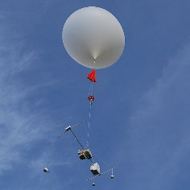
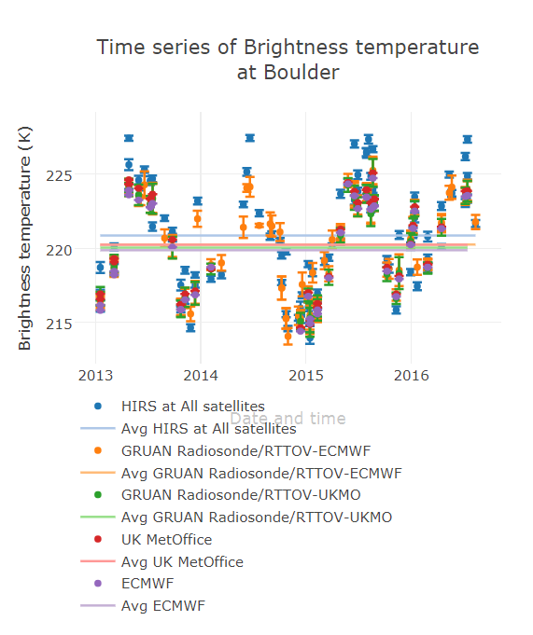
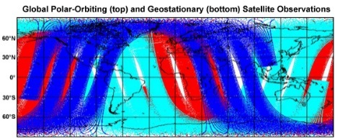
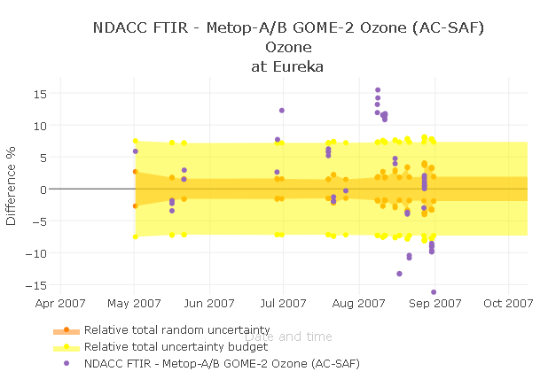

GAIA-CLIM Virtual Observatory (VO)
The VO
Characterised fiducial reference measurements
Co-locations data base (space/time)
Radiative Transfer model
Satellite data (L1 and L2) partly characterised
Visualisation in the GUI
Data export (netCDF)
Simulated satellite data form NWP model outputs

Slide 15
Gaps assessment and impacts document
A substantive and sustained effort at identifying and documenting all relevant gaps. The process evolved substantively over time.
  Gap characteristics
  Gap impacts
  Gap potential remedies
Gap traces put online and made searchable by user-driven cross-sections
Gap traces shall remain online

Slide 16
Recommendations
Far from everything that could be done has been done
11 broad thematic recommendations have been formulated (this may change depending upon your feedback)
Challenge is how this ends up being used
We would welcome suggestions on how the recommendations can best gain visibility

Slide 17
The final recommendations

