Slide 1
CLIMATE@EUMETSAT
From Weather to Climate
Jörg Schulz
Climate Service&Product Manager

Slide 2
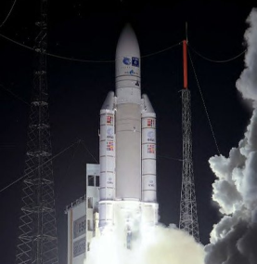
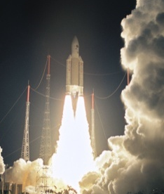
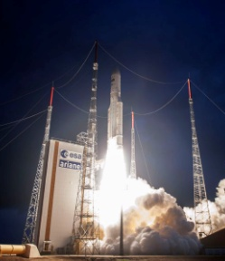
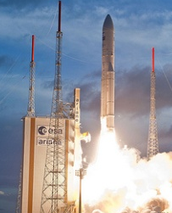
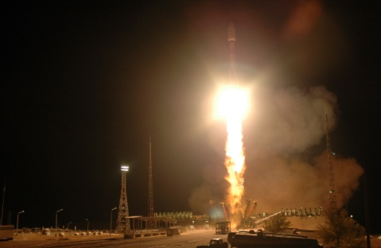
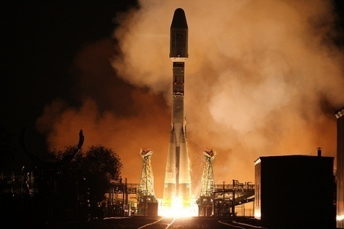
Deployment of current generation satellites completes in 2018
MSG-1
(Meteosat-8) launch
28 August 2002
MSG-2
(Meteosat-9) launch
21 December 2005
MSG-3
(Meteosat-10) launch
5 July 2012
MSG-4 launch
15 July 2015
METEOSAT SECOND GENERATION
METEOSAT-8
METEOSAT-9
MSG-3/METEOSAT-10
MSG-4/METEOSAT-11*
YEAR...
2002
2003
2004
2005
2006
2007
2008
2009
2010
2011
2012
2013
2014
2015
2016
2017
2018
2019
2020
2021
2022
2023
2024
2025
EUMETSAT POLAR SYSTEM (EPS)
METOP-A
METOP-B
METOP-C
Metop-A launch
19 October 2006
Metop-B launch
17 September 2012
Metop-C launch
September 2018

Slide 3
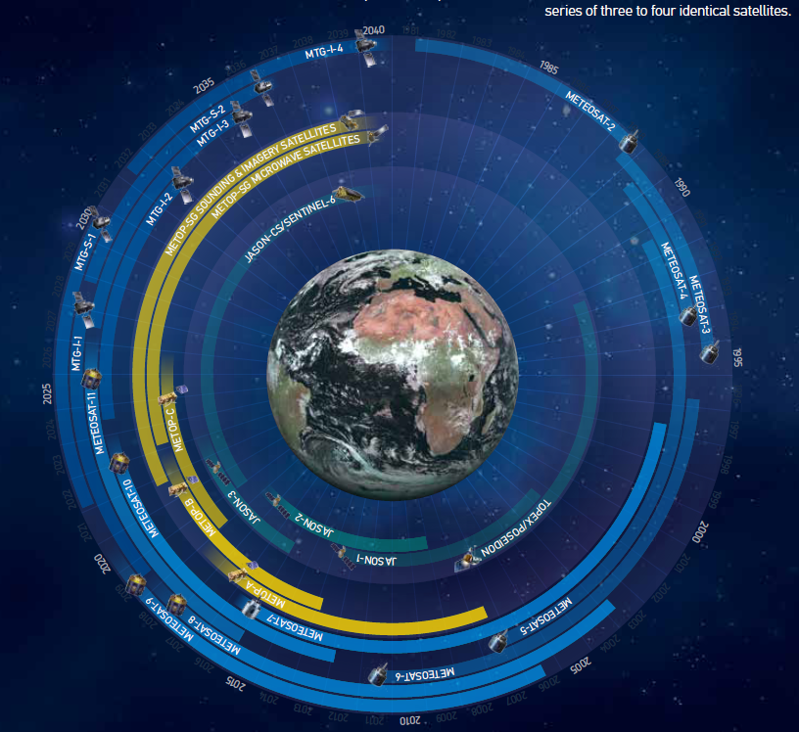
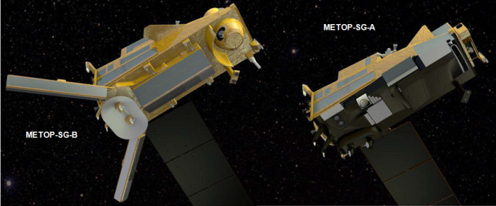
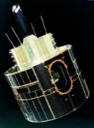
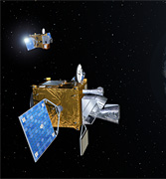
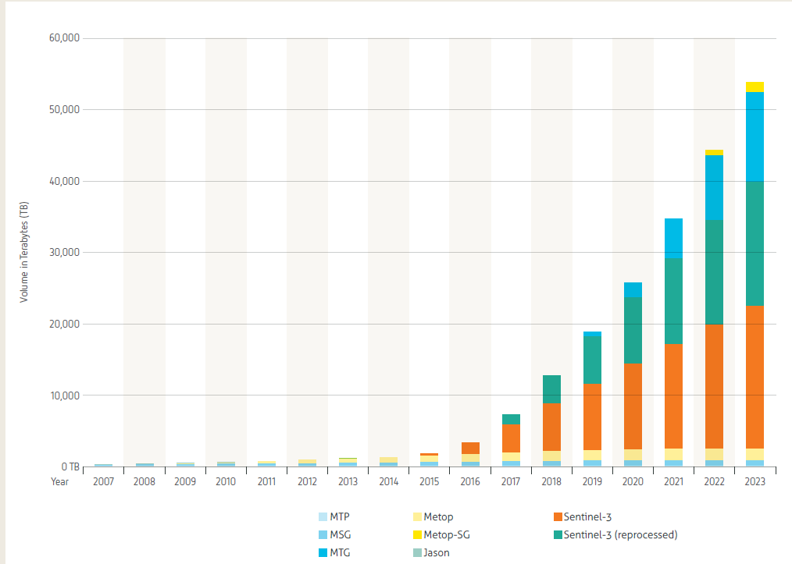
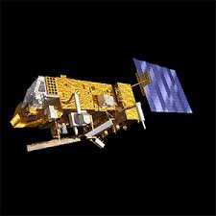
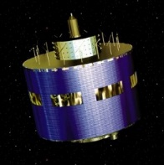
Long term commitment: multi-satellite programmes
EUMETSAT is committed to continuity and improvement of observations for 20+ years, directly and through Copernicus;
More sensors ⬄ significant increase of data volume;
Needs new ways to work with the data, e.g., hosted processing.
60 Jahre
35 Jahre

Slide 4
EUMETSAT contribution to Climate Monitoring
Long term, multi-satellite programmes, with service continuity
Continuous improvement, expansion of portfolio of observations
Unique patrimonial archive: decades of observations
Data rescue
Recalibration and production of climate records
  Physical parameters directly observed by satellites: level 1
  Geophysical parameters: ECVs (ocean, atmosphere, land)
  Estimation of uncertainties
Data access
Cooperation with users: validation, research, applications
Training, support to climate-related capacity building initiatives

Slide 5
EUMETSAT CDR Availability Status (no SAFs)
Data Record | Period | Satellites | Status | Comment
FCDR GOME-2 L1b R1 | 2007 – 2011 | Metop-A | Archived and accessible from Data Centre
FCDR ASCAT L1b R2 | 2007 – 2014 | Metop-A | Archived and accessible from Data Centre
FCDR GRAS L1b R1 (geometric optics) | 2007 – 2014 | Metop-A | Produced, validated, available on request | The data will not be archived due an error in the height referencing of bending angle profiles
FCDR GRAS L1b R1 (wave optics) | 2006 – 2016 | Metop-A | Produced, validated, available on request. | Archival expected 2018
FCDR GRAS L1b R2 (wave optics) | 2006 - 2016 | Metop-A/B | Produced, available on request to support validation | More data will be added to the data record to the end of 2018
FCDR COSMIC L1b R1 (wave optics) | 2006 - 2016 | COSMIC 1-6 | Produced and under validation | Consolidation expected in 2019.
FCDR CHAMP L1b R1 (wave optics) | 2001 – 2008 | CHAMP | Produced and under validation | Consolidation expected in 2019.
FCDR SSM/T2 R1 | 1992 – 2008 | DMSP F11, F12, F14, ,F15 | Produced, validated, available on request | Archival expected 2018
FCDR AMSU-B R1 | 1999 – 2010 | NOAA-15 – NOAA-17 | Produced, validated, available on request. | Archival expected 2018
FCDR MHS R1 | 2005 – 2015 | NOAA-18 and 19, Metop A/B | Produced, validated, available on request. | Archival expected 2018
FCDR IASI R1 | 2006 -2012 | Metop A | Produced, available on request to support validation | Expected to be finalised by March 2018. Archival expected 2019.
FCDR Meteosat IR | 1982 – 2015 | Meteosat 2-9 | Produced, validated, available on request
TCDR polar AVHRR AMV R1 | 2007 – 2012 | Metop-A | Archived and accessible from Data Centre
TCDR polar AVHRR AMV R2 | 1982 – 2016 | NOAA-7-19 (6, 8 and 10 missing), Metop A/B | Produced and under validation | Consolidation and archival expected 2018
TCDR surface albedo R1 | 1982 – 2010 | Meteosat 2-7 | Archived and accessible from Data Centre | Includes IODC, ADC and XADC data coverage.
TCDR surface albedo R2 | 1982 – 2010 | Meteosat 2-7 | Produced and under validation | MSG will be added in 2018.
TCDR AMV, CSR and ASR R1 | 2004 – 2012 | Meteosat 8, 9 | Archived and accessible from Data Centre
TCDR AMV, CSR and ASR R2 | 1982 - 2014 | Meteosat 2-9 | Produced and under validation | Consolidation and archival expected 2018

Slide 6
Uncertainties are important
Decision making requires appreciation of uncertainties
  Research is needed to narrow down uncertainties
  Science and reference data are needed to document and trace uncertainties in observations and climate records
Traceability of uncertainties in observations
  Metrology
  Cross-calibration/validation against reference observations
  Evaluation of limitations of processing algorithms
Mature Climate Records include information on uncertainties

Slide 7
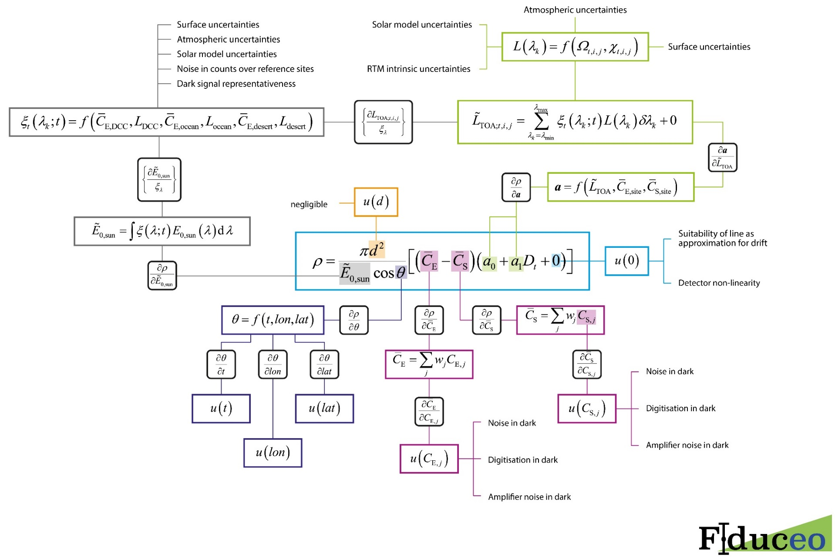
FIDUCEO Uncertainty Tree for MVIRI VIS Channel
Frank Ruethrich

Slide 8
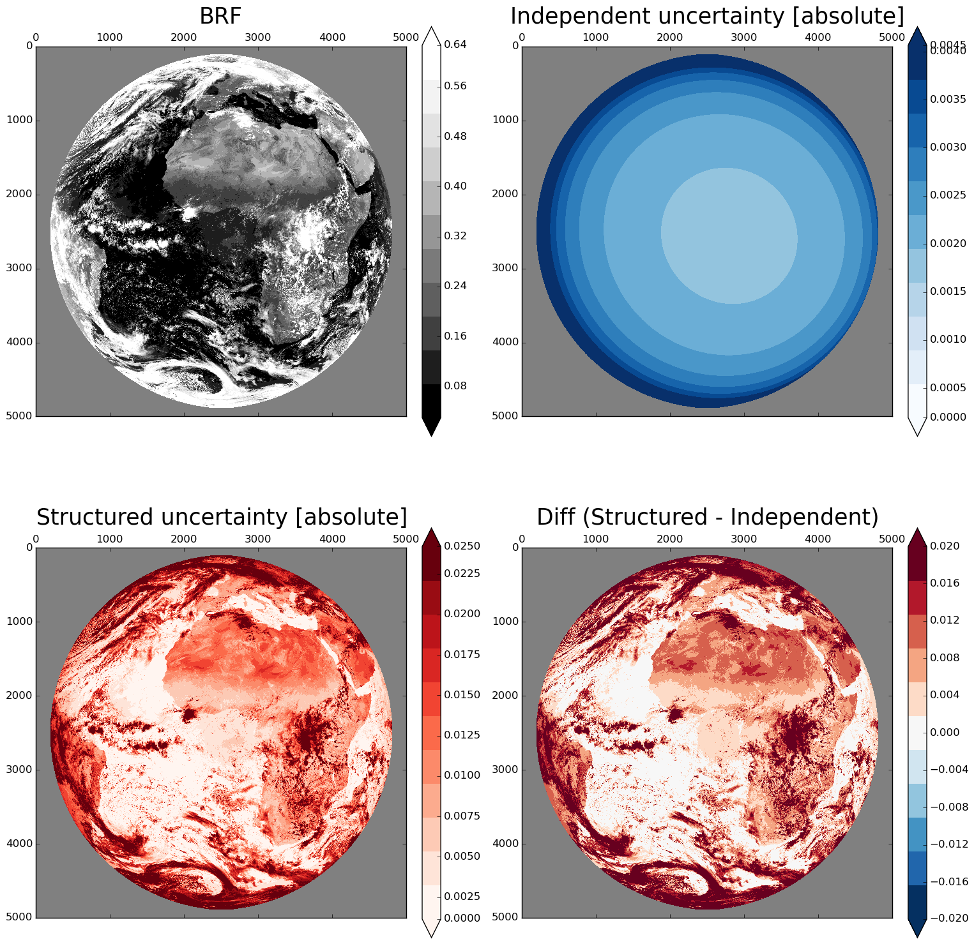
MVIRI Uncertainty Effects
X
Testsite (X):
BRF : 0.40
uCe :0.001
uCs :0.001
uE :0.013
ua0 :0.005
ua1 :0.003
uSZA:0.001
Frank Ruethrich

Slide 9
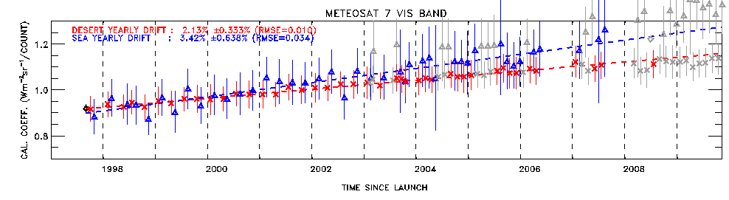
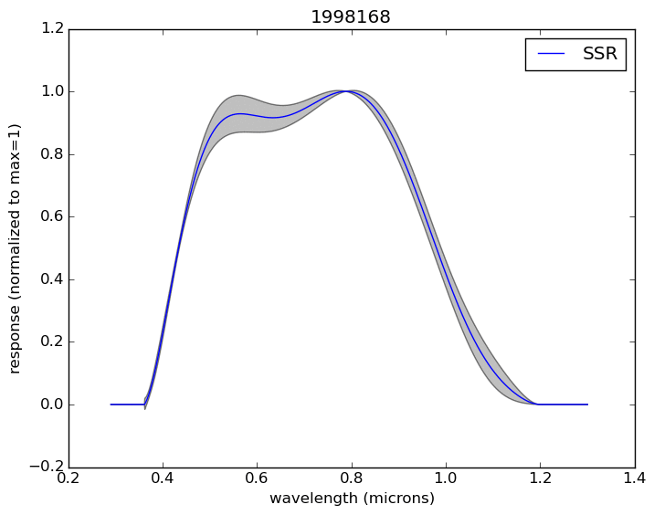
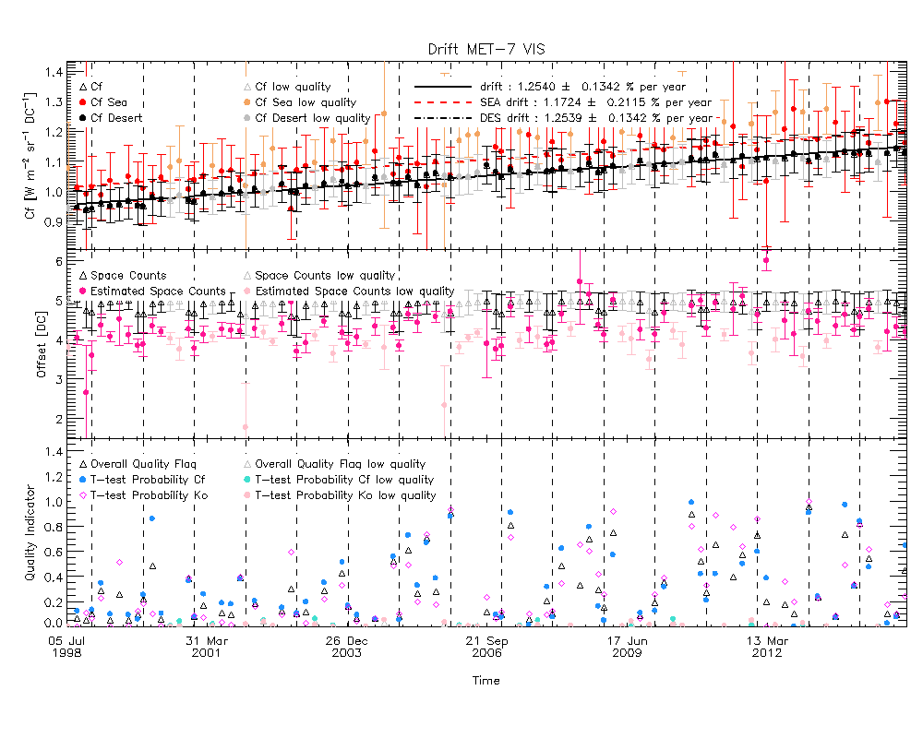

Recalibration of Meteosat Visible Imagery (FIDUCEO)
Reconstruction of temporal variation of spectral response function due to detector ageing improves VIS calibration
Notes:
Statement of the problem: The Meteosat First Generation MVIRI/VIS band spectral response pre-launch characterization is subject to large uncertainties and spectral aging processes modify its shape during the mission life time (nearly 20 years for Meteosat-7).
Objectives: to develop and apply an advanced reverse engineering method based on:
Simulated TOA spectral radiances over different well-characterized Earth targets.
Observed MVIRI/VIS radiances collected over these targets.
Modeled sensor spectral response to characterize the temporal and spectral variations in the MVIRI/VIS radiances.
Upper plot shows original calibration, with different trends for ocean and land targets and fewer and irregularly distributed calibrations over time.
Right plot shows temporal evolution of spectral aging in form of the reconstructed spectral response function.
Lower plot shows updated time series of calibration coefficients:
sea and desert targets have same trends now which means successful correction of the aging in the blue (shorter wavelength).
Computation of calibration coefficients is enabled under more extreme observation geometry after the move to IODC in 2006.

Slide 10
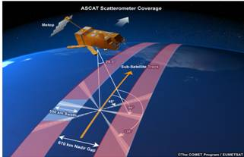
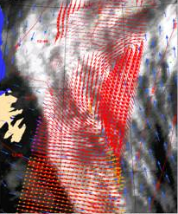
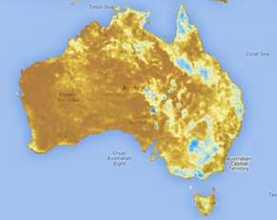
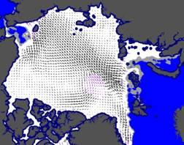
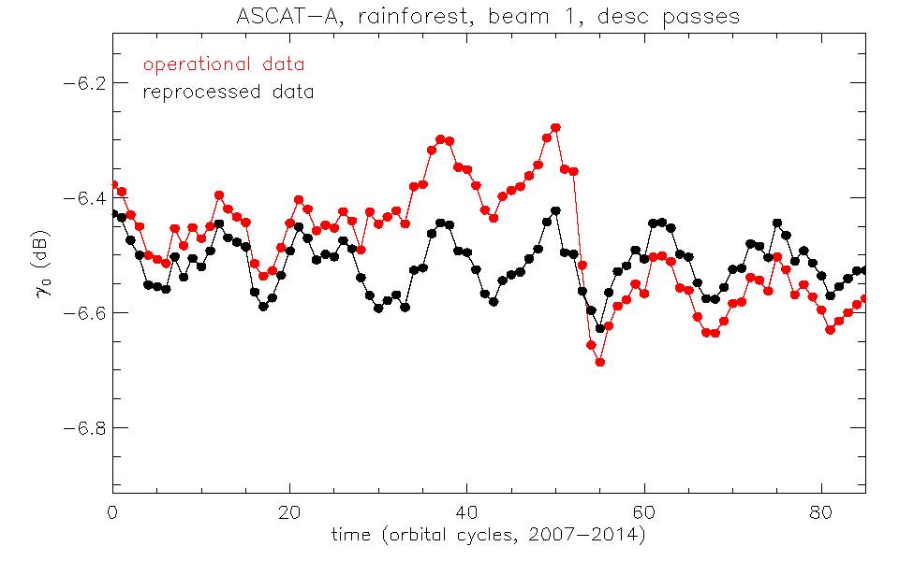


Recalibration of radar backscatter observations
ASCAT Ocean winds Sea ice drift Soil moisture
2007 2008 2009 2010 2011 2012 2013 2014
Craig Anderson, EUMETSAT

Slide 11
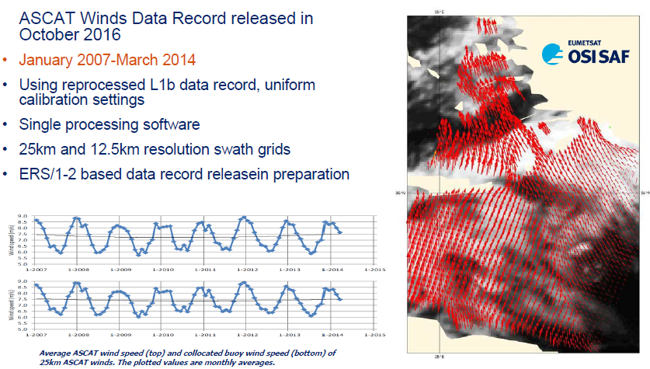
ASCAT Scatterometer Ocean Surface Winds

Slide 12
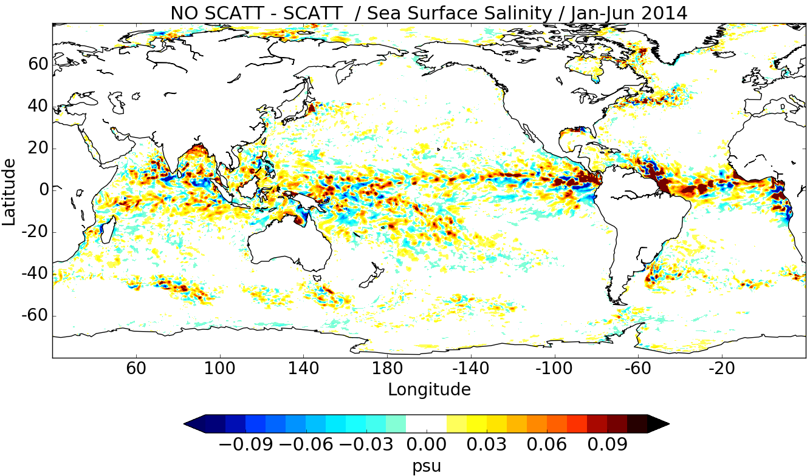
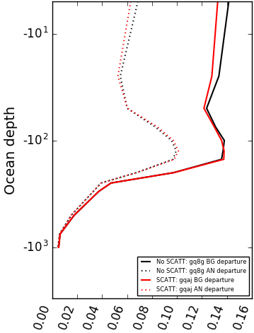
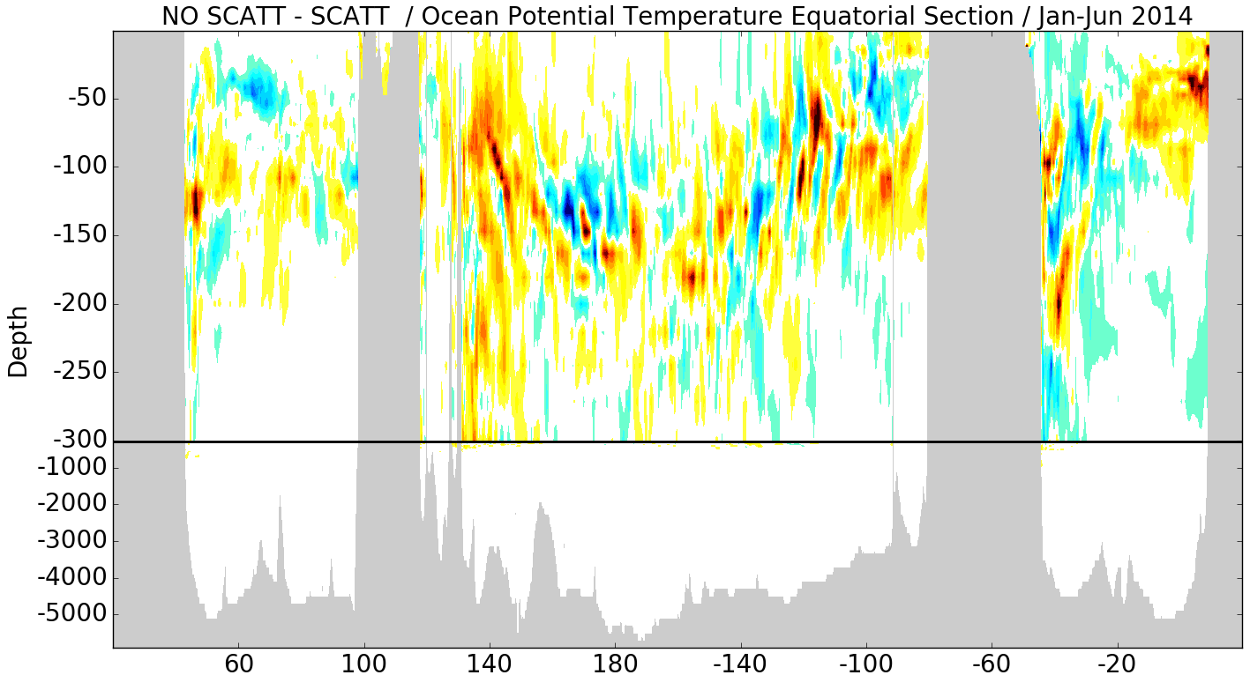
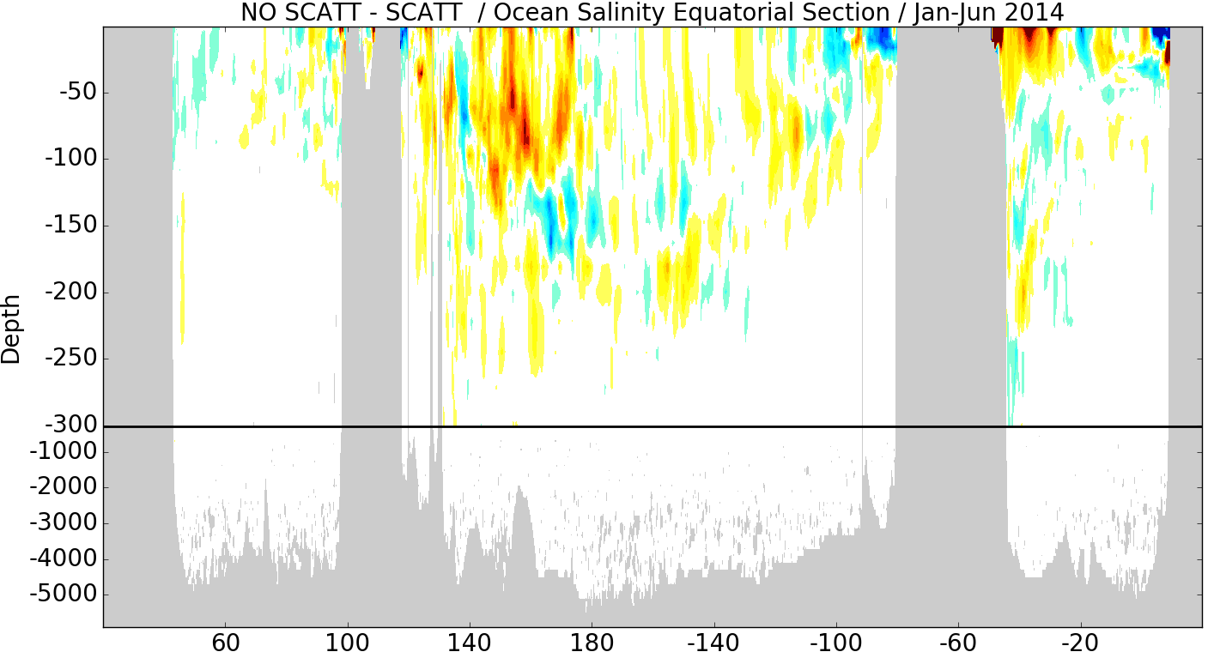
Coupled Assimilation -
Atmospheric winds impact salinity
Impact of scatterometer winds on ocean salinity
  Improved fit to in-situ observations
Mean
departure
rmse
SCATT
No SCATT
Courtesy of ECMWF
European Centre for Medium-Range Weather Forecasts
12

Slide 13
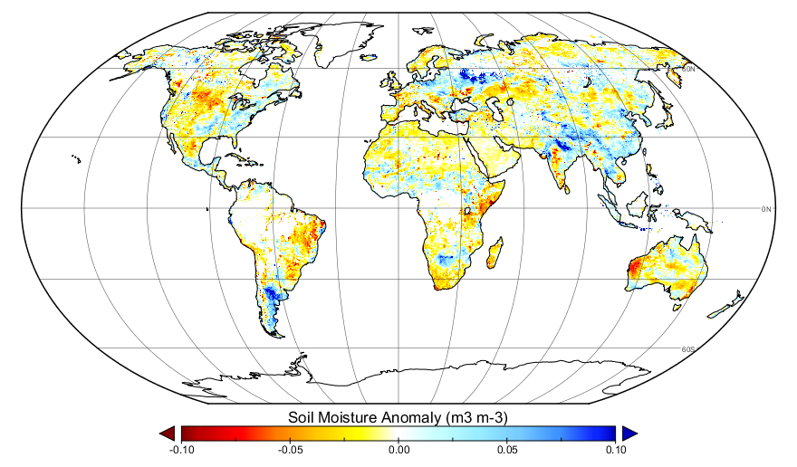

Soil moisture anomaly early July 2017
Too dry - compared to long-term July average (1979-2016) - too wet

Slide 14
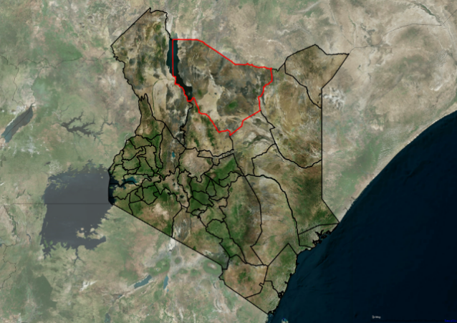
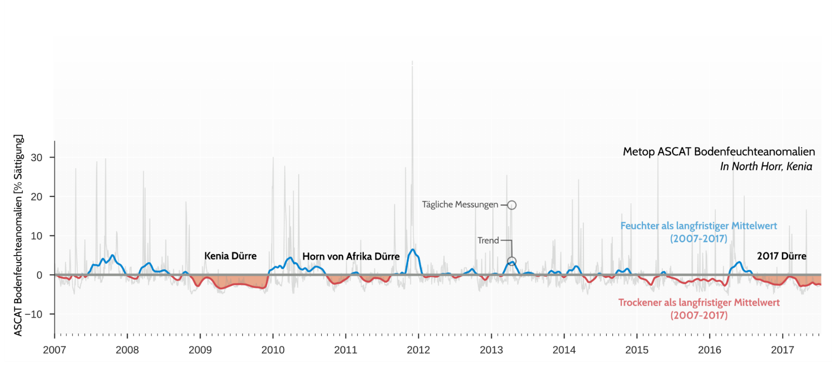
Drought 2017 in North Kenia
Soil moisture anomaly relative to mean (2007-2016) derived from ASCAT data.
Mariette Vreugdenhil/TU Wien, EUMETSAT H SAF

Slide 15
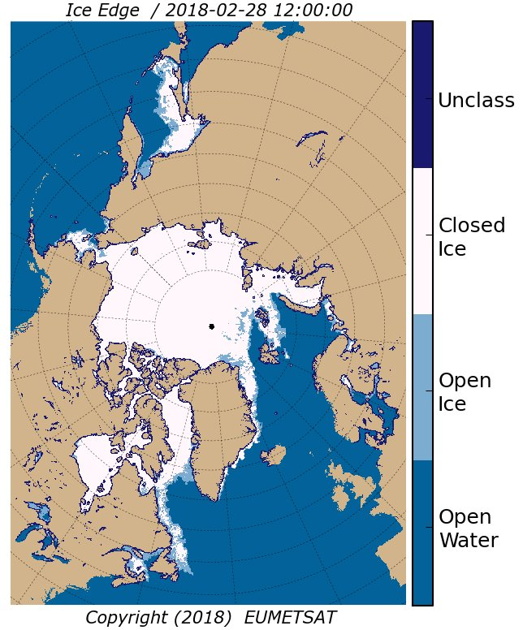

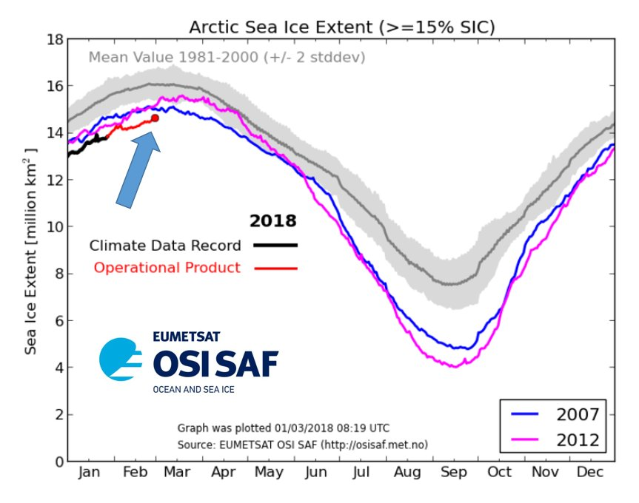
Interim Climate Data Record: Climate in “real time”
Daily updated Northern Hemisphere Sea Ice Extent compared to long term data record

Slide 16
Conclusion
EUMETSAT is committed to continuity and improvement of observations for 20+ years, directly and through Copernicus;
40+ years of observations is a unique asset;
Production of climate records is a demanding scientific task;
The formation of Fundamental Climate Data Records is essential for every mission to enable optimal use;
Uncertainty estimates for FCDRs is challenging but development is progressing well;
EUMETSAT supports many usages of climate data records, e.g., in global reanalysis also enabling analysis of high impact weather attributable to climate change.

Slide 17
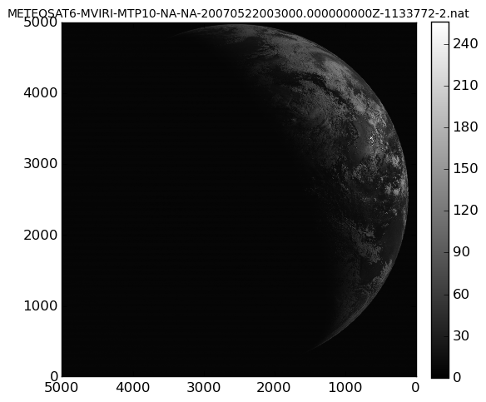
Meteosat-6 MVIRI Visible Channel Last Images

