Slide 1
TOPC XX – Aims & Expectations
Wolfgang Wagner

Slide 2
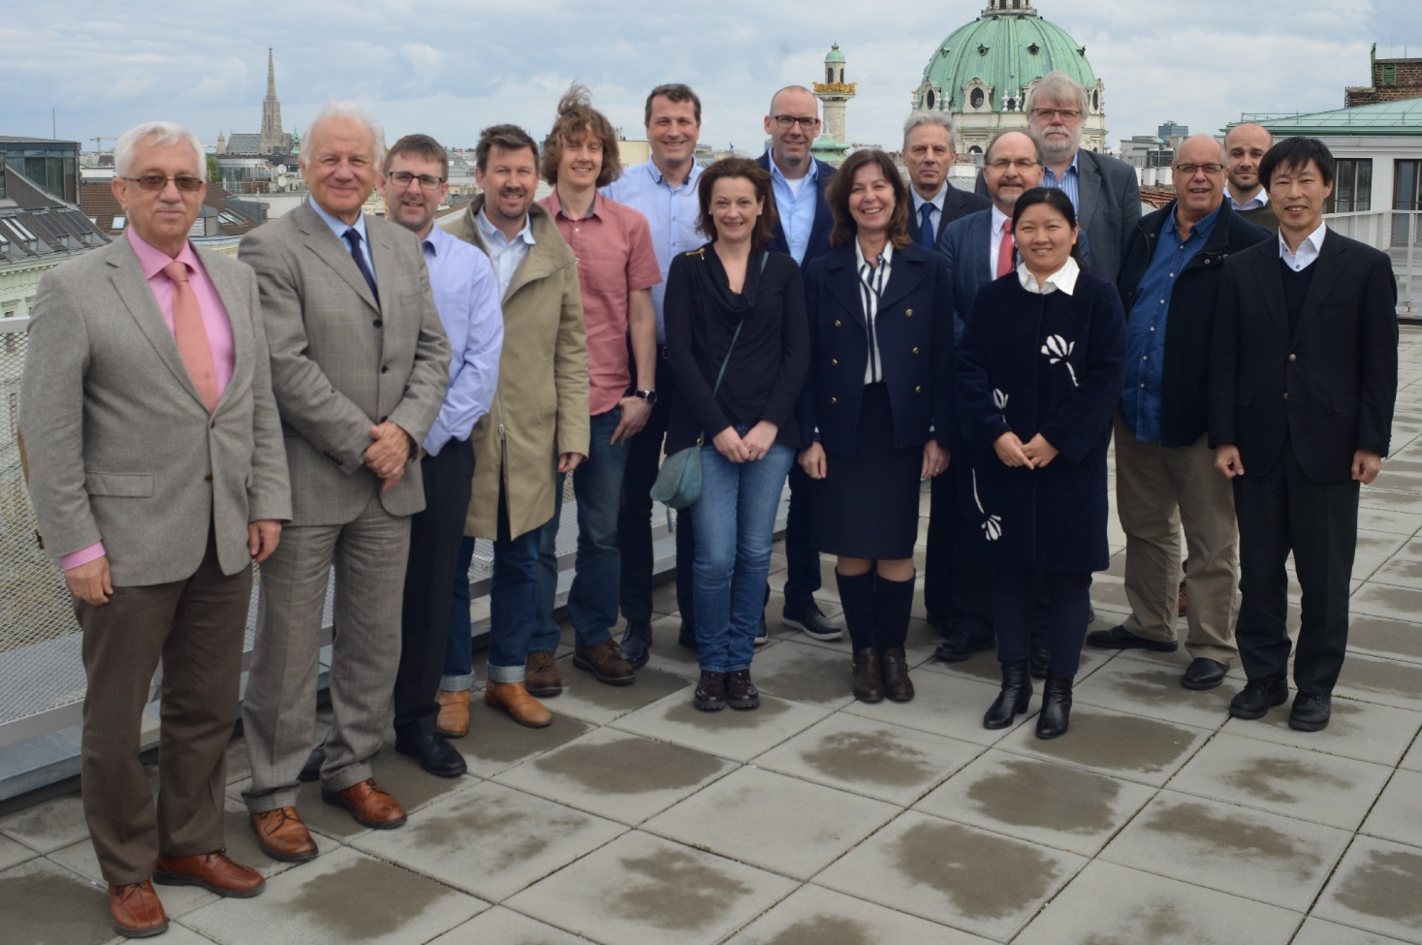
TOPC XIX
Meeting at TU Wien on 5–7 April 2017
Change in Panel Membership

Slide 3
Some Results of TOPC XIX
There is a need to better connect to the scientific community
Focus on concrete activities (and do not get lost in transgression …)
Seek continuous feedback on GCOS Action Plan
Enable critical review of ECV requirements by writing down
their current definition
Invite groups to showcase their climate indicators

Slide 4

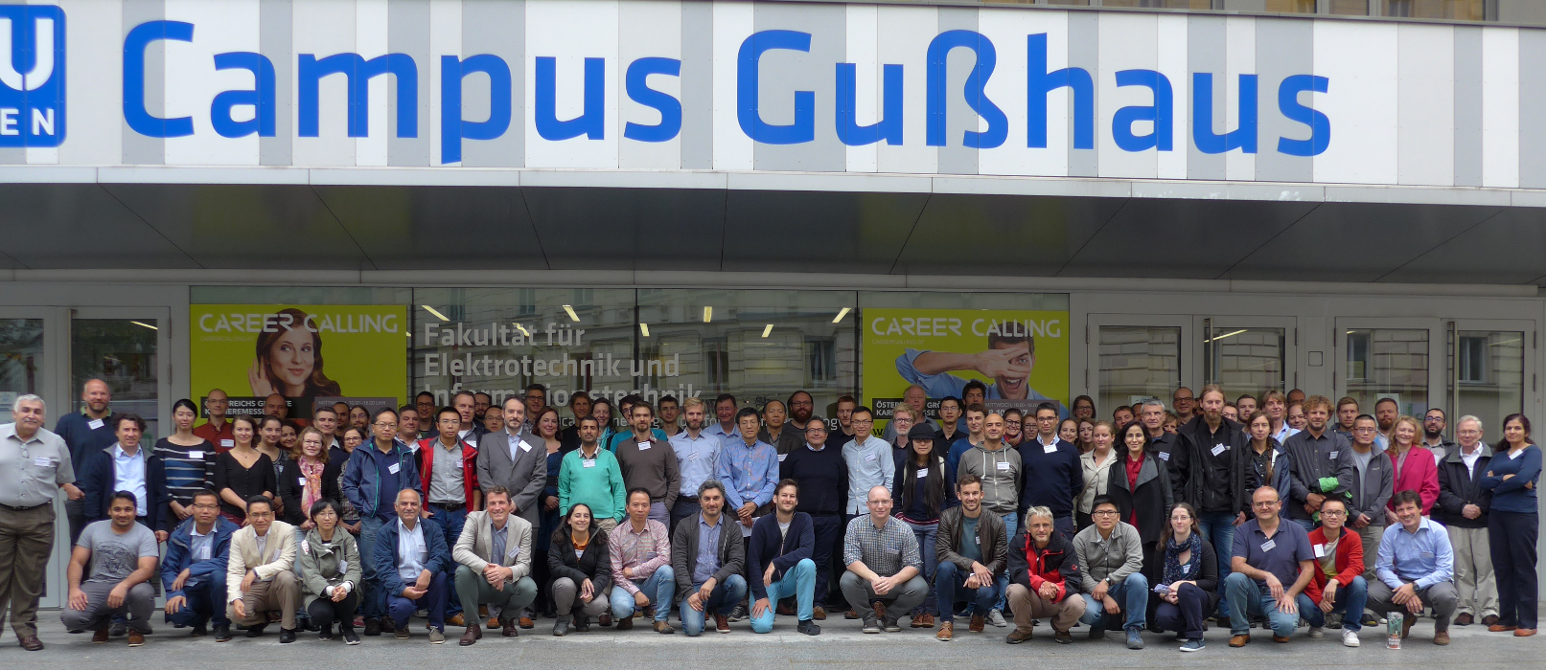
Soil Moisture Workshop 2017
Over 100 participants from 22 countries
GCOS was one of the co-sponsors
Two discussion topic:
  Feedback on GCOS requirements
  Identification of observational gaps

Slide 5
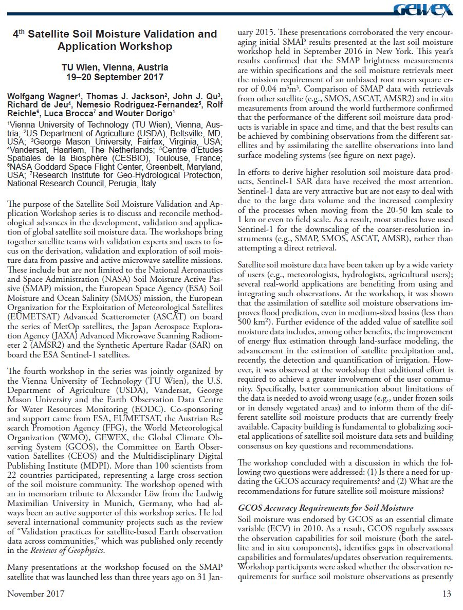
“… Workshop participants were asked whether the observation requirements for surface soil moisture observations as presently formulated in Annex 1 of the GCOS 2016 Implementation Plan (temporal sampling of 1 day, spatial resolution 1–25 km, accuracy of 0.04 m3/m-3 and stability of 0.01 m3/m3/year) are still appropriate. The consensus was that these requirements are still adequate. However, workshop participants expressed the need for a clearer definition of these requirements. Furthermore, the workshop participants emphasized the need to consider variables that are closely related to soil moisture, such as vegetation optical depth, freeze/thaw, surface inundation and root-zone soil moisture, which is in line with the GCOS 2016 Implementation Plan.”
“Therefore, it was strongly recommended to start activities defining a future L-band observation system based on the lessons learned from SMOS and SMAP.”

Slide 6
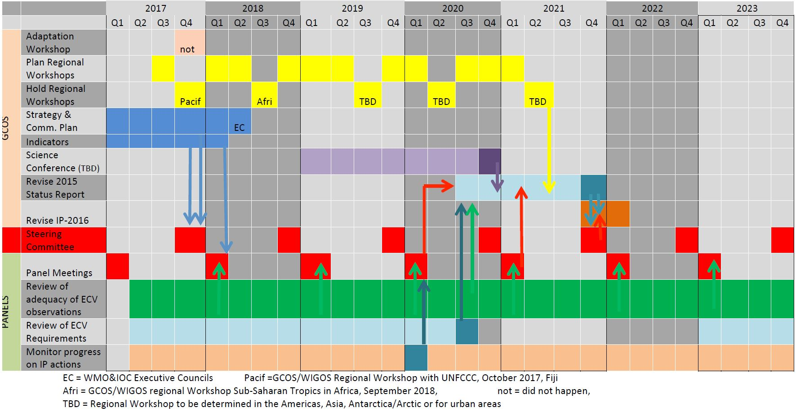

Slide 7
Panel Tasks
Review of adequacy of ECV observations
Review of ECV requirements
Monitor progress on IP actions as specified within GCOS-200
  72 Terrestrial Domain Actions
ECV Factsheets
Are we able to cover all ECVs with the existing panel & experts?

Slide 8
